Slide 1

JSON
It stands for JavaScript Object Notation, and it's a pretty popular lightweight data interchange format.
https://www.w3schools.com/js/js_json_intro.asp
COMPLETE JAVA MASTERCLASS
File Writing Challenge

Slide 2
The Challenge
Start with the Student Engagement code from the previous videos, and first generate 1000 students.
To output each student as a JSON record:
You can use the write, or writeString methods on Files.
Or you can try FileWriter, PrintWriter or BufferedWriter, or some combination of these.
The text printed should be a list of students.
The entire set of student records should be contained in square brackets.
Each student record should be enclosed in curly braces, and separated by commas.
COMPLETE JAVA MASTERCLASS
File Writing Challenge

Slide 3
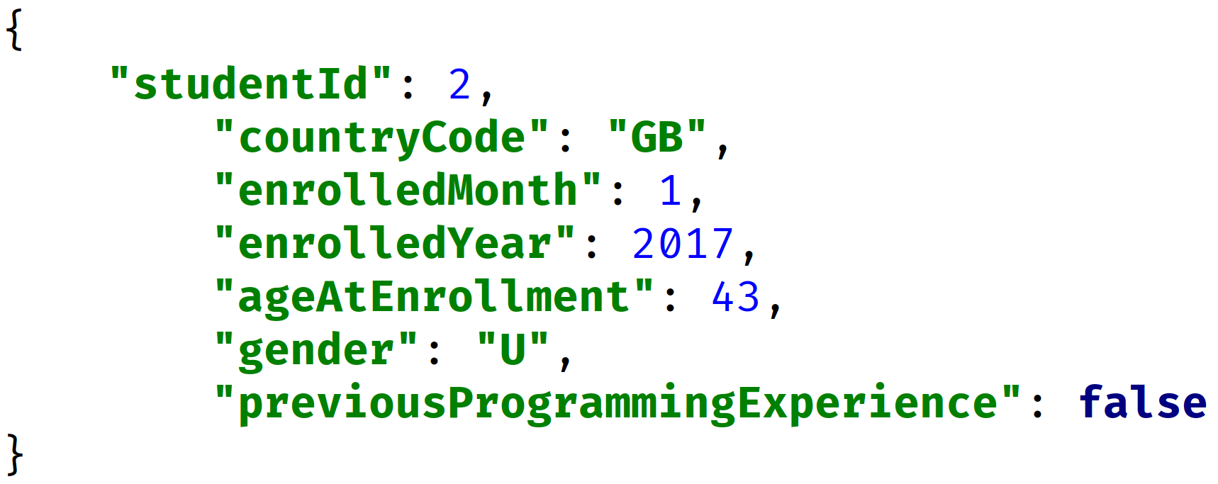
The Challenge
At a minimum, print the student id, and some demographics data.
The example on this slide, demonstrates a flattened structure.
You can see all fields are key value pairs, and all are children of the student record.
Keys are enclosed in quotes, as are values if they're text based, and the colon is used to separate the key and value.
COMPLETE JAVA MASTERCLASS
File Writing Challenge

Slide 4
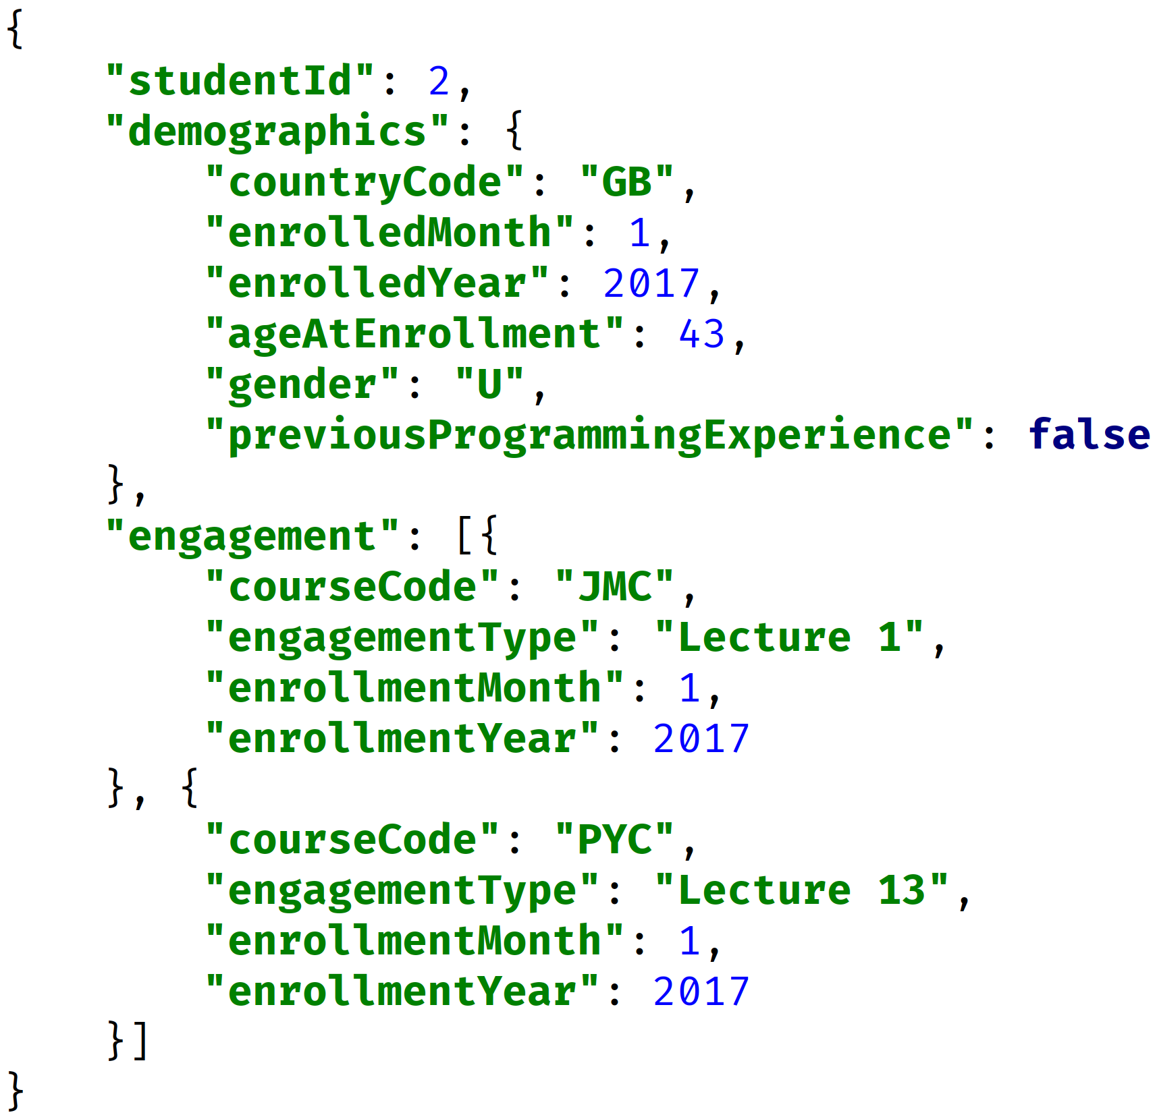
The Challenge
On this slide, I'm showing a more hierarchical structure, for a single student.
The demographics key, has a value that's an object and not a simple string, and that's enclosed in curly braces.
The engagement key's values is also an array, containing separate engagement records.
COMPLETE JAVA MASTERCLASS
File Writing Challenge

Slide 5
Hints and Suggestions
You might want to explore the use of Intelli J's template functionality, to create your own JSON string template.
Don't forget about the StringJoiner class, that lets you define a delimiter, as well as a prefix and suffix.
Start out by testing 2 or 3 students in your data set.
https://www.jetbrains.com/help/idea/2022.3/generating-code.html#customize-templates
COMPLETE JAVA MASTERCLASS
File Writing Challenge

Slide 6
Linter
A linter is a software development tool, that will analyze source code for potential errors, and styling issues.
https://jsonlint.com/
COMPLETE JAVA MASTERCLASS
File Writing Challenge

