Slide 1
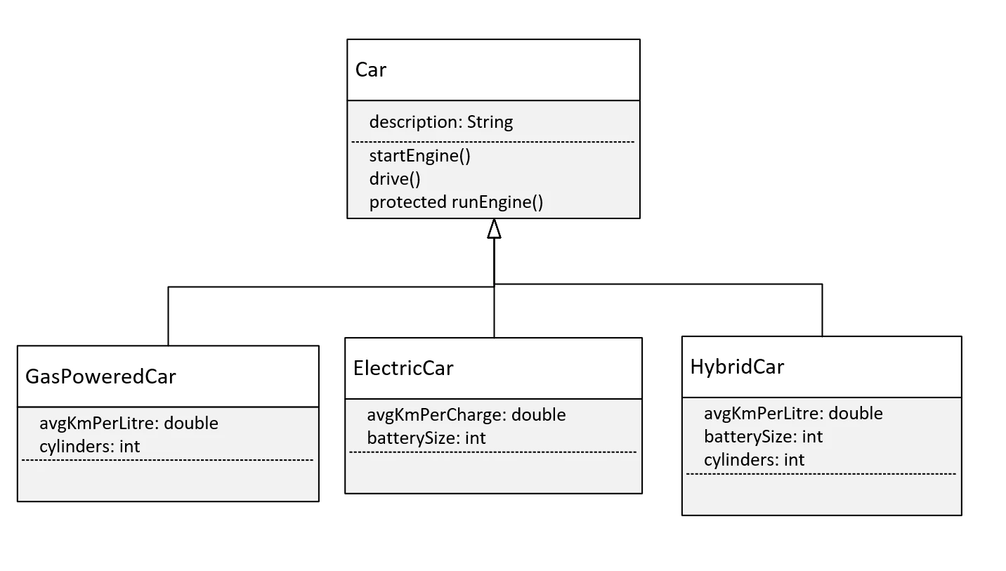

The Challenge, the Car Class Diagram
COMPLETE JAVA MASTERCLASS
Polymorphism Challenge Exercise, Part 2

