Slide 1
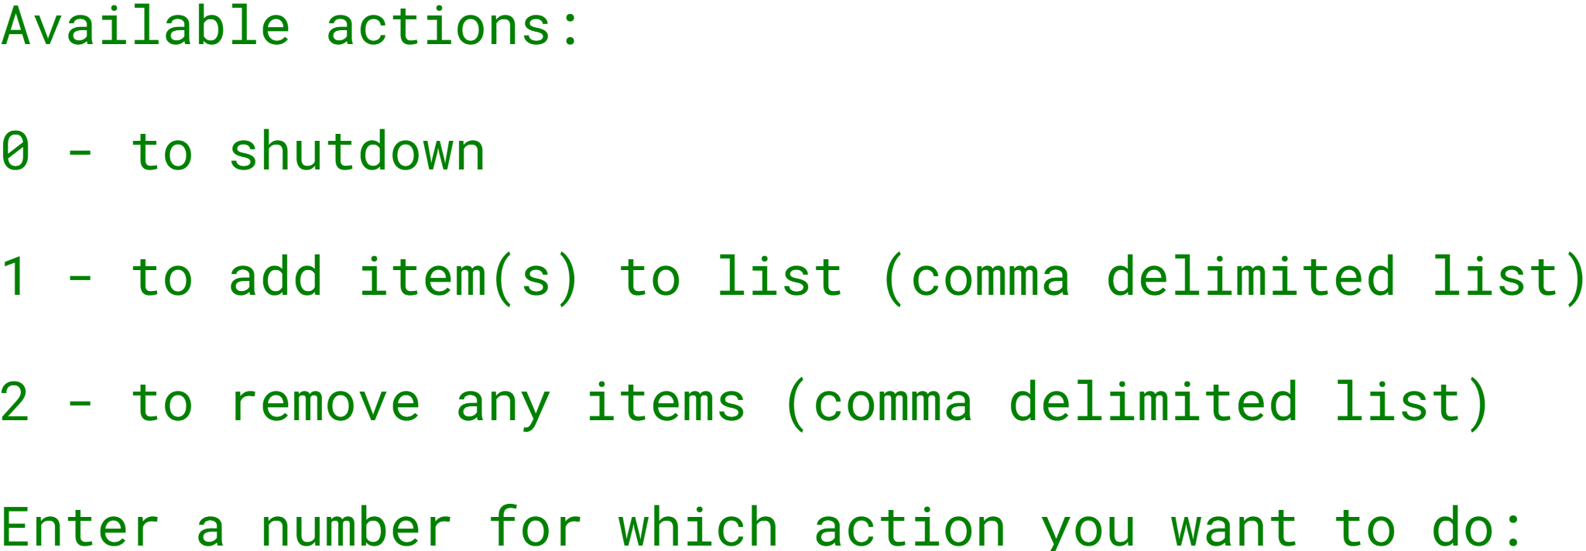

The ArrayList Challenge
The challenge is to create an interactive console program, with a menu of options as shown here, and functionality that I will describe now:
Using the Scanner class, solicit a menu choice, 0, 1, or 2, and process the item accordingly.
COMPLETE JAVA MASTERCLASS
ArrayList Challenge Part 1

Slide 2
The ArrayList Challenge
The list will be a grocery list and should be an ArrayList.
You should use methods on the ArrayList to add items, remove items, check if an item is already in the list, and print a sorted list.
You should print the list, sorted alphabetically, after each operation.
You shouldn't allow duplicate items in the list.
COMPLETE JAVA MASTERCLASS
ArrayList Challenge Part 1

