Slide 1
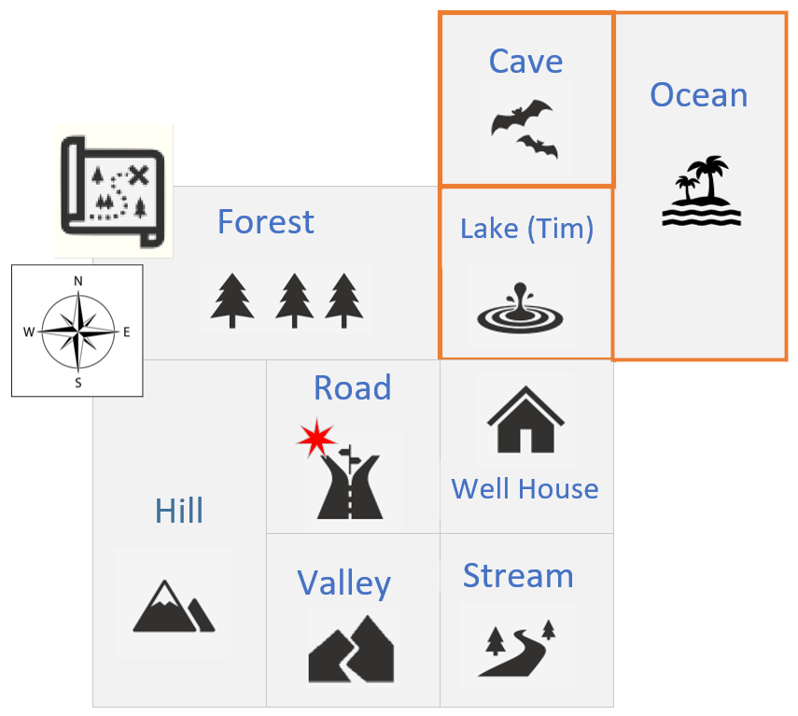

My Custom Board Locations
Lake is already in my map, but I want to customize it, first by describing it, naming it Lake Tim, and then adding two additional destinations from there, a cave to the north, and an ocean to the east.
The cave and ocean will be additional board locations.
Right now, from the lake, I can only go west to the forest, or south to the well house.
COMPLETE JAVA MASTERCLASS
Adventure Game, Continued

