Slide 1

A Collection
A collection isn’t a big mystery; it’s simply an object that represents a group of related objects.
In general, the objects in a collection share some common relationship or purpose.
In computer science, different types of collections have specific names and expected behaviors. These include arrays, lists, vectors, sets, queues, tables, dictionaries, and maps (not geographical maps, but data structures that map keys to values).
These collections are differentiated by how they store objects in memory, how objects are retrieved and ordered, and whether they allow null values or duplicate entries.
COMPLETE JAVA MASTERCLASS
Collections: Understanding the Big Picture

Slide 2
A Collections Framework
Oracle's Java documentation describes its collections framework as:
"A unified architecture for representing and manipulating collections, enabling collections to be manipulated independently of implementation details."
If you're interested in reading the Oracle documentation, they have a good overview at the following link
https://docs.oracle.com/javase/8/docs/technotes/guides/collections/overview.html
This was written for JDK-8, but it still applies.
COMPLETE JAVA MASTERCLASS
Collections: Understanding the Big Picture

Slide 3
What's in the framework, what's not?
Strictly speaking, Arrays and the Array utilities in the java.util.Arrays class are not considered part of this framework.
All collection objects implement the Collection interface, with the exception of maps, and I'll explain why in this section.The Collection interface is the foundation of the collection hierarchy in Java.
COMPLETE JAVA MASTERCLASS
Collections: Understanding the Big Picture

Slide 4
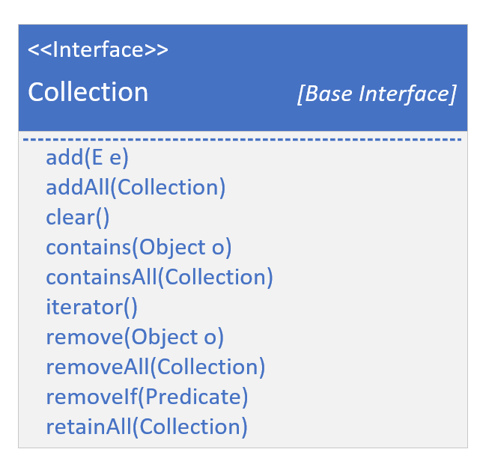
The Collection Interface
As with most roots in software hierarchies, it provides an abstract representation of the behaviors needed to manage a group of objects.
This interface is often used when you want to pass collections around and manipulate them with maximum flexibility and generality.
Remember, an interface allows us to define objects by what they can do, rather than by their specific structure or implementation.
If you examine the methods in the Collection interface, you’ll see the fundamental operations that any collection, regardless of its specific type or structure, must support.
COMPLETE JAVA MASTERCLASS
Collections: Understanding the Big Picture

Slide 5
The Collection Interface
We’ve already explored these operations in our discussions on ArrayList and LinkedList.
When managing a group of objects, you’ll typically be adding and removing elements, checking whether an element is present in the group, and iterating through the elements.
There are other methods as well, but these are the core actions you’ll use to manage a collection.
In Java, the term element refers to a member of the collection being managed.
COMPLETE JAVA MASTERCLASS
Collections: Understanding the Big Picture

Slide 6
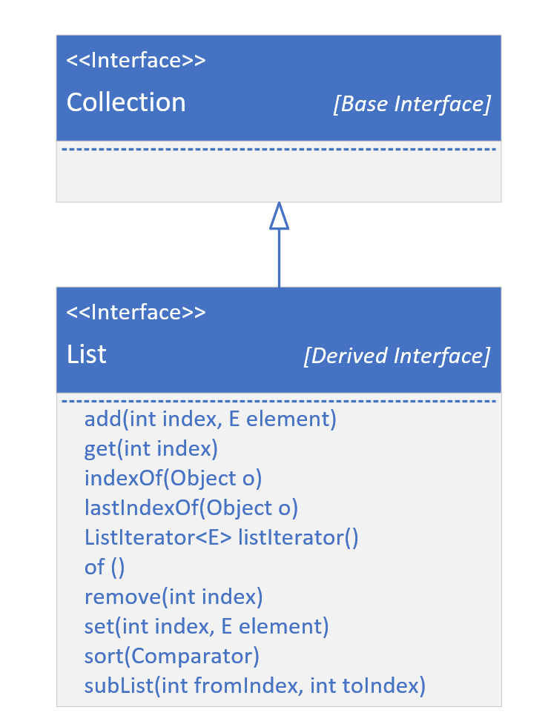
The Collection Interface
This slide shows the List interface extending Collection.
For simplicity, I'm not showing the Collection methods that I showed on the previous slide.
I'm only showing additional methods specifically declared on the List interface.
COMPLETE JAVA MASTERCLASS
Collections: Understanding the Big Picture

Slide 7
The Collection Interface
I've covered most of these methods, but I wanted you to see here that most of these are dealing with an index.
A list can be either indexed, as an ArrayList, or not, like a LinkedList, but a LinkedList is implemented to support all of these methods as well.
Derived interfaces may have specific ways to add, remove, get, and sort elements for their specific type of collection, in addition to those defined on the Collection Interface itself.
Right, so let's look at the big picture of interfaces, and some specific implementations.
COMPLETE JAVA MASTERCLASS
Collections: Understanding the Big Picture

Slide 8
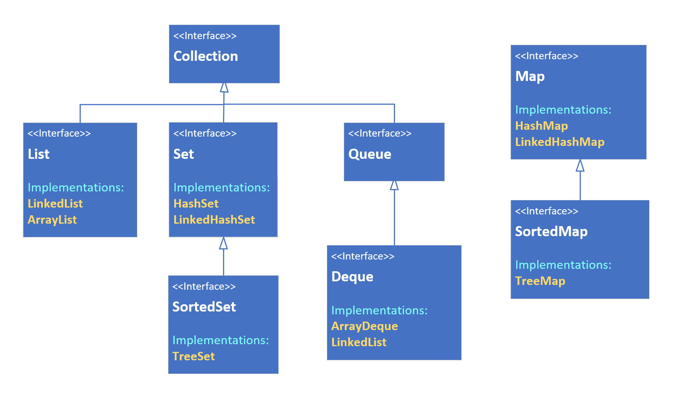
Collections - The Big Picture
This slide shows the interface hierarchy.
It's also showing the implementations or concrete classes that implement these interfaces, in yellow font.
Notice that Map does not extend Collection, although it's still part of this framework.
COMPLETE JAVA MASTERCLASS
Collections: Understanding the Big Picture

Slide 9
Collections - The Big Picture
Maps are uniquely different, which I'll be explaining when I cover Maps in this section.
You can see that LinkedList implements both List and Deque, and I discussed this in detail when I covered LinkedLists.
COMPLETE JAVA MASTERCLASS
Collections: Understanding the Big Picture

Slide 10
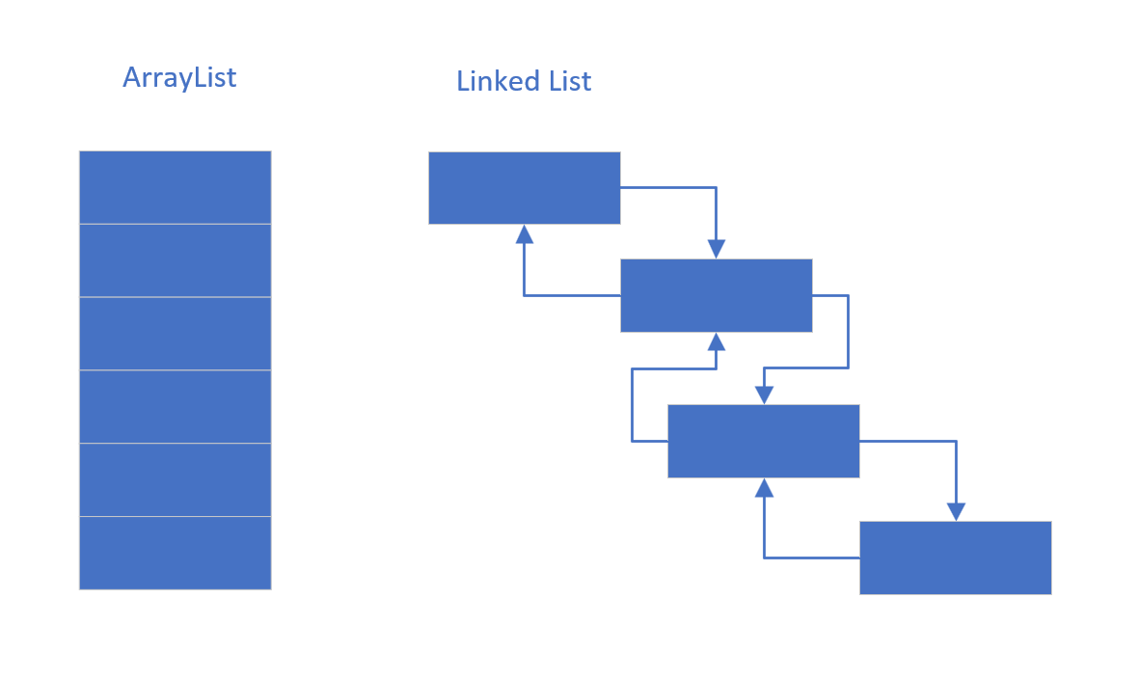
The List
A List is an ordered collection (also known as a sequence).
These can be sequenced in memory like an ArrayList, or maintain links to the next and previous values, as a LinkedList.
COMPLETE JAVA MASTERCLASS
Collections: Understanding the Big Picture

Slide 11
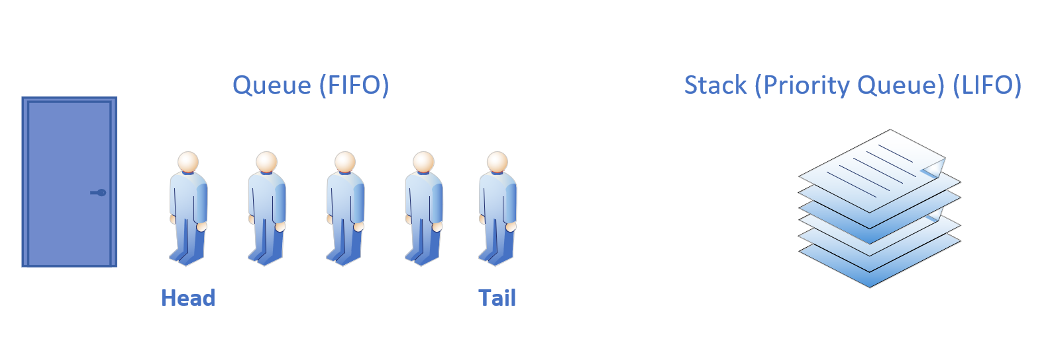
The Queue
A Queue is a collection designed for holding elements prior to processing. In other words, the processing order matters, so the first and last positions, or the head and tail, are prioritized.
Most often these may be implemented as First In, First Out (FIFO), but can be implemented like a Stack, as Last In First Out (LIFO) which we've discussed.
Remember a Deque supports both.
COMPLETE JAVA MASTERCLASS
Collections: Understanding the Big Picture

Slide 12
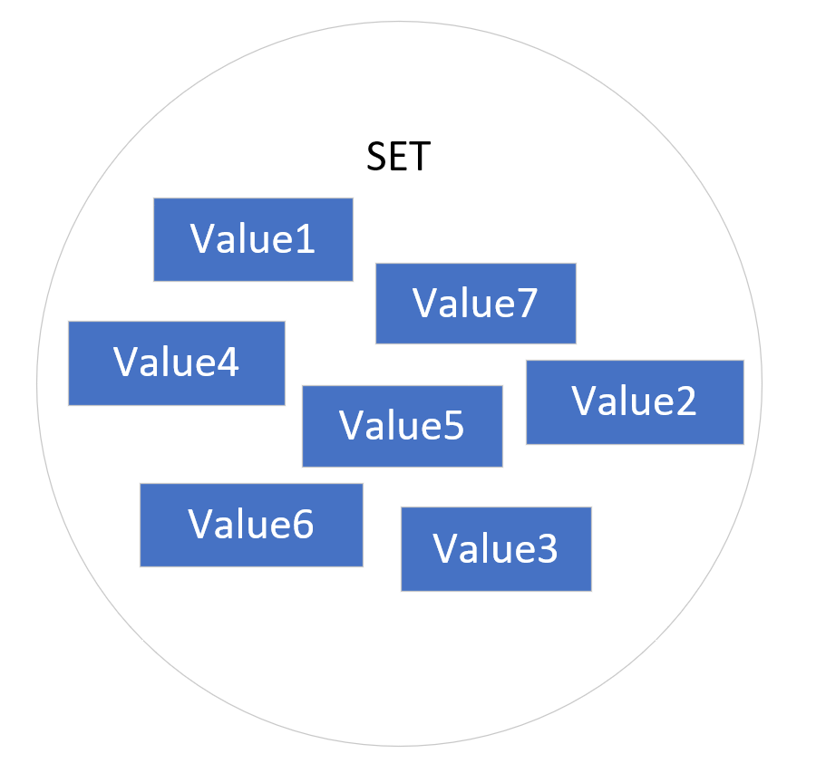
The Set
A Set is a collection conceptually based off of a mathematical set.
Importantly, it contains no duplicate elements, and isn't naturally sequenced or ordered.
You can think of a set as a kind of penned in chaotic grouping of objects.
Java has three implementations, which I'll be reviewing in this section of the course in detail, the HashSet, the TreeSet and the LinkedHashSet.
These are distinguished by the underlying way they store the elements in the set.
A SortedSet is a set that provides a total ordering of the elements.
COMPLETE JAVA MASTERCLASS
Collections: Understanding the Big Picture

Slide 13
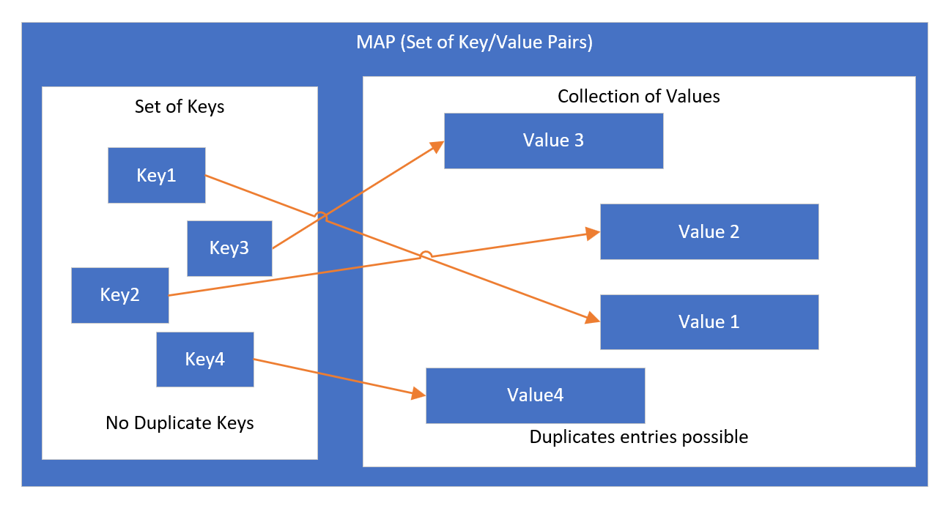
The Map
A Map is a collection that stores key and value pairs.
The keys are a set, and the values are a separate collection, where the key keeps a reference to a value.
Keys need to be unique, but values don't.
Elements in a tree are stored in a key value Node, also called an Entry.
COMPLETE JAVA MASTERCLASS
Collections: Understanding the Big Picture

Slide 14
The Map
In the videos coming up, I'll be looking at Set and Map, and how they resemble and differ from List.
But before that, I want to talk about polymorphic algorithms.
COMPLETE JAVA MASTERCLASS
Collections: Understanding the Big Picture

Slide 15
What's a polymorphic algorithm?
Oracle's documentation describes a polymorphic algorithm as a piece of reusable functionality.
At one time, most of these methods were provided to us, as static methods, on a class called java.util.Collections.
Since JDK-8, and the advent of multiple interface enhancements, some of these methods are now on the interfaces themselves, as default or static methods.
But not all are, so I'll be discussing this class, and what it has to offer, in comparison to what's available on each collection class.
It's also important to understand that legacy code will be using this class for some operations, that can be done from the class itself.
COMPLETE JAVA MASTERCLASS
Collections: Understanding the Big Picture

