Slide 1
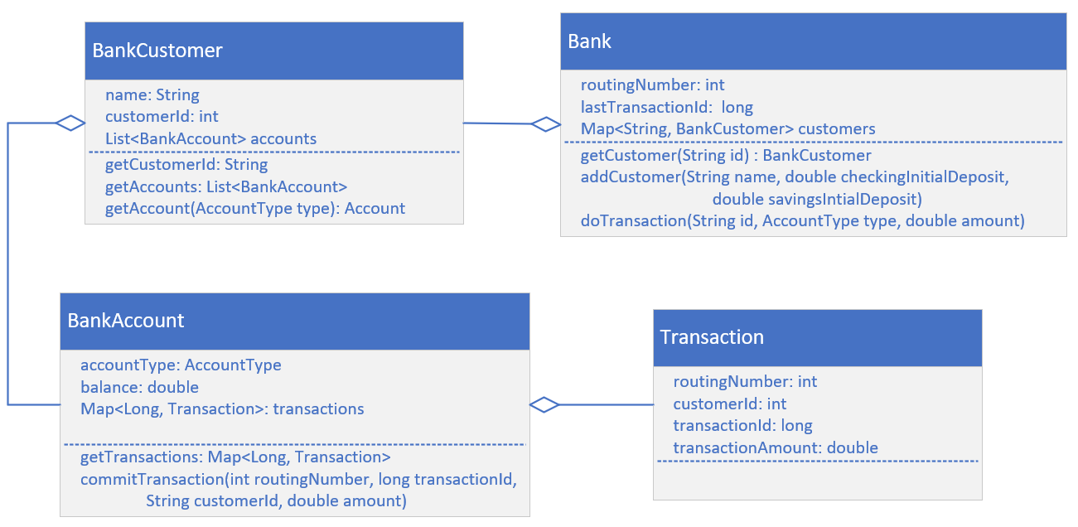

The Class Diagram (as I'll be coding it)
In the last video, I built, and modified the code to support this diagram, with the exception of the Bank class, which I'll be working on now.
COMPLETE JAVA MASTERCLASS
Challenge, Continued: Using unmodifiable collections

