Slide 1

What's an Iterator?
In a nutshell it's another way to traverse lists.
So far, we've mainly used for loops to traverse through elements in an array or list.
There is the traditional for loop and an index to index into a list.
And also, the enhanced for loop and a collection to step through the elements one at a time.
We've used both quite a few times in the course.
Let's look at how the Iterator works.
COMPLETE JAVA MASTERCLASS
Iterators

Slide 2
How does an Iterator work?
If you're familiar with databases, you might be familiar with a database cursor, which is a mechanism that enables traversal over records in a database.
An iterator can be thought of as something similar to a database cursor.
Specifically, an iterator is an object that allows traversal over records in a collection.
COMPLETE JAVA MASTERCLASS
Iterators

Slide 3
How does an Iterator work?
The Iterator is pretty simple.
When you get an instance of an iterator, you can call the next method to get the next element in the list.
You can use the hasNext method to check if any elements remain to be processed.
In the code, you can see a while loop which uses the iterator's hasNext method to determine if it should continue looping
In the loop, the next method is called and its value assigned to a local variable and the local variable printed out.
This prints each element in a list but does it through or via the iterator object.
COMPLETE JAVA MASTERCLASS
Iterators

Slide 4
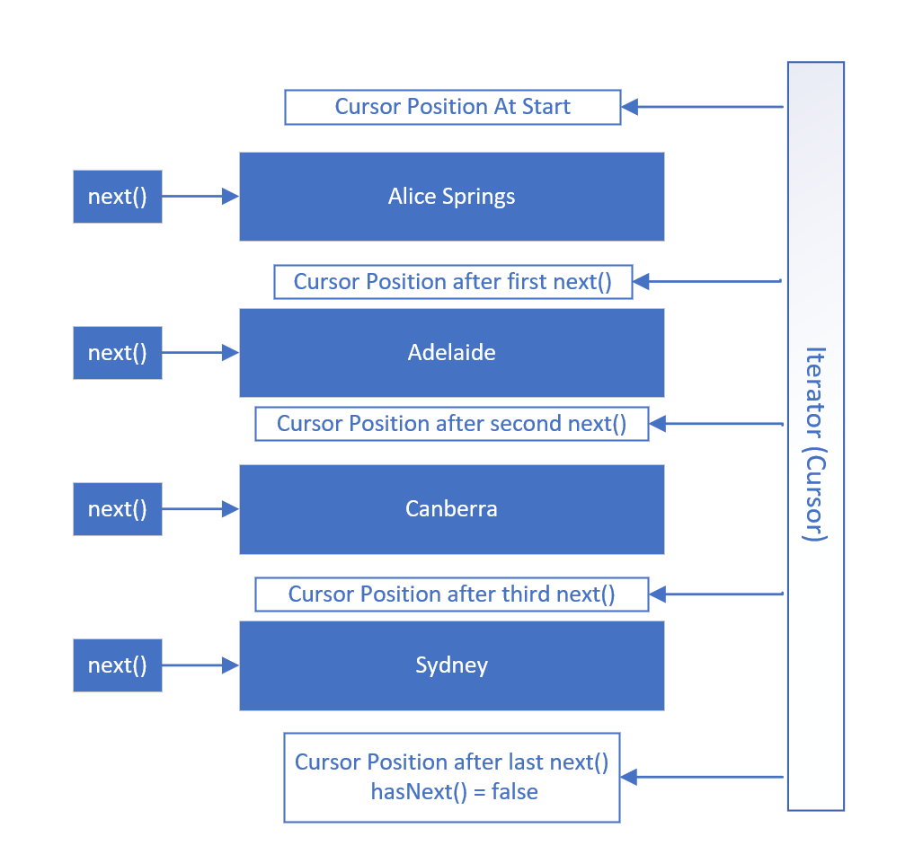
How does an Iterator work?
This slide shows visually how an Iterator works using the PlacesToVisit List.
When an iterator is first created, its cursor position is pointed at a position before the first element.
The first call to the next method retrieves the first element and moves the cursor position to be between the first and second elements.
Subsequent calls to the next method moves the iterator's position through the list, as shown, until there are no elements left, meaning hasNext = false.
At this point, the iterator or cursor position is below the last element.
COMPLETE JAVA MASTERCLASS
Iterators

Slide 5
Iterator vs. ListIterator
An Iterator is forwards only and only supports the remove method.
A ListIterator allows you to navigate both forwards and backwards. Besides the remove method, it also supports the add and set methods, which function as you probably expect.
COMPLETE JAVA MASTERCLASS
Iterators

Slide 6
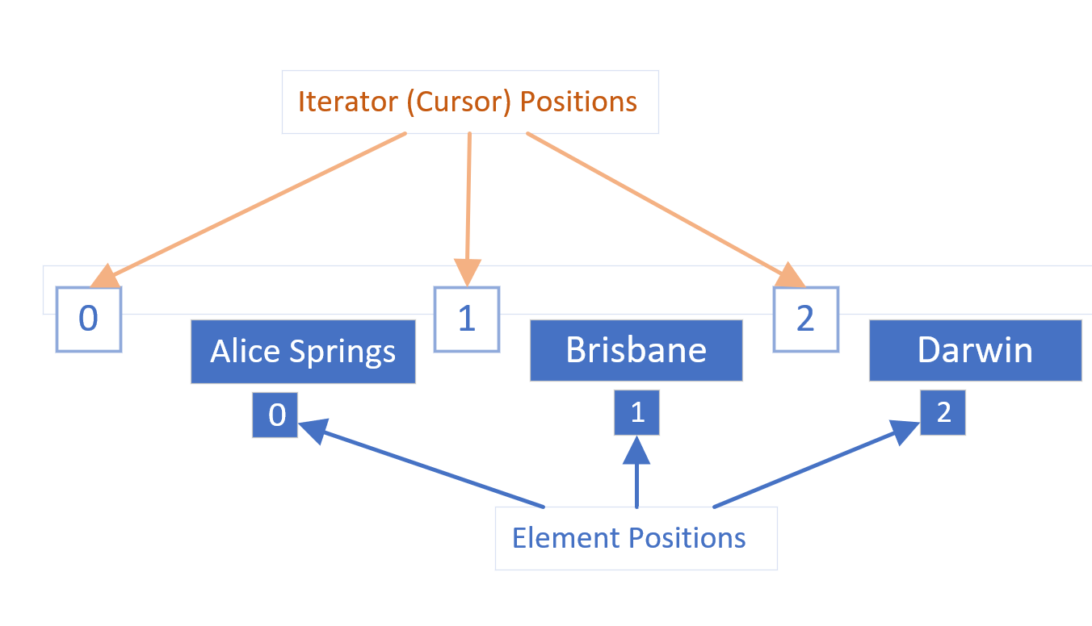
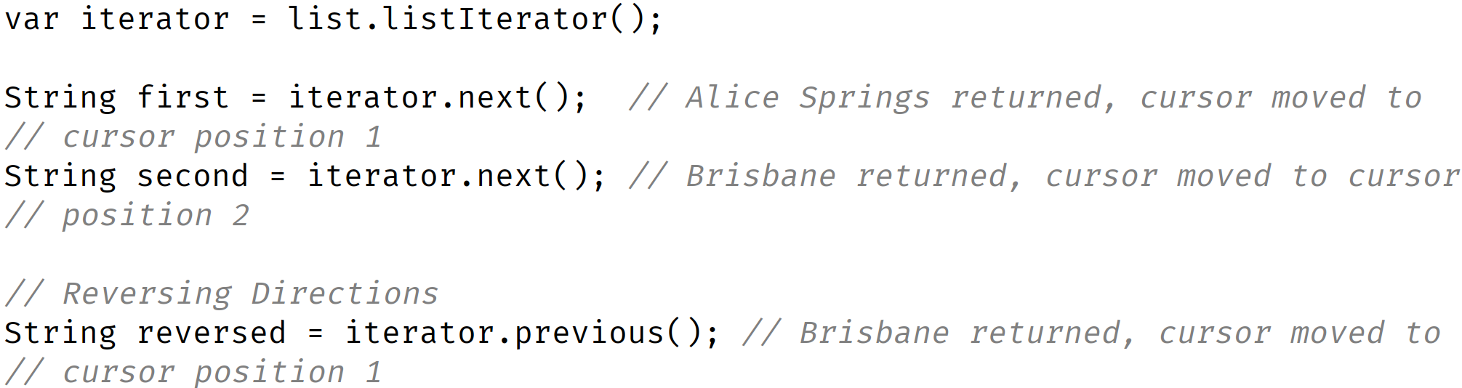
Iterator positions vs. Element positions
It's really important to understand that the iterator's cursor positions are between the elements.
COMPLETE JAVA MASTERCLASS
Iterators

