Slide 1
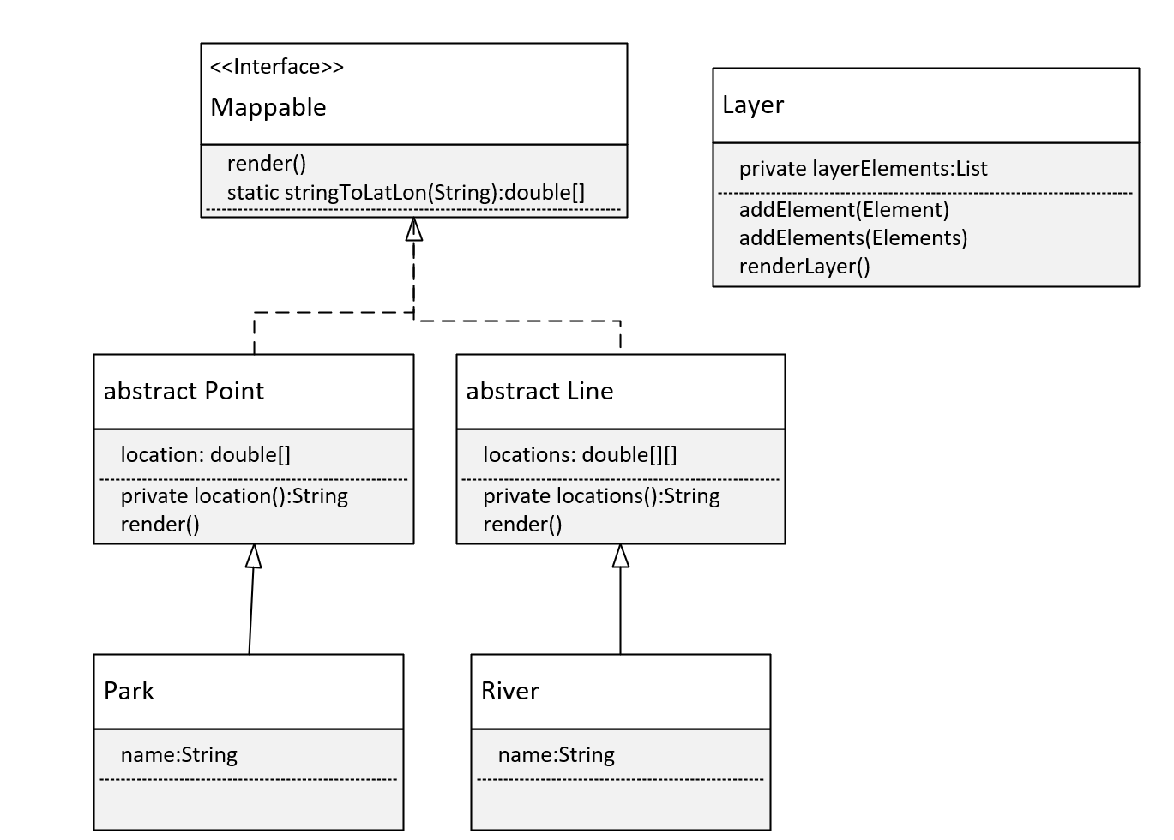

Generic Class Challenge, Part 2
I'm showing my class diagram here again, as a reminder of what I'm working towards.
I'll start with the Park class that extends Point.
COMPLETE JAVA MASTERCLASS
Generic Class Challenge, Part 2

