Slide 1

Understanding the importance of the hash code
HashSet and HashMap are based on the hash codes of objects.
This can be a confusing topic for new programmers, so I want to spend some extra time explaining it.
Since sets are designed to ensure uniqueness by not allowing duplicates, adding an element requires first checking if it already exists in the set.
For large sets, this check can become costly, potentially taking O(n) time, which is linear in relation to the size of the set, something you might recall from my discussion on Big O notation, earlier in the course.
COMPLETE JAVA MASTERCLASS
Understanding the importance of the hash code

Slide 2
Understanding the importance of the hash code
One way to reduce this cost is through a technique called hashing.
By using hashing, we can distribute elements into different buckets. If we divide the elements into two buckets, and each element can reliably determine its bucket, the lookup time can be roughly halved.
Similarly, if we use four buckets, the elements are distributed even further, which could reduce the number of comparisons needed in each bucket, improving lookup efficiency.
COMPLETE JAVA MASTERCLASS
Understanding the importance of the hash code

Slide 3
Understanding the importance of the hash code
A hashed collection will optimally create a limited set of buckets, to provide an even distribution of the objects across the buckets in a full set.
A hash code can be any valid integer, so it could be one of 4.2 billion valid numbers.
If your collection only contains 100,000 elements, you don't want to back it with a storage mechanism of 4 billion possible placeholders.
Additionally, iterating through 100,000 elements sequentially to find a match or duplicate would be inefficient.
COMPLETE JAVA MASTERCLASS
Understanding the importance of the hash code

Slide 4
Understanding the importance of the hash code
Instead, a hashing mechanism takes an integer hash code and a capacity declaration that specifies the number of buckets over which to distribute the objects.
It then maps the wide range of possible hash codes into a more manageable range of bucket identifiers.
Hashed implementations often combine the hash code with other techniques to create an efficient bucketing system that aims to evenly distribute objects, thereby optimizing performance.
COMPLETE JAVA MASTERCLASS
Understanding the importance of the hash code

Slide 5
Hashing starts with understanding equality
To understand hashing in Java, it helps to first understand the equality of objects.
I've touched on this in previous videos, but now I want to be sure you thoroughly understand this subject, because it matters when dealing with any hashed collections.
There are two methods on java.util.Object, that all objects inherit.
These are equals, and hashCode, and I am showing the method signatures from Object here.
Testing for equality | The hashcode method
COMPLETE JAVA MASTERCLASS
Understanding the importance of the hash code

Slide 6
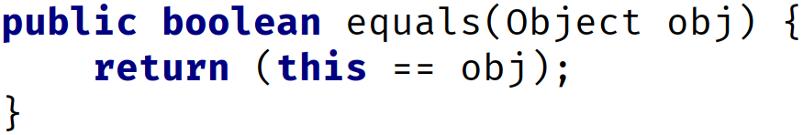
The equals method on Object
The implementation of equals on Object is shown here.
It simply returns this == obj.
COMPLETE JAVA MASTERCLASS
Understanding the importance of the hash code

Slide 7
Do you remember what == means for Objects?
Do you remember what == means for objects?
It means two variables have the same reference to a single object in memory.
Because both references are pointing to the same object, then this is obviously a good equality test.
COMPLETE JAVA MASTERCLASS
Understanding the importance of the hash code

Slide 8
Equality of Objects
Objects can be considered equal in other instances as well, if their attribute values are equal.
The String class overrides this method, so that it compares all the characters in each String, to confirm that two Strings are equal.
COMPLETE JAVA MASTERCLASS
Understanding the importance of the hash code

Slide 9
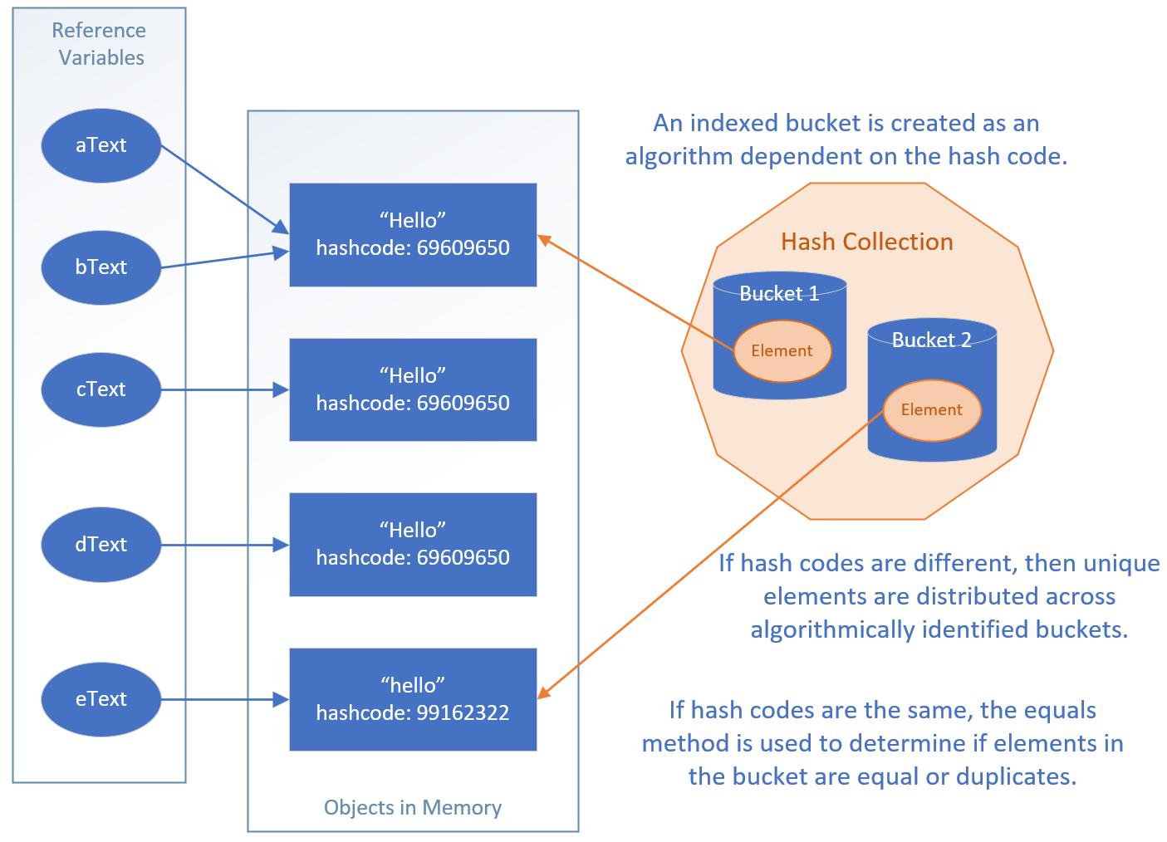
The visual representation of the code
The code set up five String reference variables, but two of these referenced the same String object in memory, as shown here with aText and bText pointing to the same String instance.
When I passed the list of five strings to the HashSet, it added only unique instances to its collection.
COMPLETE JAVA MASTERCLASS
Understanding the importance of the hash code

Slide 10
The visual representation of the code
It locates elements to match, by first deriving which bucket to look through, based on the hash code.
It then compares those elements to the next element to be added, with other elements in that bucket, using the equals method.
COMPLETE JAVA MASTERCLASS
Understanding the importance of the hash code

Slide 11
Creating the hashCode method
You don't have to use the generated algorithm as I did here.
You could create your own, but your code should stick to the following rules.
It should be very fast to compute.
It should produce a consistent result each time it's called. For example, you wouldn't want to use a random number generator, or a date time-based algorithm that would return a different value each time the method is called.
Objects that are considered equal should produce the same hashCode.
Values used in the calculation should not be mutable.
COMPLETE JAVA MASTERCLASS
Understanding the importance of the hash code

Slide 12
Creating the hashCode method
When implementing the hashCode method, it’s common to use a small prime number as a multiplier. Prime numbers are preferred because they help spread out hash codes more evenly, reducing the chance that different objects will end up with the same hash code, which is important in data structures like HashMap or HashSet.
Using a prime number as a multiplier is especially useful if your data might naturally cluster or follow patterns, which could otherwise lead to uneven distribution of hash codes.
For example, tools like IntelliJ often use 31 as a multiplier, but other primes like 29, 37, or 43 work well too. Even some non-prime numbers, like 33, can give good results, though primes are generally better.
COMPLETE JAVA MASTERCLASS
Understanding the importance of the hash code

Slide 13
Creating the hashCode method
It’s best to avoid small primes like 2, 3, 5, or 7 because many numbers are divisible by them, which could lead to less effective distribution and slower performance in hash-based collections.
If you’re curious, I encourage you to explore this topic further. For now, remember that when using your own classes in hashed collections, it’s important to override both the equals and hashCode methods.
I’ll go over these concepts in more detail in upcoming videos, so you’ll have plenty of time to get familiar with them.
COMPLETE JAVA MASTERCLASS
Understanding the importance of the hash code

Slide 14
Creating the hashCode method
For those who like to understand how things really work, let me encourage you to do some research on this topic.
For the rest of you, remember that if you are using your own classes in hashed collections, you'll want to override both the equals and the hashCode methods.
I'll be covering this quite a bit over the next couple of videos, so you'll have more time to get exposed to these concepts.
COMPLETE JAVA MASTERCLASS
Understanding the importance of the hash code

Slide 15
Java's Hashed Collection Types
Java supports four hashed collection implementations, which I'll be looking at coming up.
These are the HashSet, LinkedHashSet, the HashMap, and LinkedHashMap.
In addition, there's one legacy implementation, the HashTable, which I won't be covering, since there are more efficient implementations which replace this legacy class.
COMPLETE JAVA MASTERCLASS
Understanding the importance of the hash code

