Slide 1
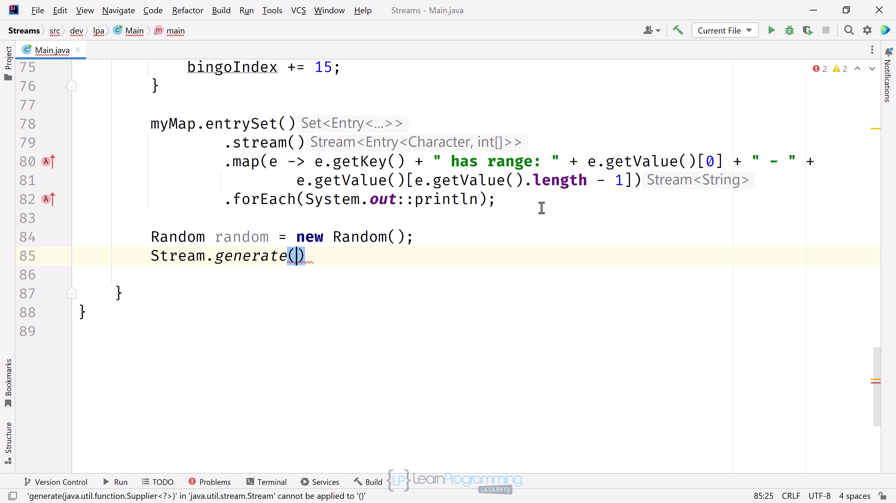

Stream Types May Change As the Pipeline Process Progresses
An intermediate operation can usually be recognized by its signature, because it returns a Stream.
I want to point out, that this doesn't mean the element type of the Stream can't change.
In practice, you'll be regularly transforming your stream element to a different type.
COMPLETE JAVA MASTERCLASS
Stream Sources

Slide 2
Stream Sources
This slide shows the eight methods I covered in this video.
Two can produce infinite streams, the Stream.generate method as well as Stream.iterate, which doesn't include a Predicate parameter.
Method | Finite | Infinite
Collection.stream() | X
Arrays.stream(T[]) | X
Stream.of(T...) | X
Stream.iterate(T seed, UnaryOperator<T> f) | X | X
Stream.iterate(T seed, Predicate<? super T> p, UnaryOperator<T> f) | X
Stream.generate(Supplier<? extends T> s) |  | X
**IntStream.range(int startInclusive, int endExclusive) | X
**IntStream.rangeClosed(int startInclusive, int endExclusive) | X
** range and rangeClosed also available on LongStream, with a long type produced for both.
COMPLETE JAVA MASTERCLASS
Stream Sources

