Slide 1
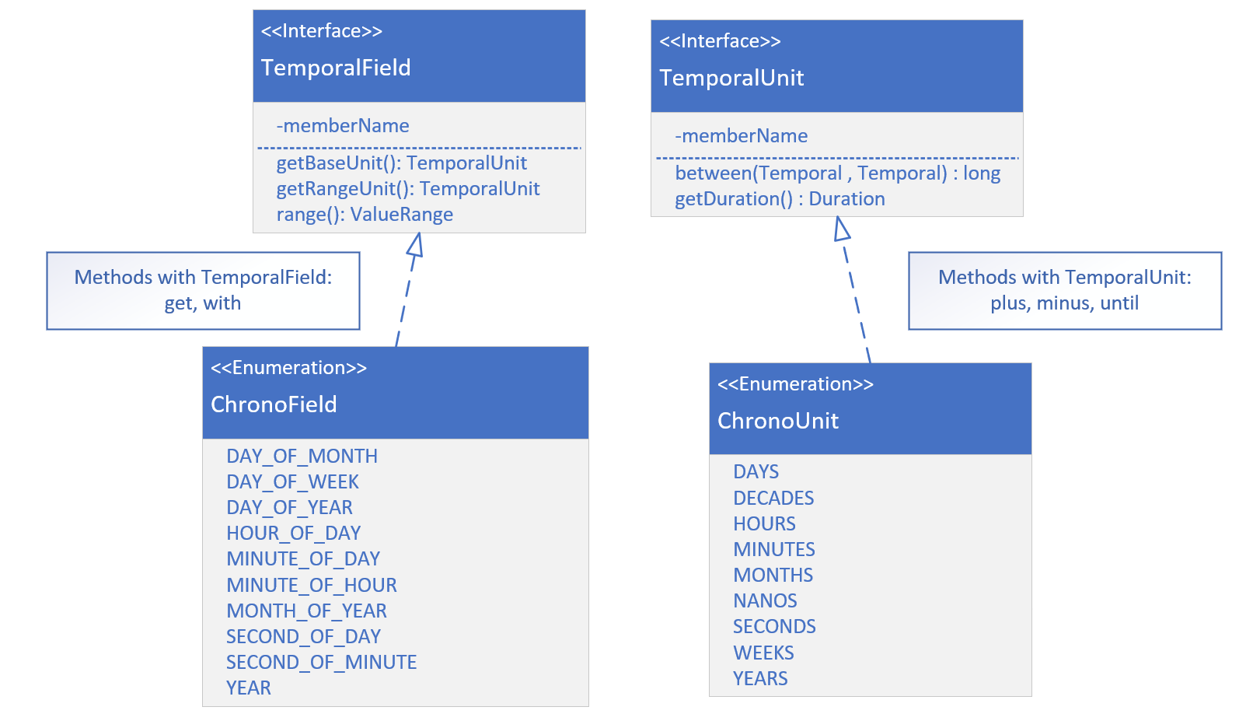

TemporalField vs. Temporal Unit
A TemporalField represents a specific field within a date-time, such as MONTH_OF_YEAR, DAY_OF_WEEK, or HOUR_OF_DAY. It defines fields we commonly think about in terms of date-time components (e.g., the month part of a date or the hour part of a time).
COMPLETE JAVA MASTERCLASS
LocalDate

Slide 2
TemporalField vs. Temporal Unit
In contrast, a TemporalUnit represents a unit or duration of time, such as YEARS, MONTHS, DAYS, or MINUTES. Rather than representing a part of a date or time, it represents the amount of time you might use to measure intervals between date-times.
On this slide, I am showing both interfaces, and a couple of the methods that would be implemented.
COMPLETE JAVA MASTERCLASS
LocalDate

Slide 3
TemporalField vs. Temporal Unit
I'm also showing you just some of the enum constants on ChronoField and ChronoUnit. Ones that are pretty commonly used.
The get and with methods take a TemporalField as a parameter.
The plus, minus, and until methods, take a TemporalUnit.
COMPLETE JAVA MASTERCLASS
LocalDate

