Slide 1
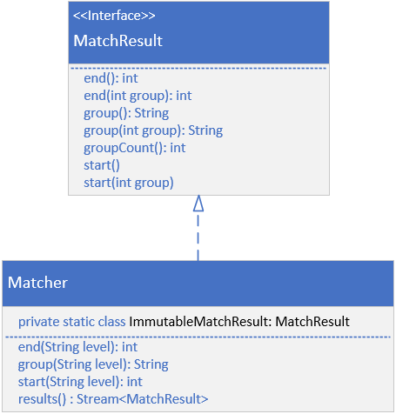

Matcher and MatchResult
The Matcher class implements MatchResult, which you can see has the end, group and start methods I reviewed with you on Matcher.
Matcher though, supports the overloaded version of these methods, which allow you to retrieve a capturing group by its name.
Note that I am only showing a few of the methods on Matcher in this particular diagram.
COMPLETE JAVA MASTERCLASS
Matcher methods for replacing text

Slide 2
Matcher and MatchResult
When you call the results method, you'll get a stream of instances, types that also implement MatchResult.
This class is declared on Matcher as a static nested class.
The actual class isn't really important, you should just know you can use the methods shown here, declared on MatchResult.
COMPLETE JAVA MASTERCLASS
Matcher methods for replacing text

Slide 3
Back References
You can use back references to refer to the text, captured by these groups, in regular expressions, and also in the replacement methods on Matcher.
In a regular expression, a back reference is identified by a backslash and a number, which is the capturing group index.
In a replacement string in Java though, a back reference starts with a $, then a number, again the grouping index.
You can also use capturing group names in back references, replacing the index with the named group.
COMPLETE JAVA MASTERCLASS
Matcher methods for replacing text

