Slide 1

File Tree Walking Challenge
I've shown you a lot of ways to navigate the file tree.
These include:
Files.list
Files.walk
Files.find
Files.newDirectoryStream
Files.walkFileTree
In addition to summing up directory sizes, I want you to summarize the number of Files in a directory.
For a bonus, include the summary of the number of subfolders.
These numbers should include nested files or folders.
COMPLETE JAVA MASTERCLASS
File Tree Walking Challenge

Slide 2
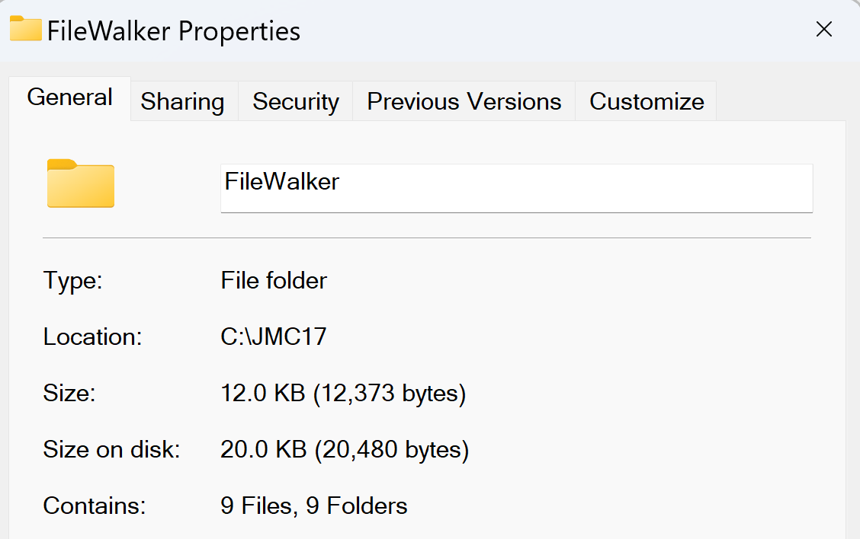
Challenge
You can see the Size, which is the cumulative size of all the files.
You also can see that this folder contains 9 files and 9 Folders in total.
This folder count doesn't include the current folder, but does include nested folders.
Here's a hint, instead of the map value being a Long, I'll be making that a nested Map.
COMPLETE JAVA MASTERCLASS
File Tree Walking Challenge

