Slide 1

Java's Threads
Threads are the fundamental building blocks, to support concurrency, in a Java application.
They're essential, because they allow us to perform multiple tasks simultaneously, within a single process.
COMPLETE JAVA MASTERCLASS
Java Threads and Thread Basics

Slide 2
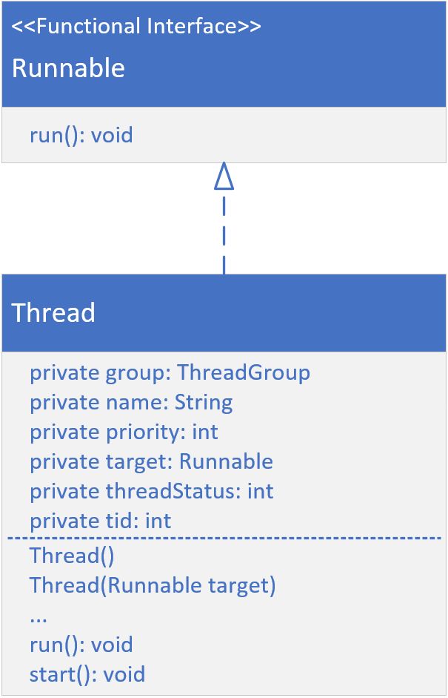
The java.util.Thread Class
You can see that this class implements the Runnable interface, which has a single abstract method, the run method.
Each instance of a thread has some state.
The fields displayed here are all encapsulated and this includes thread group, a name, a priority, a status, and a thread id.
A thread can be constructed with no arguments.
It can be constructed by passing a Runnable instance to it.
The first method is the run method, which has to be overridden, since it's declared abstract on the Runnable interface.
COMPLETE JAVA MASTERCLASS
Java Threads and Thread Basics

Slide 3
Thread Priority
Thread priority is a value from 1 to 10.
The Thread class has three pre-defined priorities, included as constants.
Higher-priority threads have a better chance of being scheduled, by a thread scheduler, over the lower-priority threads.
However, priority behavior can vary across different operating systems and JVM implementations.
You can think of this priority as more of a suggestion, to the thread management process.
Thread.MIN_PRIORITY = 1 (low) Thread.NORM_PRIORITY = 5 (default) Thread.MAX_PRIORITY = 10 (high)
COMPLETE JAVA MASTERCLASS
Java Threads and Thread Basics

Slide 4
Creating a Thread Instance
Extend the Thread class, and create an instance of this new subclass.
Create a new instance of Thread, and pass it any instance that implements the Runnable interface. This includes passing a lambda expression.
Use an Executor, to create one or more threads for you.
COMPLETE JAVA MASTERCLASS
Java Threads and Thread Basics

