Slide 1
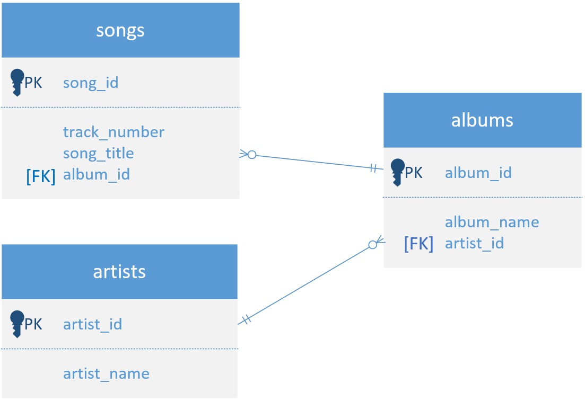

Entity Relationship Diagram (ERD)
An Entity Relationship Diagram is similar to a Class Diagram.
An Entity is a table in this case, so all three tables are shown here.
Relationships are shown with connector lines, which describe how two tables, or entities relate, to one another.
Both of the relationships shown on this diagram are one to many, or many to one, depending on how you look at it.
COMPLETE JAVA MASTERCLASS
Using MySQL WorkBench to create and view a music database

