Slide 1

Reference vs Object vs Instance vs Class
In this video, I'm going to discuss, and hopefully clear up any confusion about references, vs. objects, vs. instances, vs. classes.
COMPLETE JAVA MASTERCLASS
Reference vs Object vs Instance vs Class

Slide 2
Reference vs Object vs Instance vs Class
By now, you've probably noticed that I use the words reference, object, instance and class frequently.
These new concepts may well be confusing at first.
In this video, I'm going to go through all these terms, and show you exactly what each of these words mean in the context of Java programming.
COMPLETE JAVA MASTERCLASS
Reference vs Object vs Instance vs Class

Slide 3
Object vs Instance vs Class
Class
You create an object by ‘instantiating a class’
You can create many objects using a single class. Each may have unique attributes or values
Object
Instance
Object
Object
Object and instance are interchangeable terms
Instance
COMPLETE JAVA MASTERCLASS
Reference vs Object vs Instance vs Class

Slide 4
Reference vs Object vs Instance vs Class
Let's use the analogy of building a house to understand classes.
A class is basically a blueprint for the house.
Using the blueprint, we can build as many houses as we like based on those plans.
Each house we build (in other words, going back to programming terms, each house we instantiate using the new operator) is an object.
This object can also be known as an instance. Often, we'll say it's an instance of the class. So, we would have an instance of house in this example.
Getting back to the physical world, each house we build has an address (it's built at a physical location).
In other words, if we want to tell someone where we live, we give them our address (perhaps written on a piece of paper). This is known as a reference.
COMPLETE JAVA MASTERCLASS
Reference vs Object vs Instance vs Class

Slide 5
Reference vs Object vs Instance vs Class
We can copy that reference as many times as we like, but there is still just one house that we're referring to.
In other words, we're copying the paper that has the address on it, not the house itself.
We can pass references as parameters to constructors and methods.
COMPLETE JAVA MASTERCLASS
Reference vs Object vs Instance vs Class

Slide 6
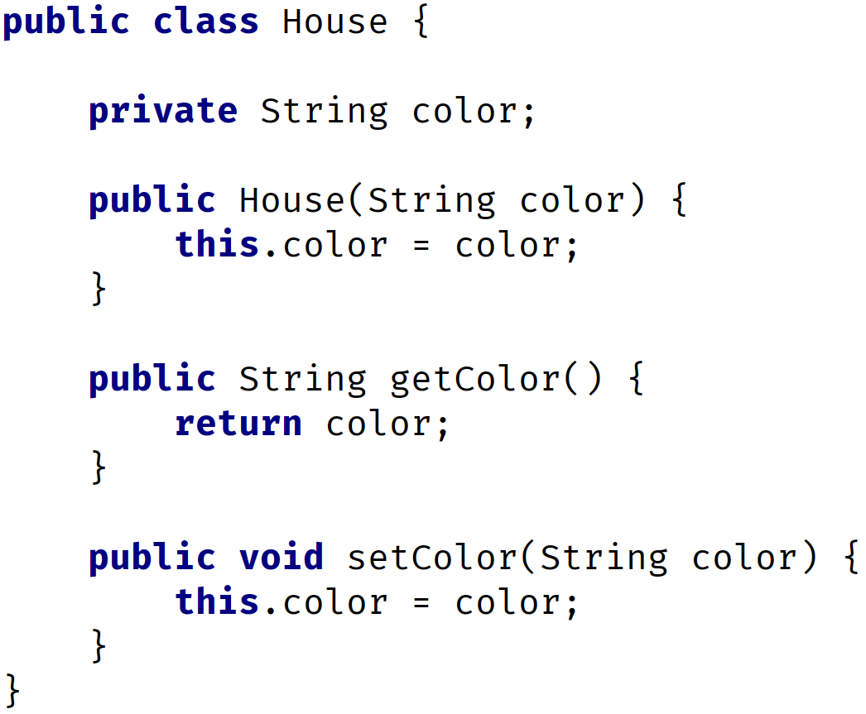
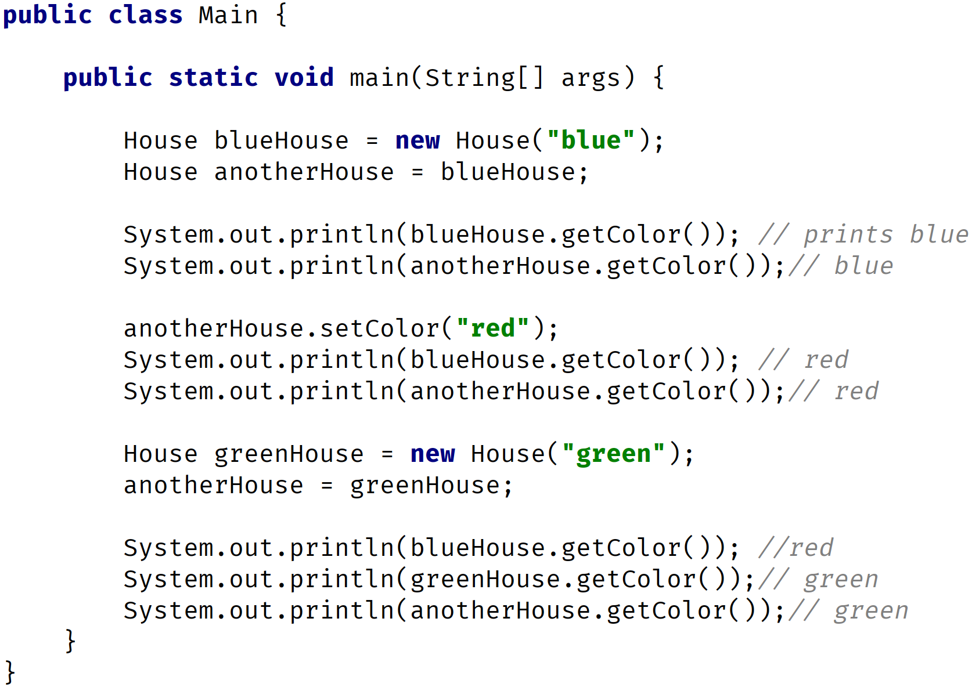
Reference vs Object vs Instance vs Class
COMPLETE JAVA MASTERCLASS
Reference vs Object vs Instance vs Class

Slide 7
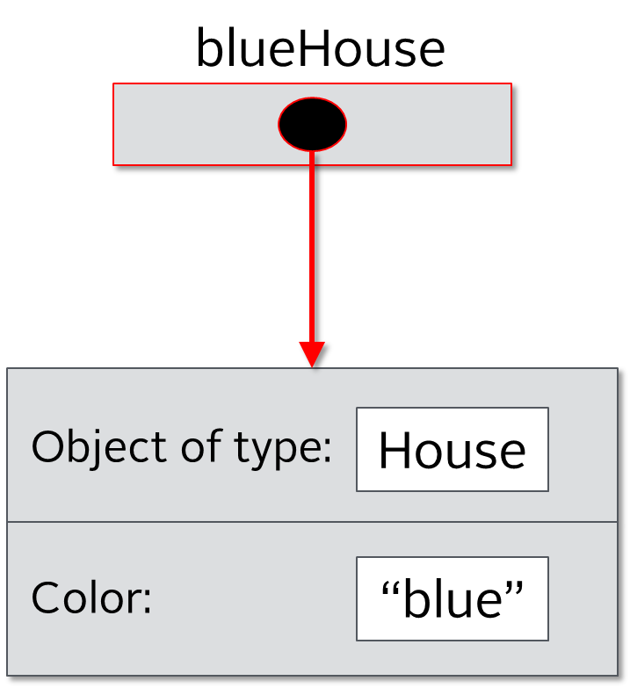
Reference vs Object vs Instance vs Class
The line House blueHouse = new House(“blue”); creates a new instance of the House class. Remember House is a blueprint, and we are assigning it to the blueHouse variable. In other words it is a reference to the object in memory. The image on the left hopefully makes sense to you now.
COMPLETE JAVA MASTERCLASS
Reference vs Object vs Instance vs Class

Slide 8
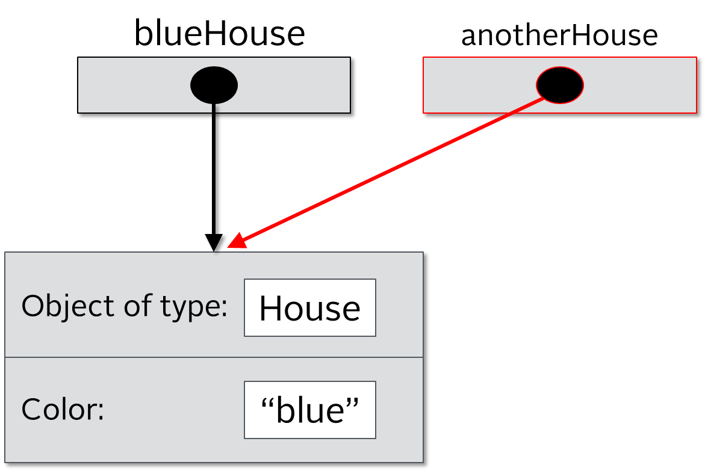
Reference vs Object vs Instance vs Class
The next line House anotherHouse = blueHouse; creates another reference to the same object in memory. Here we have two references pointing to the same object in memory. There is still one house, but two references to that one object. In other words we have two pieces of paper with the physical address of where the house is built (going back to our real world example).
COMPLETE JAVA MASTERCLASS
Reference vs Object vs Instance vs Class

Slide 9
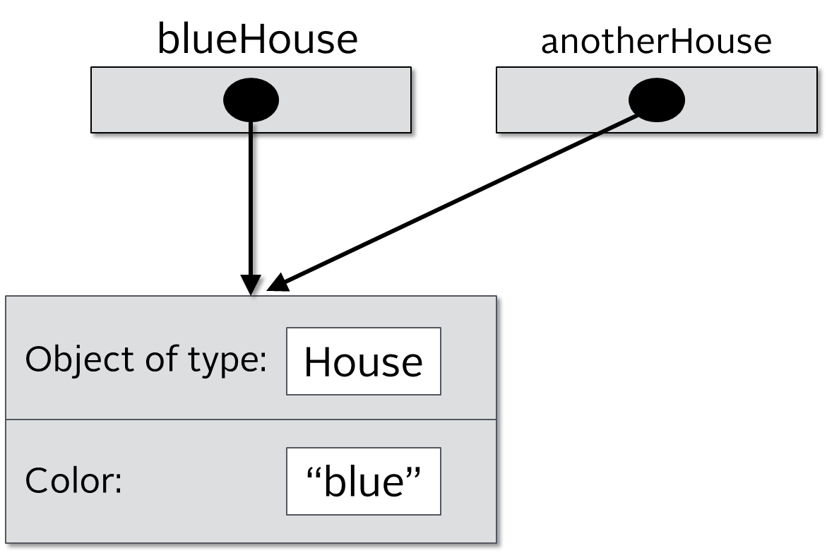
Reference vs Object vs Instance vs Class
Next we have two println statements that print the blueHouse color and anotherHouse color. Both will print “blue” since we have two references to the same object.
COMPLETE JAVA MASTERCLASS
Reference vs Object vs Instance vs Class

Slide 10
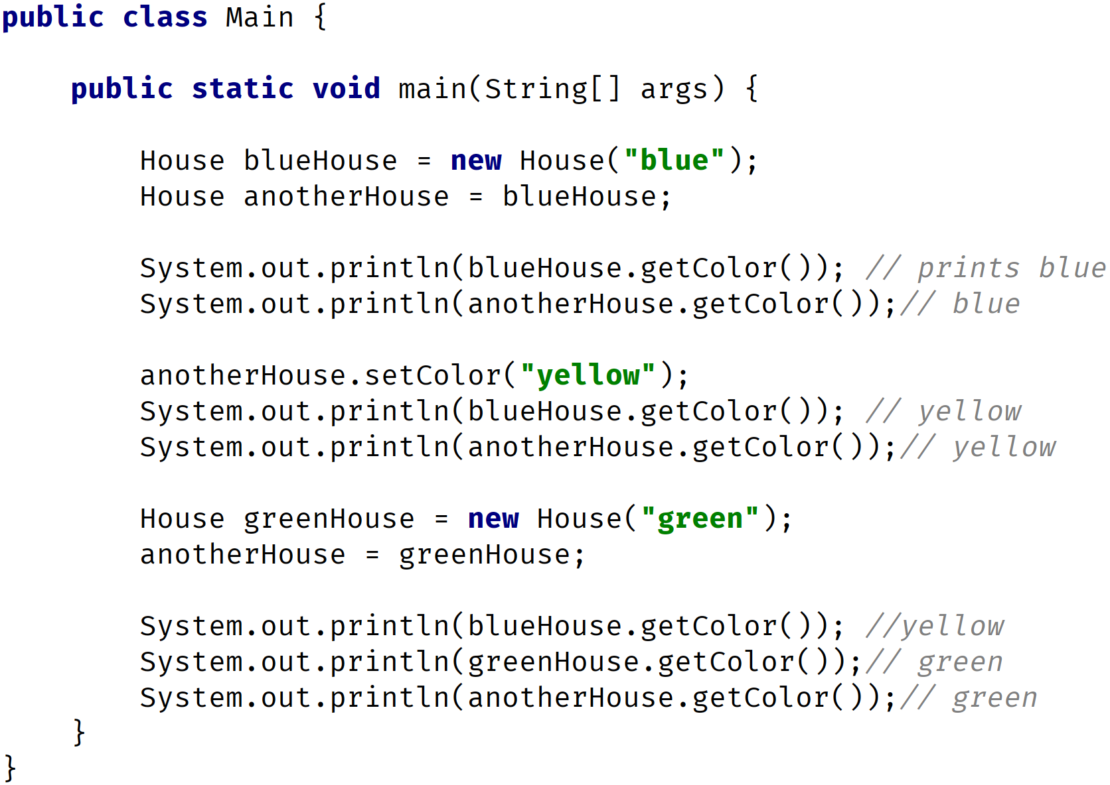
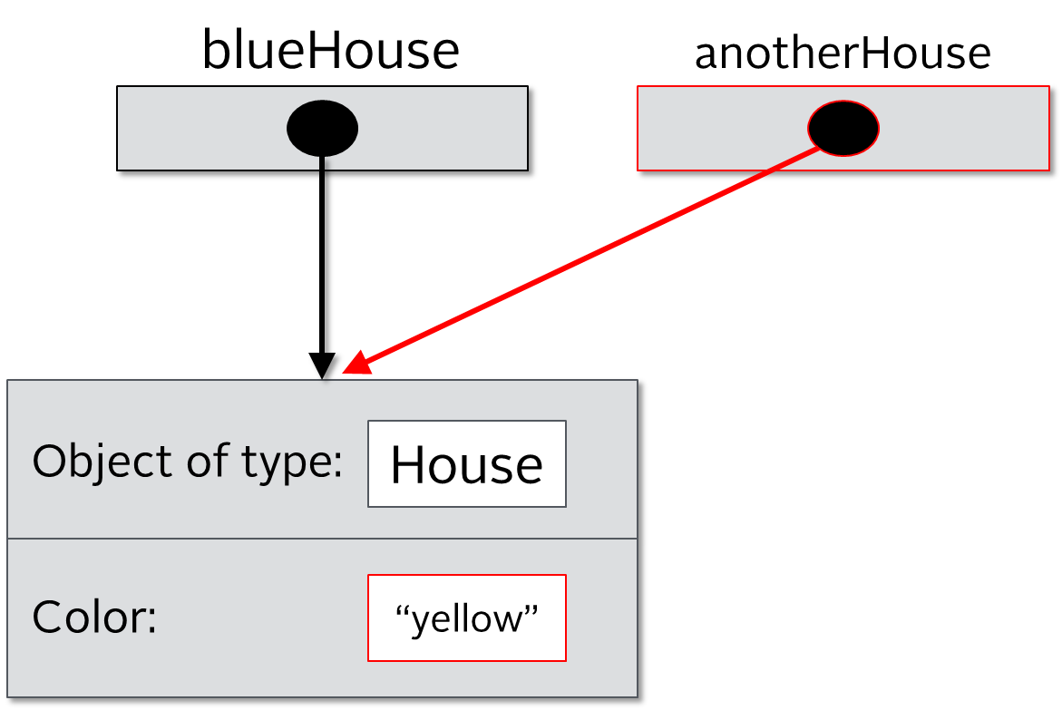
Reference vs Object vs Instance vs Class
The next line calls the method setColor and sets the color to yellow. To the left you can that both blueHouse and anotherHouse have the same color now. Why? Remember we have two references that point to the same object in memory. Once we change the color, of one, both references still point to the same object. In our real world example, there is still just one physical house at that one address, even though we have written the same address on two pieces of paper.
COMPLETE JAVA MASTERCLASS
Reference vs Object vs Instance vs Class

Slide 11

Reference vs Object vs Instance vs Class
Here we have two println statements that are printing the color. Both now print “yellow” since we still have two references that point to the same object in memory. Notice the arrows on the left hand side.
COMPLETE JAVA MASTERCLASS
Reference vs Object vs Instance vs Class

Slide 12
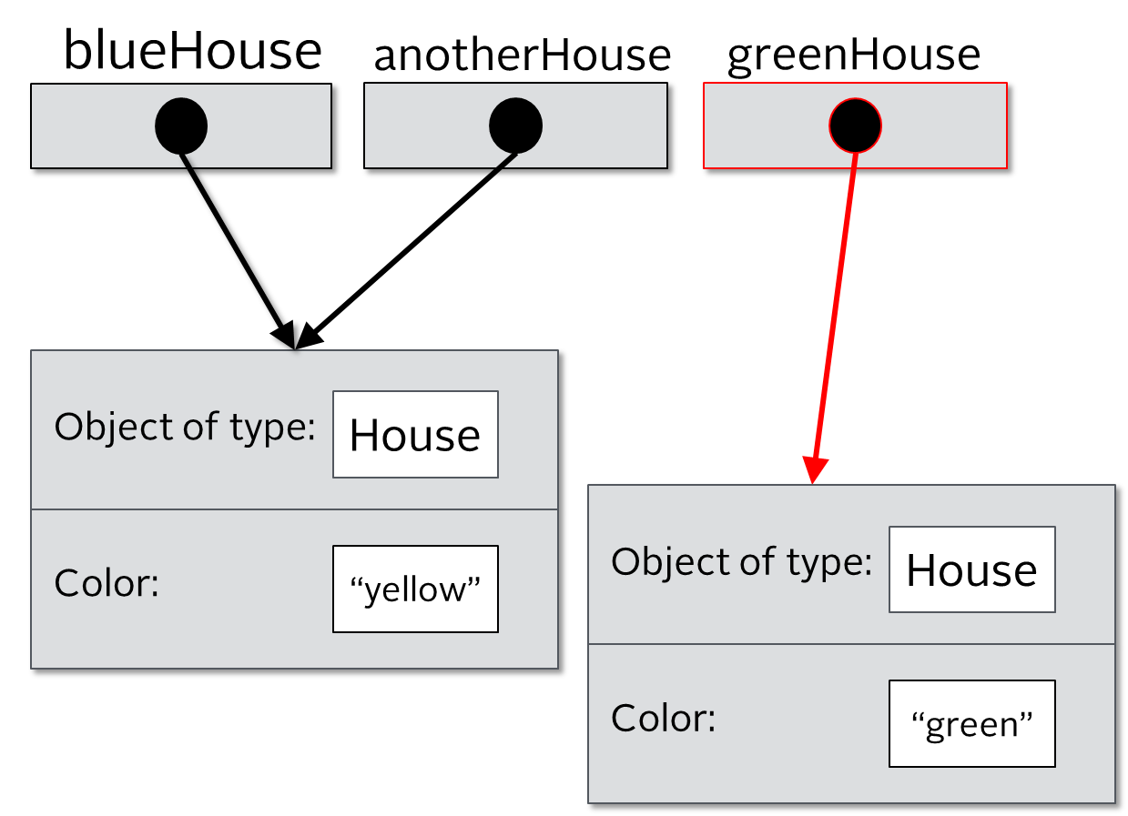
Reference vs Object vs Instance vs Class
Here we are creating another new instance of the House class with the color set to “green”. Now we have two objects in memory but we have three references which are blueHouse, anotherHouse and greenHouse. The variable (reference) greenHouse points to a different object in memory, but blueHouse and anotherHouse point to the same object in memory.
COMPLETE JAVA MASTERCLASS
Reference vs Object vs Instance vs Class

Slide 13
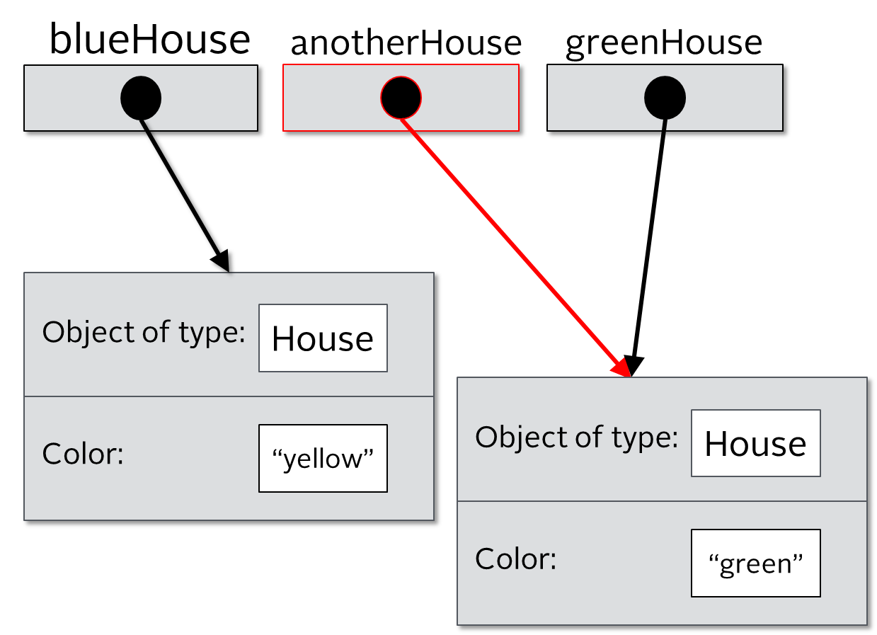
Reference vs Object vs Instance vs Class
Here we assigns greenHouse to anotherHouse. In other words we are dereferencing anotherHouse. It will now point to a different object in memory. Before it was pointing to a house that had the “yellow” color, now it points to the house that has the “green” color. In this scenario we still have three references and two objects in memory but blueHouse points to one object while anotherHouse and greenHouse point to the same object in memory.
COMPLETE JAVA MASTERCLASS
Reference vs Object vs Instance vs Class

Slide 14
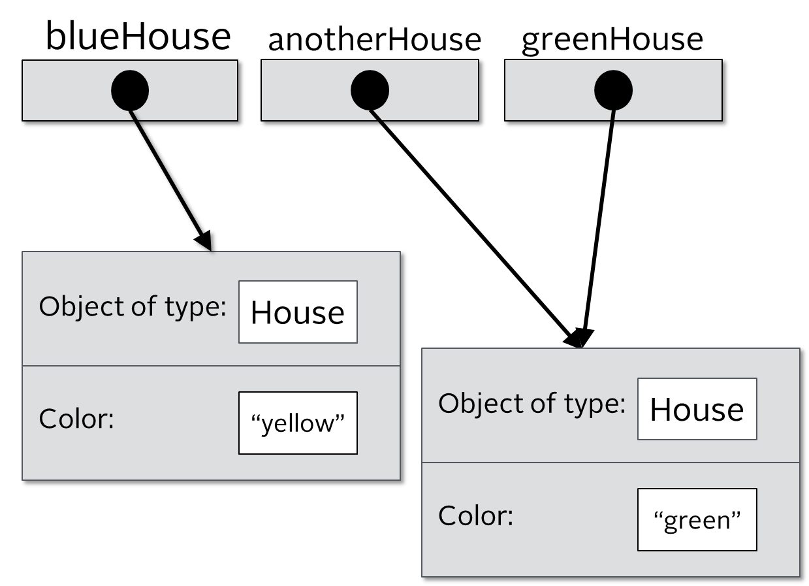
Reference vs Object vs Instance vs Class
Finally we have three println statements. The first will print “yellow” since the blueHouse variable(reference) points to the object in memory that has the “yellow” color, while the next two lines will print “green” since both anotherHouse and greenHouse point to same object in memory.
COMPLETE JAVA MASTERCLASS
Reference vs Object vs Instance vs Class

Slide 15
The reference vs The object
Consider the code on this slide.
On the first line, I create a new House and make it red.
But I am not assigning this to any variable.
COMPLETE JAVA MASTERCLASS
Reference vs Object vs Instance vs Class

Slide 16
The reference vs The object
This compiles fine and you can do this.
This object is created in memory, but after that statement completes, my code has no way to access it.
The object exists in memory, but I can't communicate with it after that statement is executed.
That's because I didn't create a reference to it.
COMPLETE JAVA MASTERCLASS
Reference vs Object vs Instance vs Class

Slide 17
The reference vs The object
On the second line, I do create a reference to the house object I created.
My reference, the variable I call myHouse, lets me have access to that beige house as long as my variable, myHouse, stays in scope. Or until it gets reassigned to reference a different object.
COMPLETE JAVA MASTERCLASS
Reference vs Object vs Instance vs Class

Slide 18
The reference vs The object
I'm creating a red house again, but this is a different object altogether from the red house I created on line one.
This third statement is creating yet another house object in memory which has no relationship to the one I created on the first line.
COMPLETE JAVA MASTERCLASS
Reference vs Object vs Instance vs Class

Slide 19
The reference vs The object
This code has three instances of house but only two references.
That first object is said to be eligible for garbage collection immediately after that first statement.
It's useless to the code because It's no longer accessible.
COMPLETE JAVA MASTERCLASS
Reference vs Object vs Instance vs Class

Slide 20
The reference vs The object
There are times we might want to instantiate an object and immediately call a method on it.
99 percent of the time, we'll want to reference the objects we create.
COMPLETE JAVA MASTERCLASS
Reference vs Object vs Instance vs Class

