Slide 1
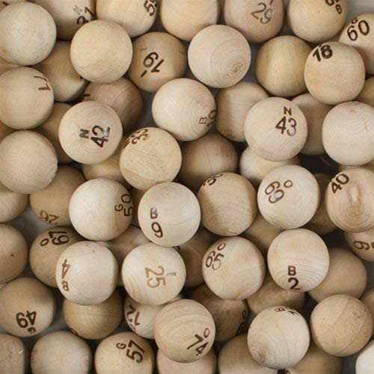
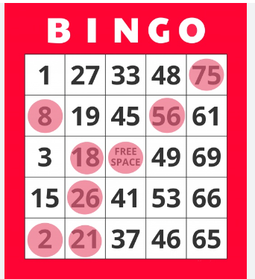

BINGO
Each ball is identified with either a B, I, N, G, or O, and followed by a number.
A B ball will have a number from 1 to 15, an I ball will get a number between 16 thru 30, and so on.
Someone will draw a ball out of the container, and announce it.
Every player will have a five-by-five card, with some randomly generated set of these numbers on it.
The first column has the B numbers, the second column has the I numbers, and so on.
You win by being the first person to match five called numbers in a row, either horizontally, vertically, or diagonally.
COMPLETE JAVA MASTERCLASS
A first look at a stream in action

