Slide 1

The difference between executing run and start on a thread
There's a big difference between calling run() and start().
If you execute the run method, it's executed synchronously, by the running thread it's invoked from.
If you want your code to be run asynchronously, you must call the start method.
COMPLETE JAVA MASTERCLASS
Thread Creation and Execution

Slide 2
The native modifier on a method
The native modifier indicates that this method's source code isn't written in Java.
It's written in another language, such as C or C++.
The code in this example, is part of a native library, such as a dll file.
COMPLETE JAVA MASTERCLASS
Thread Creation and Execution

Slide 3
Why use a native library?
The reasons to do this include
To access system-level functionality that's platform-specific.
To interface with hardware.
To optimize performance for tasks that might be computationally-intensive.
COMPLETE JAVA MASTERCLASS
Thread Creation and Execution

Slide 4
Runnable is a Functional Interface
It's important to recognize that Runnable is a functional interface.
It's functional method, or its single access method, is the run method.
Anywhere you see a Runnable type, it's a target for a lambda expression.
You can have any class implement the Runnable interface to run asynchronously.
COMPLETE JAVA MASTERCLASS
Thread Creation and Execution

Slide 5
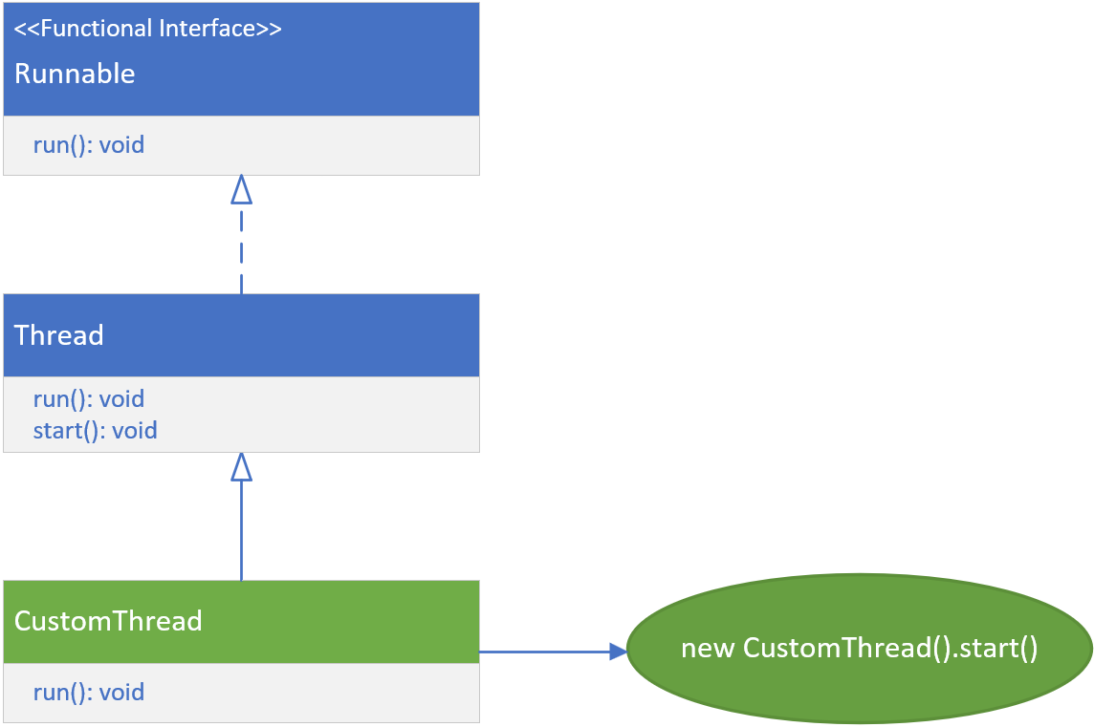
Extending the Thread class
This slide demonstrates extending the Thread class.
The new subclass overrides the Thread's run method, to provide the concurrent thread's task.
To use this thread, you create a new instance of your subclass, with a no argument constructor, and execute the start method on that instance.
COMPLETE JAVA MASTERCLASS
Thread Creation and Execution

Slide 6
Advantages of Extending Thread
You have more control over the thread's behavior and properties.
You can access the thread's methods and fields directly from your sub class.
You can create a new thread for each task.
COMPLETE JAVA MASTERCLASS
Thread Creation and Execution

Slide 7
Disadvantages of Extending Thread
You can only extend one class in Java, so your subclass can't extend any other classes.
Your class is tightly coupled to the Thread class, which may make it difficult to maintain.
COMPLETE JAVA MASTERCLASS
Thread Creation and Execution

Slide 8
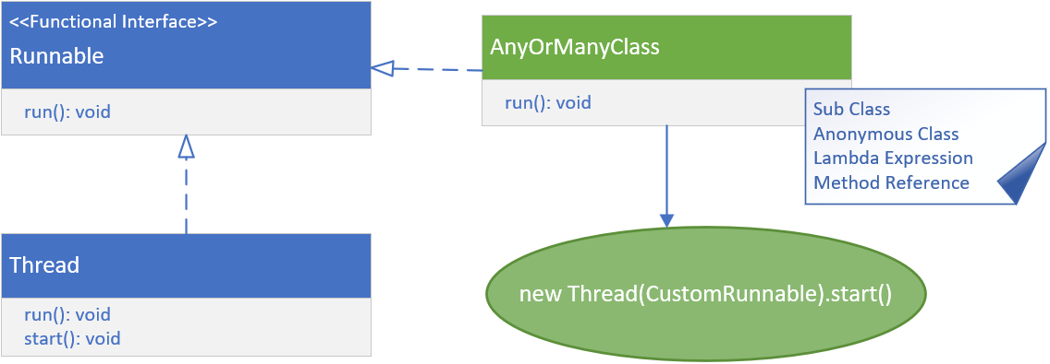
Implementing Runnable
Besides extending the Thread class, you can create threads, by implementing the Runnable interface.
This method allows any class, to implement Runnable, meaning any class at all, can be used in a thread.
COMPLETE JAVA MASTERCLASS
Thread Creation and Execution

Slide 9
Implementing Runnable
This class is passed to the Thread constructor, that accepts a Runnable.
You can also pass an anonymous class, lambda expression, or a method reference to this constructor, to create an instance of a Thread.
You again call start on the new thread instance, to execute the code asynchronously.
COMPLETE JAVA MASTERCLASS
Thread Creation and Execution

Slide 10
Advantages of Implementing a Runnable and creating a Thread instance with it
You can extend any class and still implement Runnable.
Your class (if you create a class) is loosely coupled to the Thread class, which makes it easier to maintain.
You can use anonymous classes, lambda expressions, or method references, to very quickly describe thread behavior.
COMPLETE JAVA MASTERCLASS
Thread Creation and Execution

Slide 11
Disadvantages of Implementing a Runnable and creating a Thread instance with it
You do have less control over the thread's behavior and properties.
In other words, You can't access the thread's methods and fields directly, from the run method.
COMPLETE JAVA MASTERCLASS
Thread Creation and Execution

