Slide 1

The CriteriaBuilder interface
The CriteriaBuilder interface describes a factory class, for creating various type-safe query components.
It provides methods for creating the different parts of a JPA query, each described as an object.
COMPLETE JAVA MASTERCLASS
JPA Queries, CriteriaBuilder and Native SQL

Slide 2
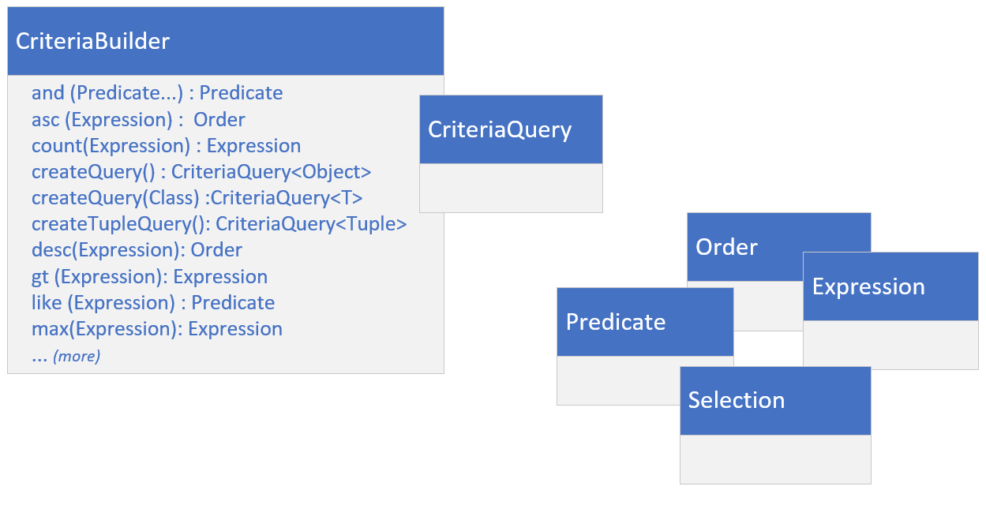
The CriteriaBuilder's factory method output types
A query in it's simplest form consists of a command, as well as a source of some sort.
A query may also have many other clauses and specifics, which define what needs to be done.
The Criteria Builder provides all the building blocks, as Java objects, to fashion a specific query.
The CriteriaBuilder is just responsible for creating customizable components you'll need.
COMPLETE JAVA MASTERCLASS
JPA Queries, CriteriaBuilder and Native SQL

Slide 3
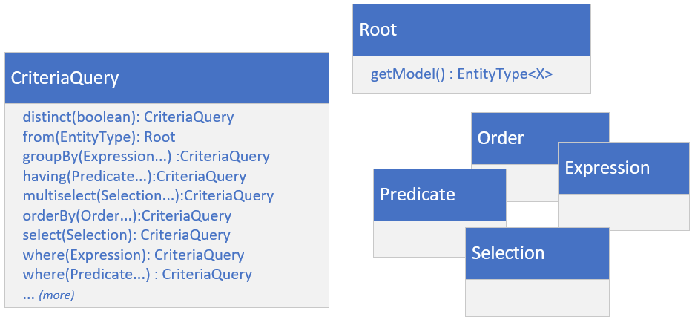
The CriteriaQuery
The CriteriaQuery is a bit like scaffolding. Things get added, and the instance mutates and grows.
The methods represent specific clauses or expressions, in a select query.
COMPLETE JAVA MASTERCLASS
JPA Queries, CriteriaBuilder and Native SQL

Slide 4
The CriteriaQuery
A Predicate represents a condition in a WHERE clause.
An Expression represents a computed value.
An Order is used to represent sorting criteria for the ORDER BY clause.
A Selection represents an attribute, expression, or result, used to define the selectable output of the query.
COMPLETE JAVA MASTERCLASS
JPA Queries, CriteriaBuilder and Native SQL

Slide 5
The CriteriaQuery
The Root is a special type, and it's the bridge between the criteria query and your entity.
It's the source of the query's data.
All of these methods return an instance of CriteriaQuery.
This means you can optionally chain these methods together.
COMPLETE JAVA MASTERCLASS
JPA Queries, CriteriaBuilder and Native SQL

Slide 6
The Process to create an executable query, using CriteriaBuilder
This slide summarizes how to use the CriteriaBuilder and CriteriaQuery types, to execute queries using JPA entities.
 | Steps | Method
1 | Get an instance of CriteriaBuilder | entityManager.getCriteriaBuilder
2 | Get an instance of CriteriaQuery | criteriaBuilder.createQuery
3 | Specify the entity (the query root) | criteriaQuery.from(Entity.class);
4 | Select data | criteriaQuery.select(root)
5 | Add expressions, predicates, sorting criteria, and other parts to the query | invoke various methods on criteriaQuery, using criteriaBuilder to manufacture the appropriate components passed as arguments.
6 | Retrieve a query instance | entityManager.createQuery(criteriaQuery)
7 | Execute and get results | criteriaQuery.getResultsList criteriaQuery.getResultStream criteriaQuery.getSingleResult
COMPLETE JAVA MASTERCLASS
JPA Queries, CriteriaBuilder and Native SQL

Slide 7
Summary of JPA Queries
This slide summarizes the three types of queries you can execute, using JPA.
Type | Description | Advantages
Native Query | Executes native SQL queries directly | Full control over SQL syntax Performance optimization for specific databases Access to vendor-specific features
CriteriaBuilder query | Builds queries programmatically using Java objects and expressions | Type-safe Compile-time checking Dynamic query construction
JPQL query | Expresses queries using a SQL-like syntax tailored for entities | Portable across JPA implementations Hides implementation-specific details Intuitive for SQL-proficient developers
COMPLETE JAVA MASTERCLASS
JPA Queries, CriteriaBuilder and Native SQL

