Slide 1

Arrays Recap
Lets recap what we've learned so far about arrays and discuss some of the common errors that occur when using them.
COMPLETE JAVA MASTERCLASS
Arrays Recap

Slide 2
Arrays Recap
An array is a data structure that allows us to store multiple values of the same type in a single variable.
The default values of numeric array elements are set to zero.
Arrays are zero-indexed, so an array with n elements is indexed from 0 to n - 1. For example, 10 elements would have the index range from 0 through 9.
If we try to access an index that is out of range, Java will give us an ArrayIndexOutOfBoundsException, which indicates that the index is out of range, in other words, out of bounds.
To access array elements, we use square braces. This is also known as the array access operator.
COMPLETE JAVA MASTERCLASS
Arrays Recap

Slide 3
Arrays Recap - Creating a New Array
This array contains the elements from array[0] through array[4].
It has 5 elements and an index range from 0 to 4.
The new keyword is used to create the array and initialize the array elements to their default values.
In this example, all the array elements will default to zero because it is an int array.
For boolean arrays, elements would be initialized to false.
If you use String or other objects, they would be set to a null reference.
COMPLETE JAVA MASTERCLASS
Arrays Recap

Slide 4
Arrays Recap - Creating a new Array
We can also initialize an array inline using an array initializer block, as shown here.
I define the values for the array in curly braces, in the order I want them assigned, each value separated by a comma.
COMPLETE JAVA MASTERCLASS
Arrays Recap

Slide 5
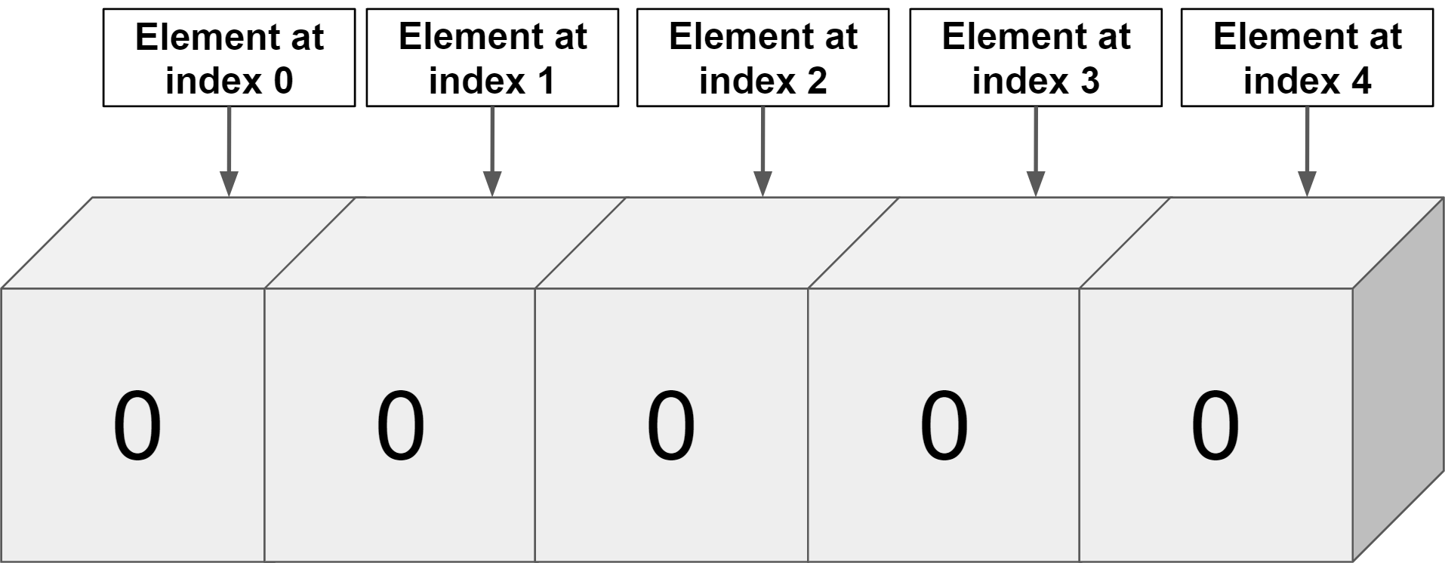
Arrays Recap
COMPLETE JAVA MASTERCLASS
Arrays Recap

Slide 6
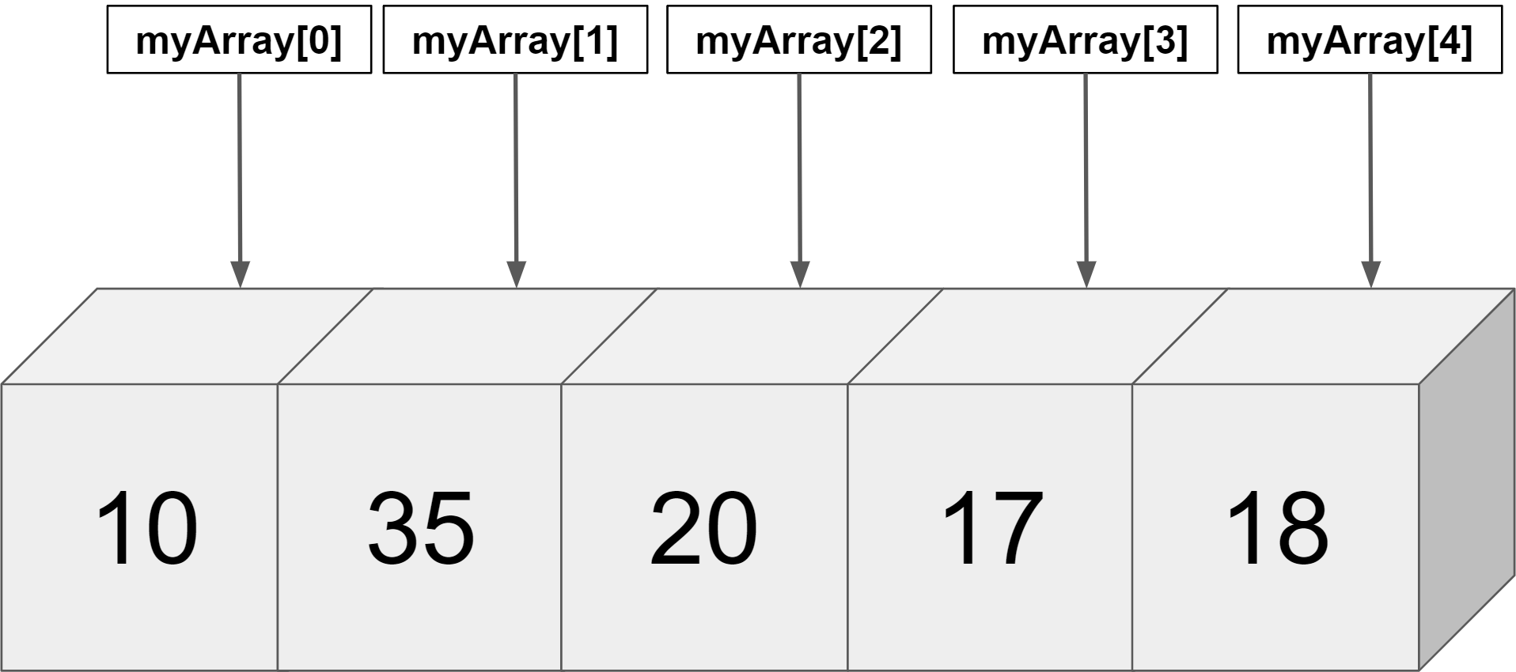
Arrays Recap
COMPLETE JAVA MASTERCLASS
Arrays Recap

Slide 7
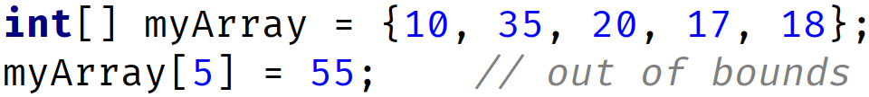
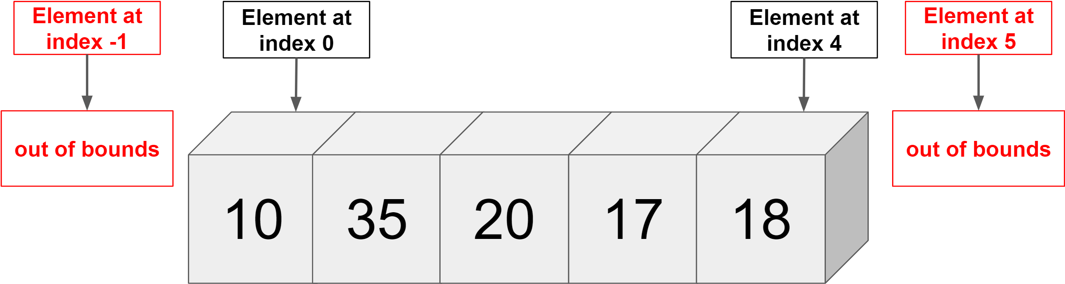
First Common Error
Accessing index out of range will cause error in other words ArrayIndexOutOfBoundsException
We have 5 elements and index range is 0 to 4
COMPLETE JAVA MASTERCLASS
Arrays Recap

Slide 8
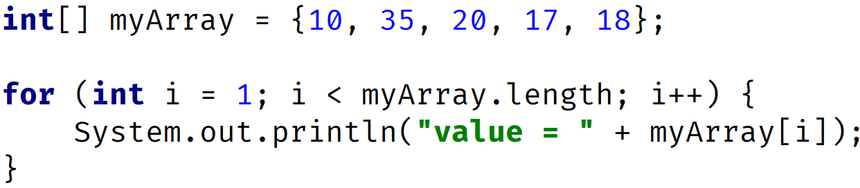
Second Common Error
OUTPUT: value= 35 value= 20 value= 17 value= 18
COMPLETE JAVA MASTERCLASS
Arrays Recap

Slide 9
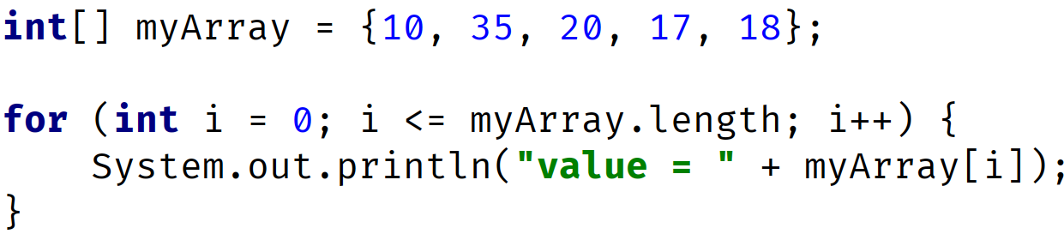
Third Common Error
OUTPUT: value = 10 // printed when i = 0 -> condition 0 <= 5 is true value = 35 // printed when i = 1 -> condition 1 <= 5 is true value = 20 // printed when i = 2 -> condition 2 <= 5 is true value = 17 // printed when i = 3 -> condition 3 <= 5 is true value = 18 // printed when i = 4 -> condition 4 <= 5 is true ArrayIndexOutOfBoundsException when i = 5 since condition 5 <= 5 is true
COMPLETE JAVA MASTERCLASS
Arrays Recap

Slide 10
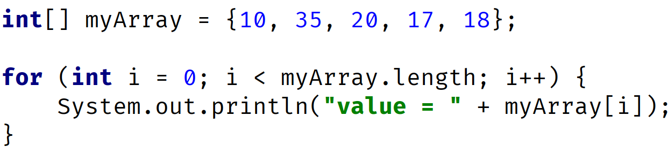
Third Common Error
OUTPUT: value = 10 // printed when i = 0 -> condition 0 <= 5 is true value = 35 // printed when i = 1 -> condition 1 <= 5 is true value = 20 // printed when i = 2 -> condition 2 <= 5 is true value = 17 // printed when i = 3 -> condition 3 <= 5 is true value = 18 // printed when i = 4 -> condition 4 <= 5 is true
COMPLETE JAVA MASTERCLASS
Arrays Recap

Slide 11
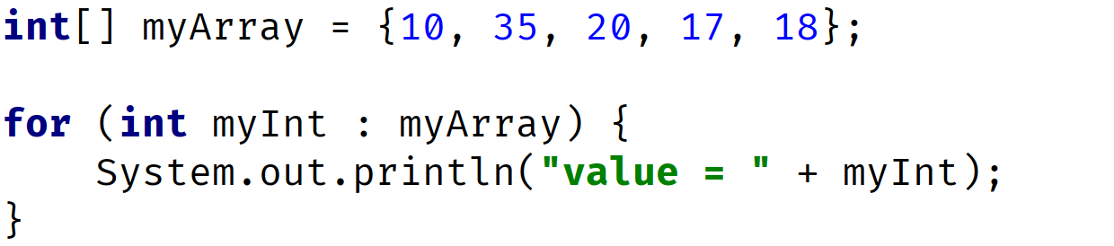
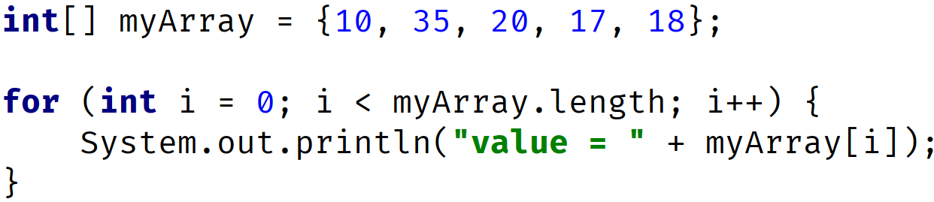
Use Enhanced For Loop to avoid some of these errors
Use the enhanced for loop if you're looping through elements from first to last, and you want to process them one at a time, and you're not setting or assigning values to elements.
Enhanced For Loop (Preferred for this kind of processing)
Traditional For Loop
COMPLETE JAVA MASTERCLASS
Arrays Recap

