Slide 1

Ordered Sets
If you need an ordered set, you'll want to consider either the LinkedHashSet or the TreeSet.
A LinkedHashSet maintains the insertion order of the elements.
The TreeSet is a sorted collection, sorted by the natural order of the elements, or by specifying the required sort during the creation of the set.
COMPLETE JAVA MASTERCLASS
LinkedHashSet and TreeSet

Slide 2
The LinkedHashSet
The LinkedHashSet extends the HashSet class.
It maintains relationships between elements with the use of a doubly linked list between entries.
The iteration order is therefore the same as the insertion order of the elements, meaning the order is predictable.
All the methods for the LinkedHashSet are the same as those for the HashSet.
Like HashSet, it provides constant-time performance, O(1) for the add, contains and remove operations.
COMPLETE JAVA MASTERCLASS
LinkedHashSet and TreeSet

Slide 3
TreeSet
A TreeSet's class uses a data structure that's a derivative of what's called a binary search tree, or Btree for short, which is based on the concept and efficiencies of the binary search.
I've discussed the binarySearch method on List, as well as the java.util.Collections class, and shown that this type of search is very fast, if the elements are sorted.
This search iteratively tests the mid-range of a group of elements to be searched, to quickly find its element, in a collection.
COMPLETE JAVA MASTERCLASS
LinkedHashSet and TreeSet

Slide 4
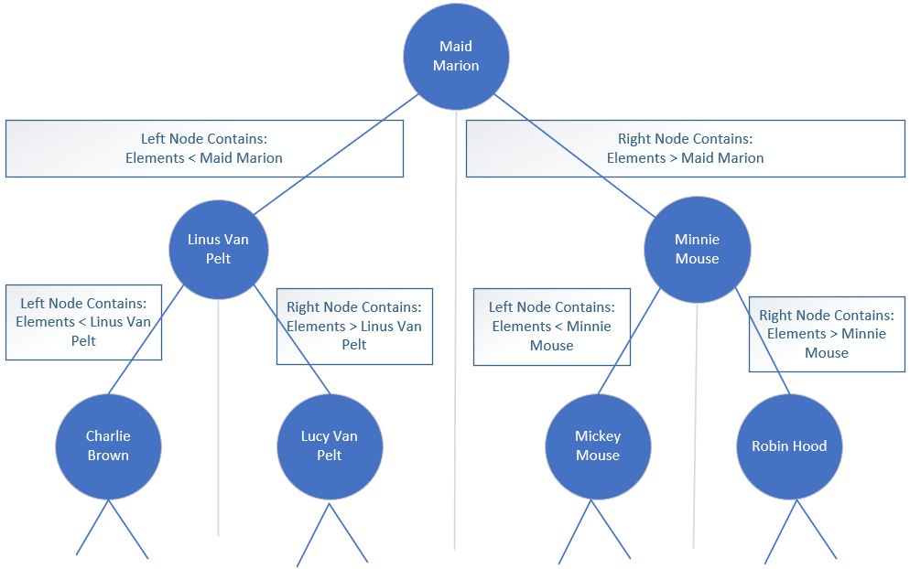
TreeSet
As elements are added to a TreeSet, they're organized in the form of a tree, where the top of the tree represents the mid-point of the elements.
This slide shows a conceptual example, using some of the String contacts from my last samples of code.
COMPLETE JAVA MASTERCLASS
LinkedHashSet and TreeSet

Slide 5
TreeSet
Further binary divisions become nodes under that.
The left node and its children are elements that are less than the parent node.
The right node and its children are elements that are greater than the parent node.
COMPLETE JAVA MASTERCLASS
LinkedHashSet and TreeSet

Slide 6
TreeSet
Instead of looking through all the elements in the collection to locate a match, this allows the tree to be quickly traversed, each node being a simple decision point.
The main point is the tree remains balanced as elements are added.
COMPLETE JAVA MASTERCLASS
LinkedHashSet and TreeSet

Slide 7
TreeSet O Notation
Remember that O(1) is constant time, meaning the time or cost of an operation doesn't change, regardless of how many elements are processed.
O(n) is linear time, meaning it grows in line with the way the collection grows.
Another notation is O(log(n)), which means the cost falls somewhere in between constant and linear time.
The TreeSet promises O(log(n)) for the add, remove, and contains operations, compared to the HashSet which has constant time O(1) for those same operations.
COMPLETE JAVA MASTERCLASS
LinkedHashSet and TreeSet

Slide 8
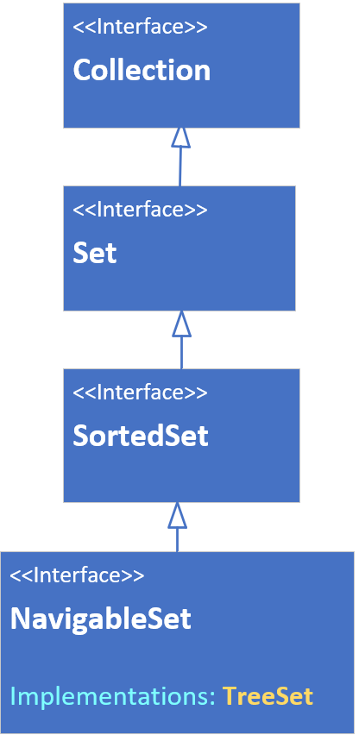
The TreeSet interface hierarchy
A TreeSet can be declared or passed to arguments typed with any of the interfaces shown on this slide.
This class is sorted, and implements the SortedSet interface, which has methods such as first, last, headSet and tailSet, as well as comparator.
This set also implements the NavigableSet Interface. As such, it has methods such as ceiling, floor, higher, lower, descendingSet and others.
COMPLETE JAVA MASTERCLASS
LinkedHashSet and TreeSet

Slide 9
The TreeSet relies on Comparable or Comparator methods
Elements which implement Comparable (said to have a natural order sort, like Strings and numbers) can be elements of a TreeSet.
If your elements don't implement Comparable, you must pass a Comparator to the constructor.
COMPLETE JAVA MASTERCLASS
LinkedHashSet and TreeSet

