Slide 1

Abstract Class Challenge
In this challenge, you need to build an application that can be a store front for any imaginable item for sale.
Instead of the Main class we usually create, create a Store class with a main method.
The Store class should:
manage a list of products for sale, including displaying the product details.
manage an order, which can just be a list of OrderItem objects.
have methods to add an item to the order, and print the ordered items, so it looks like a sales receipt.
COMPLETE JAVA MASTERCLASS
Abstract Class Challenge Part 1

Slide 2
Abstract Class Challenge
Also create a ProductForSale class that should have at least three fields: a type, price, and a description. This class should also have methods to:
getSalesPrice, a concrete method, which takes a quantity, and returns the quantity times the price.
printPricedItem, a concrete method, which takes a quantity, and should print an itemized line item for an order, with quantity and line-item price.
showDetails, an abstract method, which represents what might be displayed on a product page. Product type, description, price, and so on.
Also create an OrderItem type, that has at a minimum 2 fields, quantity and a Product for Sale.
You should also create two or three classes that extend the ProductForSale class, that will be products in your store.
COMPLETE JAVA MASTERCLASS
Abstract Class Challenge Part 1

Slide 3
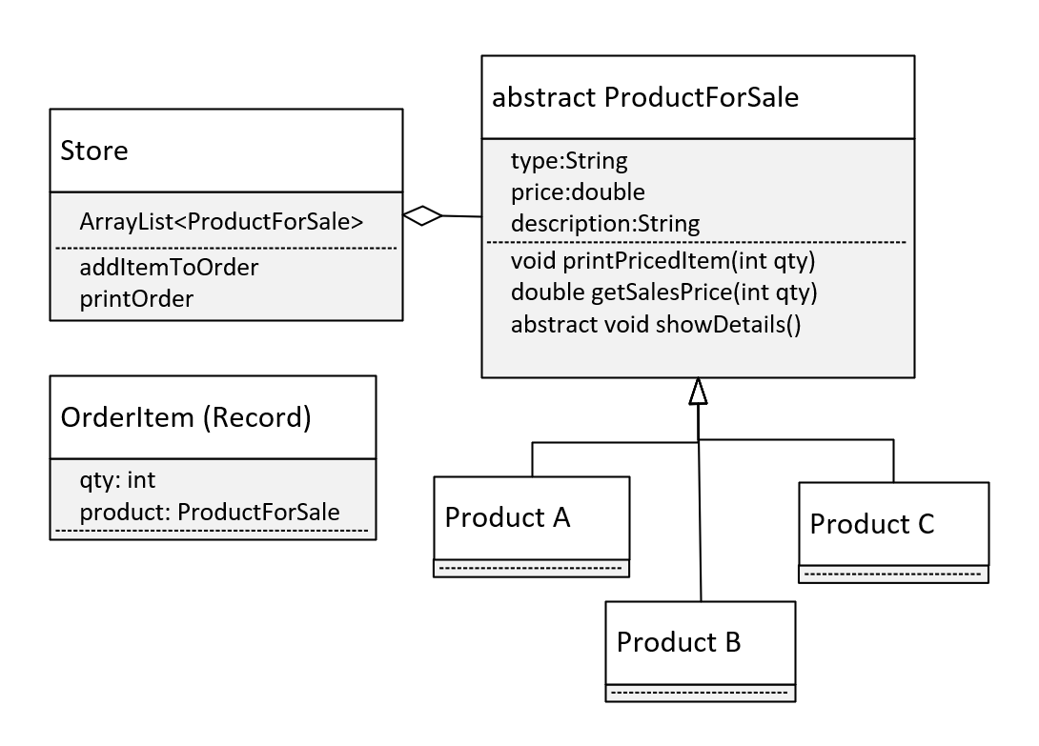
The Design
Let's look at my approach.
Here is the class diagram of what you'll be building.
This covers all the requirements I talked about.
Notice I'm specifying that OrderItem will be a record. This is just to keep the code simple.
I'm not really specifying what our store products are, you can really put anything there.
COMPLETE JAVA MASTERCLASS
Abstract Class Challenge Part 1

