Slide 1
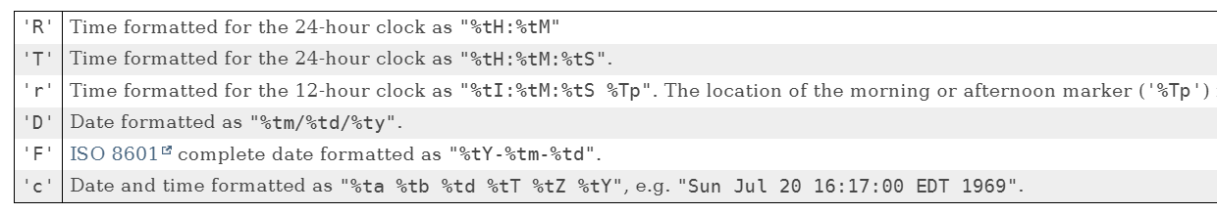

Formatting Date Time
There are many ways to format date and time.
A couple of standardized ones are shown here.
These apply to the formatted method on String, as well as the printf method.
This information was retrieved from the link I show here.
https://docs.oracle.com/en/java/javase/17/docs/api/java.base/java/util/Formatter.html#dt
COMPLETE JAVA MASTERCLASS
When Change isn't good

Slide 2
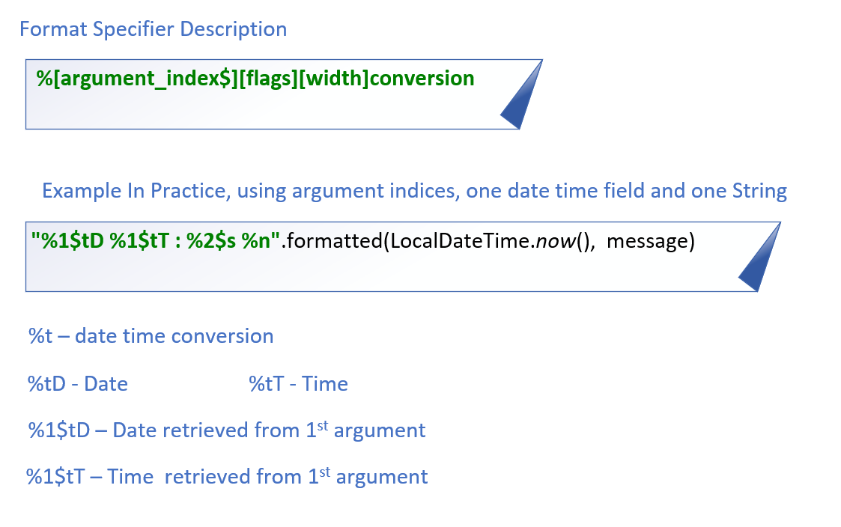
Formatting Date and Time
This slide explains the code I'm using in a bit more detail.
It's common when using date time conversions, to use the argument index feature, which is called Explicit Indexing.
COMPLETE JAVA MASTERCLASS
When Change isn't good

Slide 3
Controlling Change
Java provides mechanisms to control changes, and extensibility of your code, at many different levels.
You can prevent:
Changes to data in Instance fields, which is called the state of the object, by not allowing clients or subclasses to have access to these fields.
Changes to methods, by not allowing code to override or hide existing functionality.
Your classes from being extended.
Instantiation of your classes.
COMPLETE JAVA MASTERCLASS
When Change isn't good

