Slide 1

Static vs Instance Variables
Let's discuss the differences between static variables and instance variables.
COMPLETE JAVA MASTERCLASS
Static vs Instance Variables

Slide 2
Static Variables
Declared by using the keyword static.
Static variables are also known as static member variables.
Every instance of the class shares the same static variable.
If changes are made to that variable, all other instances of that class will see the effect of that change.
COMPLETE JAVA MASTERCLASS
Static vs Instance Variables

Slide 3
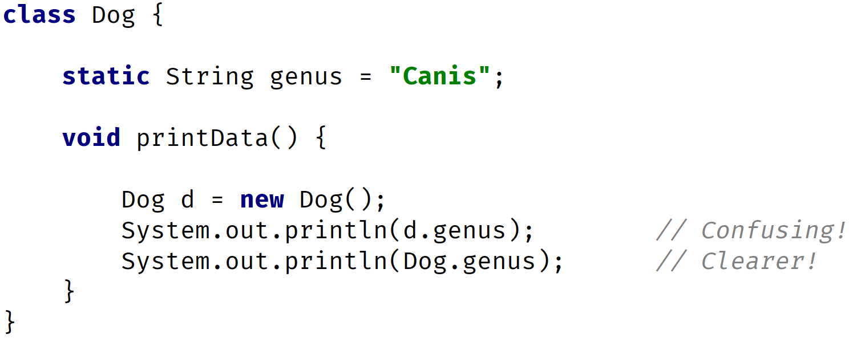
Static Variables
It is considered best practice to use the Class name and not a reference variable to access a static variable.
COMPLETE JAVA MASTERCLASS
Static vs Instance Variables

Slide 4
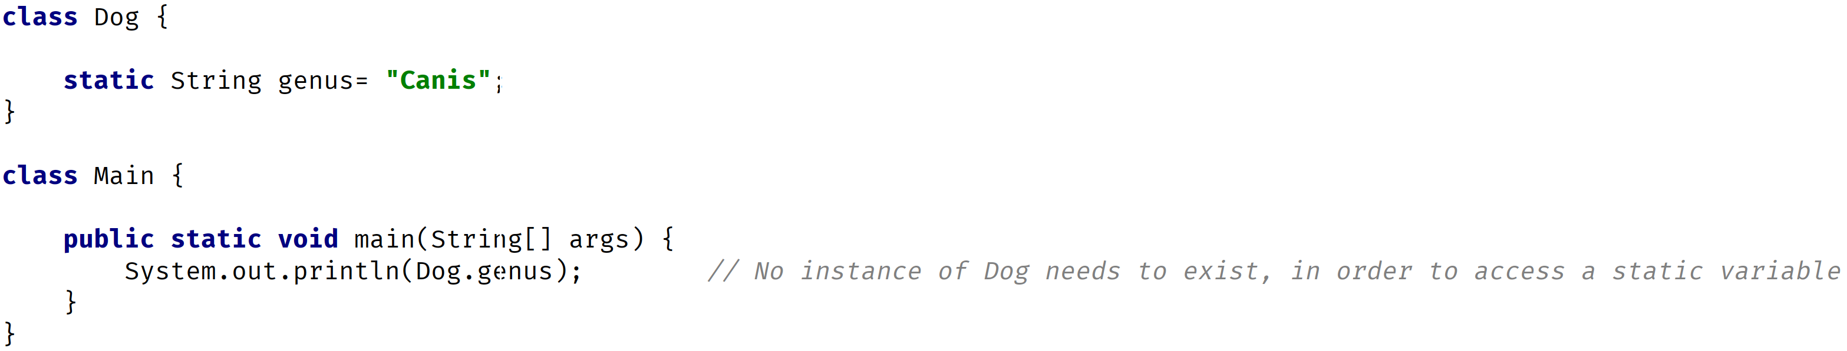
Static Variables
An instance isn't required to exist to access the value of a static variable.
COMPLETE JAVA MASTERCLASS
Static vs Instance Variables

Slide 5
Static Variables
Static variables aren't used very often but can sometimes be very useful.
They can be used for:
Storing counters.
Generating unique IDs.
Storing a constant value that doesn't change, like PI, for example.
Creating and controlling access to a shared resource.
COMPLETE JAVA MASTERCLASS
Static vs Instance Variables

Slide 6
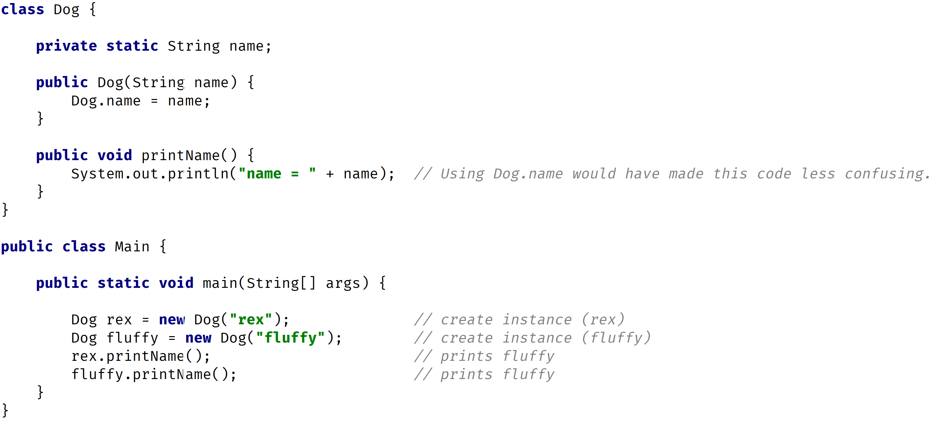
Static Variables
COMPLETE JAVA MASTERCLASS
Static vs Instance Variables

Slide 7
Instance Variables
They don't use the static keyword.
They're also known as fields or member variables.
Instance variables belong to a specific instance of a class.
COMPLETE JAVA MASTERCLASS
Static vs Instance Variables

Slide 8
Instance Variables
Each instance has its own copy of an instance variable.
Every instance can have a different value.
Instance variables represent the state of a specific instance of a class.
COMPLETE JAVA MASTERCLASS
Static vs Instance Variables

Slide 9
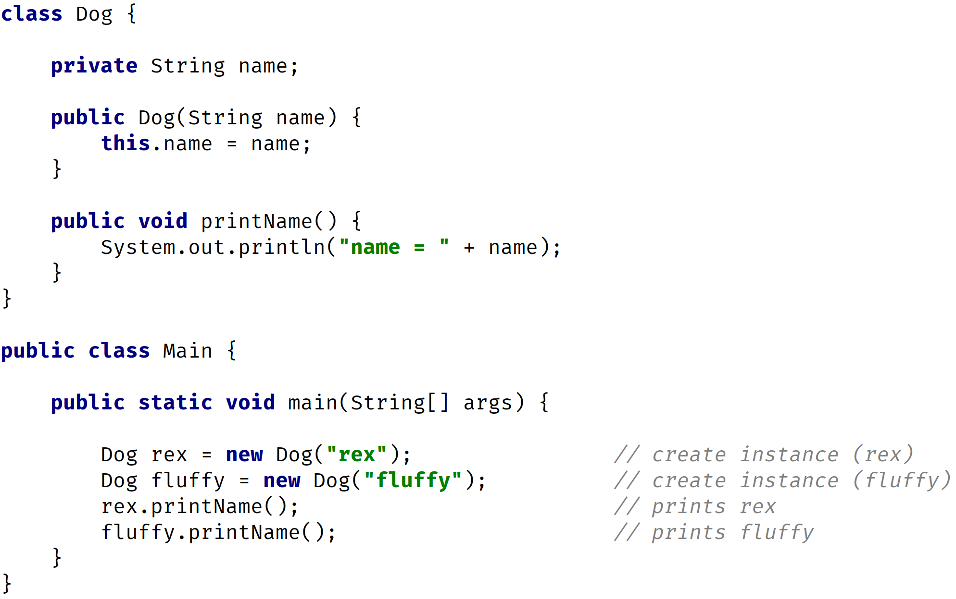
Instance Variables
COMPLETE JAVA MASTERCLASS
Static vs Instance Variables

