Slide 1
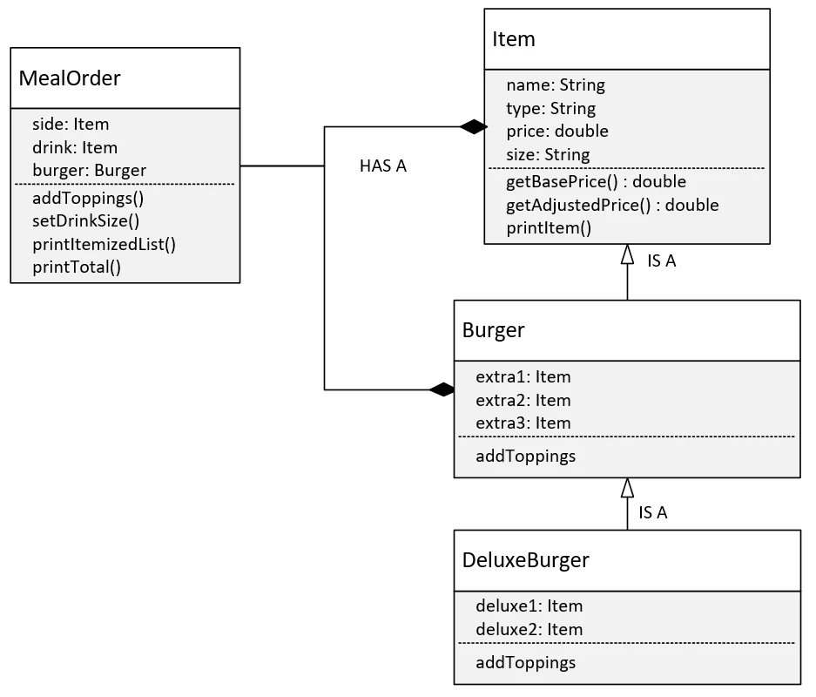

Bills Burger Challenge with the Bonus - the DeluxeBurger
In that last video, we created all the classes for a default meal order and provided methods for adding toppings and customizing a drink size.
Now, I want to create a burger subclass, the DeluxeBurger, which has two additional toppings, so a total of five, all up.
COMPLETE JAVA MASTERCLASS
OOP Master Challenge Exercise, The Bonus

