Slide 1

Reference Types vs. Value Types
In a previous video, I talked about the differences between a Reference vs. an Object, vs. an Instance, vs. a Class.
I want to revisit this a little and talk about why this matters when we're talking about arrays.
When you assign an object to a variable, the variable becomes a reference to that object.
This is true of arrays, but the array has yet another level of indirection if it's an array of objects.
This means every array element is also a reference.
COMPLETE JAVA MASTERCLASS
References Types vs Value Types

Slide 2
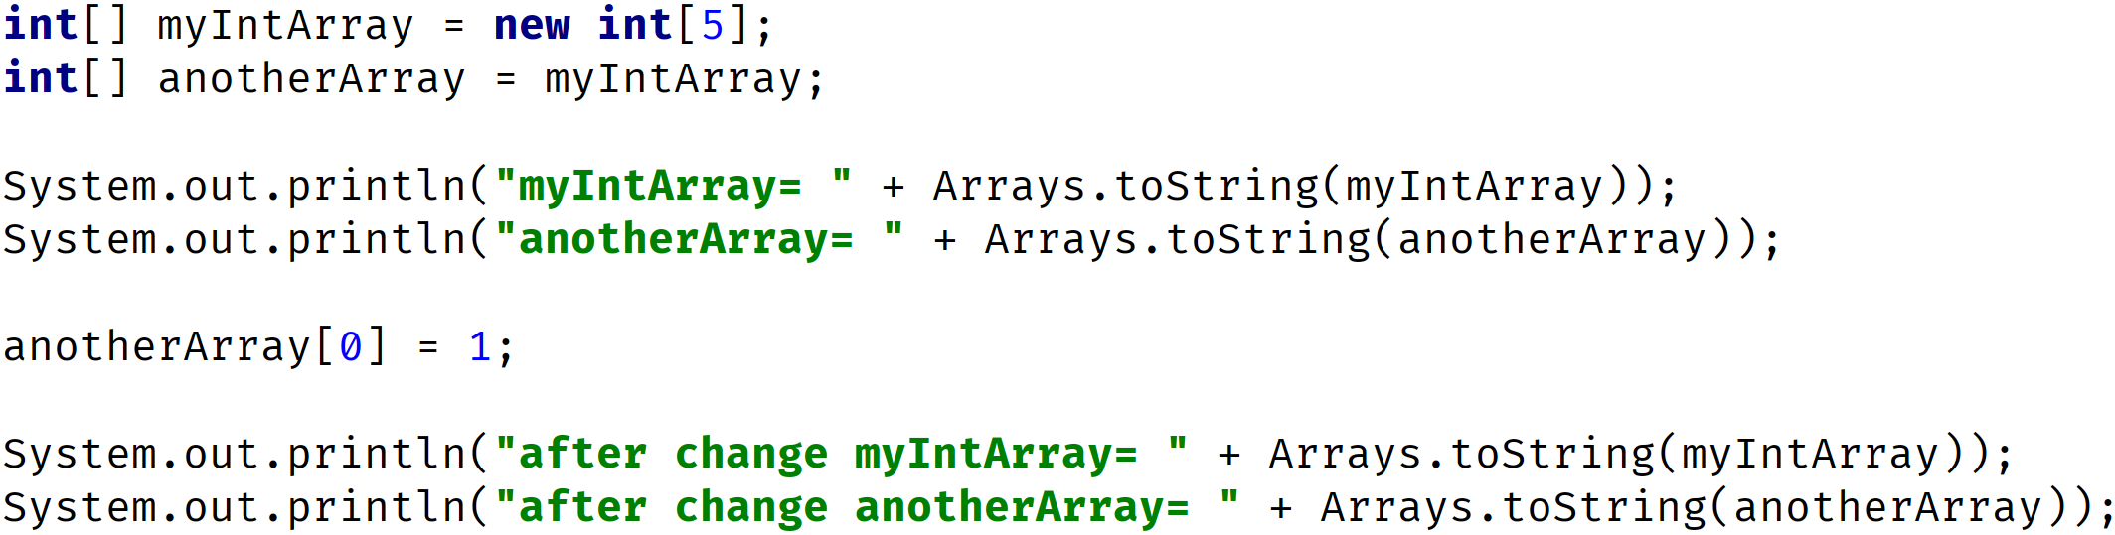
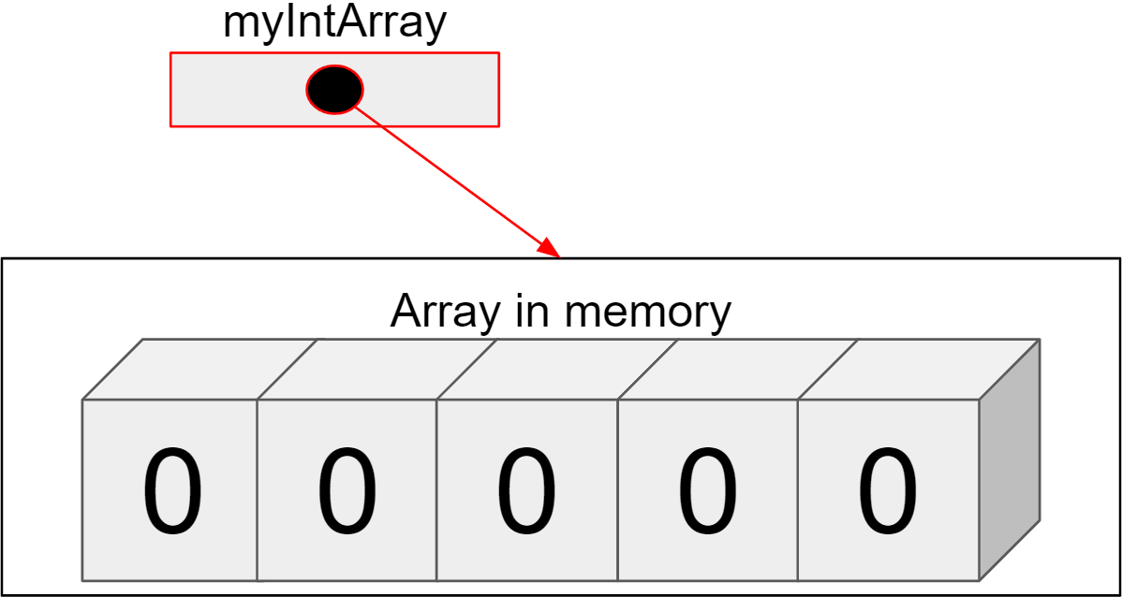
Reference Types vs. Value Types
COMPLETE JAVA MASTERCLASS
References Types vs Value Types

Slide 3
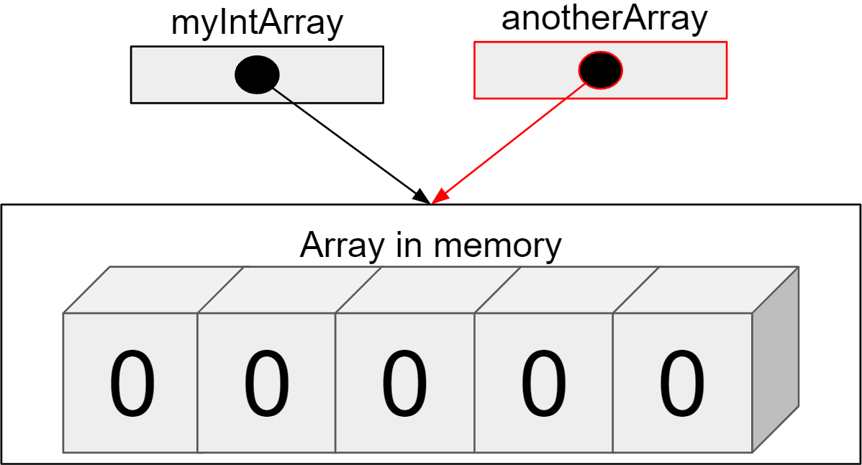
Reference Types vs. Value Types
COMPLETE JAVA MASTERCLASS
References Types vs Value Types

Slide 4
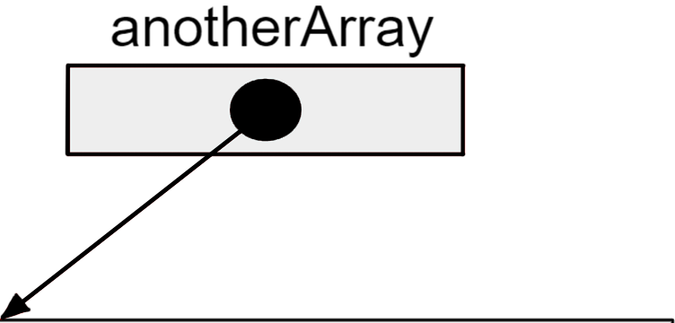
Reference Types vs. Value Types
COMPLETE JAVA MASTERCLASS
References Types vs Value Types

Slide 5
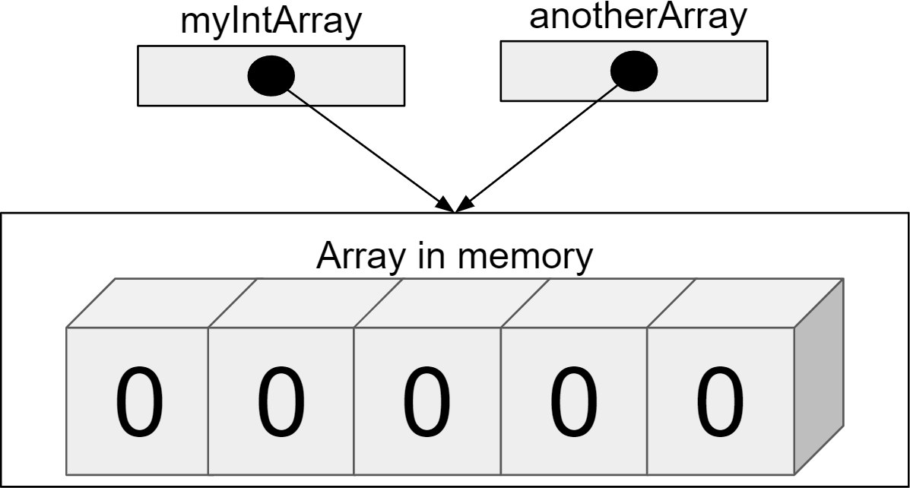
Reference Types vs. Value Types
OUTPUT: myIntArray= 0 0 0 0 0 anotherArray= 0 0 0 0 0
COMPLETE JAVA MASTERCLASS
References Types vs Value Types

Slide 6
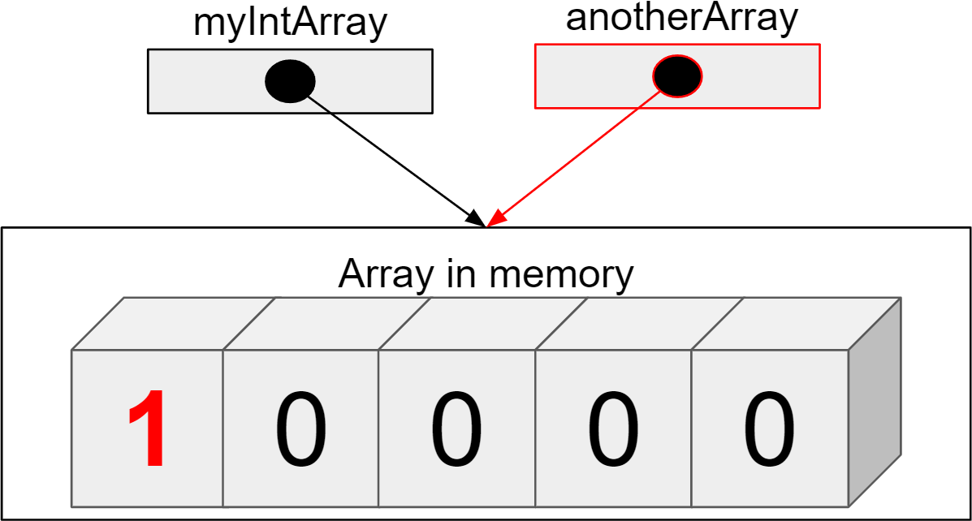
Reference Types vs. Value Types
OUTPUT: myIntArray= 0 0 0 0 0 anotherArray= 0 0 0 0 0
COMPLETE JAVA MASTERCLASS
References Types vs Value Types

Slide 7
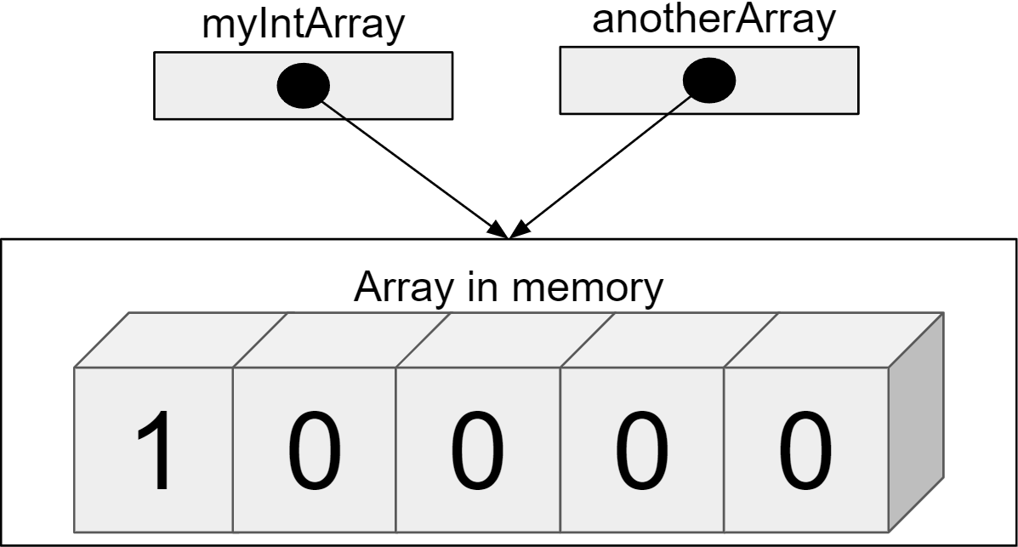
Reference Types vs. Value Types
OUTPUT: myIntArray= 0 0 0 0 0 anotherArray= 0 0 0 0 0 after change myIntArray= 1 0 0 0 0 after change anotherArray= 1 0 0 0 0
COMPLETE JAVA MASTERCLASS
References Types vs Value Types

