Slide 1

Why does Java have primitive data types?
Some object-oriented languages don't support any primitive data types at all, meaning everything is an object.
But most of the more popular object-oriented languages of the day, including Java, support both primitive types and objects.
Primitive types generally represent the way data is stored on an operating system.
Primitives have some advantages over objects, especially as the number of elements you need to store increase.
Objects take up additional memory and may require a little more processing power.
We know we can create objects, with primitive data types as field types, for example, and we can also return primitive types from methods.
COMPLETE JAVA MASTERCLASS
Introduction to Autoboxing and Unboxing

Slide 2
Why don't all of Java's collection types support primitives?
When we look at classes like the ArrayList or the LinkedList, which we've reviewed in detail in this section, we find that these classes don't support primitive data types as a collection type.
In other words, we can't do something like creating a LinkedList, using an int primitive type.
As an example the code below won't compile.
This means, we can't take advantage of the great functionality that Lists provide, with primitive values. At least not directly.
COMPLETE JAVA MASTERCLASS
Introduction to Autoboxing and Unboxing

Slide 3
Why don't all of Java's collection types support primitives?
More importantly, we can't easily use primitives in some of the features we'll be learning about in the future, like generics.
But Java, as you have learned, does give us wrapper classes for each primitive type.
And we can go from a primitive to a wrapper, which is called boxing, or a wrapper to a primitive, which is called unboxing, with relative ease in Java.
COMPLETE JAVA MASTERCLASS
Introduction to Autoboxing and Unboxing

Slide 4
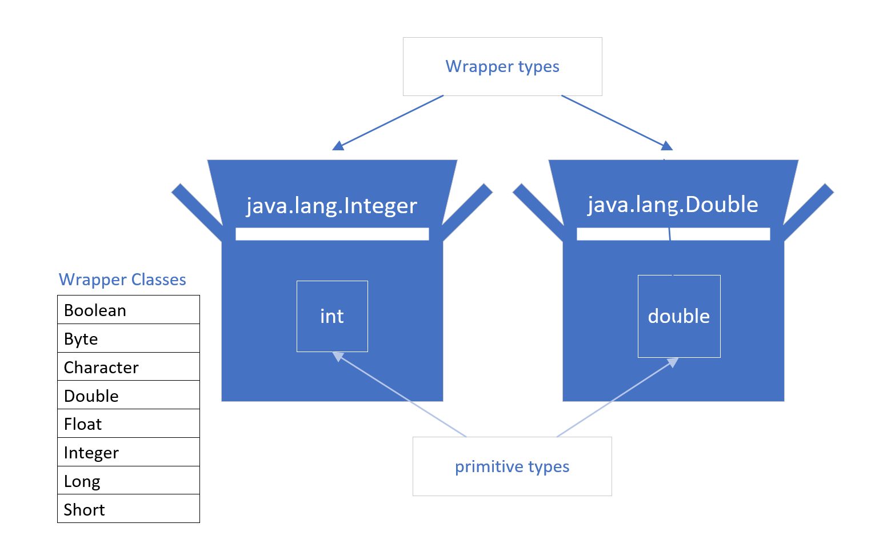
What is Boxing?
A primitive is boxed, or wrapped, in a containing class, whose main data is the primitive value.
Each primitive data type has a wrapper class, as shown on the list, which we've seen before.
Each wrapper type boxes a specific primitive value.
COMPLETE JAVA MASTERCLASS
Introduction to Autoboxing and Unboxing

Slide 5
How do we box?
Each wrapper has a static overloaded factory method, valueOf, which takes a primitive as an argument and returns an instance of the wrapper class.
The code shown on this slide, returns an instance of the java.lang.Integer class, to the boxedInt variable, with the value 15.
We can say the code below manually boxes a primitive integer.
COMPLETE JAVA MASTERCLASS
Introduction to Autoboxing and Unboxing

Slide 6
Deprecated Boxing using the wrapper constructor
Another manual way of boxing, which you'll see in older code, is by creating a new instance of the wrapper class, using the new keyword, and passing the primitive value to the constructor.
See this example below.
If you try this in IntelliJ, with any Java version greater than JDK-9, IntelliJ will tell you that this is deprecated code. And rightly so.
COMPLETE JAVA MASTERCLASS
Introduction to Autoboxing and Unboxing

Slide 7
Deprecated Code
Deprecated code means it's outdated code and is likely to not be supported in a future version. It's been marked for deletion from the language at some point in the future.
If you come across deprecated code, there is usually always a newer, better way to do what you are trying to achieve, and you should use the new way.
COMPLETE JAVA MASTERCLASS
Introduction to Autoboxing and Unboxing

Slide 8
Using new (with a constructor) is deprecated for wrappers
Java's own documentation states the following about the code above:
It is rarely appropriate to use this constructor.
The static factory valueOf(int) is generally a better choice, as it is likely to yield significantly better space and time performance.
This deprecation applies to all the constructors of the wrapper classes, not just the Integer class.
In truth, we rarely have to manually box primitives, because Java supports something called autoboxing.
COMPLETE JAVA MASTERCLASS
Introduction to Autoboxing and Unboxing

Slide 9
What is autoboxing?
Autoboxing is where Java automatically boxes a primitive type for you. Hence the term autoboxing.
Java makes it easy to assign a primitive to a wrapper variable, as shown below.
Java supports this syntax, and its actually preferred and in my opinion easier to read as well.
Underneath the covers, Java is doing the boxing. In other words, an instance of Integer is created, and its value is set to 15.
Allowing Java to autobox is preferred to any other method, because Java will provide the best mechanism to do it.
COMPLETE JAVA MASTERCLASS
Introduction to Autoboxing and Unboxing

Slide 10
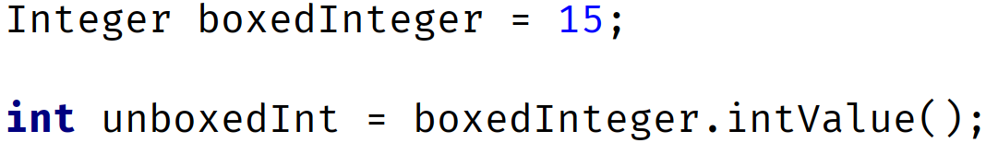
What is autoboxing?
Every wrapper class supports a method to return the primitive value it contains.
This is called unboxing.
In the example on this slide, I've autoboxed the integer value 15, to a variable called boxedInteger.
This gives us an object which is an Integer wrapper class, with the value of 15.
To unbox this on an Integer class, you can use the intValue method to do it manually, which returns the boxed value, the primitive int in this case.
COMPLETE JAVA MASTERCLASS
Introduction to Autoboxing and Unboxing

Slide 11
What is autoboxing?
Just like boxing, it's unnecessary to manually unbox.
COMPLETE JAVA MASTERCLASS
Introduction to Autoboxing and Unboxing

Slide 12
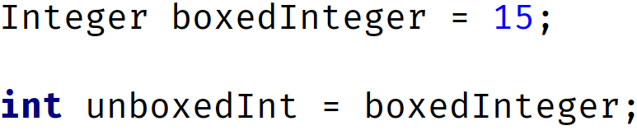
Automatic unboxing
Automatic unboxing is really just referred to as unboxing in most cases.
You can assign an instance of a wrapper class directly, to a primitive variable.
The code on this slide shows an example.
We're assigning an object instance to a primitive variable, in the second statement.
COMPLETE JAVA MASTERCLASS
Introduction to Autoboxing and Unboxing

Slide 13
Automatic unboxing
This is allowed, because the object instance is an Integer wrapper, and we're assigning it to an int primitive type variable.
Again, this is the preferred way to unbox a wrapper instance.
Let's get back to some code now and see different examples of autoboxing and unboxing in action.
COMPLETE JAVA MASTERCLASS
Introduction to Autoboxing and Unboxing

