Slide 1

Difference between Runnable and Callable
What's the difference between Runnable and Callable?
Significantly, Callable returns a value.
This means you can get data back from your running threads.
Runnable's Functional Method | Callable's Functional Method
void run() | V call() throws Exception
COMPLETE JAVA MASTERCLASS
Additional Thread Pools, Callable, Submit and the Future

Slide 2
execute vs. submit
On this slide, I'm showing you the method signatures for both the execute and submit methods.
method | signature
execute | void execute(Runnable command)
submit | Future<?> submit(Runnable task) <T> Future<T> submit(Runnable task, T result) <T> Future<T> submit(Callable<T> task)
COMPLETE JAVA MASTERCLASS
Additional Thread Pools, Callable, Submit and the Future

Slide 3
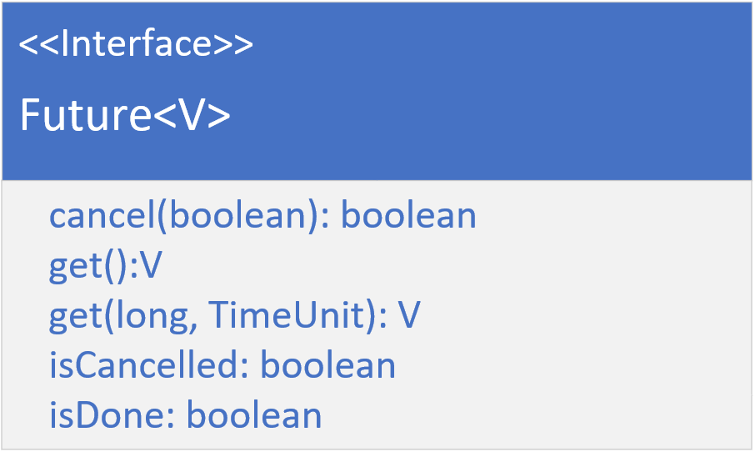
The Future Interface
A Future represents a result, of an asynchronous computation.
It's a generic type, a placeholder for a result instance.
It has methods that cancel the task, retrieve the result, or check if the computation was completed or cancelled.
The get method returns the result, but you can only call this get method, when the computation is complete, otherwise the call will block, until it does complete.
The overloaded version of the get method allows you to specify a wait time, rather than blocking.
COMPLETE JAVA MASTERCLASS
Additional Thread Pools, Callable, Submit and the Future

Slide 4
invokeAll vs. invokeAny
When would you want to use invoke Any vs. invokeAll?
Characteristic | invokeAny | invokeAll
Tasks Executed | At least one, the first to complete. | All tasks get executed.
Result | Result of the first task to complete, not a Future. | Returns a list of results, as futures, for all of the tasks, once they have all completed.
Use cases | Use this method when you need a quick response back from one of several tasks, and you don't care if some will fail. | Use this method when you want all the tasks to be executed concurrently, and all tasks must complete before proceeding.
COMPLETE JAVA MASTERCLASS
Additional Thread Pools, Callable, Submit and the Future

