Slide 1
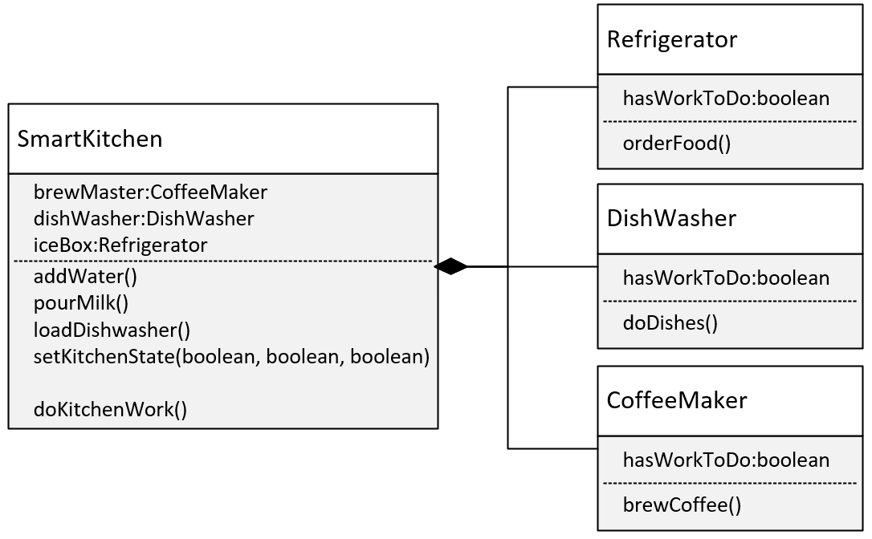

The Composition Challenge
In this challenge, you need to create an application for controlling a smart kitchen.
Your smart kitchen will have several appliances.
Your appliances will be Internet Of Things (IoT) devices, which can be programmed.
COMPLETE JAVA MASTERCLASS
Composition Challenge

Slide 2
The Composition Challenge
It's your job to write the code to enable your Smart Kitchen application to execute certain jobs.
Methods on your SmartKitchen class, will determine what work needs to be done:
addWater() will set the Coffee Maker's hasWorkToDo field to true.
pourMilk() will set the Refrigerator's hasWorkToDo to true.
loadDishwasher() will set the hasWorkToDo flag to true for that appliance.
Alternately, you could have a single method called setKitchenState that takes three boolean values, which would set each appliance accordingly.
COMPLETE JAVA MASTERCLASS
Composition Challenge

Slide 3
The Composition Challenge
To execute the work needed to be done by the appliances, you'll implement this in two ways:
First, your application will access each appliance by using a getter and execute a method.
The appliance methods are orderFood() on Refrigerator, doDishes() on DishWasher, and brewCoffee() on CoffeeMaker.
These methods should check the hasWorkToDo flag, and if true, print a message out indicating what work is being done.
Second, your application won't access the appliances directly.
It should call doKitchenWork(), which delegates the work to any of its appliances.
COMPLETE JAVA MASTERCLASS
Composition Challenge

