Slide 1

Polymorphism
Simply stated, polymorphism means many forms.
How does this apply to code?
COMPLETE JAVA MASTERCLASS
Polymorphism, Part 1

Slide 2
Polymorphism
Polymorphism in Java allows us to write code that can call a method, but the actual method that gets executed can be different for different objects at runtime.
This means that the behavior that occurs during program execution depends on the runtime type of the object, which might differ from its declared type in the code.
For polymorphism to work, the declared type must have a relationship with the runtime type. Inheritance is one way to establish this relationship, where a subclass can override a method from its superclass, enabling polymorphic behavior.
There are other mechanisms to achieve polymorphism, but in this discussion, we’ll focus on using inheritance to support polymorphism.
Previously, I touched on this concept in the inheritance videos, but now, we will delve into polymorphism specifically.
COMPLETE JAVA MASTERCLASS
Polymorphism, Part 1

Slide 3
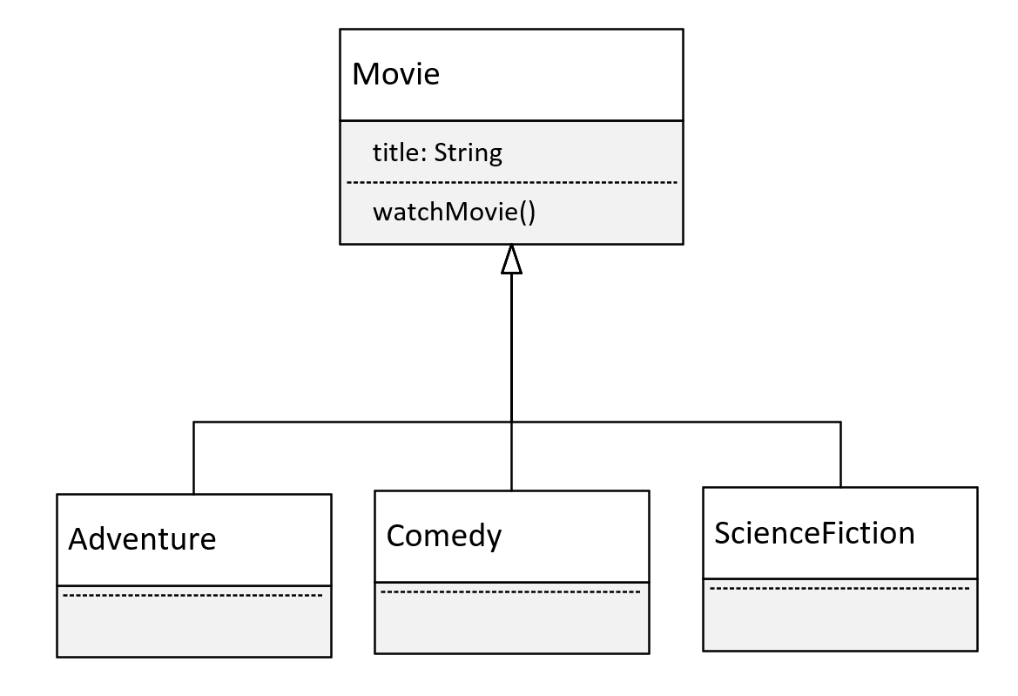
Movie Genres
This time, we're going to look at a polymorphism example using movies.
I'll have a base class of Movie, which has the title of the movie.
And Movie will have one method, watchMovie.
COMPLETE JAVA MASTERCLASS
Polymorphism, Part 1

Slide 4
Movie Genres
I'll have 3 subclasses, each a different kind of movie.
I'll have an Adventure film, a Comedy, and a Science Fiction movie.
These are the different categories, so I'll use these as the subclasses.
All of these will override and implement unique behavior for the watchMovie method.
COMPLETE JAVA MASTERCLASS
Polymorphism, Part 1

