Slide 1
MSA-DATB09-03 · MUTUALISED PROJECT
Teaching a museum guide
to see and to listen
Artwork classification · failure diagnosis · ResNet · question matching · production trade-off
Jules Bordais · Albert School · Neural Networks & Deep Learning Foundations
Notes:
Context: the AI team of a French museum builds an intelligent guide. Two jobs: recognise the style of the artwork in front of the visitor, and match the visitor's question to the right artwork. I built and compared five neural components.
[Sources] Figures and numbers: results/ folder of the project repo (Colab T4 run, seed 42).

Slide 2
PROBLEM & DATA
Six styles, 1 800 paintings, one clean protocol
Task
Classify a painting into Impressionism, Baroque, Cubism, Ukiyo-e, Pop Art or High Renaissance.
Protocol
WikiArt, random 70/15/15 split. Model selection on validation only; test touched once. Same seed for every run; one factor changed per experiment.
6
1 800
styles (chance = 16.7 %)
images, 300 per style
1 259
281 / 260
train images
validation / test
Metrics: accuracy, macro-F1, confusion matrix · Recall@k and MRR for retrieval
Museum guide · Neural networks
02
Notes:
300 images per style from WikiArt, split 70/15/15. Test classes are not perfectly balanced (30 to 57 images), so I also report macro-F1. Validation is used for early stopping and checkpoint selection; the test set is only evaluated once per model.
[Sources] Figures and numbers: results/ folder of the project repo (Colab T4 run, seed 42).

Slide 3
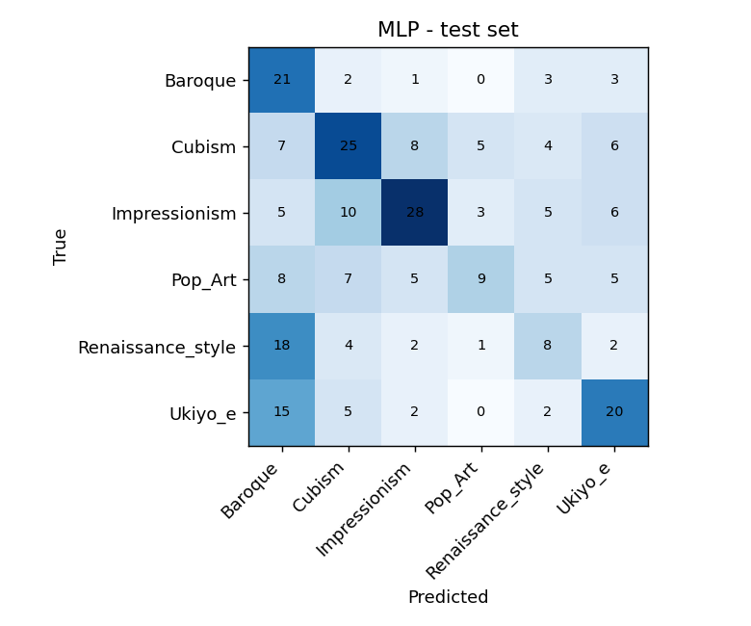
1 · FEED-FORWARD NETWORK
A plain MLP learns colour, not structure
12 288 px
Linear → BN → ReLU → Dropout
He init · AdamW · warmup + cosine · clipping · early stopping
512
256
42.7 %
128
test accuracy · 6.46 M params
6
Baroque is a ‘dark-painting sink’: recall 0.70 but precision 0.28.
Museum guide · Neural networks
03
Notes:
The MLP flattens a 64x64 image into 12,288 numbers. It reaches 42.7% on test, 2.5x chance, but 18 of 35 Renaissance and 15 of 44 Ukiyo-e paintings are predicted Baroque. Without spatial structure it mainly learns colour and brightness.
[Sources] Figures and numbers: results/ folder of the project repo (Colab T4 run, seed 42).

Slide 4
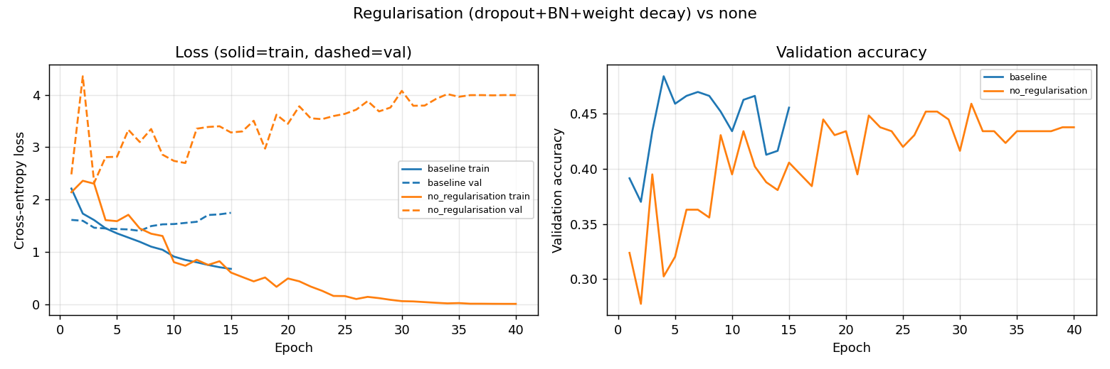
2 · DIAGNOSIS — OVERFITTING
Unregularised, the MLP memorises its data
100 %
2.3 → 4.0
31.9 %
train accuracy, train loss 0.005
validation loss keeps rising
test accuracy (vs 42.7 % baseline)
Museum guide · Neural networks
04
Notes:
Same network without BatchNorm, dropout, weight decay or early stopping, trained 40 epochs. Classic overfitting signature: train loss goes to zero while validation loss climbs from 2.3 to 4.0. Fix: dropout, BN, weight decay and early stopping on validation loss — the baseline stops at epoch 15 and keeps the epoch-7 checkpoint.
[Sources] Figures and numbers: results/ folder of the project repo (Colab T4 run, seed 42).

Slide 5
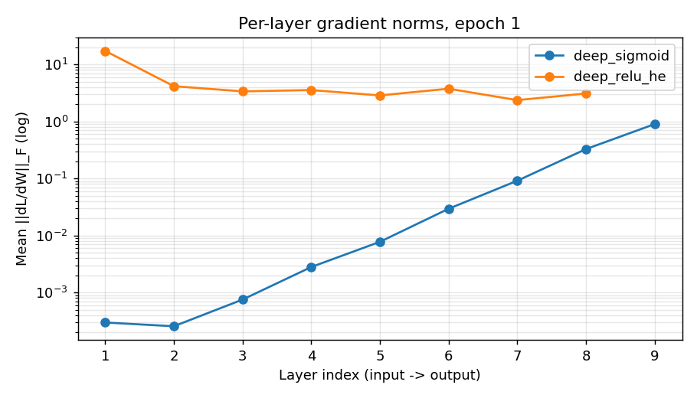
2 · DIAGNOSIS — VANISHING GRADIENTS
Deep sigmoid networks starve their first layers
~3 000×
smaller gradient at layer 1 than at the output (3.0e-4 vs 0.90)
Why: σ′ ≤ 0.25 multiplies at each of 8 layers.
Effect: test 15 % = chance.
Fix: ReLU + He keeps norms flat → 37.7 %.
Museum guide · Neural networks
05
Notes:
Two 8-hidden-layer networks, same widths, same seed. Measured mean Frobenius norm of dL/dW per layer at epoch 1. With sigmoid, the gradient shrinks by about 3,000x from the output back to layer 1 because sigmoid's derivative is at most 0.25 and these factors multiply. The network never learns: 15% test, chance level. ReLU with He init gives a flat profile.
[Sources] Figures and numbers: results/ folder of the project repo (Colab T4 run, seed 42).

Slide 6
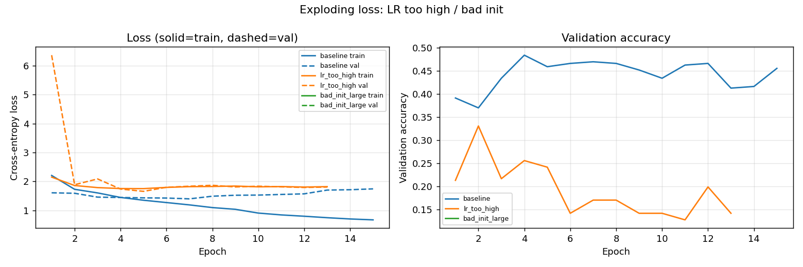
2 · DIAGNOSIS — EXPLODING LOSS
Too-large steps and weights break training
98 %
NaN
Fix
dead ReLUs in last layer at LR = 1.0
N(0,1) init: loss overflows in epoch 1
He init · LR 1e-3 + warmup · clipping
Museum guide · Neural networks
06
Notes:
SGD with learning rate 1.0 and no clipping: validation loss jumps to 6.4 at epoch 1, then accuracy falls below chance; 98% of last-layer ReLUs are permanently dead. With N(0,1) weights, Var(z) is roughly fan_in = 12,288 times the input variance, so the loss is non-finite in the first epoch and the run aborts — that is why the green curve is empty.
[Sources] Figures and numbers: results/ folder of the project repo (Colab T4 run, seed 42).

Slide 7
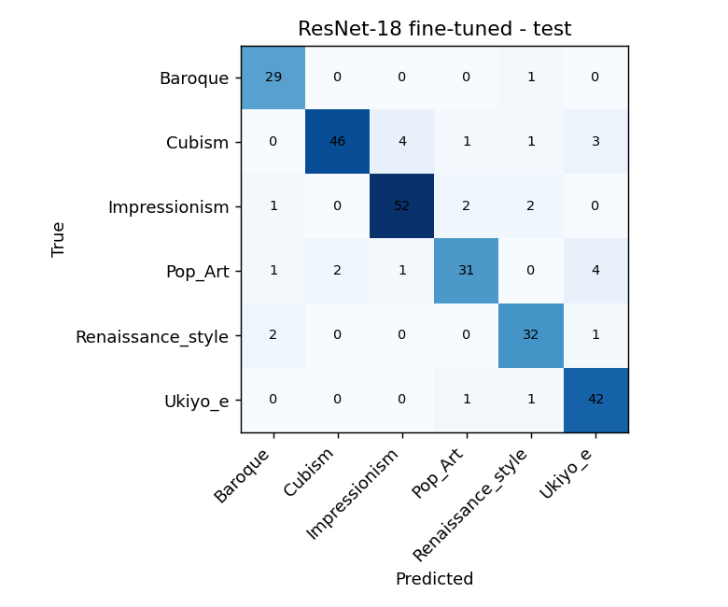
3 · RESNET-18 TRANSFER LEARNING
Pretrained convolutions double the accuracy
76.2 %
→
89.2 %
linear probe
(frozen backbone)
fine-tune layer4
(macro-F1 0.891)
Convolution: local, shared filters fit grid data.
Residuals: ∂(x+F(x))/∂x = I + ∂F/∂x keeps gradients alive.
Left errors: Cubism→Impressionism, Pop Art→Ukiyo-e (flat colour).
Museum guide · Neural networks
07
Notes:
ImageNet ResNet-18. Stage A trains only the new 3,078-parameter head: 76.2%. Stage B also unfreezes the last residual block at lr 1e-4: 89.2% test, more than double the MLP. Validation accuracy reaches about 0.90 by epoch 3; after that train loss keeps falling while validation plateaus. Remaining confusions are between styles sharing flat colour areas.
[Sources] Figures and numbers: results/ folder of the project repo (Colab T4 run, seed 42).

Slide 8
4 · QUESTION → ARTWORK MATCHING
Embeddings understand how visitors talk
“Show me paintings where faces are broken into shapes”
MiniLM maps paraphrases to meaning (+8.4 pts R@1).
TF-IDF nails exact artist names (best R@5, 0.11 ms).
Hybrid takes both: MRR 0.969.
Museum guide · Neural networks
08
Notes:
Each artwork has a catalogue text; visitor questions are written in visitor vocabulary. all-MiniLM-L6-v2 sentence embeddings with cosine similarity beat TF-IDF on Recall@1, 93.8 vs 85.4. TF-IDF stays strong on exact names and has the best Recall@5. Averaging both similarity matrices gives the best result: 95.8% R@1, MRR 0.969. Limitation: synthetic questions that include the artist name.
[Sources] Figures and numbers: results/ folder of the project repo (Colab T4 run, seed 42).

Slide 9
5 · NEURAL VS CLASSICAL
Production pick: frozen ResNet + logistic head
Model | Test acc | Macro-F1 | CPU ms/img | Size MB
HOG + colour → LogReg | 48.1 % | 0.485 | 0.97 | 0.13
HOG + colour → SVM | 53.8 % | 0.545 | 2.3 | 18.2
MLP (ours) | 42.7 % | 0.408 | 1.8 | 25.8
ResNet-18 fine-tuned | 89.2 % | 0.891 | 60 | 44.8
ResNet embeddings → LogReg | 89.6 % | 0.894 | ≈60 | ≈44.8
Why
Best accuracy, head retrains in 0.05 s when a new room opens.
60 ms on CPU: no GPU needed on the kiosk.
Keep HOG + LogReg as offline fallback.
Insight: hand-crafted features beat our MLP — inductive bias matters more than parameters.
Museum guide · Neural networks
09
Notes:
Same test split for every model. Classical HOG plus colour histograms beat our MLP by up to 11 points: without spatial bias, 6.5M parameters on 1,260 images learn less than edge-orientation features. Pretrained features are the step change. Recommendation: freeze the ResNet backbone and train a logistic head — same accuracy as full fine-tuning, retrains in 0.05 s, 60 ms per image on CPU.
[Sources] Figures and numbers: results/ folder of the project repo (Colab T4 run, seed 42).

Slide 10
TAKEAWAYS
What the museum should ship
01
Diagnose with evidence
02
Inductive bias wins
Loss curves, gradient norms and dead-ReLU rates explained every failure.
CNN 89 % vs MLP 43 % on the same 1 800 images.
03
Ship the cheap head
04
Hybrid search
Frozen ResNet + LogReg: 89.6 %, CPU-only, 0.05 s retraining.
TF-IDF + MiniLM: 95.8 % Recall@1 on visitor questions.
Limits: single seed · WikiArt scans ≠ visitor photos · synthetic questions → next: 3 seeds, in-gallery test set, real question logs
Notes:
Four messages: measure before you fix; the right inductive bias matters more than parameter count; the cheapest production option is also the most accurate here; and hybrid lexical + semantic search is the right Q&A design. Limits: one seed, domain shift between scans and phone photos, synthetic questions. Thank you — happy to take questions.
[Sources] Figures and numbers: results/ folder of the project repo (Colab T4 run, seed 42).

