Slide 1
Volatility forecasting with Macro-indicators
in the April 2025 tariff shock
Do macroeconomic indicators improve five-day volatility forecasts by sectors?
Sector-level analysis of S&P 500 stocks
Jules Dao
DATA 400 personal mini-project
01
Notes:
[~0:30] SAY:
- This project tests whether macro information helps forecast the next five days of volatility, across seven sector groups, with April 2025 as the stress test.
- I'll walk through the experiment and main findings. The written report has the deeper reasoning.

Slide 2
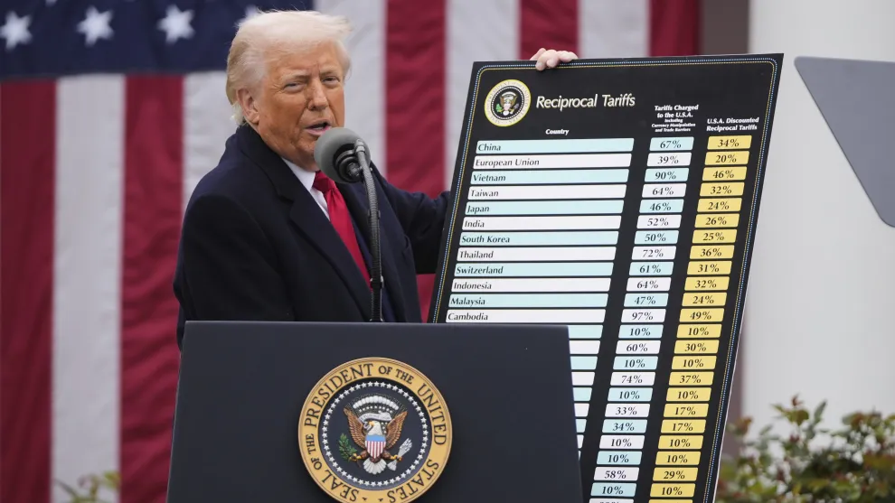
Research question
Additional predictive value beyond recent volatility and returns
Main question
What is the prediction ability of the model in extreme event? Do macroeconomic indicators improve five-day volatility forecasts?
Sector comparison
Does their contribution differ across sectors?
April 2025 is the main case study. Calmer and later periods provide comparisons.
02
Notes:
[~1:00] SAY:
- Main question: how well can a model predict volatility in an extreme event, and do macro indicators add anything beyond recent volatility and returns?
- Second question: does the contribution differ by sector?
- April 2025 is the case study; calmer and later periods are comparisons.
- I compare forecast error. I am not claiming the tariffs caused anything and I am not testing trading profit.
IF ASKED (WHY):
- Why volatility and not price direction: volatility measures the size of moves, and sharp drops and sharp rallies both raise it.

Slide 3
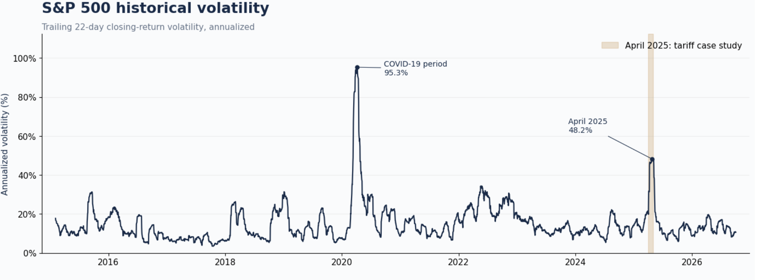
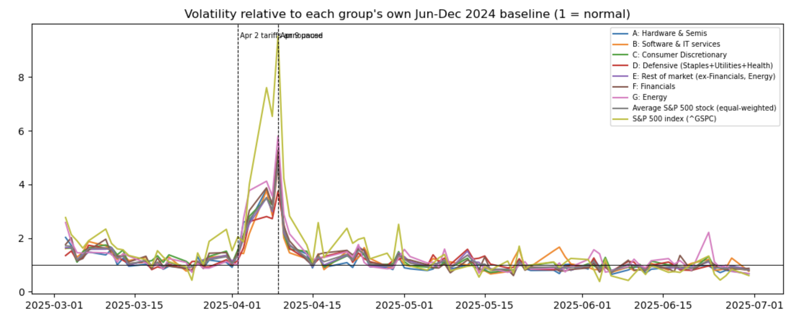
Case-study context and sector differences
A market-wide surge with different relative responses across A–G
Event timeline
Apr 2: Broad US tariffs announced.
Apr 9: Higher tariffs paused for most partners; China excluded.
Economic risks: Higher costs, inflation and weaker growth.
Our focus: Sector volatility forecasting during market stress.
Relative daily volatility peaks
Energy: 5.80× baseline
Financials: 5.27× baseline
Defensive: 3.74× baseline
03
Notes:
[~0:45] SAY:
- Apr 2: broad tariffs announced. Apr 9: 90-day pause for most partners.
- Volatility surged everywhere, but not equally. Relative to each sector's own 2024 baseline, Energy peaked at 5.8x, Financials 5.3x, Defensive 3.7x.
- All peaks fell on April 9. This is a descriptive case study, not causal identification.
IF ASKED (WHY):
- Why sector level: the shock hit sectors differently, and one index could hide that.

Slide 4
Research workflow
Every series follows the same experiment
1 Data
04
04 Evaluation
Prices, macro series and cleaning
Average validation error
04
04
02 Features and target
05 Final test
Past inputs and future five-day variance
April episode and later periods
03 Validation
04
04
06 Feature contribution
Expanding training and validation folds
Paired losses and uncertainty
04
Notes:
[~0:30] SAY:
- Six steps: data, features and target, chronological validation, evaluation, final test, then feature contribution.
- Every series goes through exactly the same experiment, so comparisons are fair.
- The winning model family is chosen from training cross-validation, not from the final test.

Slide 5
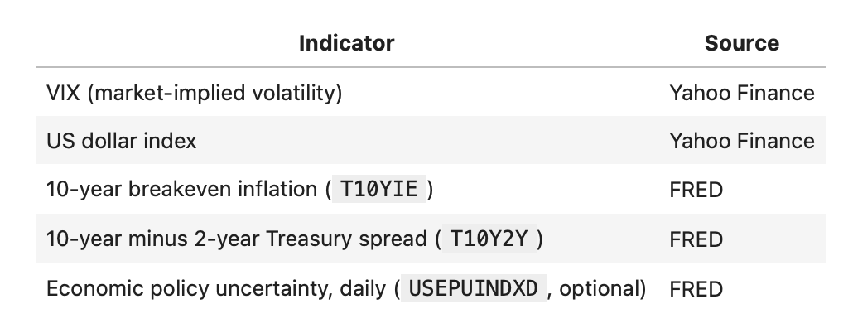
Why include macroeconomic indicators?
Possible information
The empirical test
Inflation expectations and the yield curve
may reflect changing economic conditions.
Does that information lower forecast error
after recent volatility and returns are included?
05
Notes:
[~0:45] SAY:
- Hypothesis: recent volatility captures persistence, while inflation expectations and the yield curve may add information about economic conditions.
- The test is incremental: do they lower forecast error after price history is already in the model?
- Macro series are transformed with five-day changes to reduce drift. The transform was chosen by training cross-validation, never by test performance.
IF ASKED (WHY):
- Why change5: raw levels made validation worse (about +0.08 RMSE); five-day changes were least harmful.
- What levels / z-scores / changes mean: level = raw value, z-score = distance from the training average in standard deviations, change = five-day difference.

Slide 6
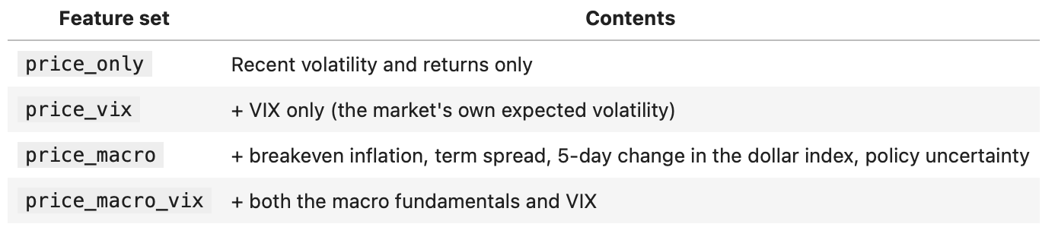
Why examine VIX separately?
Market-implied volatility and macro fundamentals represent different information sets
Macro fundamentals
VIX
Indicators of economic conditions
and policy uncertainty.
Option-market expectations of volatility
for the S&P 500.
VIX has a roughly 30-day horizon. Our forecasting target covers five trading days.
06
Notes:
[~0:45] SAY:
- Macro fundamentals and VIX are different information. VIX is the option market's expectation of S&P 500 volatility over roughly 30 days; my target is five days.
- I separate them to see which kind of information contributes. VIX is market-wide, not sector-specific.
IF ASKED (WHY):
- Why same-day VIX: it is known after the close, so there is no look-ahead. Slower macro series are lagged one to two days.
- Do you have implied volatility: only VIX, which is market-wide, not sector-level.

Slide 7
Four information sets
Matched dates isolate the contribution of added features
Specification | Inputs | Comparison purpose
Price only | Recent variance and returns | Reference forecast
Price + fundamentals | Price inputs + four macro features | Fundamentals beyond price
Price + VIX | Price inputs + log VIX | VIX beyond price
Price + fundamentals + VIX | All inputs | Fundamentals beyond VIX
Every model and series uses all four specifications. Comparisons use the same eligible dates.
07
Notes:
[~0:30] SAY:
- Four information sets: price only, price + fundamentals, price + VIX, and everything together.
- All use the same eligible dates, so any difference comes from the added features only.

Slide 8
Data and preprocessing
Daily prices and macro series from January 2015 to October 2026
Sources
Cleaning
Yahoo Finance: prices, VIX and USD
FRED: rates and policy uncertainty
Remove missing or invalid prices
Check high–low ranges and group coverage
Return construction
Sample limitation
Calculate returns before filtering
to preserve the original trading calendar
503 current constituent securities
Historical membership is not reconstructed
08
Notes:
[~0:40] SAY:
- Daily data, January 2015 to October 2026, from Yahoo Finance and FRED. 503 current S&P 500 stocks.
- Cleaning: drop missing or invalid prices and impossible high-low ranges. Returns are computed before filtering to keep the true trading calendar.
- Limitation: current constituents only, so there is survivorship bias.
IF ASKED (WHY):
- Why data to 2026: the final test needs the whole period after the shock, not just April.

Slide 9
Sector groups and the market index
A–G describe average constituent-stock variance, while SPX is the actual index
Group | Stocks included
A | Hardware and semiconductors
B | Software and IT services
C | Consumer discretionary
D | Staples, utilities and health care
E | Other sectors
F | Financials
G | Energy
Additional series
ALL: average stock variance
SPX: actual S&P 500 index
09
Notes:
[~0:45] SAY:
- Groups A-G are the average variance of the stocks in each group (GICS-based). E is the rest of the market.
- SPX is the actual S&P 500 index; ALL is the equal-weighted average stock.
- Group variance is not sector portfolio risk, which would include covariance.
IF ASKED (WHY):
- Why add SPX: ALL is not the S&P 500. It weights every stock equally and averages out variance. In my check, calm-period volatility was about 24% for ALL against 7% for the index.
- Roles: A-G are the main results, SPX is the headline series, ALL is only a comparison. Pooled tests use A-G only because ALL and SPX overlap them.

Slide 10
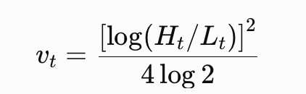
Measuring daily variance
The Parkinson estimator uses the daily high–low range
Interpretation
A wider daily range gives a larger variance estimate. However, this misses the overnight gap
10
Notes:
[~0:30] SAY:
- Daily variance comes from the high-low range: a wider range gives a larger estimate.
- It misses overnight gaps. I list that as a limitation.
IF ASKED (WHY):
- Why not squared returns: a stock can swing widely and close flat, so its squared return is near zero while the range shows the movement.

Slide 11
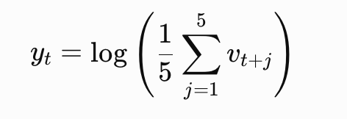
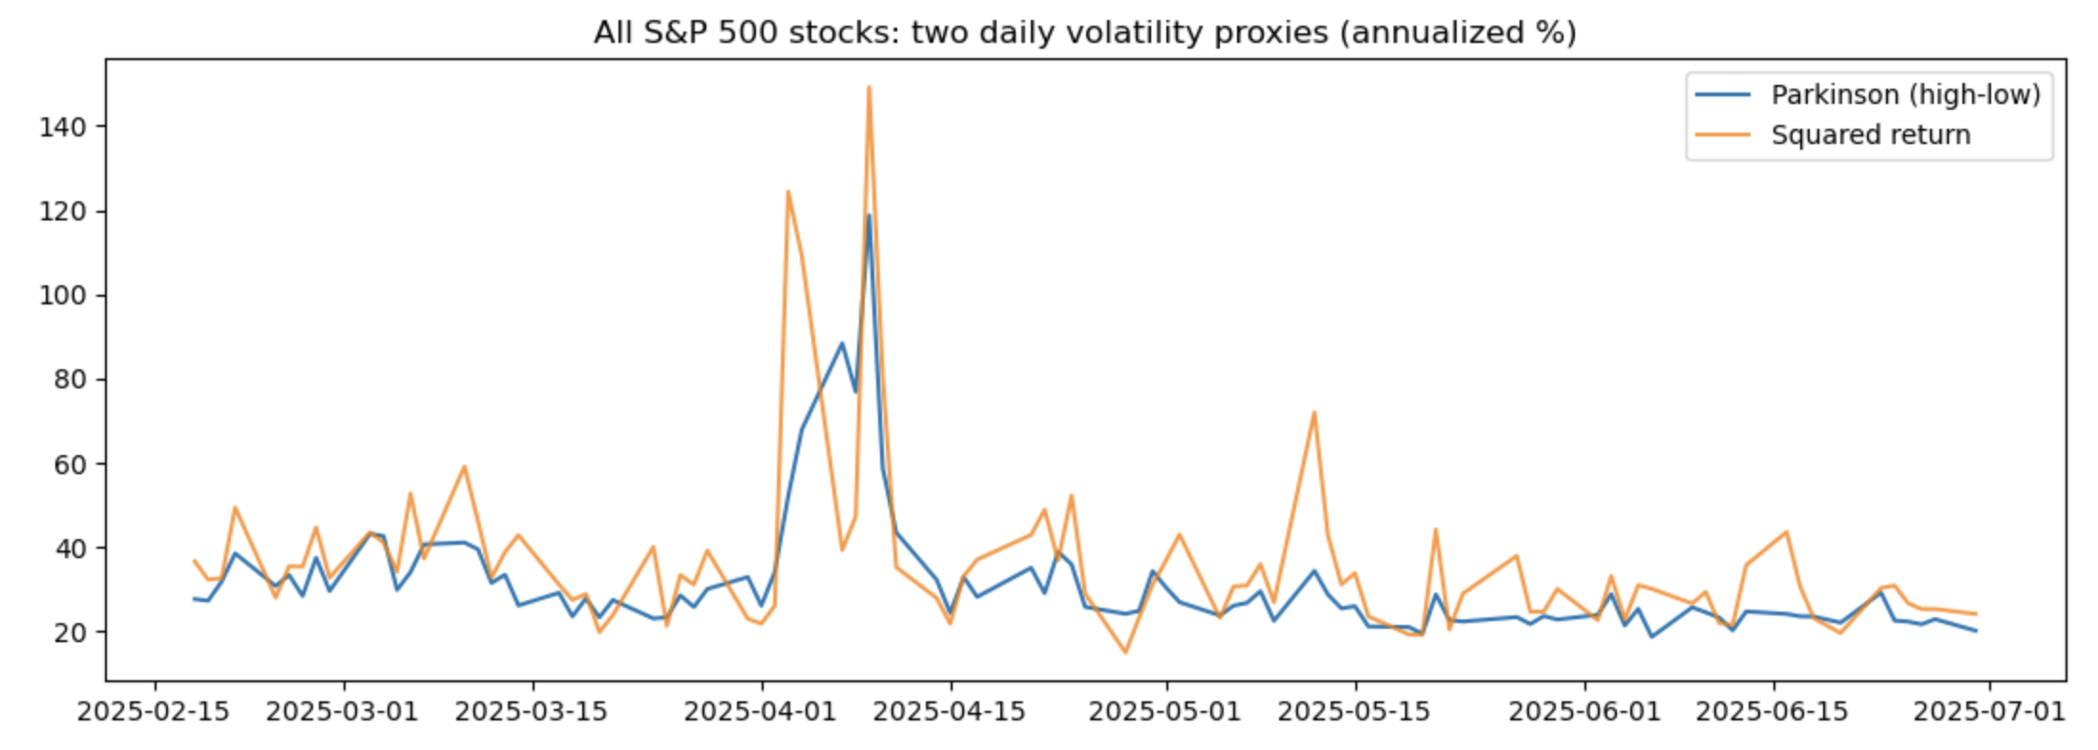
The five-day forecasting target
Interpretation
It is an average of future variance, not variance of a five-day cumulative return
11
Notes:
[~0:40] SAY:
- The target is the average of the next five days of variance, modeled in logs.
- It is not the variance of a five-day cumulative return.
- On the chart the target rises before the event marker, because each date shows the volatility of the next five days.

Slide 12
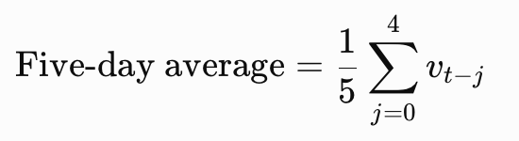
Lagged and rolling features
A forecast uses observed history, while the target lies strictly in the future
t−4
t−3
t−2
t−1
t
t+1
t+2
t+3
t+4
t+5
Observed history: average
Future prediction target
Daily, five-day and 22-day variance features to captured patterns
12
Notes:
[~0:30] SAY:
- Features are today's variance plus five-day and 22-day averages, all known after the close.
- The target lies strictly in the future. No future data enters a feature.

Slide 13

Why use log transformations?
Model proportional changes and reduce the scale of large variance values
A proportional interpretation
The logarithm of our variance features to compress these extreme values and make the scale easier for the models to work with
Logs compress the scale. They do not remove outliers or guarantee normally distributed errors.
13
Notes:
[~0:30] SAY:
- Logs compress extreme variance values and turn proportional changes into additive ones.
- They do not remove outliers or guarantee normal errors.
IF ASKED (WHY):
- Why log: the model works on the same scale as the target. Forecasts are converted back to variance with a smearing correction fitted on training data.

Slide 14
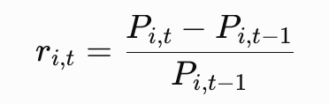
Return features
Recent movements and downside returns complement volatility history
Three return inputs
Why include downside separately?
Today’s return
Today’s negative return
Sum of the last five daily returns
Allow the model to associate down days
with future variance differently.
The five-day feature is a return sum, not an exact compounded five-day return.
14
Notes:
[~0:30] SAY:
- Three return inputs: today's return, today's negative return, and the sum of the last five daily returns.
- The negative-return feature lets down days relate to future variance differently. It does not prove a causal leverage effect.

Slide 15
Models and regularization
Ridge and Lasso shrink coefficients to limit model complexity
Regularized linear models
Flexible alternatives
Ridge penalty: λ Σ βⱼ²
Lasso penalty: λ Σ |βⱼ|
Decision Tree
Random Forest
Gradient Boosting
Benchmarks
Penalty selection
Last-five-day variance
Historical average variance
Tune separately for each series
Reuse across its four feature sets
15
Notes:
[~0:45] SAY:
- Ridge and Lasso shrink coefficients to limit complexity. I also compare a decision tree, random forest and gradient boosting.
- Two benchmarks: last-five-day variance (naive) and the historical average.
- Penalties are tuned once per series and reused across feature sets.
IF ASKED (WHY):
- Why tune once on price-only: if each feature set got its own penalty, any difference could come from the penalty instead of the added features.
- Why Ridge and Lasso: regularized, handle correlated inputs, easy to explain.

Slide 16
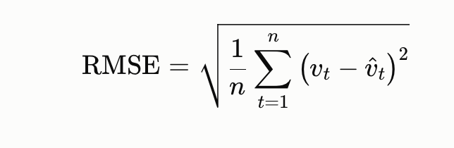
Fitting objective and validation metric
Fit log variance, then compare out-of-fold prediction errors
During fitting
During model comparison
Squared errors on log variance
Ridge and Lasso add a penalty.
Average RMSE across validation folds
Lower values indicate better forecasts.
Reported CV is not nested. Penalty selection and model comparison reuse training-period folds.
16
Notes:
[~0:45] SAY:
- Models are fit on log variance. Validation compares out-of-fold RMSE on that same scale.
- This CV is not nested: penalty selection and model comparison reuse the training folds. I say so openly.
IF ASKED (WHY):
- Why not QLIKE in CV: log-variance RMSE matches what the model is trained on and is stable. The cost is that CV and test use different losses.
- Is that inconsistent: it is a known mismatch. The literature recommends matching losses where possible and declaring the loss in advance. I report QLIKE, volatility RMSE and asymmetric RMSE on the test.

Slide 17
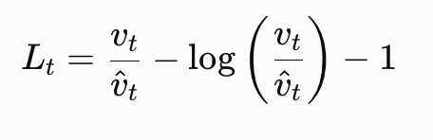
Final-test loss functions
QLIKE compares variance forecasts, while RMSE describes volatility errors
QLIKE
Volatility RMSE
Proportional variance error
Strong penalty for severe underprediction
Error in annualized volatility points
Lower values indicate smaller errors
Asymmetric RMSE gives underprediction twice the squared-error weight. Lower loss is better.
17
Notes:
[~0:40] SAY:
- QLIKE compares variance in proportional terms and penalizes under-forecasting heavily.
- Volatility RMSE is in annualized volatility points, so it is easy to read. Asymmetric RMSE weights under-forecasts twice.
IF ASKED (WHY):
- Why QLIKE is primary on the test: missing a spike costs more than over-forecasting.
- RMSE: square root of the average squared gap between forecast and actual.

Slide 18
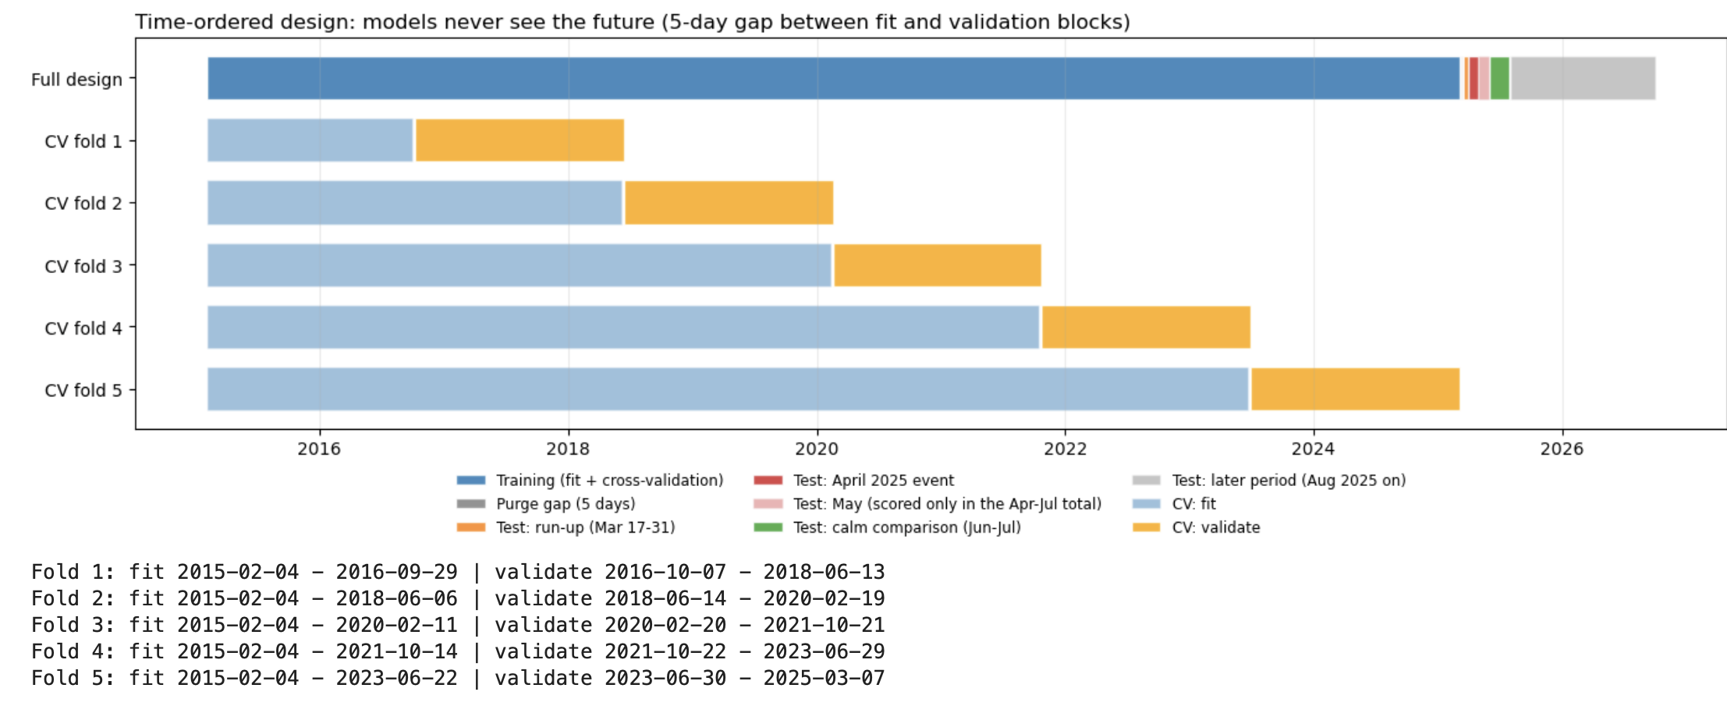
Chronological split and cross-validation
Five expanding folds and five-day gaps protect target boundaries
Within each validation fold
Fit on earlier observations
Predict the next validation block
Split and CV diagram
Final fitting
Insert notebook C-2
Show expanding folds and purge gaps
Fit on all training data
Keep parameters fixed in the test
18
Notes:
[~1:00] SAY:
- Five expanding folds with a five-day gap, so no target crosses a boundary. Last training origin is March 7; test starts March 17.
- Parameters are fitted once on all training data and kept fixed in the test; only the inputs update daily.
IF ASKED (WHY):
- Why start the test before April: it gives a run-up period, so April is not the first test day.
- Did you use TimeSeriesSplit: yes, n_splits=5 with gap=5, inside the training data only.
- What is out-of-sample: data the model never saw while fitting or choosing.
- Do you rerun everything for the test: yes, every sector and feature set is fitted once on the full training period, then scored on the test.

Slide 19
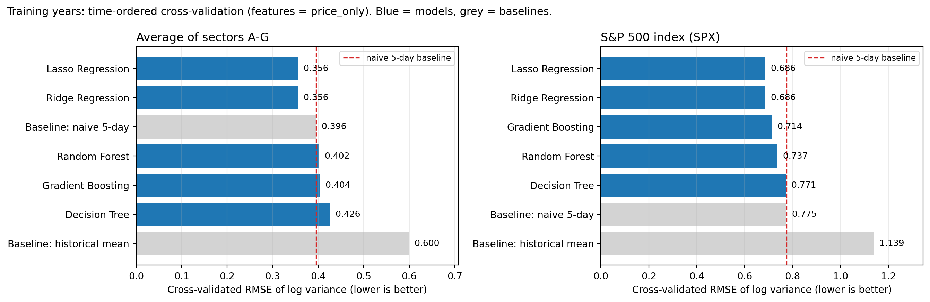
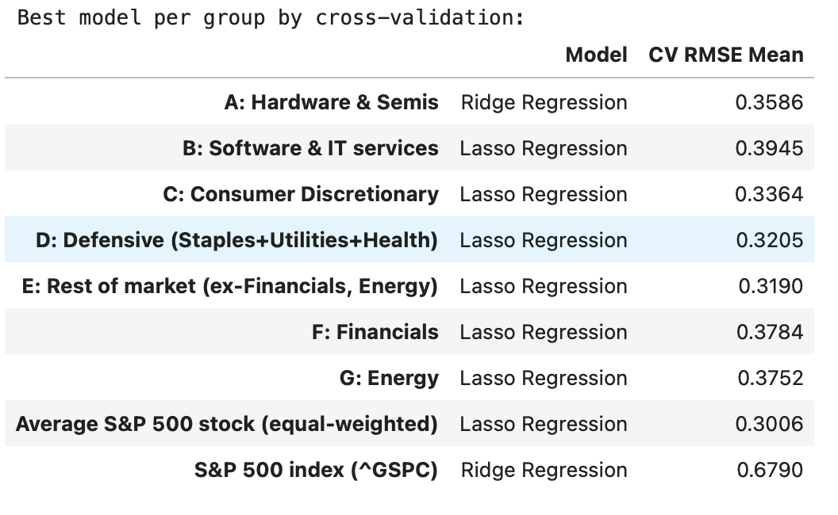
Training results
Lasso wins the CV, only slightly ahead of Ridge
Training comparison
Model-family result
Lasso ranks first overall across all validation (sector x features)
Overall family ranking averages A–G and all four specifications. Historical CV favors price + VIX.
19
Notes:
[~1:00] SAY:
- Lasso is first overall, only slightly ahead of Ridge (0.3547 vs 0.3554). The trees are clearly worse.
- Lasso wins 24 of 28 sector-by-feature comparisons. Historical CV favors price + VIX.
IF ASKED (WHY):
- Why choose from CV: to keep the test clean. Lasso was chosen before seeing any test result.
- Why Lasso when Ridge looks slightly better on the test: the choice was fixed from training, and the two are effectively tied. Lasso is a selection rule, not a finding.

Slide 20
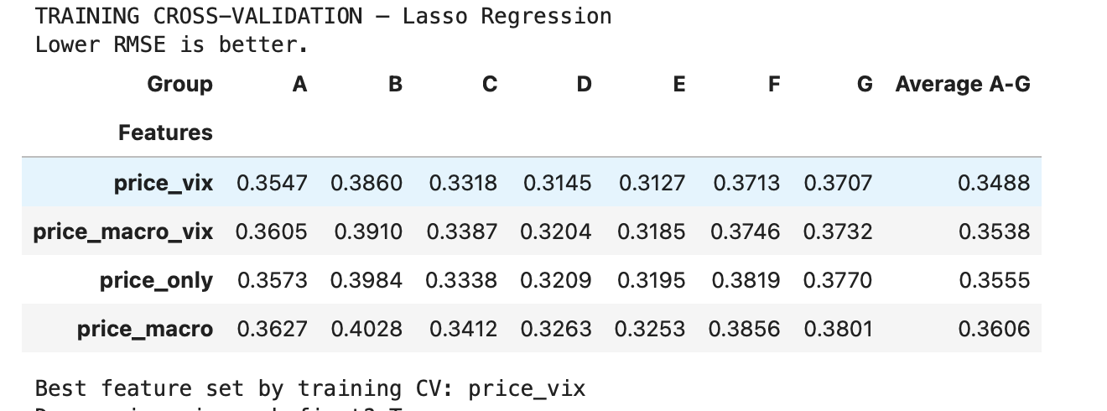
Training results
Macro indicators do not help prediction; VIX does in CV
CV result
Training comparison
VIX improves historical CV
Macro set worsen CV error
Lasso, average RMSE across A–G: VIX lowers validation error, macro fundamentals raise it.
20
Notes:
[~0:30] SAY:
- VIX improves historical CV; macro fundamentals make it worse.
- So the macro null result is not a missing-data accident. It shows up in training validation.
IF ASKED (WHY):
- Why would macro make loss worse: overfitting, multicollinearity, frequency mismatch, look-ahead bias and scaling are the standard causes. I checked them on the next slide.

Slide 21
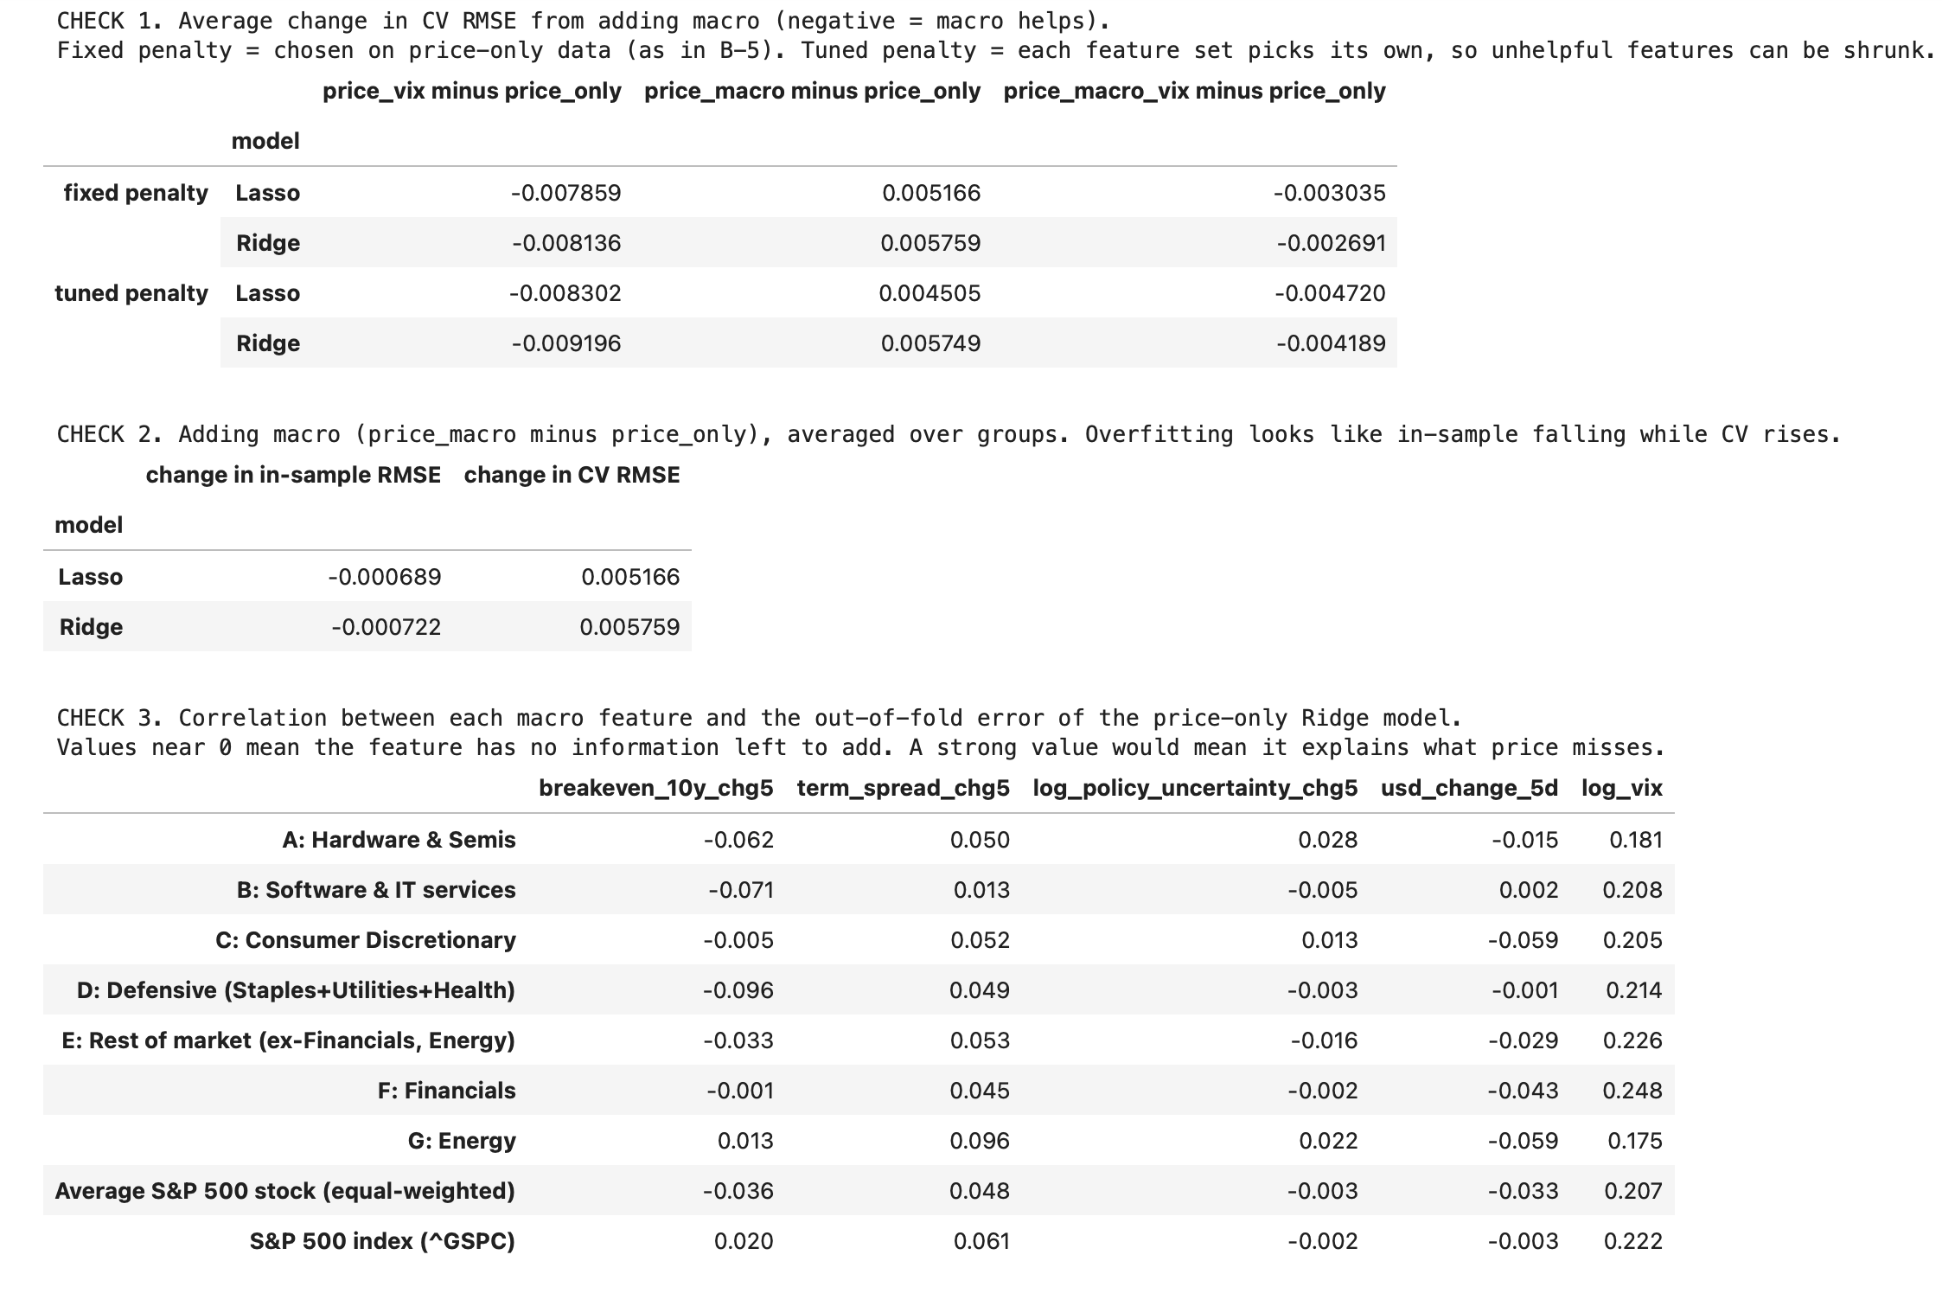
Training results
Macro indicators do not help prediction
Information-set result
Training comparison
Tuned penalty
Overfitting signal
No gain at a 22-day horizon
21
Notes:
[~1:00] SAY:
- Not the penalty: even with a separately tuned penalty, macro still hurts validation. VIX alone helps.
- Macro lowers training error slightly but raises validation error: a mild overfitting pattern.
- Macro has weak correlation with what price history leaves unexplained, and VIF is near one, so multicollinearity is not the cause.
- A 22-day horizon does not rescue it.
IF ASKED (WHY):
- Is this normal: yes. The literature often finds macro adds little at short horizons because price history already contains most of the information.

Slide 22
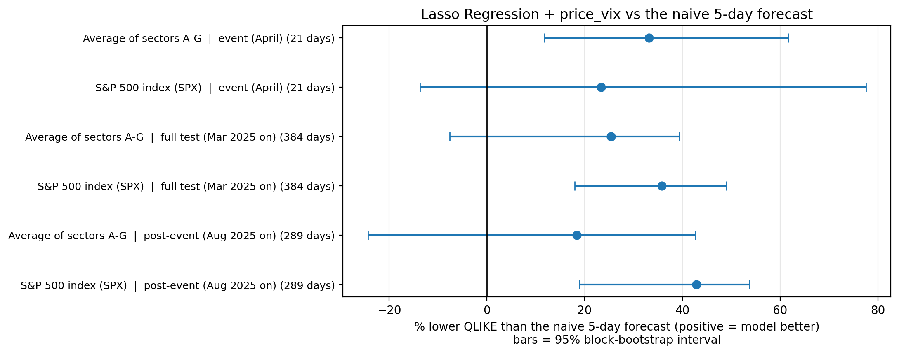
Test performance and forecast behavior
Selected model from CV: Lasso + price_vix feature set
April: 33% lower QLIKE than naive (sector). Full test: 36% lower QLIKE than naive (SPX).
22
Notes:
[~1:00] SAY:
- The selected model is Lasso with price + VIX, chosen from training CV.
- April: 33% lower QLIKE than naive, averaged over sectors. Full test: 36% lower for the S&P 500.
- The pooled evidence is in the full test (384 days).
IF ASKED (WHY):
- What is the baseline: the naive forecast is the last five days of realized variance for the same series, so each sector is compared with its own naive rule.
- Why a test after CV: CV picks the model on older, calmer data. The test shows whether it works on unseen data in the shock regime.

Slide 23
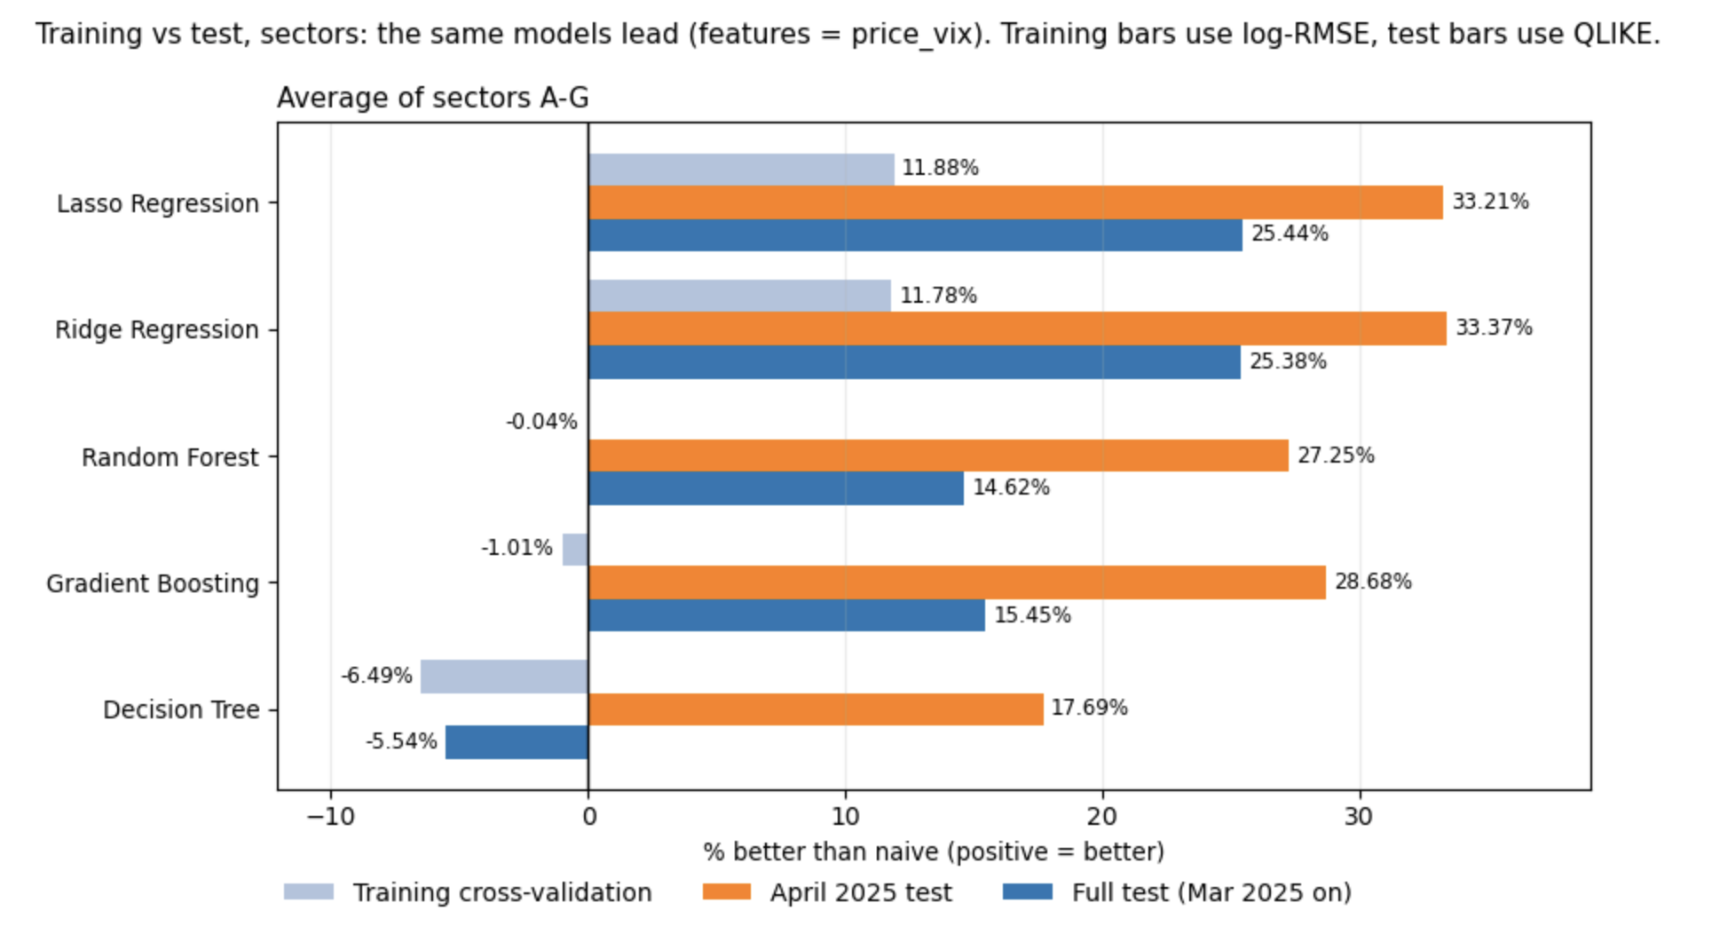
Test performance and forecast behavior
Does the CV ranking hold up in the test? Ridge and Lasso stay nearly tied
23
Notes:
[~0:45] SAY:
- The CV ranking carries over to the test in direction, and Ridge and Lasso stay nearly tied.
- The test does not change the choice. It measures how the chosen model performs.
IF ASKED (WHY):
- Why not switch to Ridge if it is slightly better on test: selecting on the test uses up the untouched data and biases the result. The gap is within noise anyway.

Slide 24
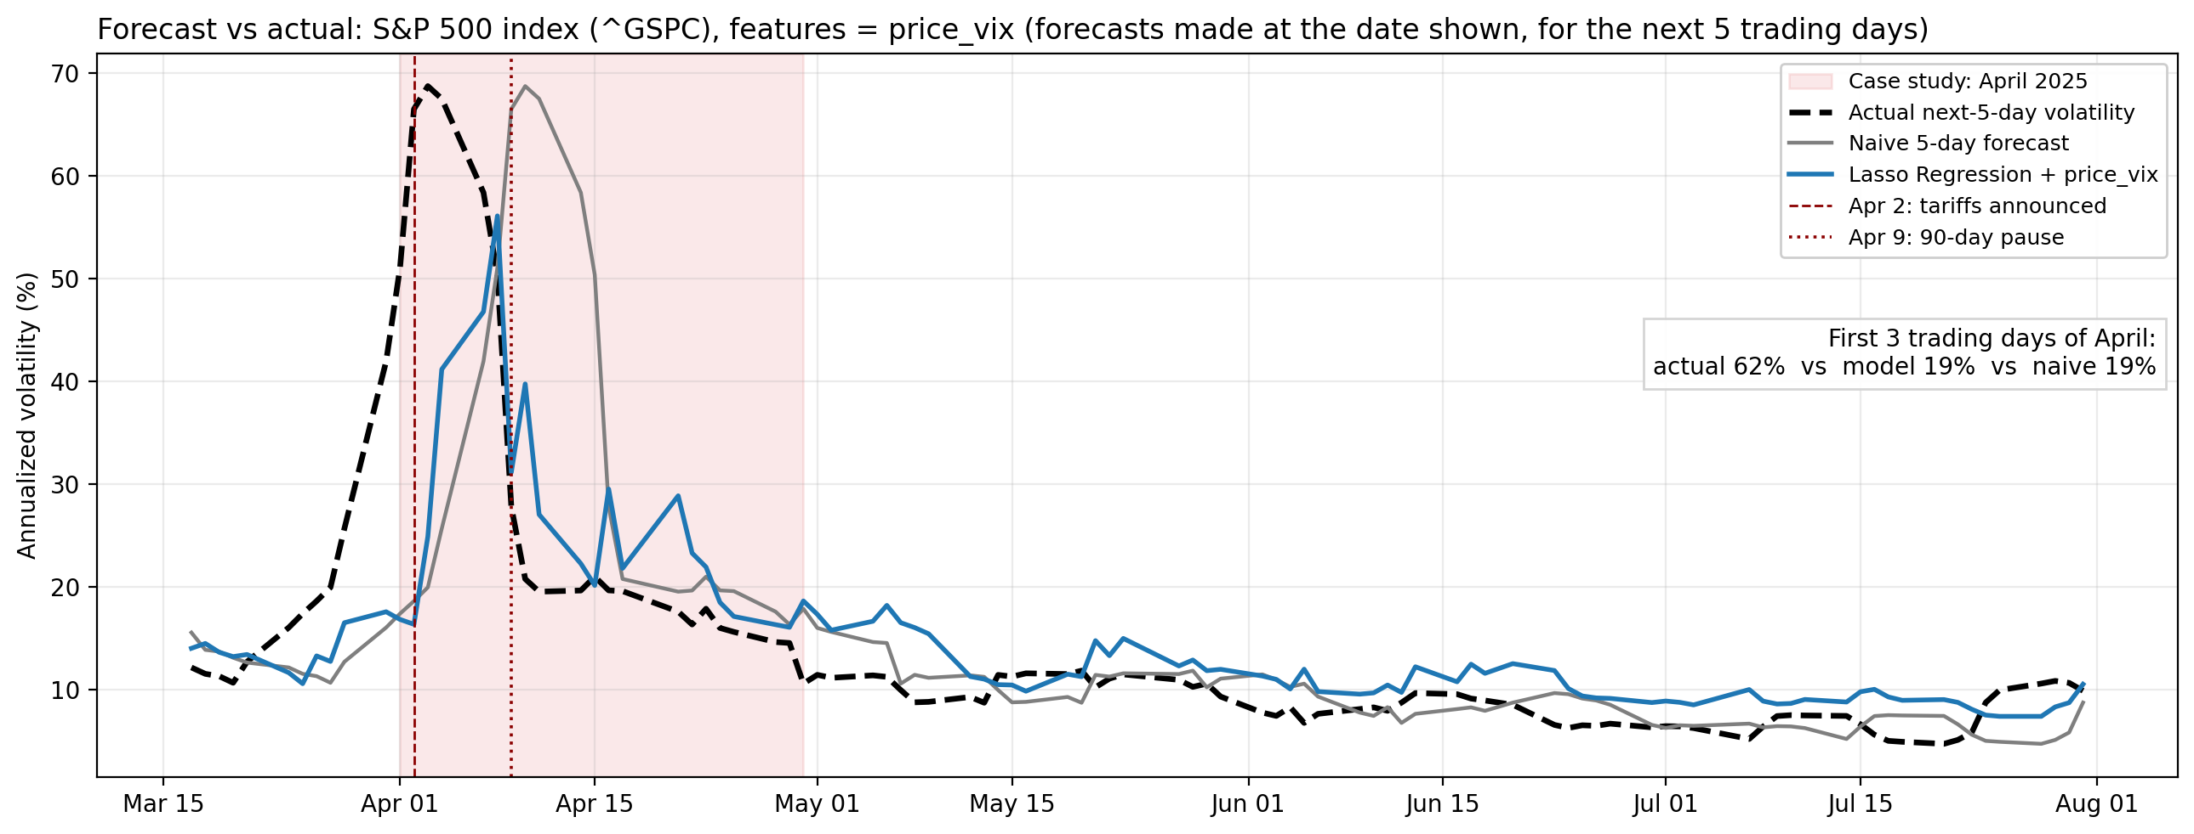
Test performance and forecast behavior
The model misses the onset (actual 62% vs model 19%), then adjusts faster than naive.
24
Notes:
[~1:15] SAY:
- The model misses the onset: 62% actual against 19% forecast in the first three April days.
- After the surge it adjusts faster than naive. The gain over naive comes from faster decay, not from predicting the surge.
IF ASKED (WHY):
- Why does it lag: features look backward, so nothing on April 1-2 signals the announcement. It reacts once the inputs jump, and a model trained on calm data shrinks toward normal levels.
- Why naive is worse: it is exactly five days late.
- Can it be fixed: not honestly after seeing the test. Future work is forward-looking inputs such as implied volatility at several horizons.

Slide 25
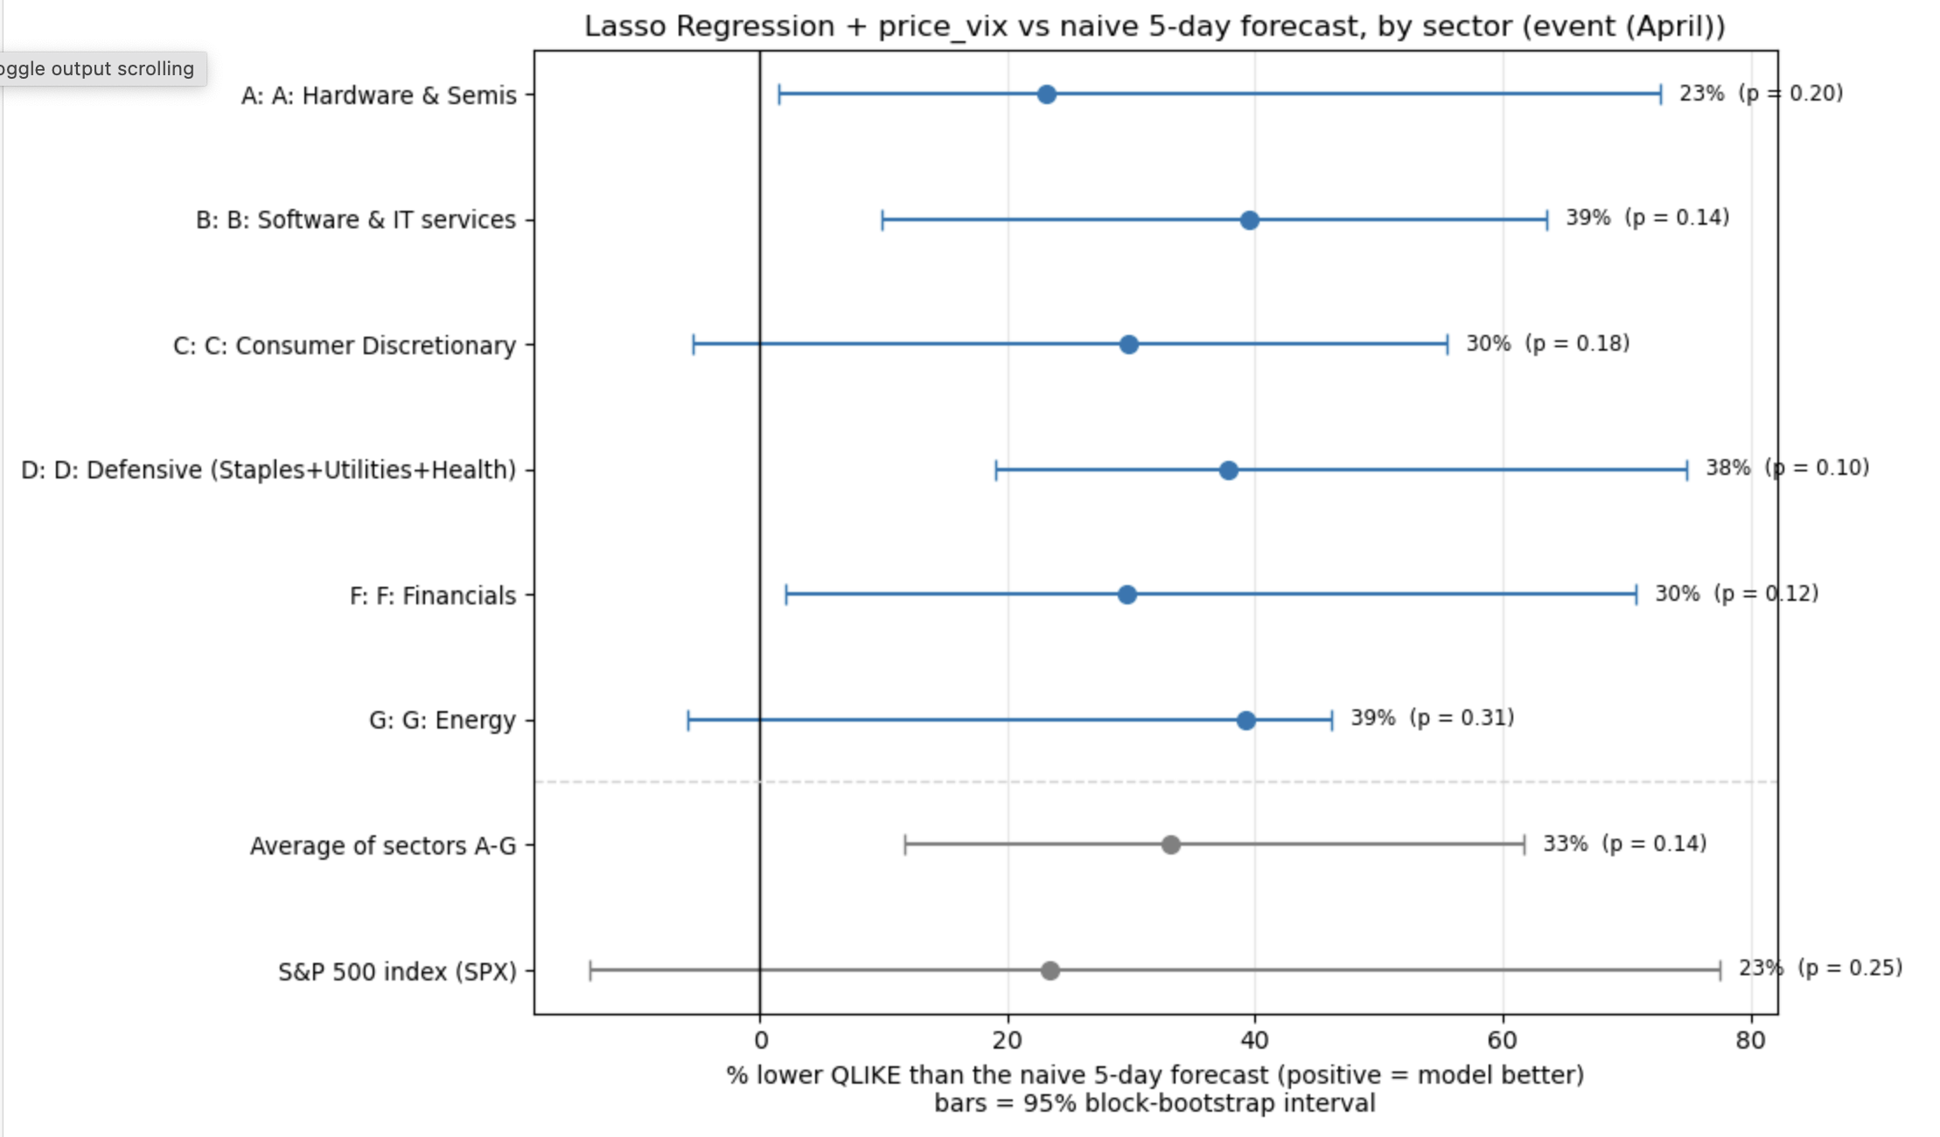
Test performance and forecast behavior
April by sector: lower QLIKE than naive in all six (23–40%), but only ~21 overlapping days
25
Notes:
[~1:00] SAY:
- All six sectors point the same way: 23-40% lower QLIKE than naive in April.
- April has only 21 days and overlapping targets, roughly four independent observations. So no single sector test reaches 5%, and I treat April as descriptive.
- Say this out loud: the pattern across sectors matters more than any single bar.
IF ASKED (WHY):
- Why are p-values so high: too little data, not zero effect. The formal evidence is the full test: p = 0.032 for the sector average and 0.003 for SPX.
- Why do bootstrap and DM disagree in April: the bootstrap resamples blocks inside a 21-day window and is more optimistic. DM is the conservative one, so I trust it more.

Slide 26
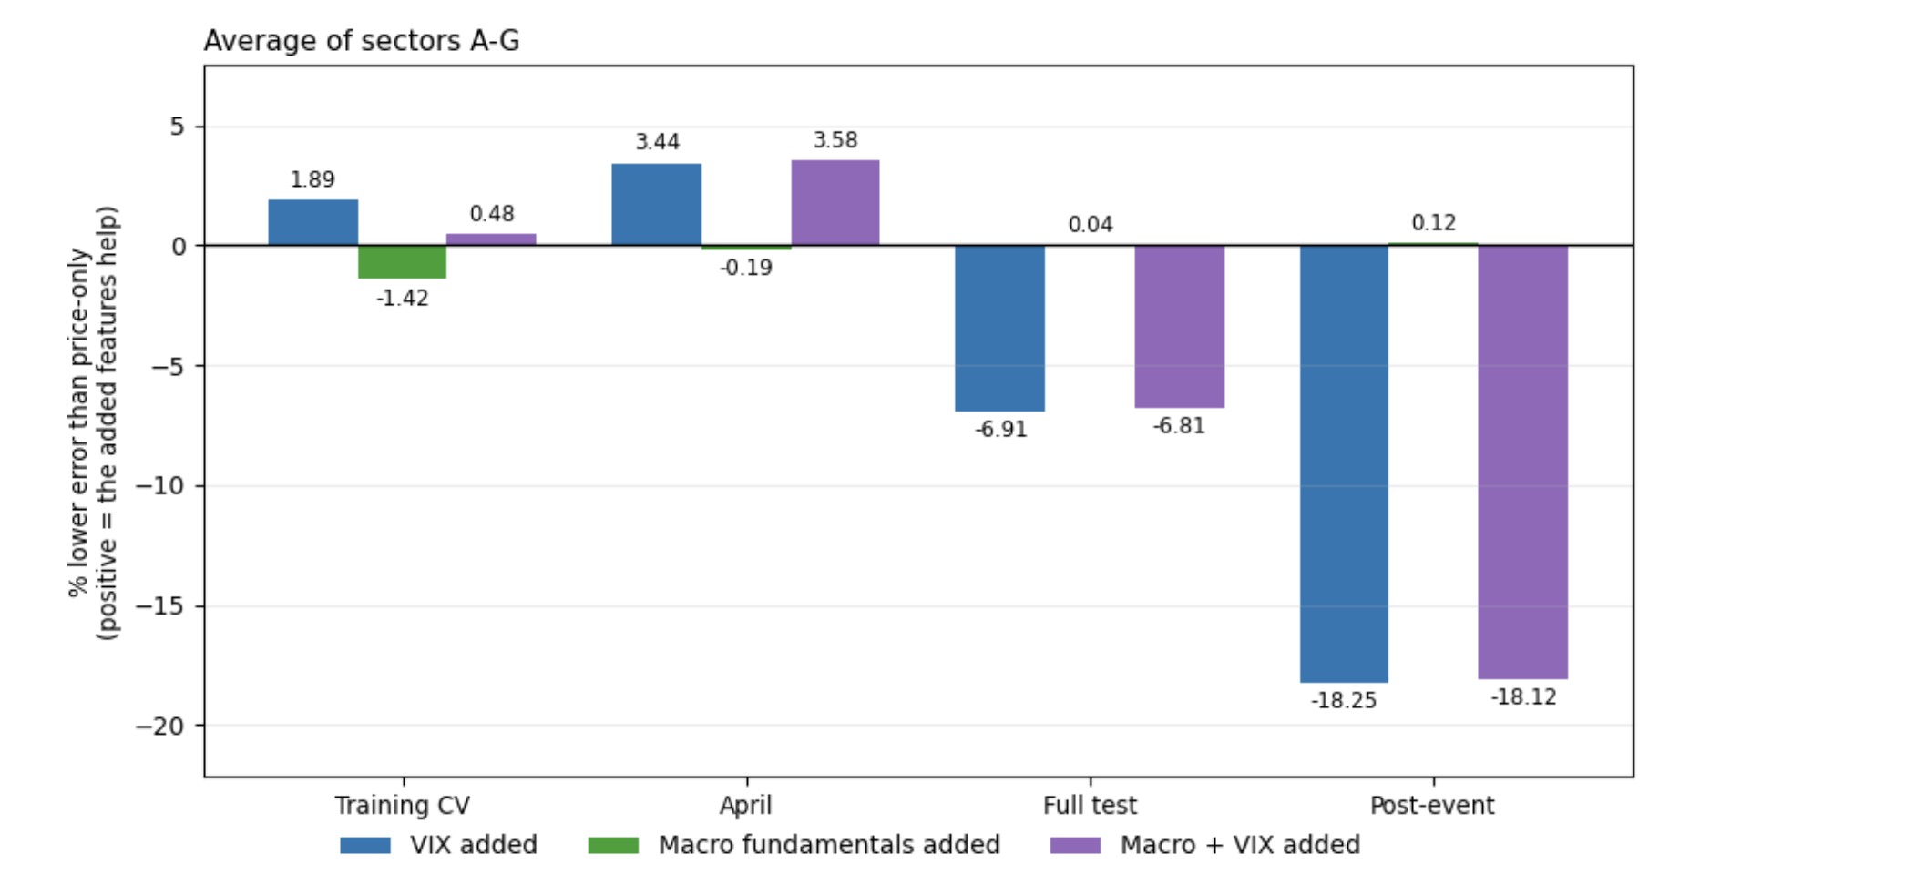
Does macro or VIX improve forecasts?
Fundamentals add little, while VIX’s contribution varies by period and sector
Macro fundamentals
No reliable pooled improvement
Mixed sector-level changes
VIX
April: uncertain pooled gains
Full test: worse pooled forecasts
Full-test VIX deterioration for pooled A–G: DM p = 0.0066. Tests are unadjusted for multiplicity.
26
Notes:
[~1:00] SAY:
- Macro fundamentals add nothing reliable.
- VIX helps in April for Energy, Defensive and Software, but over the full test it makes the pooled forecast worse (p = 0.0066).
- These tests are not adjusted for multiple comparisons, so I make no stronger claim.
IF ASKED (WHY):
- Why VIX hurts later: it is a 30-day market-wide measure, so once the shock fades it adds noise to a five-day sector target.
- Why keep VIX: it answers a different question from macro. It matters in stress and not in calm, which is itself a result.

Slide 27
Conclusion and limitations
Recent market information provides useful forecasts in this experiment
Main finding
Lasso and Ridge beat persistence.
Selected fundamentals add little reliable value.
Main limitations
Next steps
One event with overlapping targets
Could not anticipate the initial surge
More events and rolling model refitting
Economic context in the written report
Overnight-sensitive target
27
Notes:
[~0:45] SAY:
- Regularized models on recent market data beat persistence. Selected fundamentals add little. VIX depends on period and sector.
- Neither approach anticipates the initial surge.
- Limitations: one event, overlapping targets, survivorship, static models, non-nested CV, high-low proxy.
- Next steps: more events, rolling refits, an overnight-sensitive target, and economic context in the report.
IF ASKED (WHY):
- Can it predict extreme events: it adapts to them faster than a simple rule, but it cannot see them coming.

