Slide 1
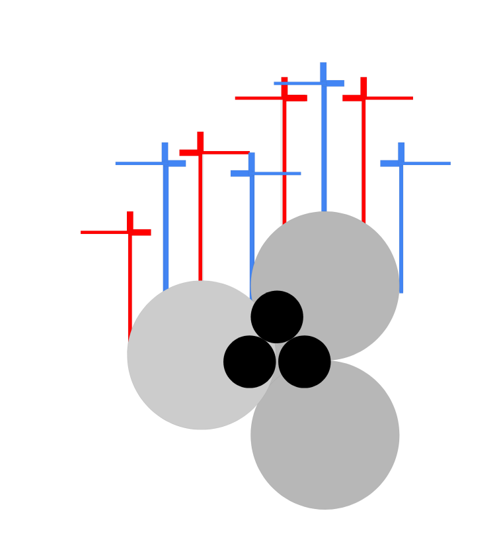
Ráfaga™

Slide 2
Bao’s MRLRSV Model
Estimate spot VIX from evolution of futures modulo strike price evaluation
Call(τ,K) = e^(-Integral{ r_s ds} over tau) * [F_τ * Π_1 – K * Π_2]

Slide 3
Model Metrics
Ingests data from CBOE, Bloomberg and Yahoo! Finance
Calculates per-strike value in two seconds on 8GB RAM
RMSE in initial testing is 3.543 for 30 day call on VIX

Slide 4
Computational Convergence
Math does not always translate to code easily
The limit may not yield improvement

Slide 5
Solution
Machine learning on hyper-parameters to tune model

