Slide 1
United Kingdom Railway Sytem
Jules Saldivar
Audrey Warner

Slide 2
Table of Contents
01
02
03
04
05
Business Problem
Data
Analysis
Results
Further Considerations

Slide 3
01
Business Problem

Slide 4

Is the United Kingdom Railway System accessible, convenient, and reliable?
Accessible | Convenient | Reliable
Are train stations located in populous areas? | Are train routes running at times when needed? | Will the train get you to your destination on-time, without delays?

Slide 5
Audience
Rail Passengers
Daily commuters
Weekend travelers
Tourists
Business Travelers
Why do they care?
Public transit can enable easy, affordable, and sustainable travel.

Slide 6
02
Data

Slide 7
Data Sources
United Kingdom National Rail Data (REST API)
Rail References Data (Grand Circus)
2021 UK Census Population Data

Slide 8
United Kingdom National Rail Data
Retrieved Values
Route ID
Scheduled Arrival and Departure Time
Actual Arrival and Departure Time
Delay Status
Rail Station ID (Tiploc Code)
Collected during 7/3/2024-7/17/2024
Collected 577,254 rows of data
Calculated Values
Trip Duration
Delay Duration (Arrival and Departure)

Slide 9
Rail References Data
Given Values
Rail Station ID (Tiploc Code)
Station Name
Easting
Northing
Merged onto UK Rail References Data to gain further insights
Completed research to add missing station names
Calculated Values
Latitude*
Longitude*
* Utilized Python pyproj library

Slide 10
UK Population Data
Given Values
City
Country
Population
Based on 2021 Census data
Only shows cities with population over 50,000

Slide 11
03
Analysis

Slide 12
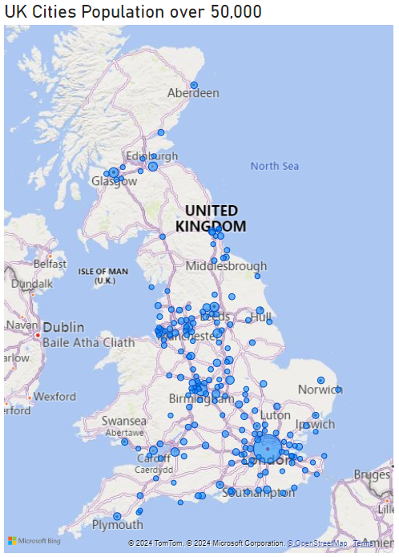
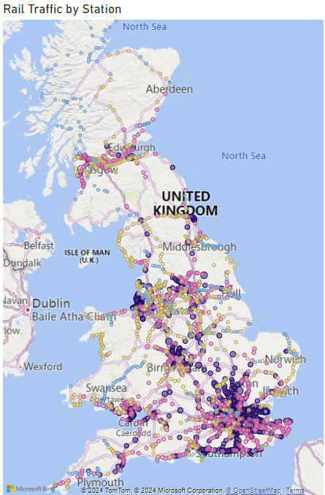
Accessible: Are train stations located in populous areas?
Key Insights:
The UK's most densely populated areas have the highest train traffic.
In cities like London, Birmingham, Manchester, and Glasgow, the UK Railway System is highly accessible.
Bubble colors indicate rail traffic by station:
Light Blue (0-26): Lowest range, below the 25th percentile.
Yellow (26-80): Between the 25th and 50th percentiles.
Pink (80-198): Between the 50th and 75th percentiles.
Purple (198-4000): Highest range, above the 75th percentile.

Slide 13
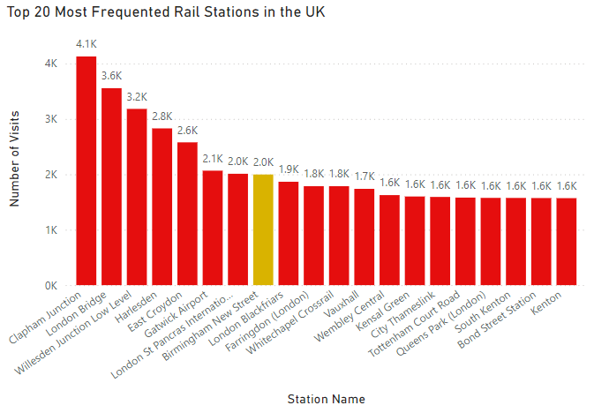
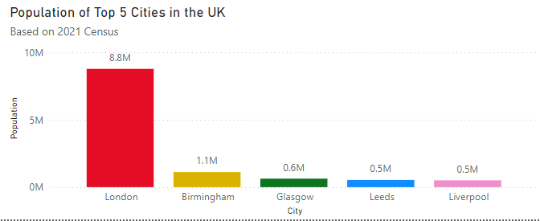
Accessible: Are train stations located in populous areas?
Key Insights:
19 out of the top 20 stations are within the Greater London area.
London's large population of approximately 9 million, drives the high traffic at its stations.

Slide 14
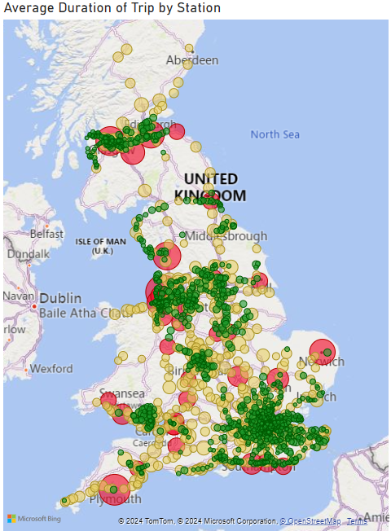
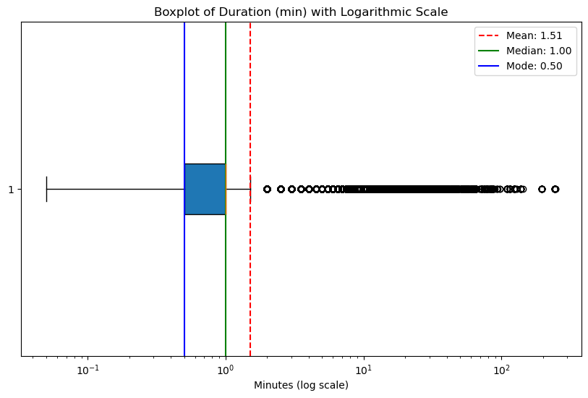
Accessible: Are train stations located in populous areas?
Key Insights:
Half of all rail trips are 1 minute or less in duration.
Short trips are concentrated in metropolitan areas.
Green: Trips <1 min
Yellow: Trips 1-5 min
Red: Trips over 5 min
Bubble colors indicate trip durations:

Slide 15
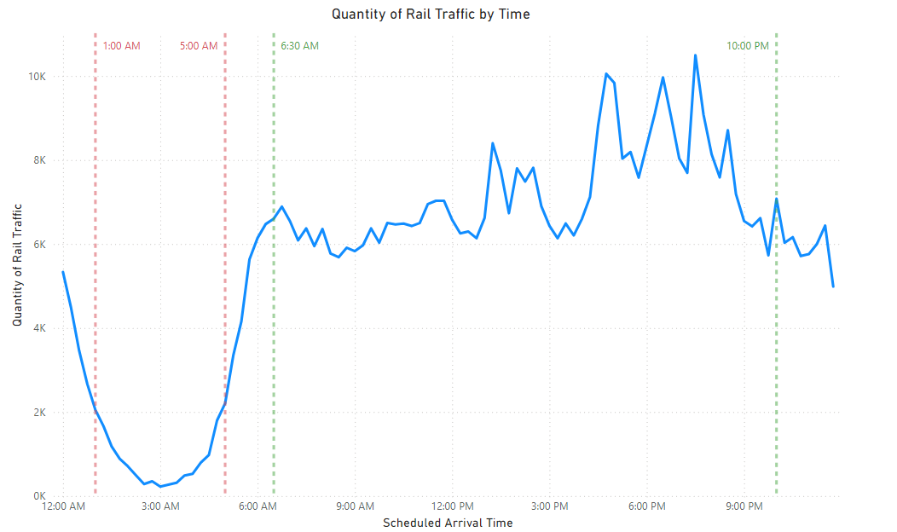
Convenient: Are train routes running at times when needed?
Key Insights:
Very few trains run 1:00AM - 5:00AM.
Many trains are running 6:30AM - 10:00PM.

Slide 16
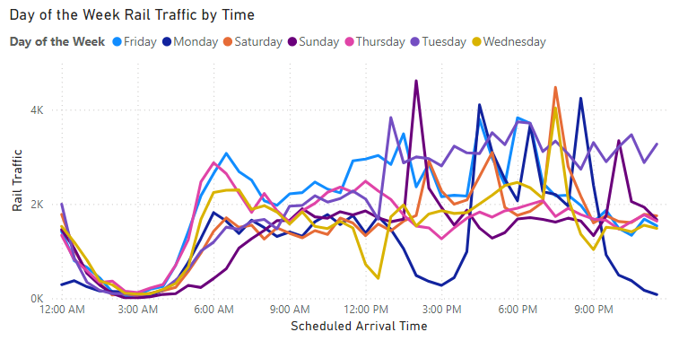
Convenient: Are train routes running at times when needed?
Key Insights:
Train availability is consistent across weekdays.
Weekend availability mirrors this except for a dip in early morning services on Sundays.

Slide 17
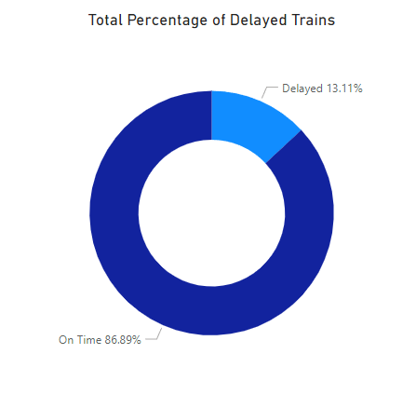
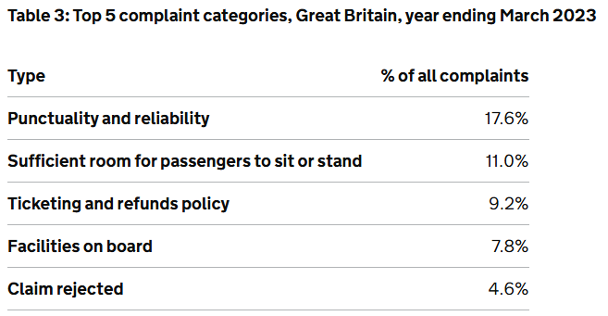
Reliable: Will the train get you to your destination on-time?
Key Insights:
13.11% of all trains are delayed.
According to the UK Department for Transport, the top complaint about the rail system is related to delays.

Slide 18
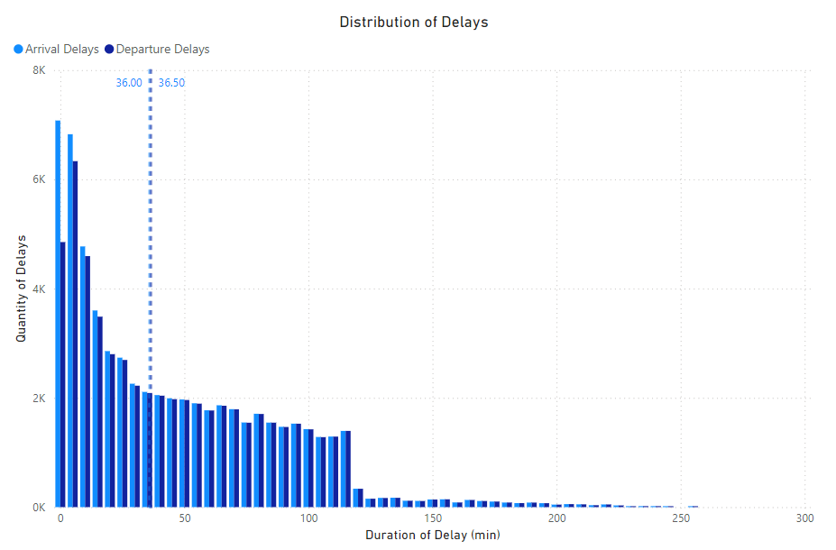
Reliable: Will the train get you to your destination on-time?
Key Insights:
There is a strong concentration of shorter delays, however 75% of all delays are over 11 minutes.
A delay greater than 11 minutes may be a dissatisfier.

Slide 19
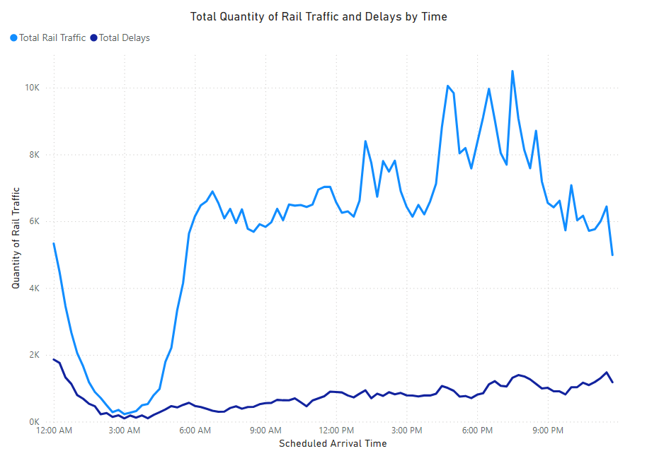
Reliable: Will the train get you to your destination on-time?
Key Insights:
Trains are 29% more likely to be delayed if the scheduled arrival time is between 12AM and 3:30AM.
Delays increase by 39% when the duration exceeds 4.5 minutes.
Increase in traffic did not proportionally increase delays.

Slide 20
04
Results

Slide 21
Accessible?
Convenient?
Reliable?
Is the United Kingdom Railway System accessible, convenient, and reliable?
Yes, there are rail stations in all major UK cities, correlating with population.
Yes, the rail system runs many trains most hours of the day.
No, over 13% of trains are delayed and delays can be long.

Slide 22
Travelers considering the UK Rail System must evaluate
what factors are most important to their travel.
If delays are not a concern, travelers will find the UK Rail System
an accessible and convenient mode of transportation.
However, if reliability and timeliness is important to the traveler,
other options should be considered.

Slide 23
05
Further Considerations

Slide 24
Opportunities for Improvement
Expand Data Collection Period
Evaluate Cost and Safety
Compare Alternative Travel Options

Slide 25
Thanks!
Do you have any questions?
Jules Saldivar julessaldivar@gmail.com linkedin.com/in/jules-saldivar | Audrey Warner audrey.warner1@outlook.com linkedin.com/in/audrey-warner-data1
https://github.com/julessaldivar/-UK-Rail-Data-Pipeline-EDA

