Slide 1
Accelerated vs. Unaccelerated Maxwellian Precipitation: Comparing Evans (1974) Data vs. Equivalent Maxwellian
June 6, 2023

Slide 2
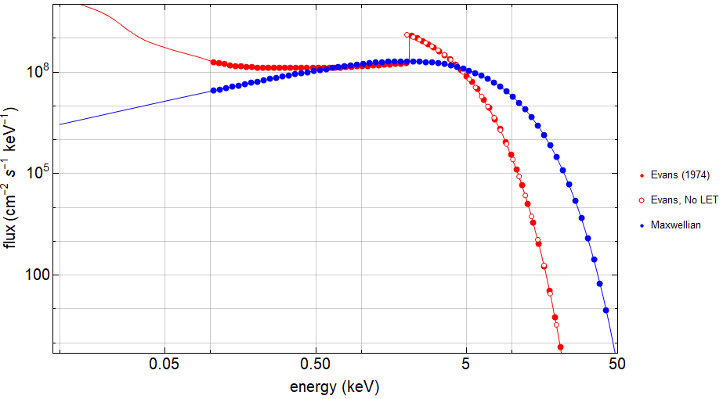
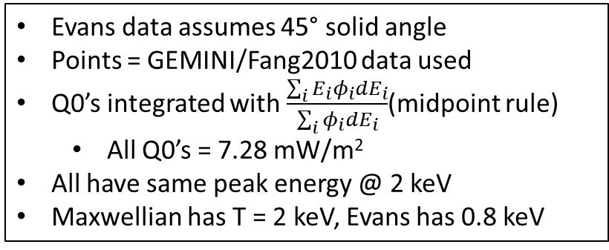
Same peak
Hard, high energy tail
Different temperatures
Evans data assumes 45° solid angle
Points = GEMINI/Fang2010 data used
Q0’s integrated with $\frac{\sum_{i}{E_{i}}φ_{i}dE_{i}}{\sum_{i}{φ_{i}dE_{i}}}$(midpoint rule)
All Q0’s = 7.28 mW/m²
All have same peak energy @ 2 keV
Maxwellian has T = 2 keV, Evans has 0.8 keV

Slide 3
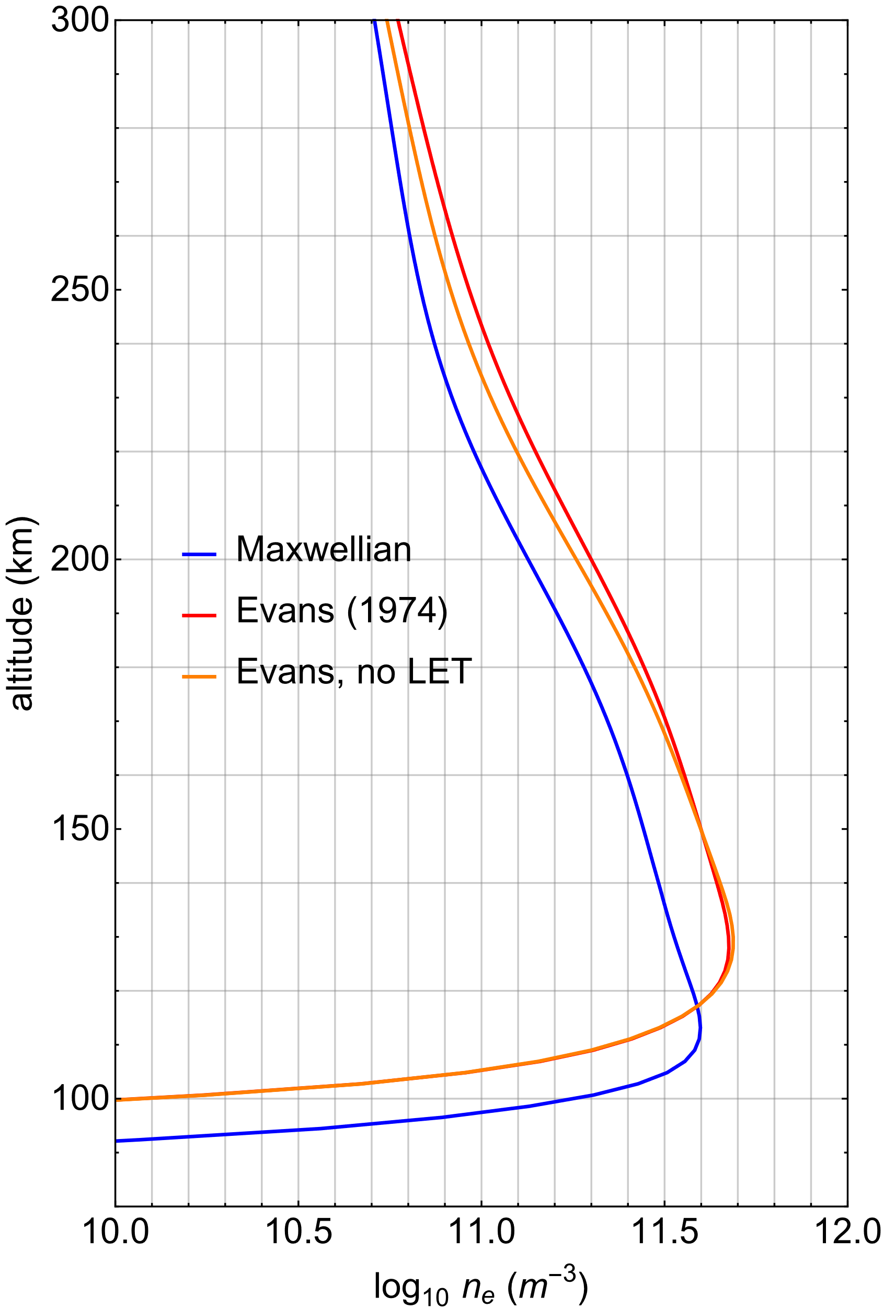
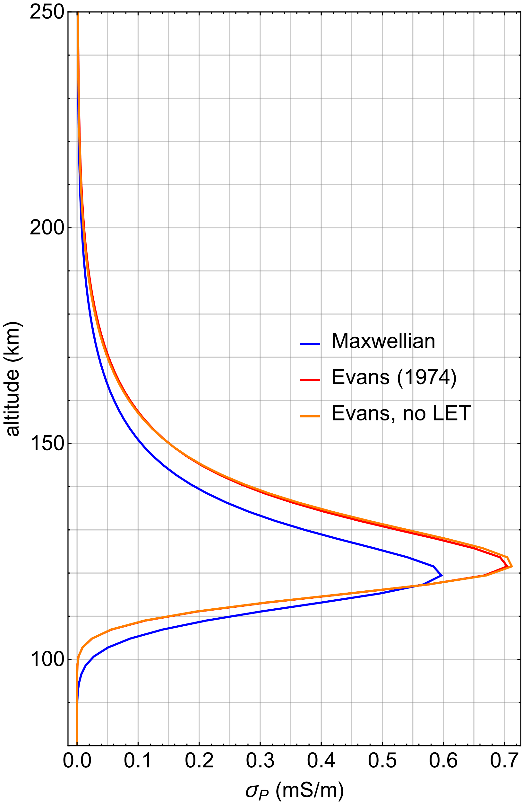
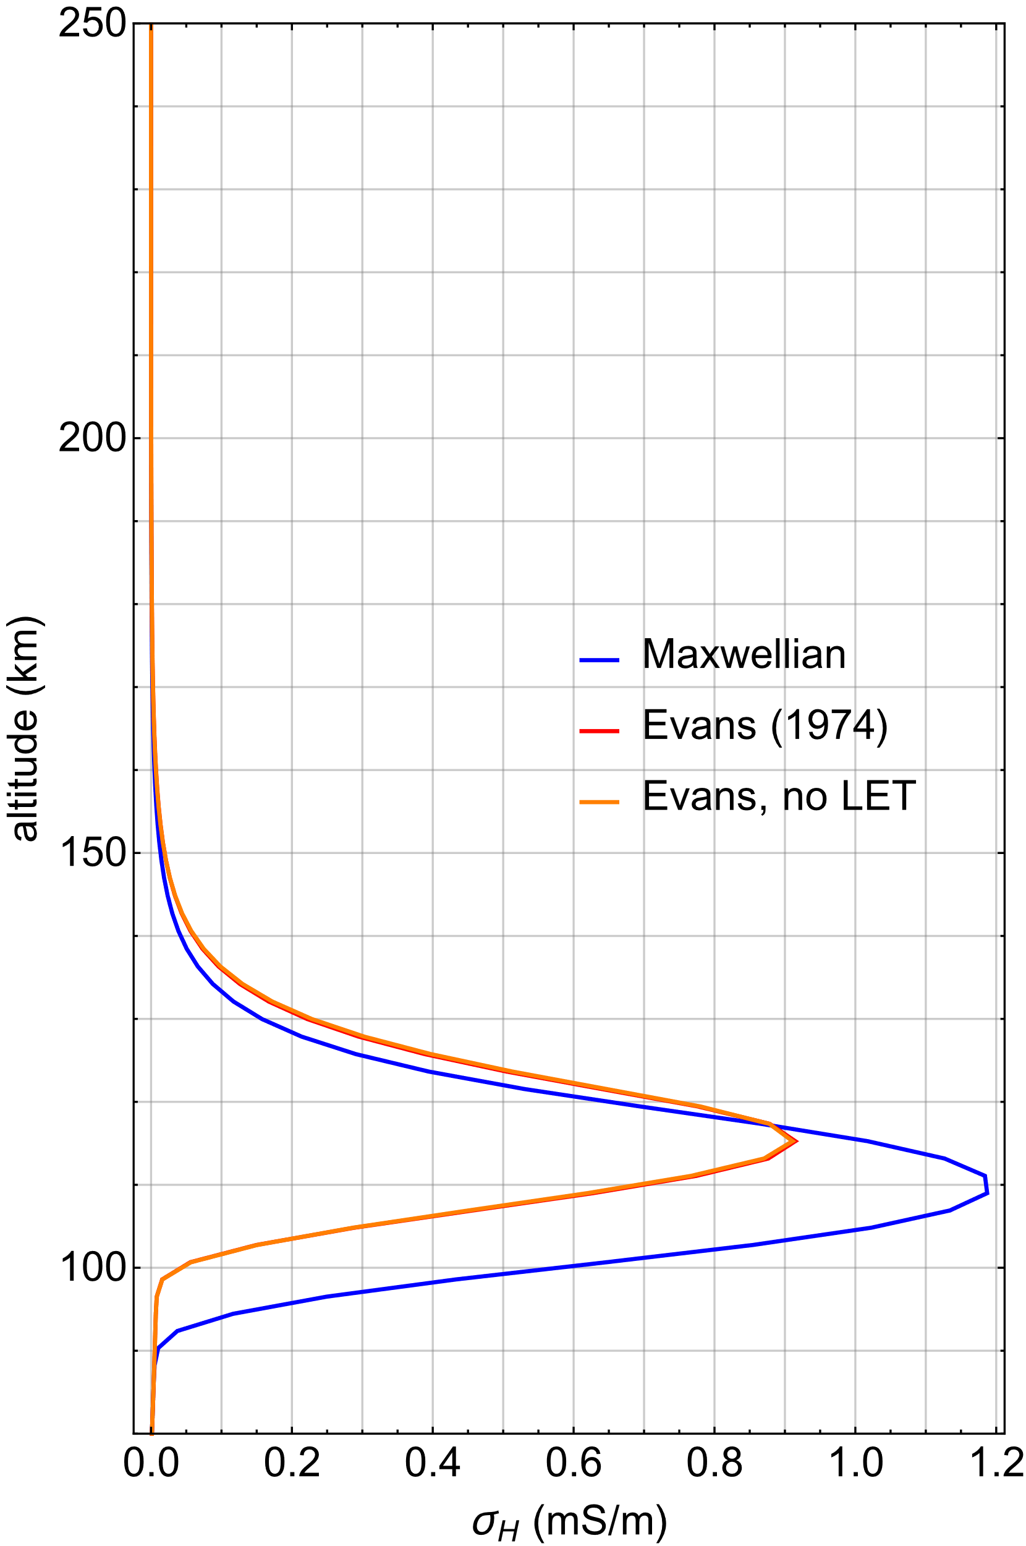
LET difference
HET difference

Slide 4
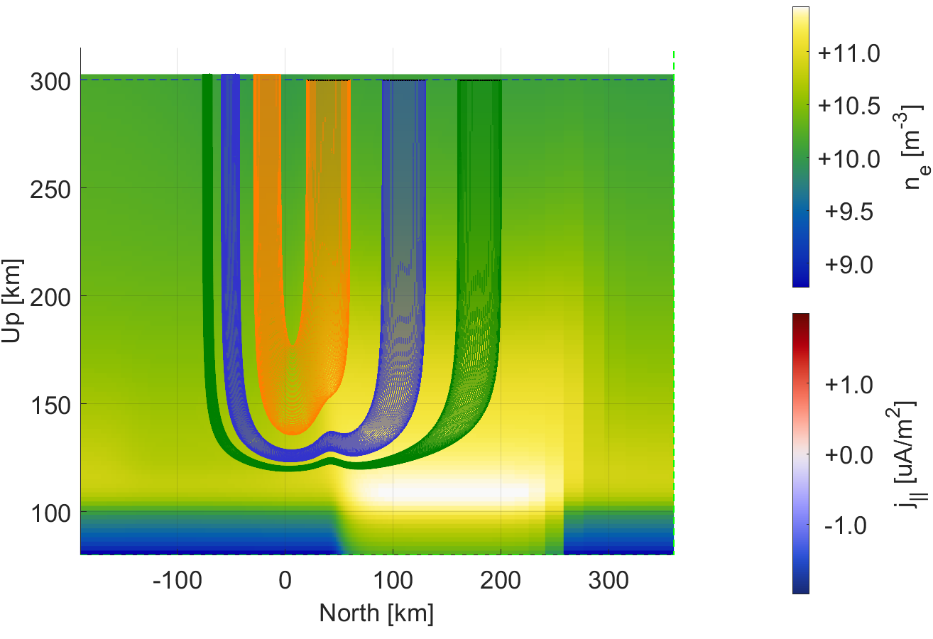
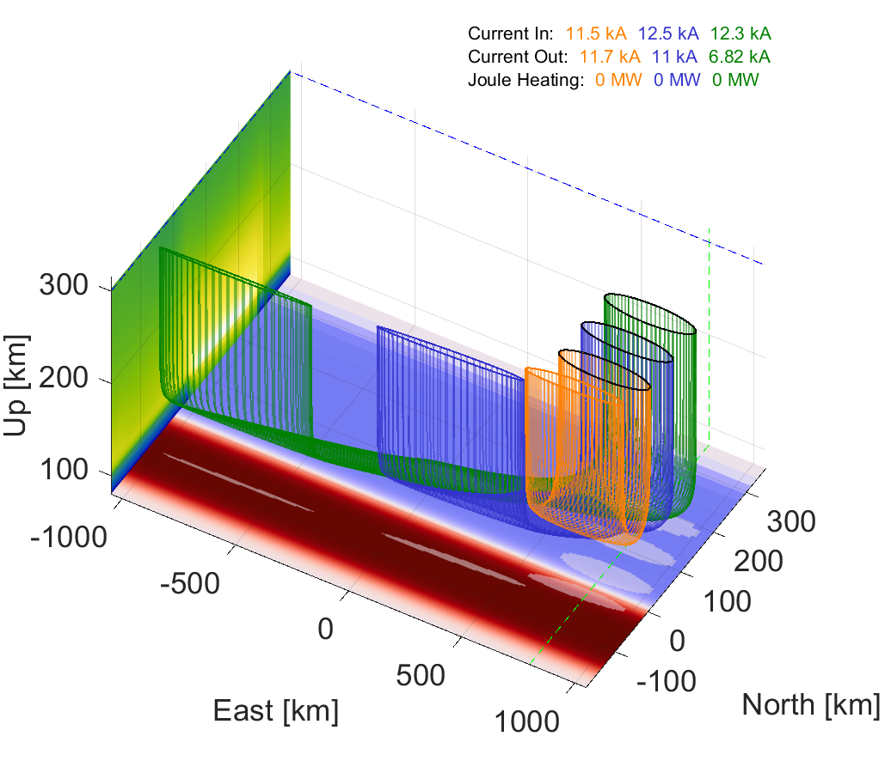
Closure should go up in alt.
Closure should go east
Need to push request code, or pull fork onto andes
Run this run again with max, Evans, and Evans, no tail

