Slide 1
BPMN
An Introduction
ISIS

Slide 2
Definition of BPMN
Business Process Modeling Notation provides:
  The capability of defining and understanding their internal and external business procedures through a Business Process Diagram.
  The ability to communicate these procedures in a standard manner.

Slide 3
Core Set of Diagram Elements
Core set of modeling elements enables the easy development of simple Business Process Diagrams
Looks familiar to most Business Analysts (flowchart diagram)

Slide 4
ISIS guideline
Event triggers a process:
  Each process should have at least one event
Sequence flow links:
  Activities in the same swim lane (see later)
Message flow links:
  Activities between teams so swim lanes,
  Asynchronous activities.

Slide 5
Events
An Event is something that “happens” during the course of a business process.
Events affect the flow of the Process and usually have a trigger or a result.
Events can start, interrupt, or end the flow.

Slide 6
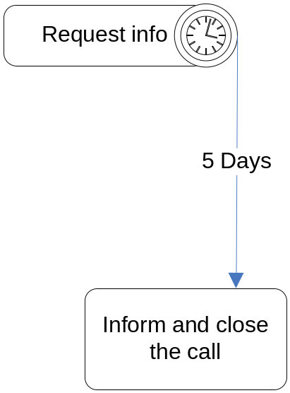
ISIS guideline
Intermediate Events:
  Represents an exception or compensation handling.
  Shown by placing the Intermediate Event on the boundary of a Task or Sub-Process.
  Example: timer expire

Slide 7


ISIS guideline
Intermediate event types indicate the different ways that a Process may be interrupted or delayed after it has started.
Compensation Event
  This is used for compensation handling--both setting and performing compensation. It call for compensation if the Event is part of a Normal Flow. It reacts to a named compensation call when attached to the boundary of an activity.
Rule Event
  This is only used for exception handling. This type of event is triggered when a Rule becomes true. Link Event

Slide 8


ISIS guideline
Link
  A Link is a mechanism for connecting an End Event (Result) of one Process to an Intermediate Event (Trigger) in another Process. Paired Intermediate Events can also be used as “Go To” objects within a Process.
Multiple Event
  This means that there are multiple ways of triggering the Event. Only one of them will be required.

Slide 9
Activities
An activity is work that is performed within a business process.
An activity can be atomic or non-atomic (compound).
The types of activities that are a part of a Process Model are: Process, Sub-Process, and Task.

Slide 10
Sub-Process
Sub-Process can be in an expanded form that shows the process details of the a lower-level set of activities.

Slide 11
Connections
A Sequence Flow is used to show the order that activities will be performed in a Process.
A Message Flow is used to show the flow of messages between two entities that are prepared to send and receive them.
An Association is used to associate information and artifacts with flow objects.

Slide 12
Gateways
Gateways are modeling elements that are used to control how Sequence Flows interact as they converge and diverge within a Process.
If the flow does not need to be controlled, then a Gateway is not needed.

Slide 13
Swimlanes
A Pool is a “swimlane” and a graphical container for partitioning a set of activities from other Pools, usually in the context of B2B situations.
A Lane is a sub-partition within a Pool and will extend the entire length of the Pool, either vertically or horizontally.

Slide 14
Artifacts
Data Objects are not flow objects (i.e., connected through Sequence Flow), but they do provide information about how documents, data, and other objects are used and updated within a Process.
Text Annotations are a mechanism for a modeler to provide additional information for the reader of a BPMN diagram.
Groups provide a mechanism to visually organize activities

Slide 15
Normal Flow

Slide 16
B2B Modeling
Enhancements are being considered for BPMN 1.x

Slide 17
Exception Handling
Intermediate Events attached to the boundary of an activity represent triggers that can interrupt the activity.
All work within the activity will be stopped and flow will proceed from the Event.
Timer, Exceptions, Messages, etc. can be Triggers.

Slide 18
Compensation Handling and Transactions
Transaction is an activity that has a double border. Transactions are supported by a transaction protocol (e.g., WS-Transaction).
Normal Outgoing Sequence Flow represents the path to follow a successful completion.
Cancel Intermediate Event represents the path to follow a cancelled completion.
Exception Intermediate Event represents the path to follow a transaction hazard.
Activities used for compensate (with marker) are outside normal flow and are Associated normal activities.

Slide 19
A Complex Process

Slide 20
References
BPMI
  www.bmpi.org
BPMN specification http://www.omg.org/docs/dtc/06-02-01.pdf
BPMN stencil for Visio
  See in ISIS: BPMN 0-9-V2003.vss
Enterprise Architect
  Business Process Modeling

