Slide 1
Image Caption Generation
Machine Learning and Neural Networks
Julen Etxaniz and Oihane Cantero
17-12-2020

Slide 2
Contents
Introduction
Approach
Get Dataset
Prepare Photo Data
Prepare Text Data
Load Data
Encode Text Data
Define Model
Fit Model
Evaluate Model
Generate Captions
Conclusions

Slide 3
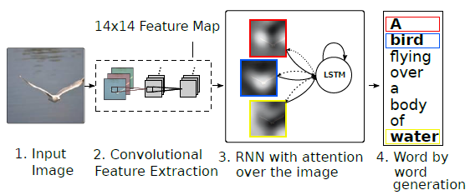
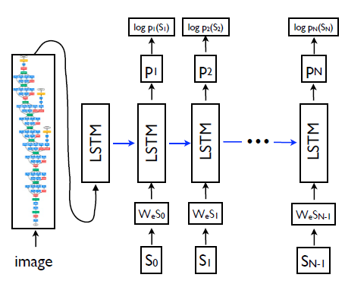
1. Introduction
2 objectives:
Implement a caption generation model using a CNN to condition a LSTM language model
Add attention mechanism to the model

Slide 4
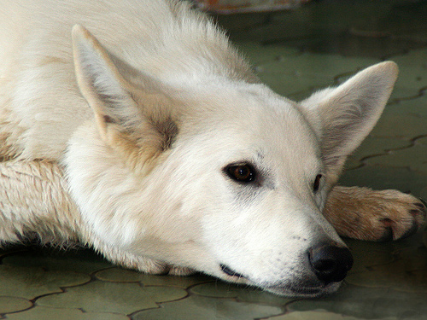
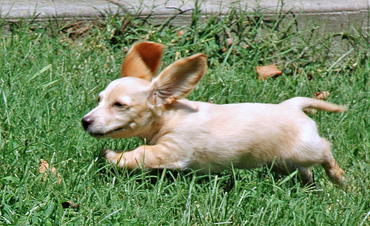
2.1. Get Dataset
Caption1: closeup of white dog that is laying its head on its paws
Caption 2: large white dog lying on the floor
Caption 3: white dog has its head on the ground
Caption 4: white dog is resting its head on tiled floor with its eyes open
Caption 5: white dog rests its head on the patio bricks
Flickr8k Dataset:
8000 images
5 captions for each image
Larger datasets:
Flickr30k
MSCOCO
Caption 1: little tan dog with large ears running through the grass
Caption 2: playful dog is running through the grass
Caption 3: small dogs ears stick up as it runs in the grass
Caption 4: the small dog is running across the lawn
Caption 5: this is small beige dog running through grassy field

Slide 5
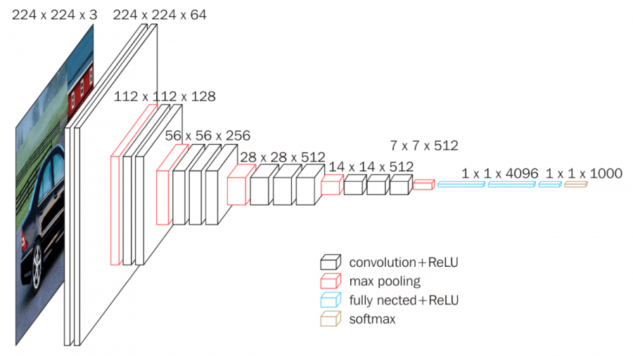
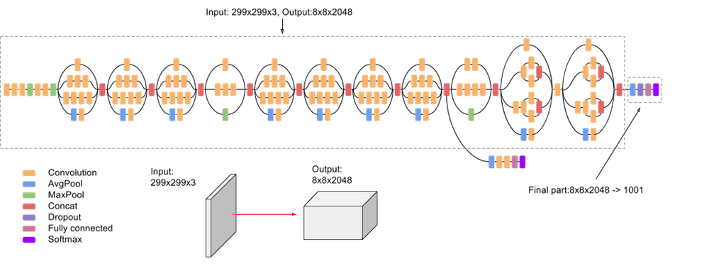
2.2. Prepare Photo Data
CNN models to extract features:
Remove last layers used for predicting
Preprocess image
Calculate and save features
VGG16
134,260,544 parameters
Input: 224 x 224 image
Output: 4096 feature vector
InceptionV3
21,768,352 parameters
Input: 299 x 299 image
Output: 2048 feature vector

Slide 6
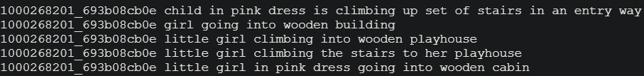
2.3. Prepare Text Data
Load all descriptions
Create a dictionary mapping descriptions to images
Clean descriptions:
Convert all the words to lowercase
Remove all the punctuation
Remove words one character long
Remove words with numbers
Create a vocabulary
8,763 unique words
Save descriptions to a file

Slide 7

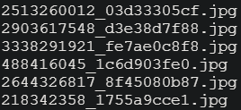

2.4. Load Data
Predefined subsets:
Train 6000
Validation 1000
Test 1000
Captions
Read from saved files
Add startseq and endseq
Image features
Read from saved file

Slide 8
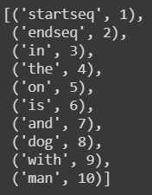

2.5. Encode Text Data
Convert descriptions to lists of words
Use a tokenizer
Map from words of the vocabulary to integers
Calculate vocabulary size
Compute maximum caption length

Slide 9
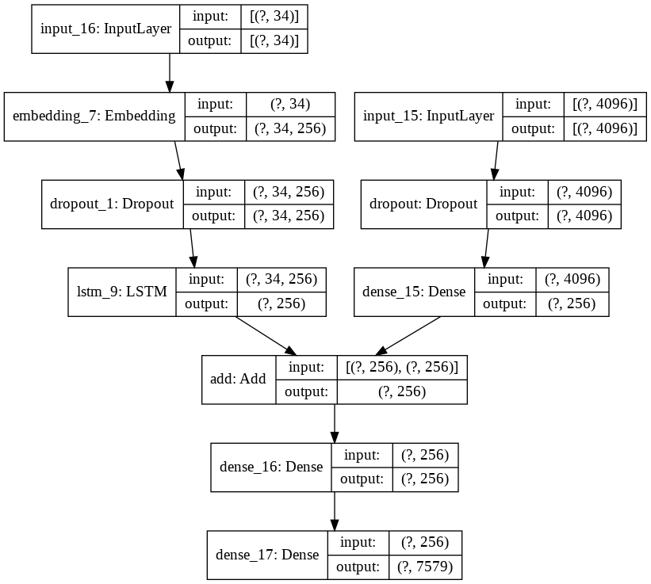
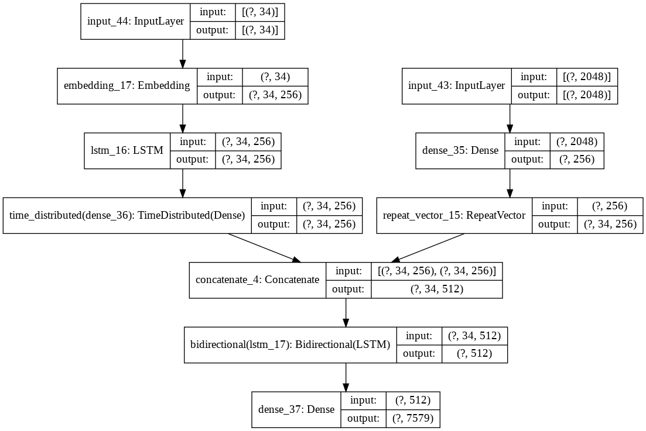
2.6. Define Model
Model 1
Model 2

Slide 10
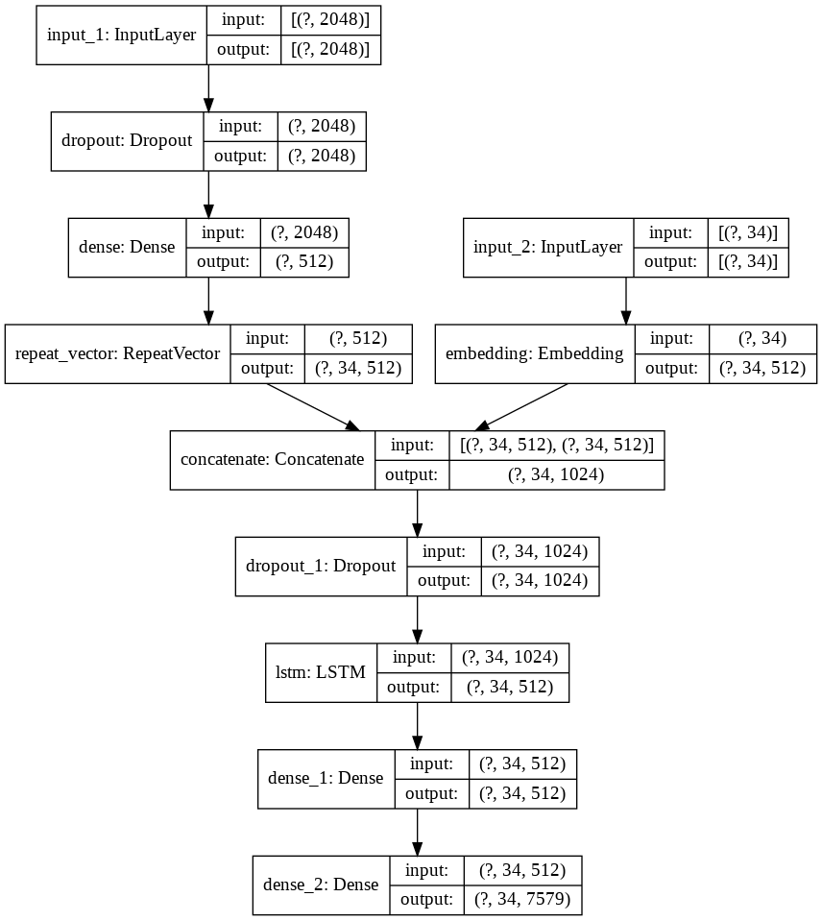
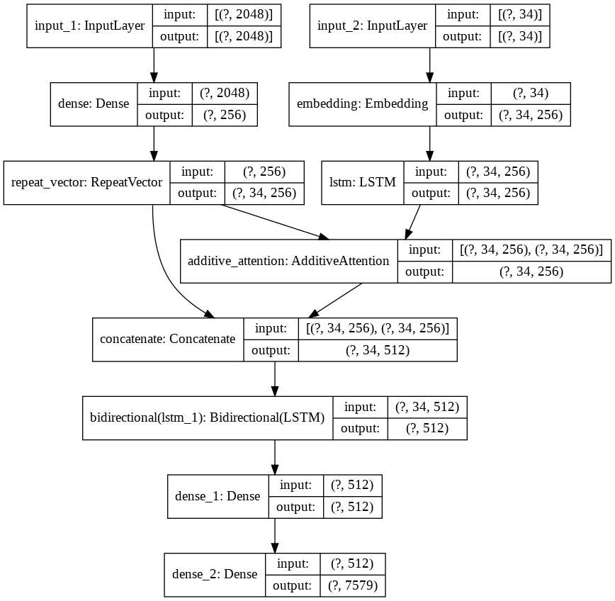
2.6. Define Model
Model 3
Model 2 Attention

Slide 11
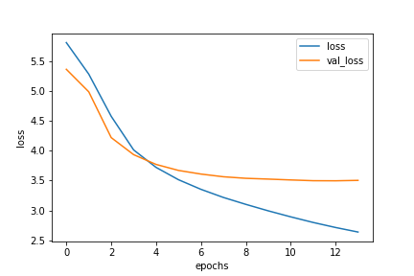
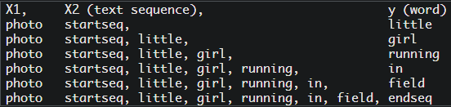
2.7. Fit Model
20 epochs max (early stop)
32 batch size
Save only lowest loss model
Create sequences X1, X2, y
Data generator
Avoid RAM and GPU limits
Shuffle train data
Work with image ids

Slide 12
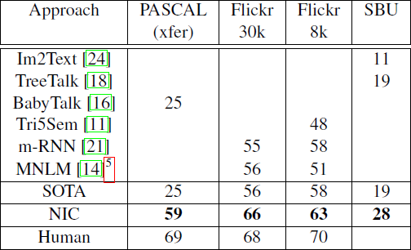
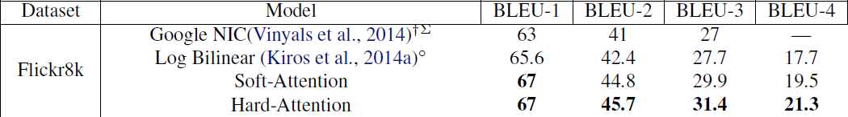
2.8. Evaluate Model
Sampling:
Take the best word at each time step
Beam Search
Considers the k best sentences at each time step
Increases the chance of getting a better description
Sampling BLEU scores:
BLEU-1: 0.595796
BLEU-2: 0.369997
BLEU-3: 0.272431
BLEU-4: 0.144684

Slide 13
2.9. Generate Captions
Original 1: closeup of white dog that is laying its head on its paws
Original 2: large white dog lying on the floor
Original 3: white dog has its head on the ground
Original 4: white dog is resting its head on tiled floor with its eyes open
Original 5: white dog rests its head on the patio bricks
Sampling (BLEU-1: 0.500000): dog is jumping over log in the air
Beam Search k=3 (BLEU-1: 0.600000): the white dog is running through the snow
Beam Search k=5 (BLEU-1: 0.583333): the white dog is in the middle of the snow
Original 1: little tan dog with large ears running through the grass
Original 2: playful dog is running through the grass
Original 3: small dogs ears stick up as it runs in the grass
Original 4: the small dog is running across the lawn
Original 5: this is small beige dog running through grassy field
Sampling (BLEU-1: 0.644123): dog runs on the grass
Beam Search k=3 (BLEU-1: 0.900000): the brown dog is running through the grass
Beam Search k=5 (BLEU-1: 0.900000): the brown dog is running through the grass

Slide 14
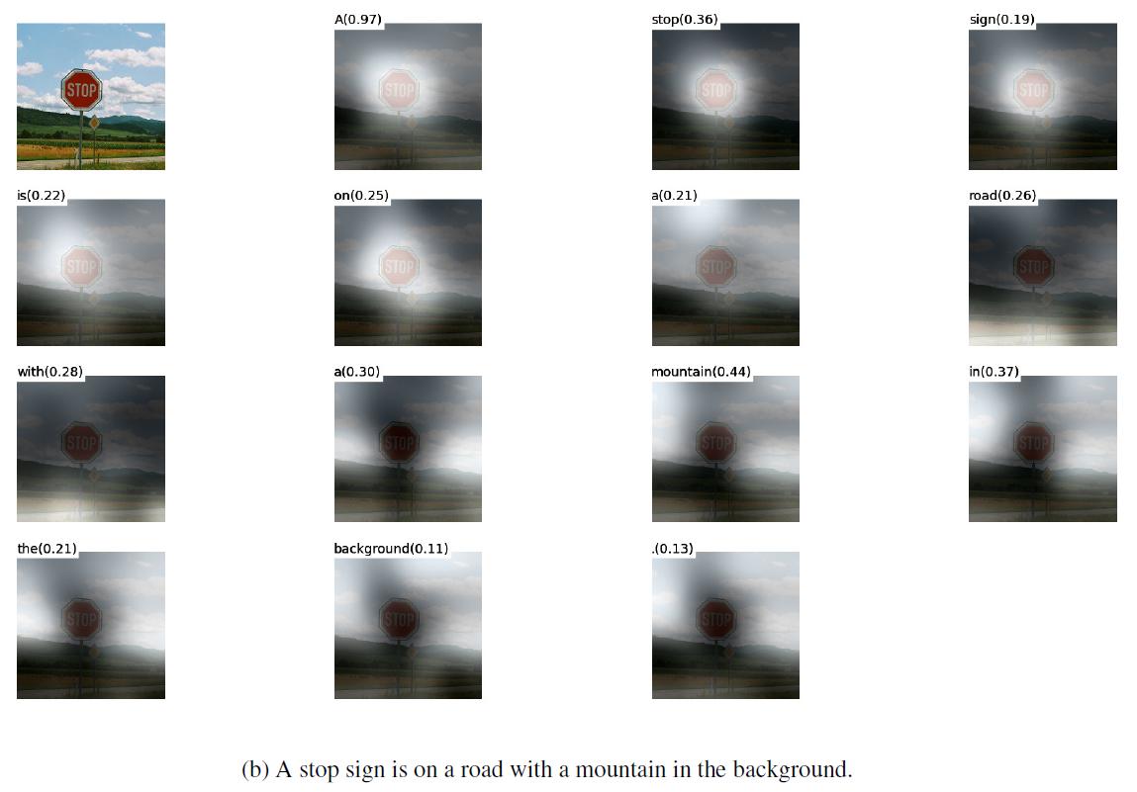
2.9. Generate Captions

Slide 15
3. Conclusions
Caption generation is challenging
We obtained quite good results
Still there are many mistakes
Improvements:
Change model architecture
Remove some words from vocabulary
Increase the size of dataset (Flickr30k)
Implement attention correctly
Evaluate model with beam search

