Slide 1
Casting tasks as Question Answering
http://www.ixa.eus/iltapp/
@ragerri @joseba_fdl @iker_garciaf #iltapp

Slide 2
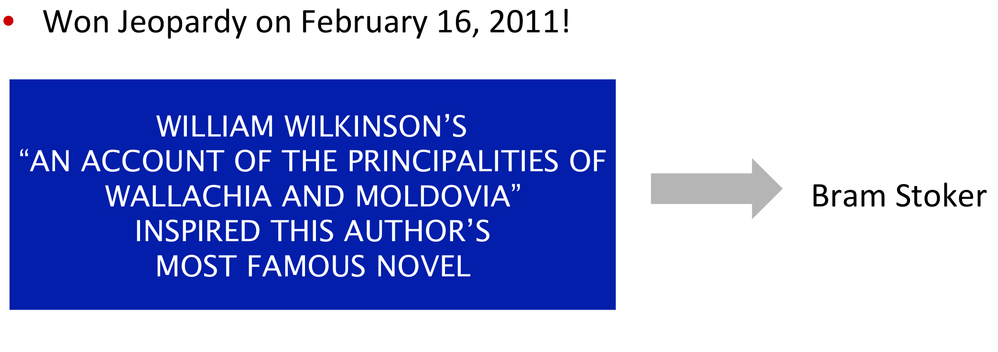
Question Answering: IBM Watson won Jeopardy (2011)

Slide 3
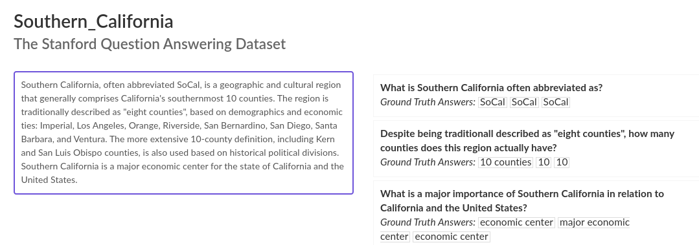
Question Answering (SQUAD 2.0)
https://rajpurkar.github.io/SQuAD-explorer/explore/v2.0/dev/

Slide 4
Semantic Role Labelling
“He would not accept anything of value from those he was writing about.”
[A0 He ] [AM-MOD would ] [AM-NEG not ] [V accept ][A1 anything of value ] from [A2 those he was writing about ] .
V: verb
A0: acceptor
A1: thing accepted
A2: accepted-from
A3: attribute
AM-MOD: modal
AM-NEG: negation

Slide 5
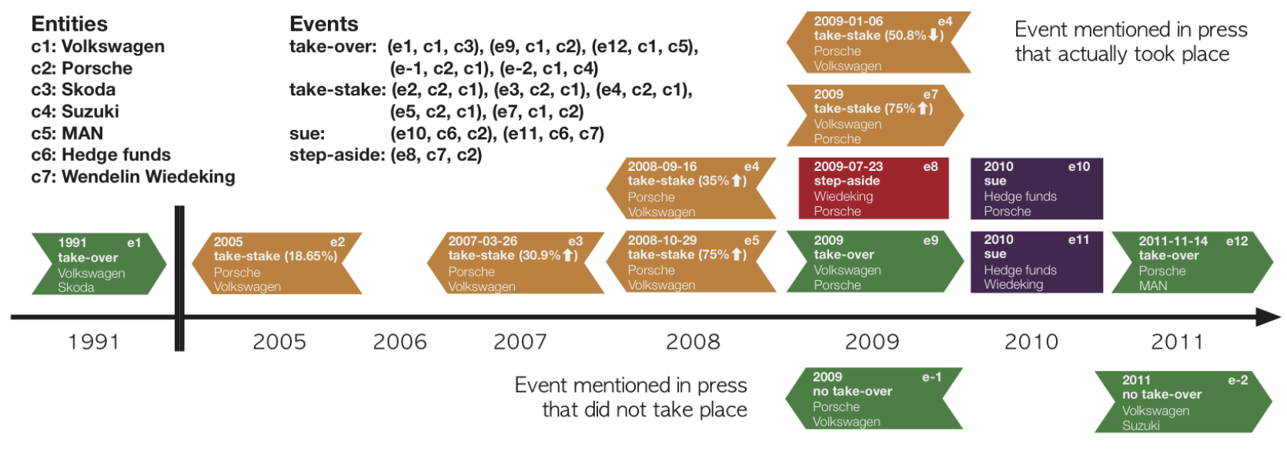
Tasks Overview
http://www.newsreader-project.eu/

Slide 6
Semantic Role Labelling - Early Work
Early work [Hirst 87] [Dolan, Richardson, Vanderwende, 93&98]
Main Corpora (for English):
FrameNet [Fillmore et al. 01]
http://framenet.icsi.berkeley.edu
PropBank [Palmer et al. 05]
https://propbank.github.io/
Other corpora for other languages (mapped to propbank):
Arabic, Basque, Chinese, Finnish, Hindi, Portuguese, Spanish, Turkish...

Slide 7
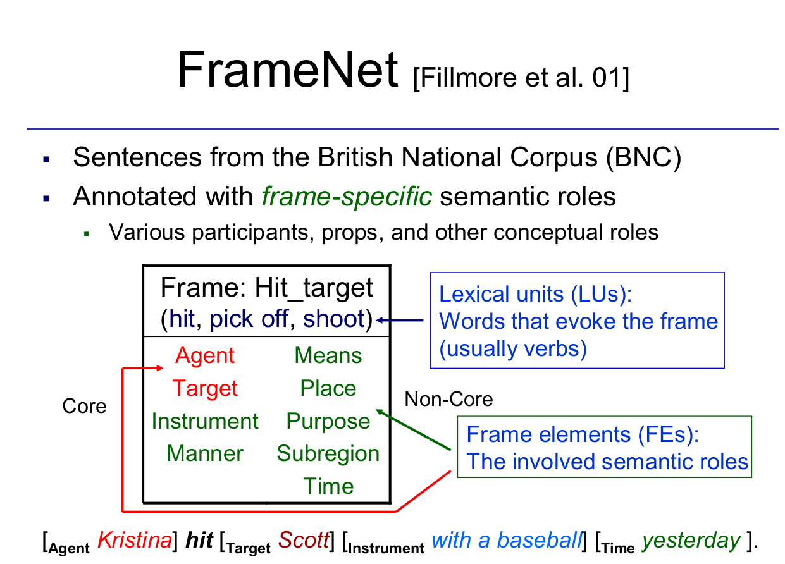

Slide 8
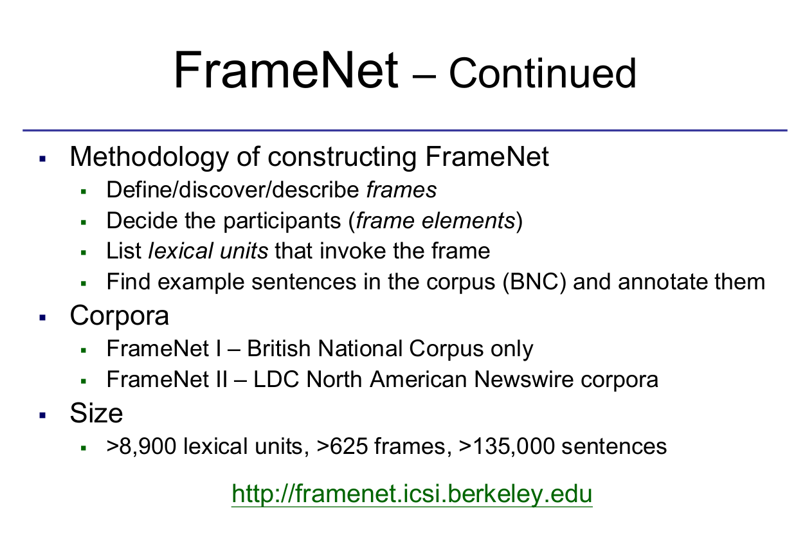

Slide 9
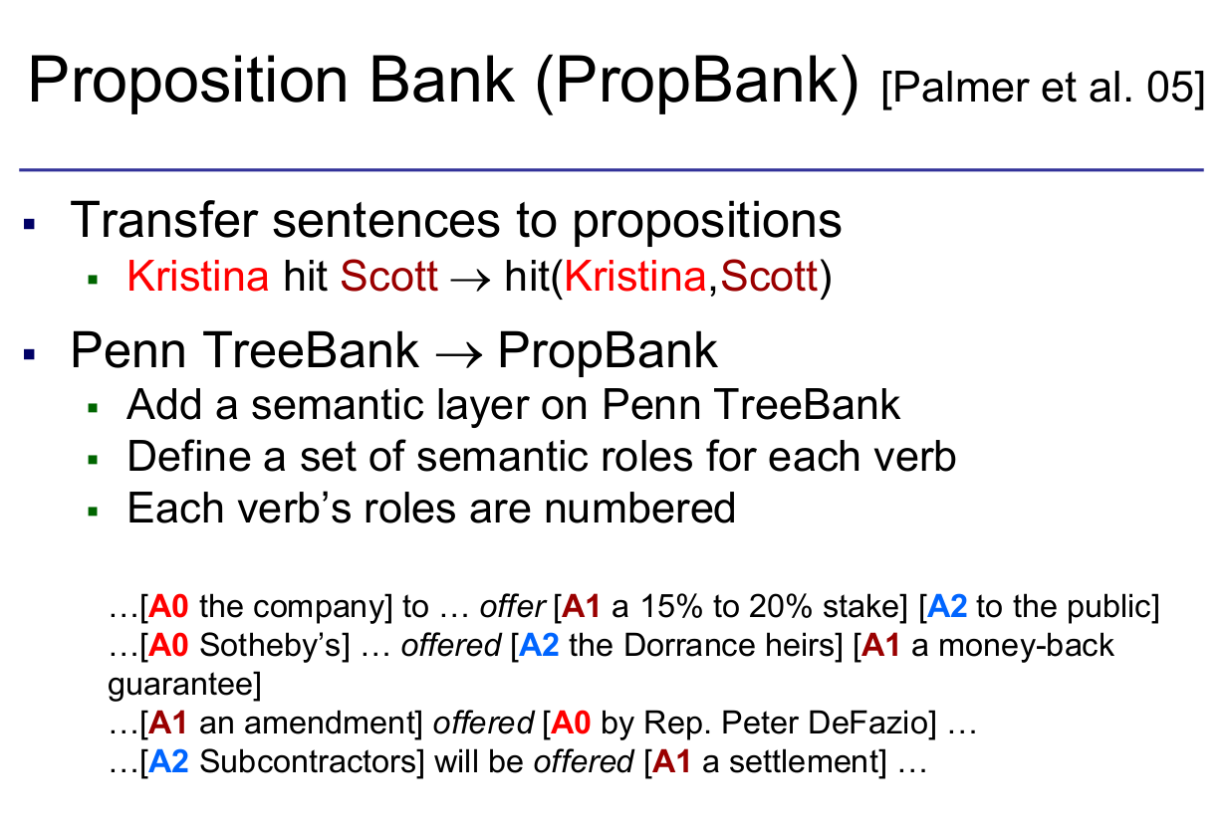

Slide 10
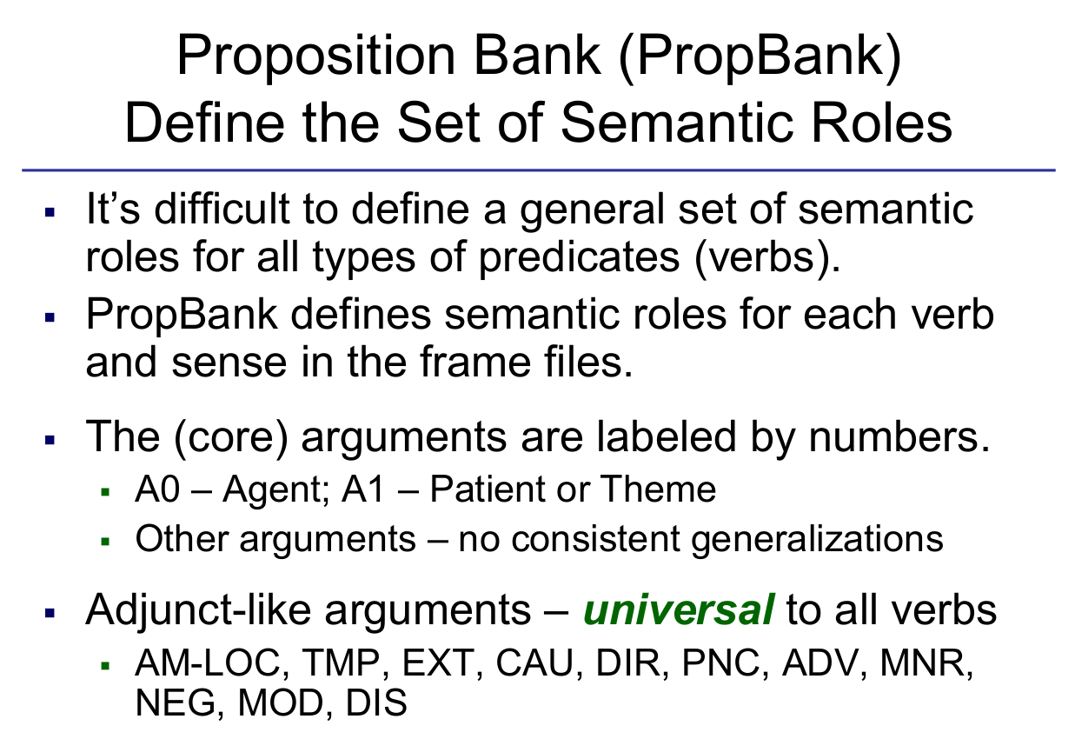

Slide 11
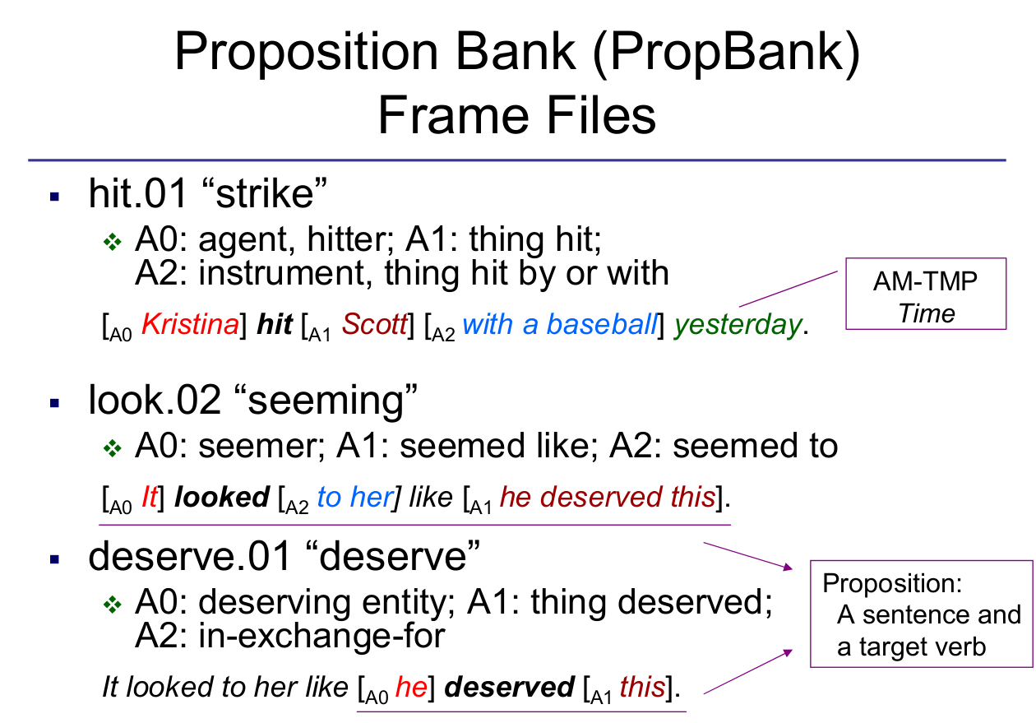

Slide 12
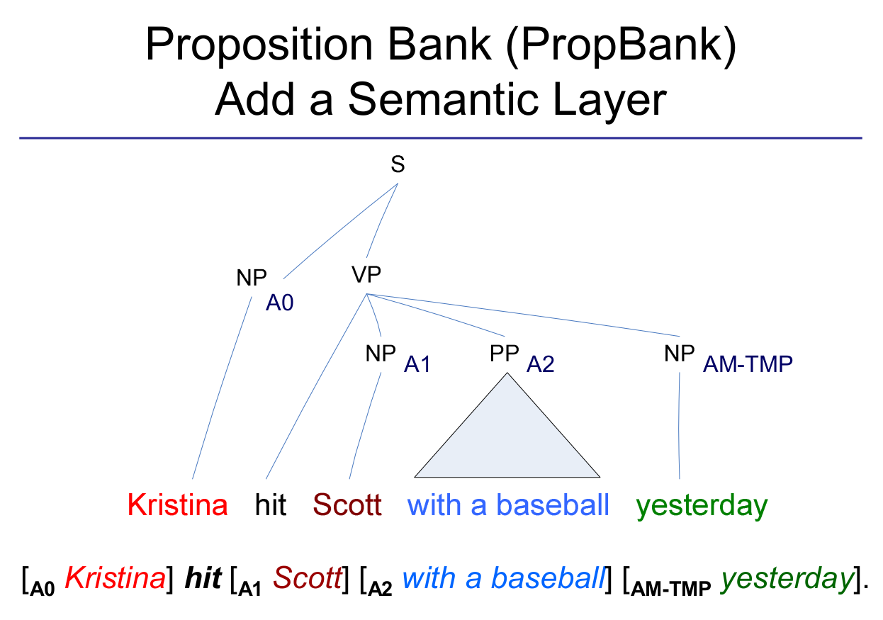

Slide 13
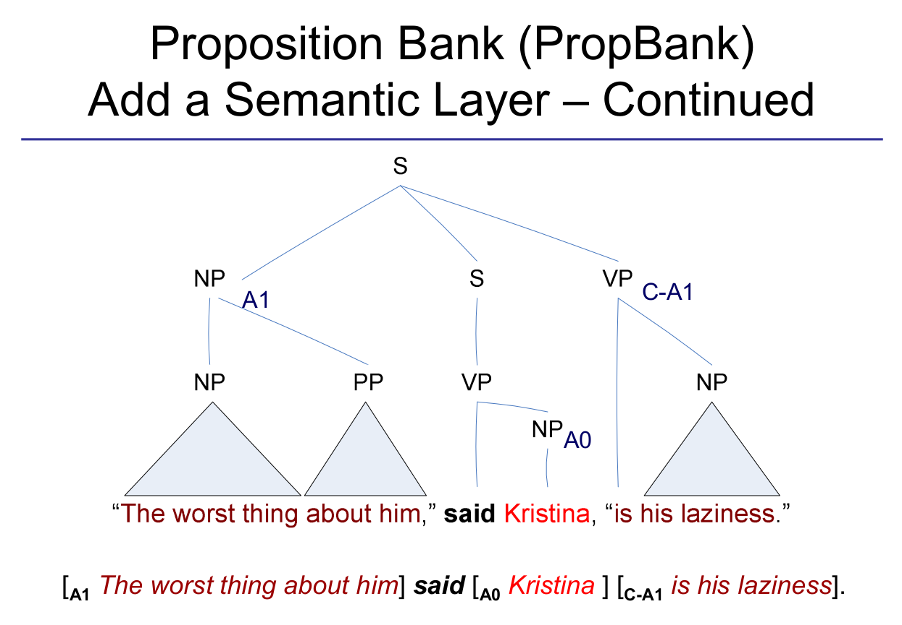

Slide 14
Proposition Bank
Verb Lexicon: 3,324 frame files
Annotation: ~113,000 propositions
Example: http://verbs.colorado.edu/propbank/framesets-english-aliases/kill.html
Alternative formats:
CoNLL-04,05 shared tasks
Tabulated format, including constituent parsing
CoNLL 2008 shared task, tabulated, format, dependencies

Slide 15
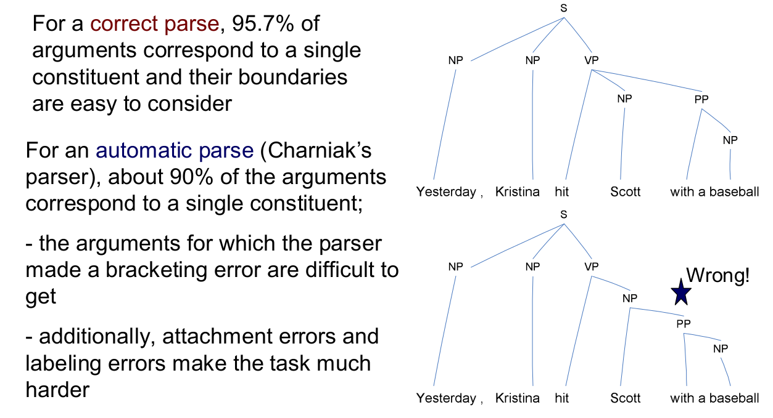
SRL - Annotations

Slide 16
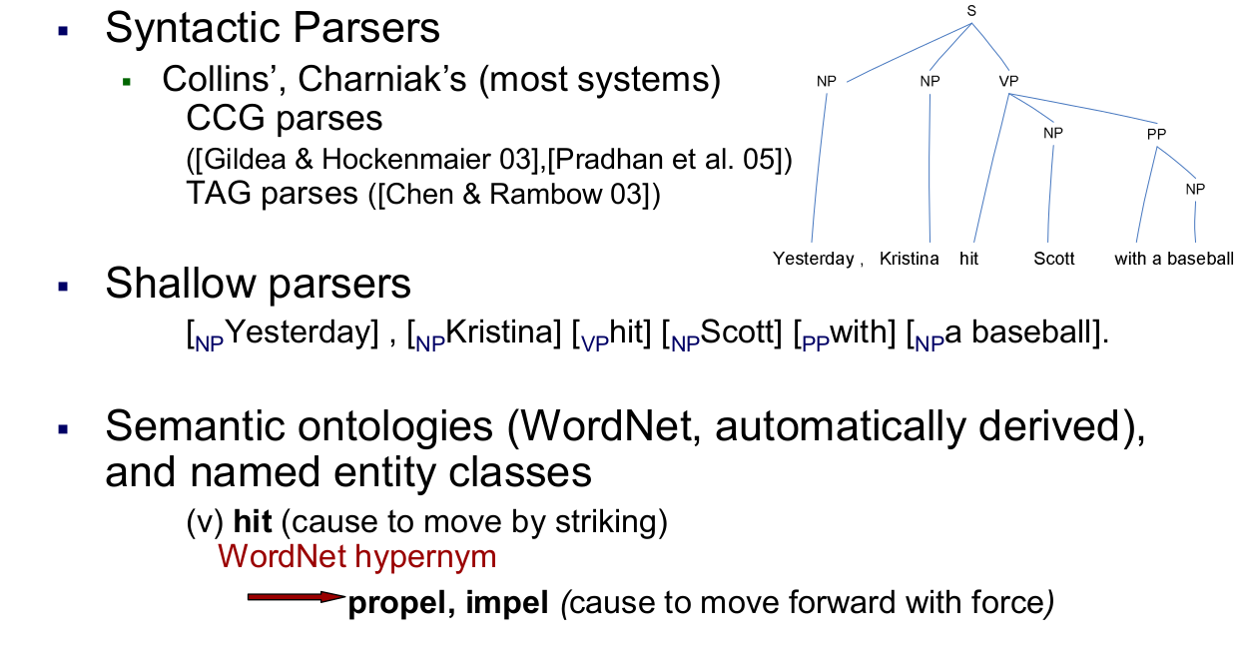
SRL - Annotations

Slide 17
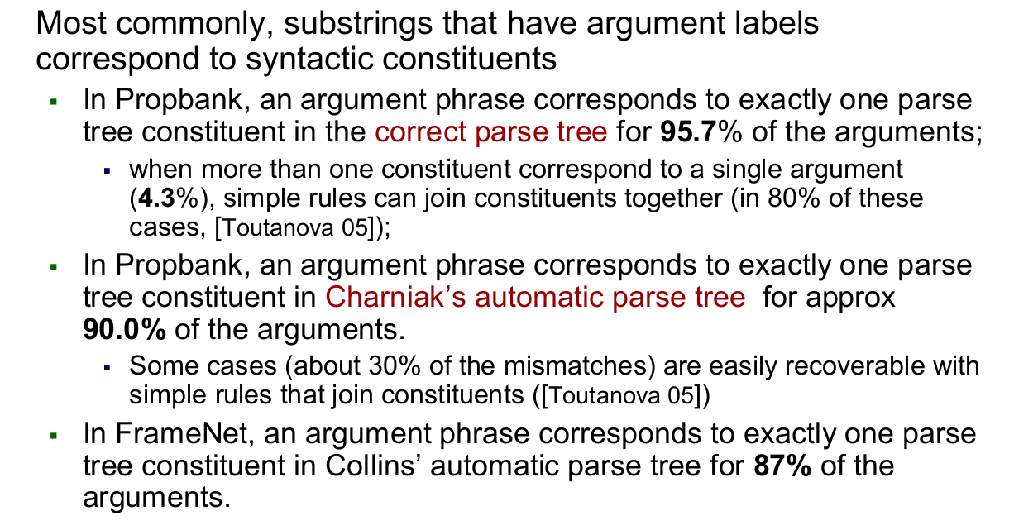
SRL - Annotations

Slide 18
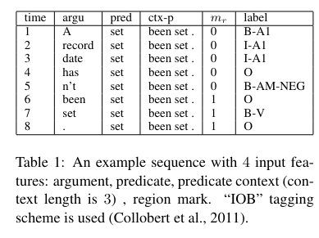
SRL - end-to-end
No intermediate annotations used (parsing, pos tags, ner, wordnet, etc.)
Almost 2 points in F1 score improvement over previous SOTA.
Start of a trend modelling SRL as Sequence Labelling
Zhou and Wu. End-to-end learning of semantic role labeling using recurrent neural networks. In ACL 2015.

Slide 19
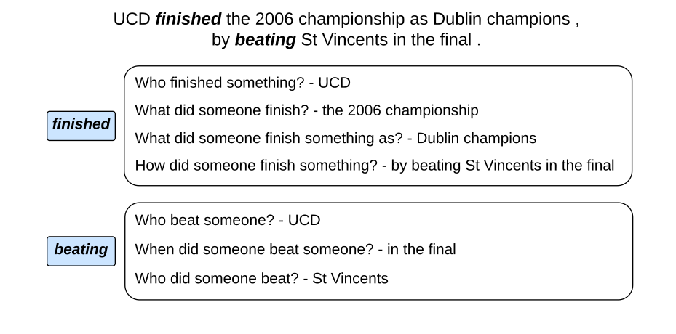
QA SRL - Motivation
The goal is to determine “who does what to whom,” “when,” and “where,” etc.
Previous efforts such as Propbank to define this task can be complex and require significant linguistic expertise to understand, causing challenges for data annotation and use in many target applications.
QA-SRL Pros:
More intuitive
No pre-defined inventory of semantic roles or build on grammar formalisms
QA-SRL data is more easily maintained and improved
https://qasrl.org/

Slide 20
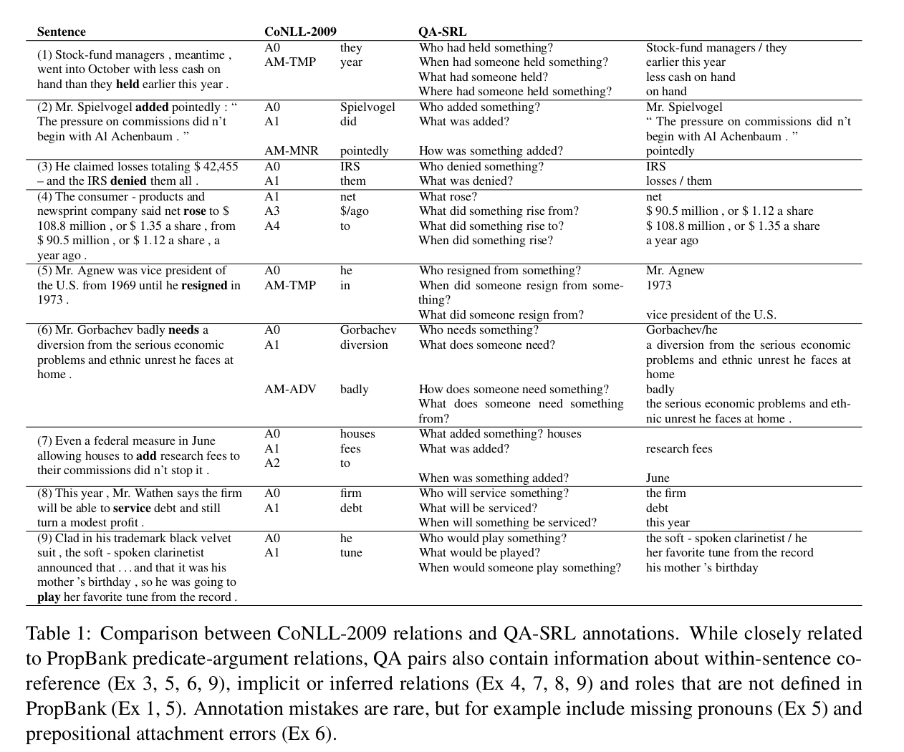

Slide 21
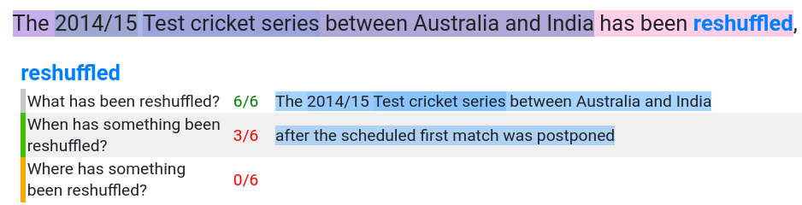
QA SRL
https://browse.qasrl.org/

Slide 22
Question Answering (SQUAD 2.0)
https://rajpurkar.github.io/SQuAD-explorer/explore/v2.0/dev/

Slide 23
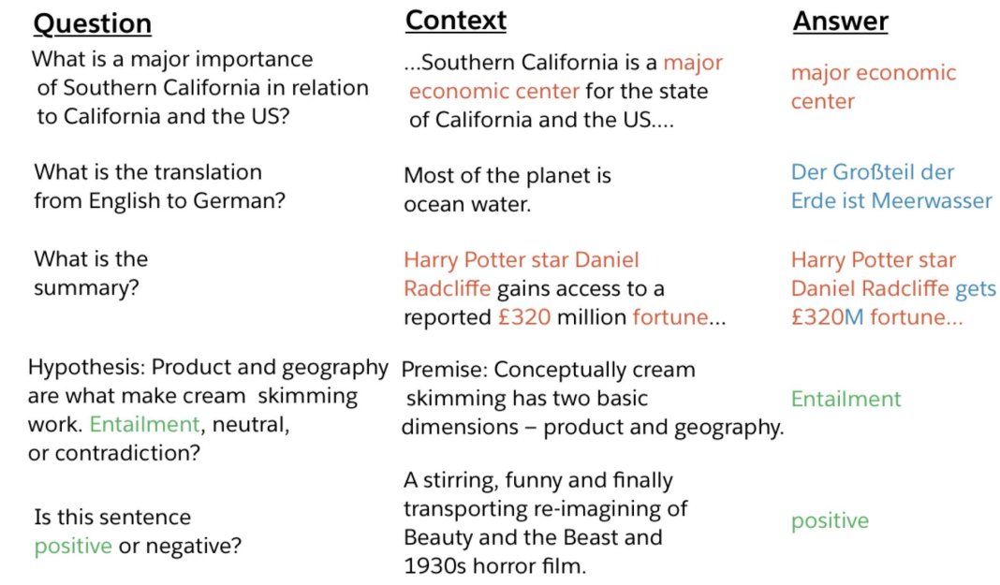
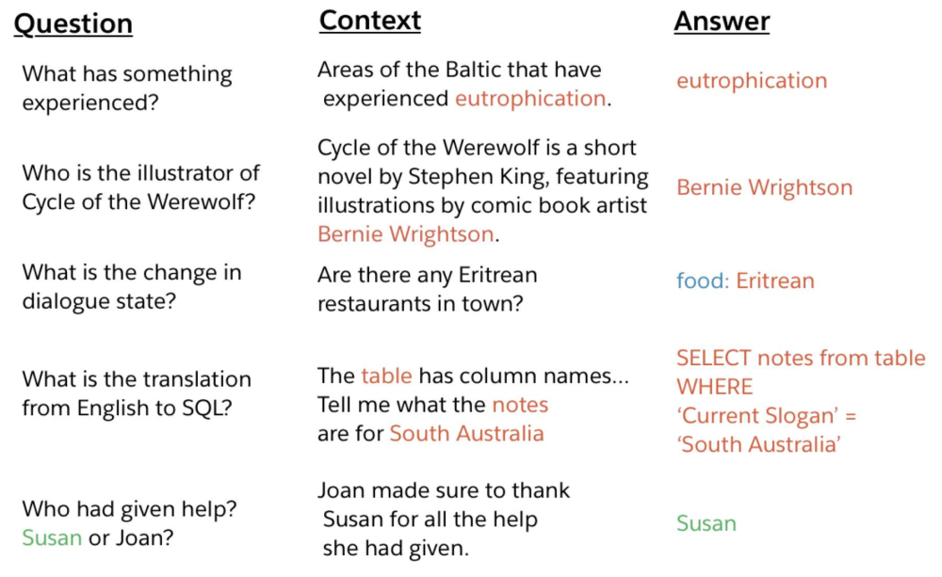
DecaNLP - The Natural Language Decathlon

Slide 24
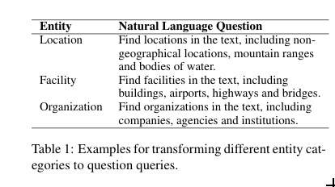
NER as QA

Slide 25
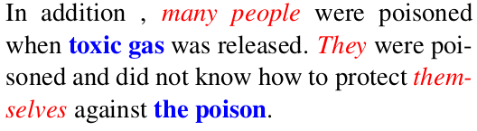
Coreference
(many people, they, themselves)
(toxic gas, the poison)

Slide 26
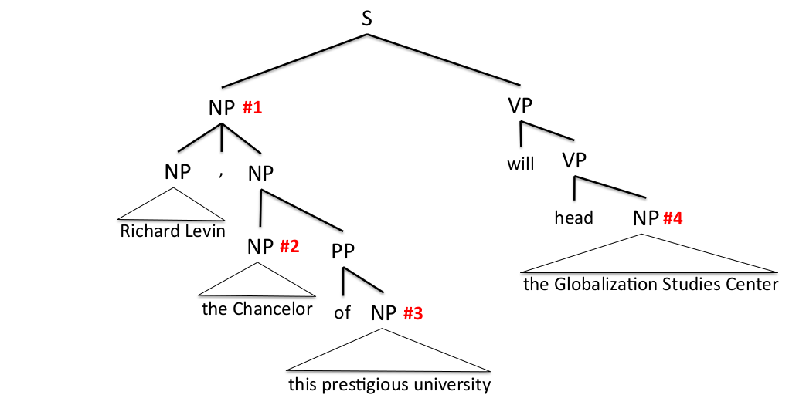
Coreference: previous to end-to-end
parsers for head features and highly engineered mention proposal algorithms.
(Lee et al. 2013, In Computational Linguistics)

Slide 27
End-to-end coreference (Lee et al. 2017)
Pipelined systems suffer from two major drawbacks:
parsing mistakes can introduce cascading errors and
many of the hand-engineered rules do not generalize to new languages
End-to-end coreference: as a set of decisions for every possible span in the document.
Input: a document D containing T words along with metadata such as speaker and genre information.
N = n ∗ (n + 1)/2 denotes the number of all possible text spans in a document D.
The task is to assign to each span i and antecedent y_i.

Slide 28
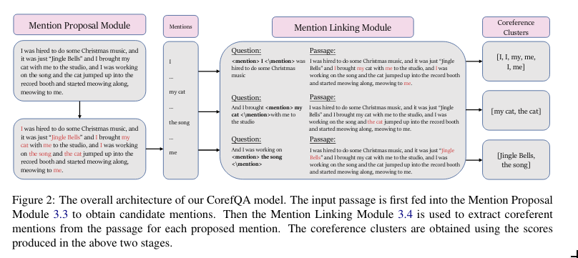
Corefqa architecture

Slide 29
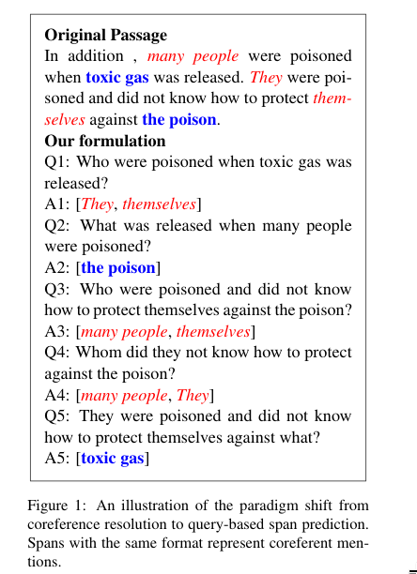
Corefqa mention linking
{context(x), query(q), answers(a)}
Given e_i, we use the sentence that e_i is in as a query, encapsulating e_i within special tokens <mention> </mention>

Slide 30
Mila esker!

