Slide 1
Text Classification
http://www.ixa.eus/iltapp/
@ragerri @joseba_fdl @iker_garciaf #iltapp
(some slides adapted from ANLP, David Bamman)

Slide 2
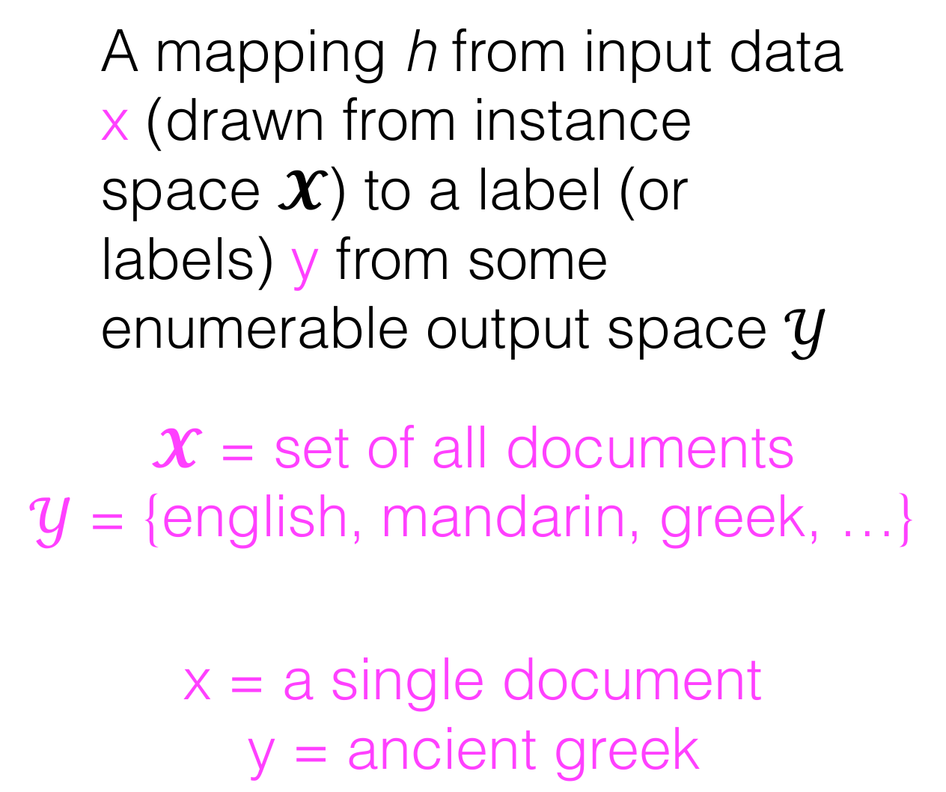
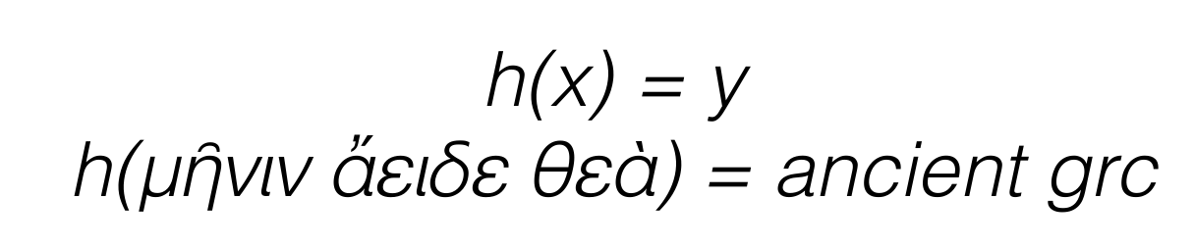
Classification

Slide 3
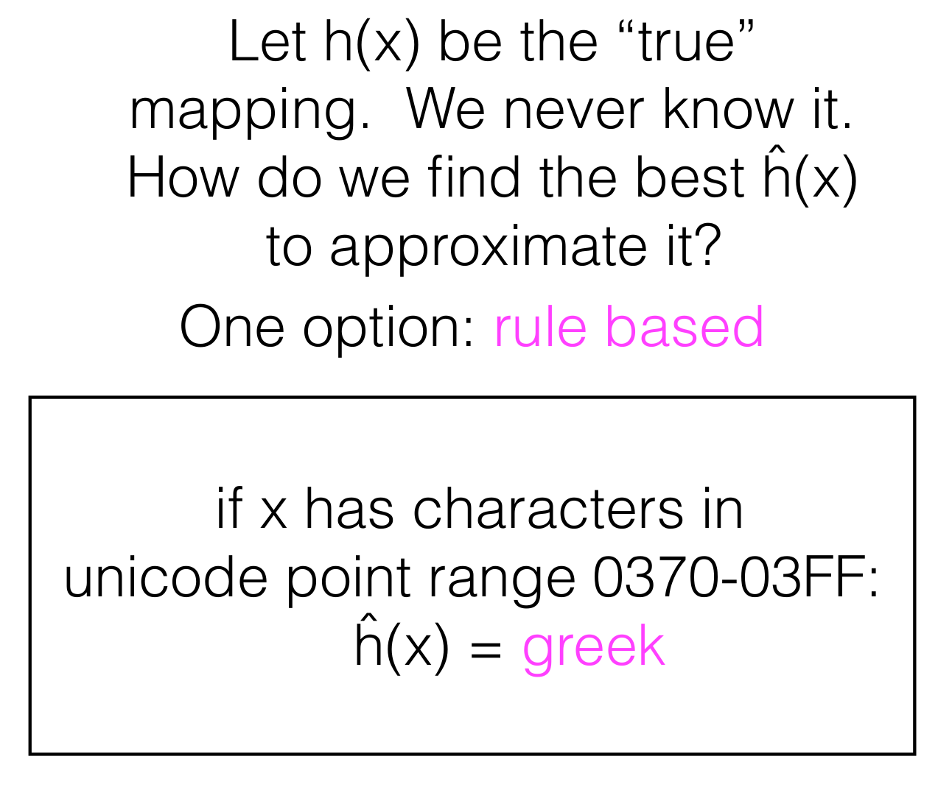
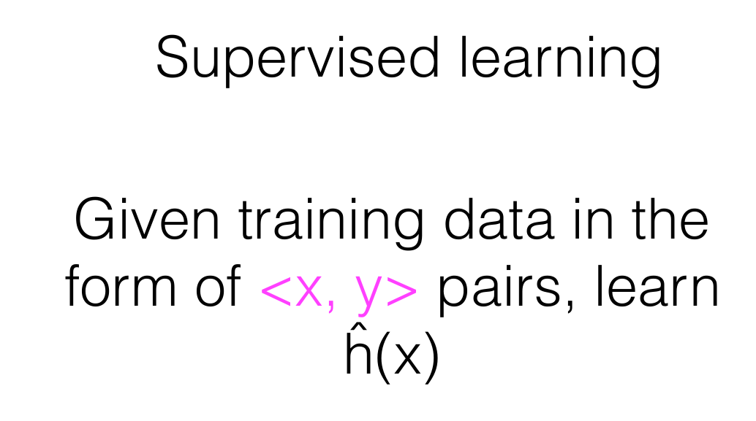
Classification

Slide 4
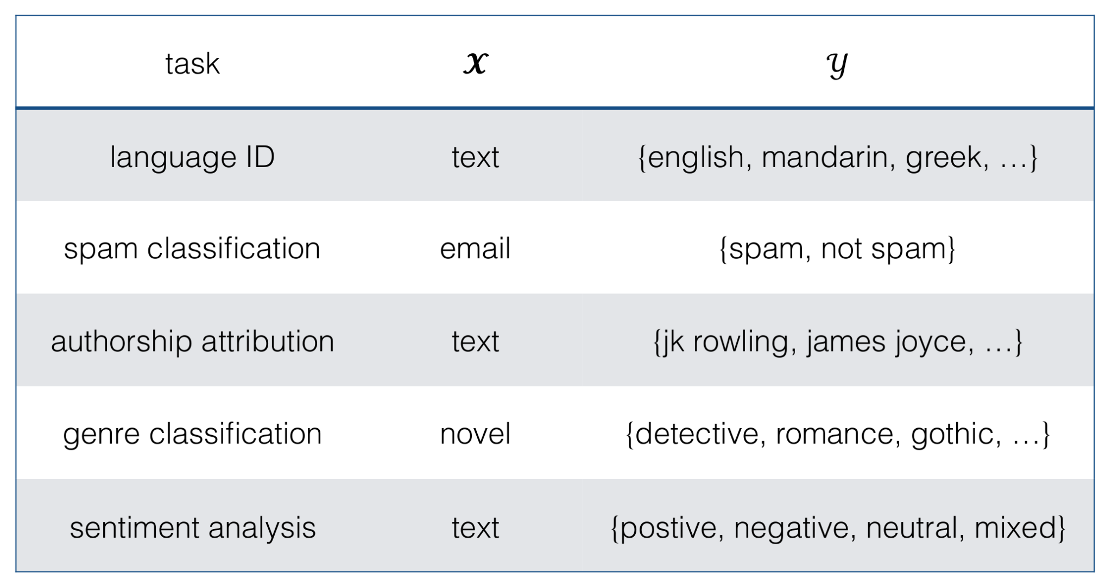
Text Classification - Tasks

Slide 5
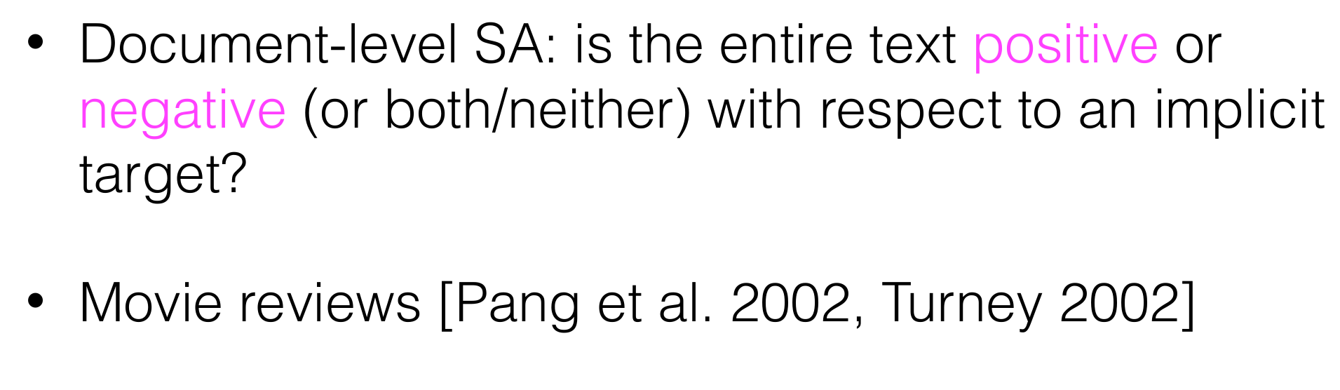
Sentiment Analysis

Slide 6
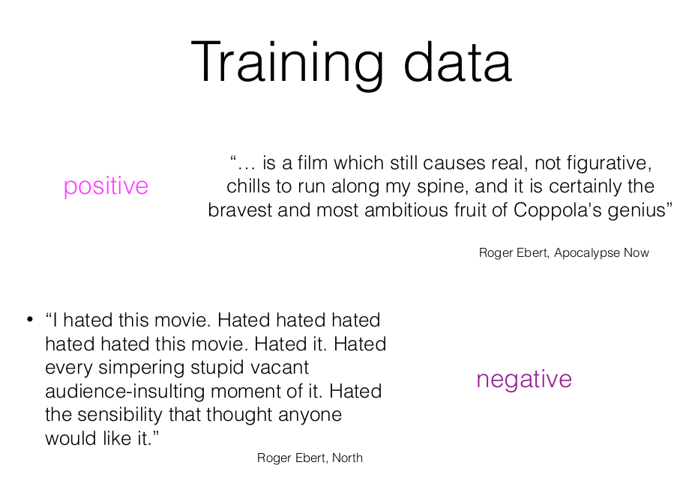
Sentiment Analysis - Supervised approach

Slide 7
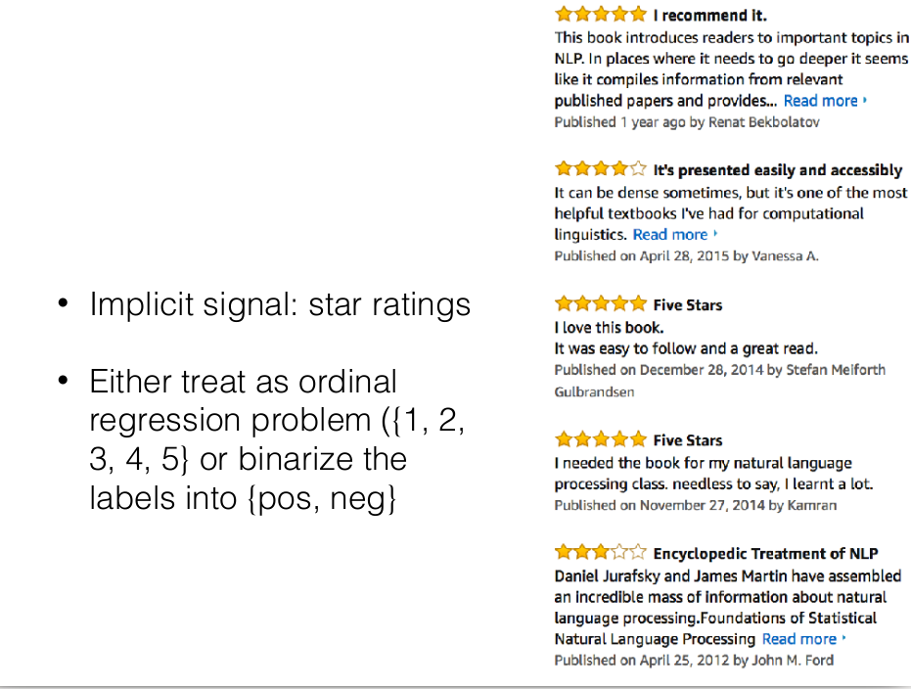
Sentiment Analysis - Supervised approach

Slide 8
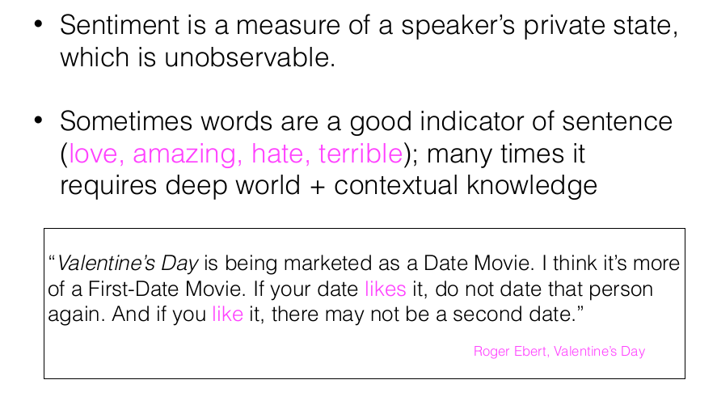
Sentiment Analysis - Supervised approach

Slide 9
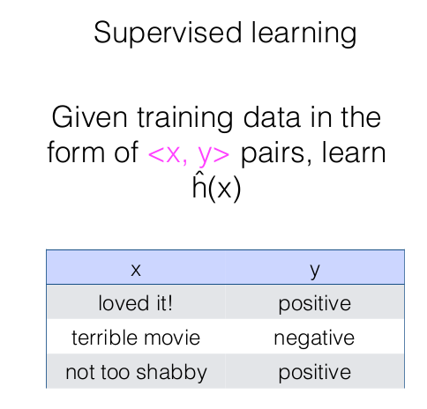
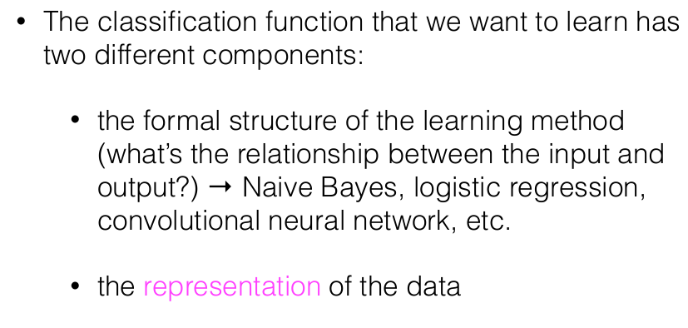
Sentiment Analysis - Supervised approach

Slide 10
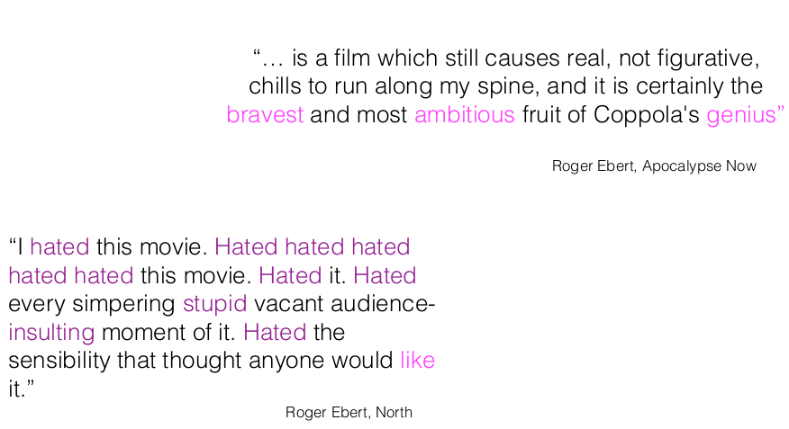
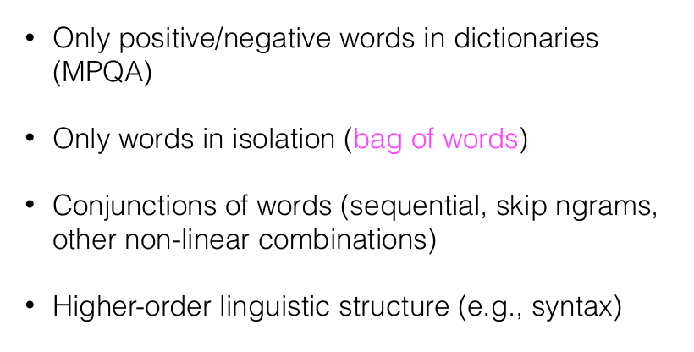
Representation of Words - Supervised approach

Slide 11
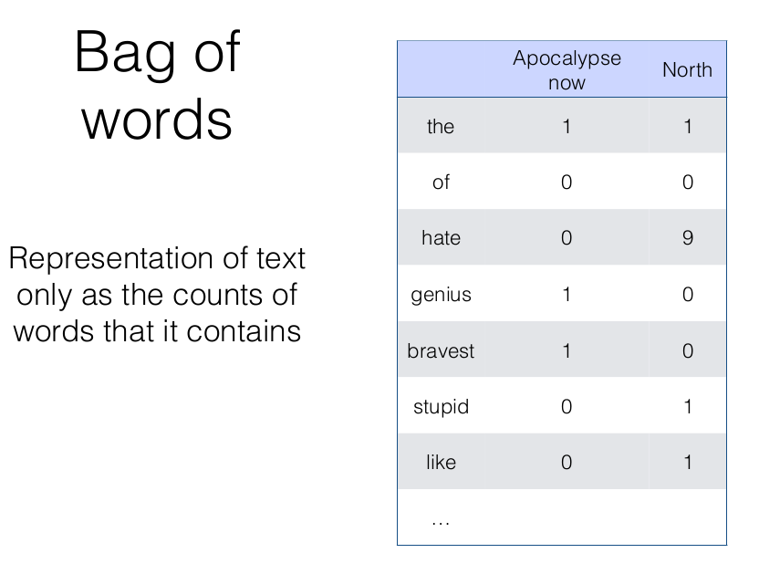
Representation of Words - Supervised approach

Slide 12
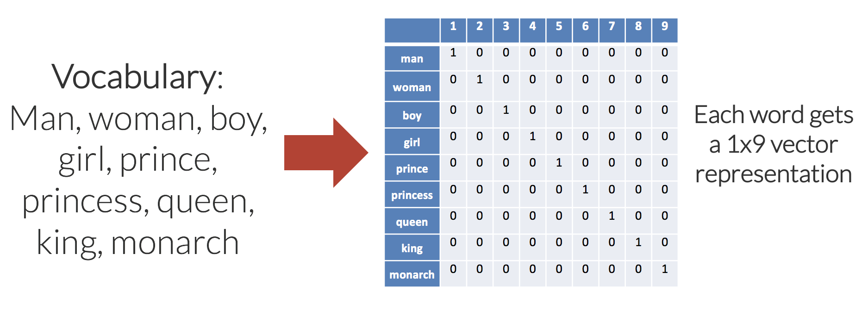
One-hot representation

Slide 13
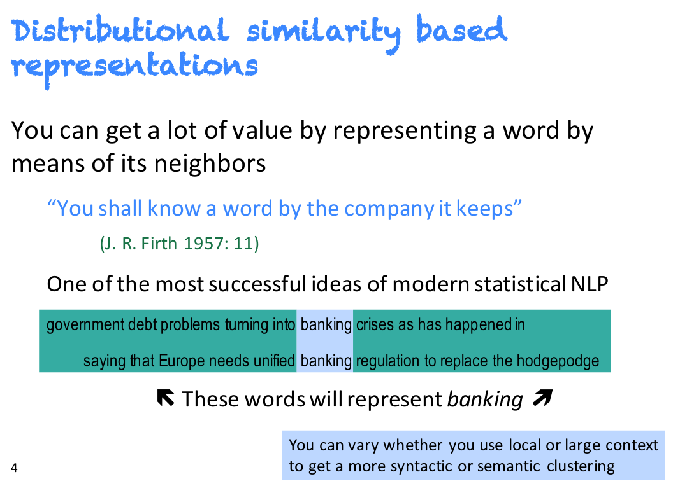
Distributional Semantics
Adapted from Manning CS224n slides

Slide 14
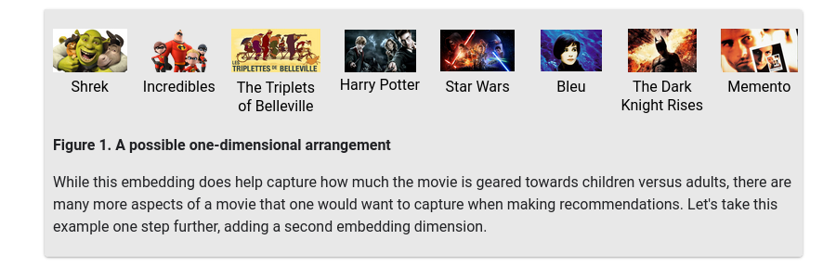
Arranging items along dimensions
https://developers.google.com

Slide 15
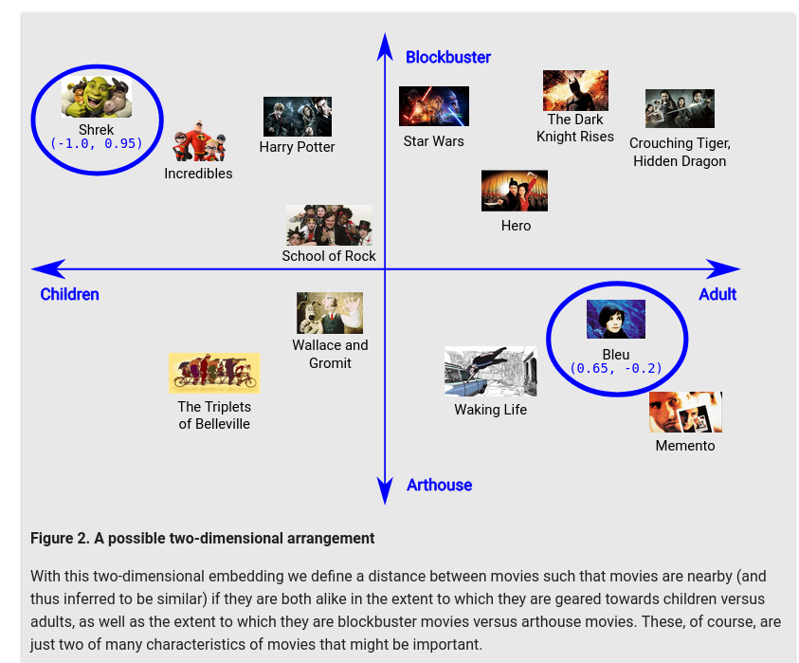
Arranging items along dimensions
These movies are mapped into an embedding space, where each word is described by a two-dimensional set of coordinates.
"Shrek" maps to (-1.0, 0.95) and "Bleu" maps to (0.65, -0.2).
In general, when learning a d-dimensional embedding, each movie is represented by d real-valued numbers, each one giving the coordinate in one dimension.
Latent dimensions: When learning embeddings, the individual dimensions are not learned with names. Sometimes, we can look at the embeddings and assign semantic meanings to the dimensions, and other times we cannot
https://developers.google.com

Slide 16
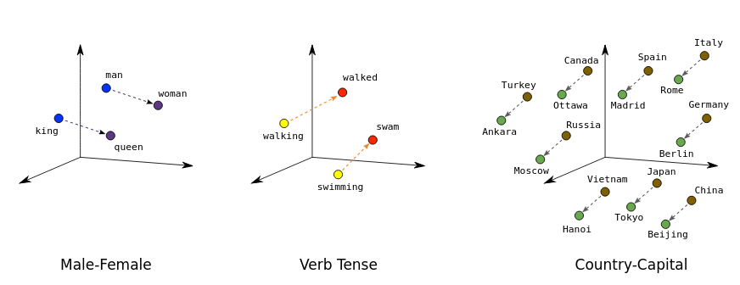
Embedding words in lower dimensional spaces
Lack of meaningful relations between one-hot vectors
The distributional hypothesis states that words which often have the same neighboring words tend to be semantically similar.
Word2Vec exploits contextual information like this by training a neural net to distinguish actually co-occurring groups of words from randomly grouped words.
Position (distance and direction) in the vector space can encode semantics in a good embedding.
https://www.tensorflow.org/tutorials/text/word2vec

Slide 17
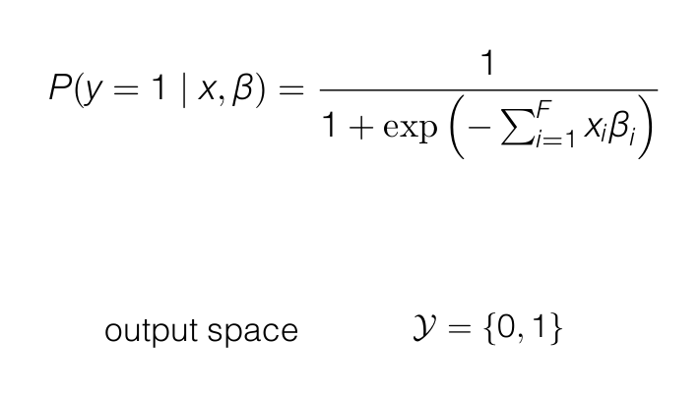
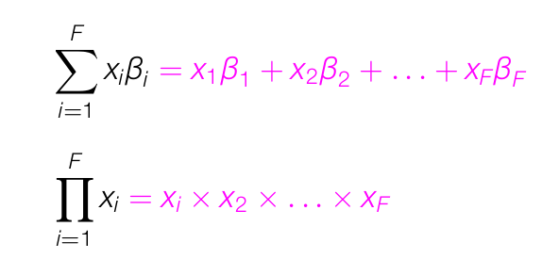
Classification method - Supervised approach
Logistic/sigmoid function to map predictions to the range of 0 and 1

Slide 18
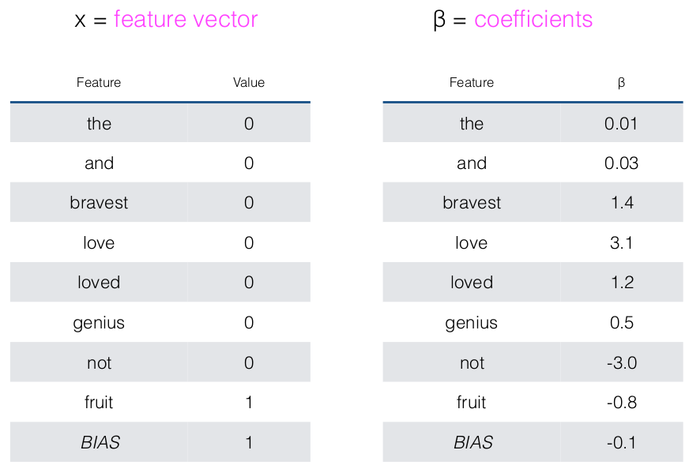
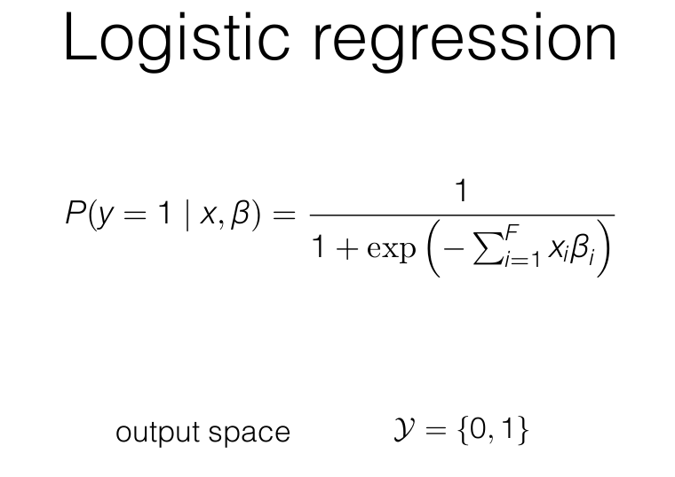
Classification method - Supervised approach

Slide 19
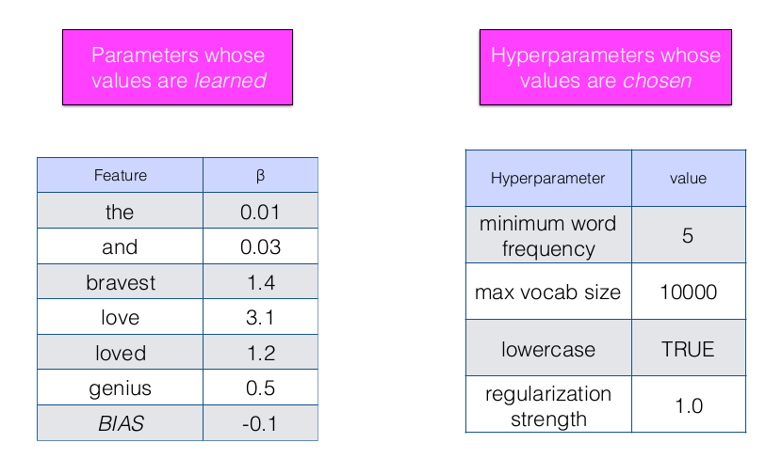
Classification method - Supervised approach

Slide 20
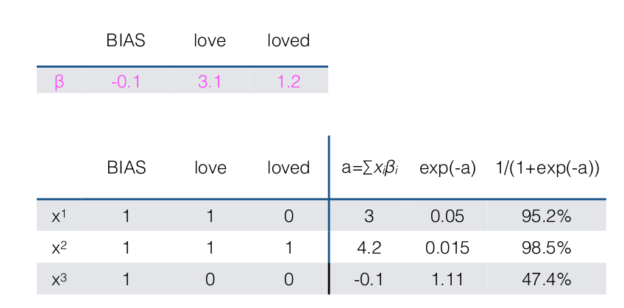
Classification method - Supervised approach

Slide 21
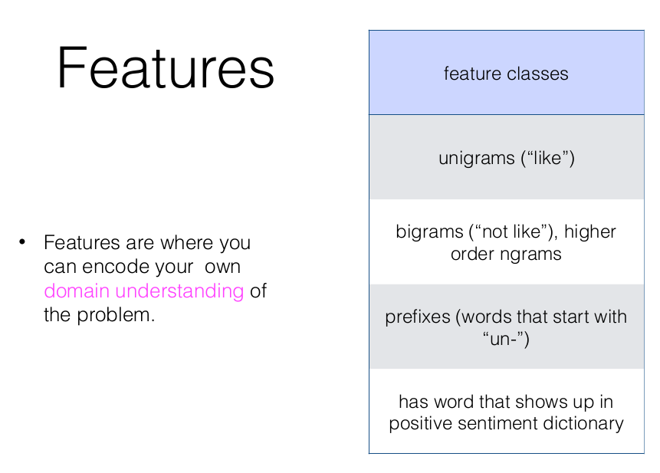
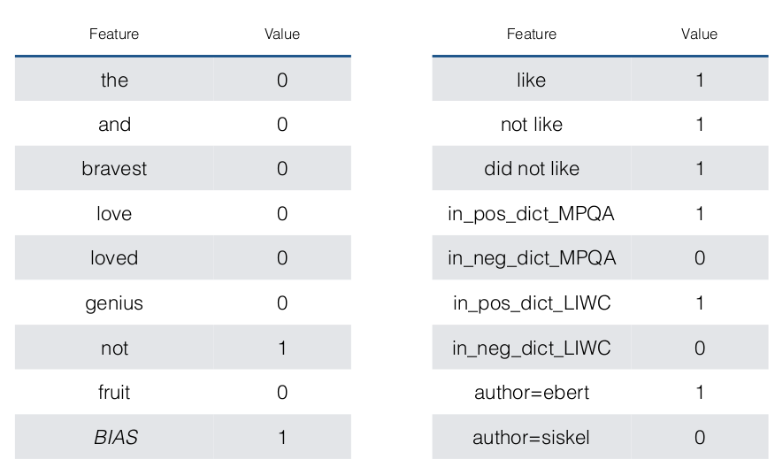
Classification - Supervised approach

Slide 22
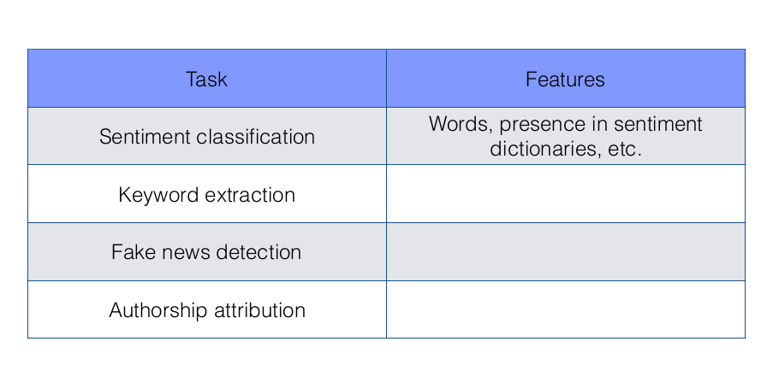
Classification - Supervised approach

Slide 23
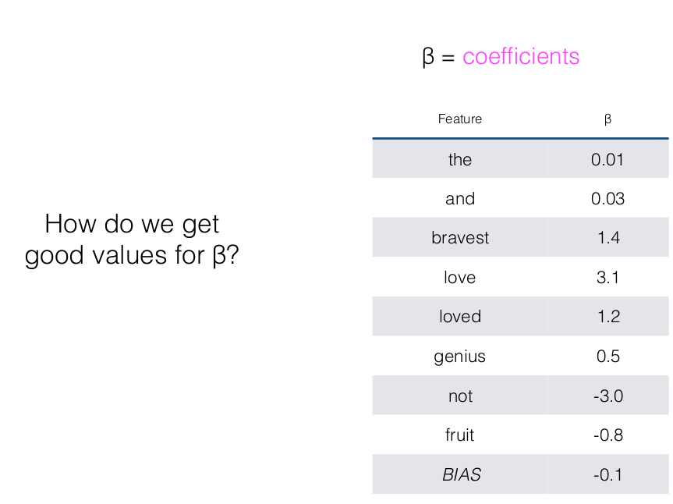
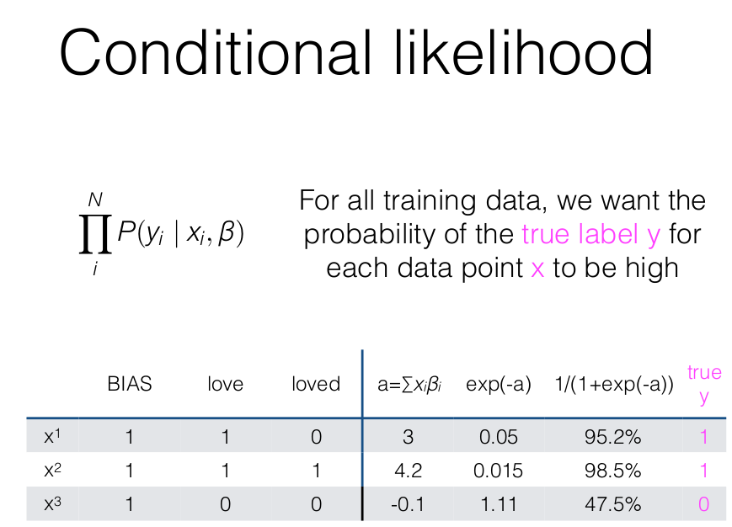
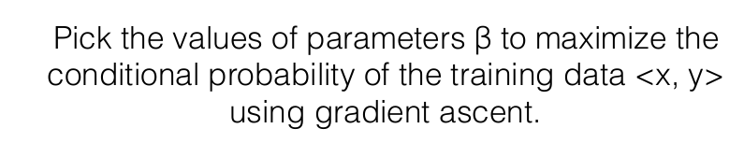
Learning Parameters - Supervised approach

Slide 24
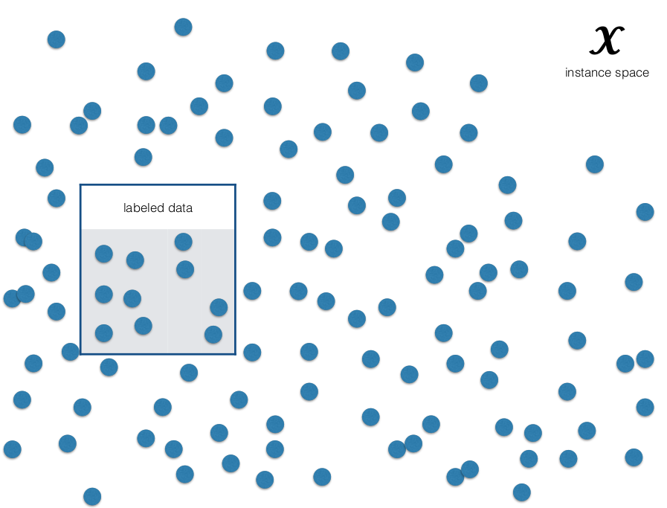
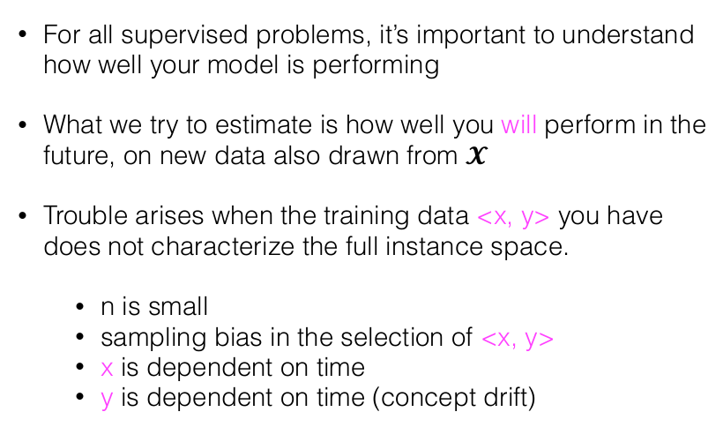
Evaluation - Supervised approach

Slide 25
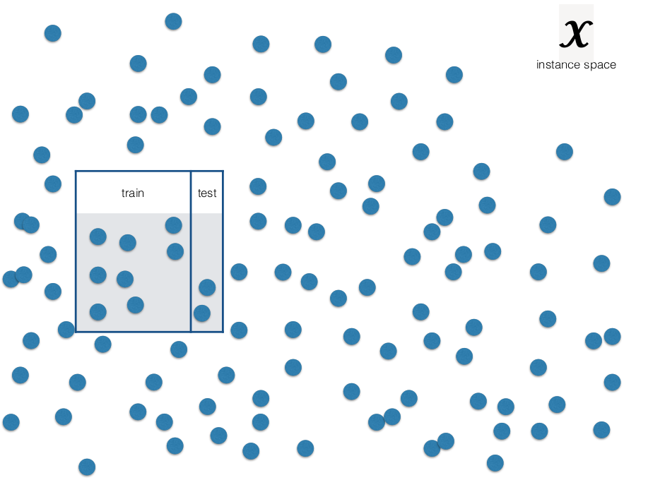
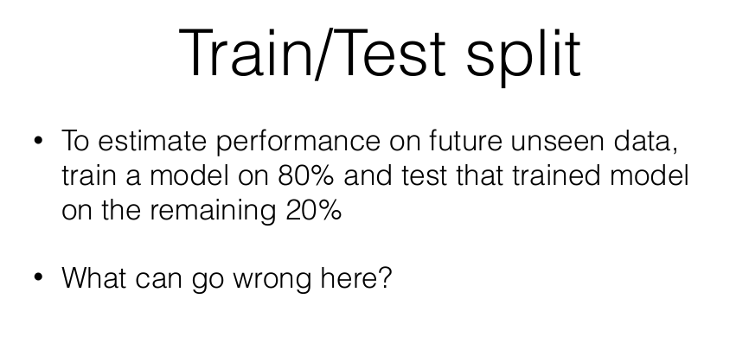
Evaluation - Supervised approach

Slide 26
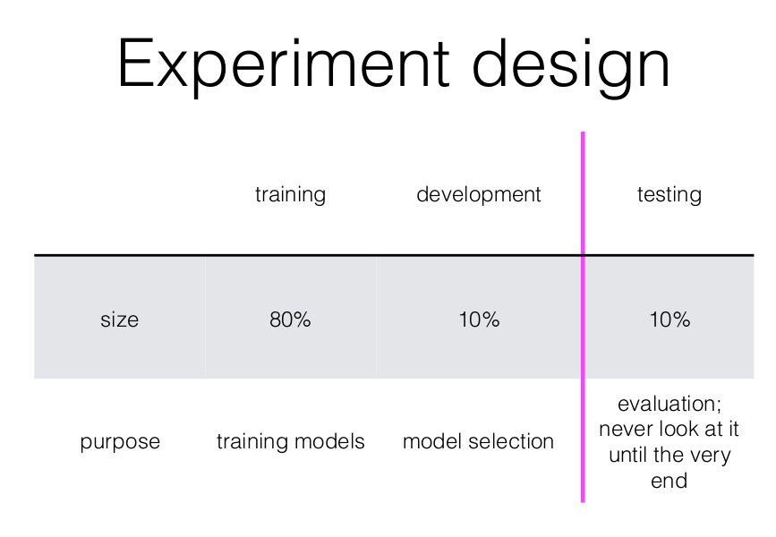
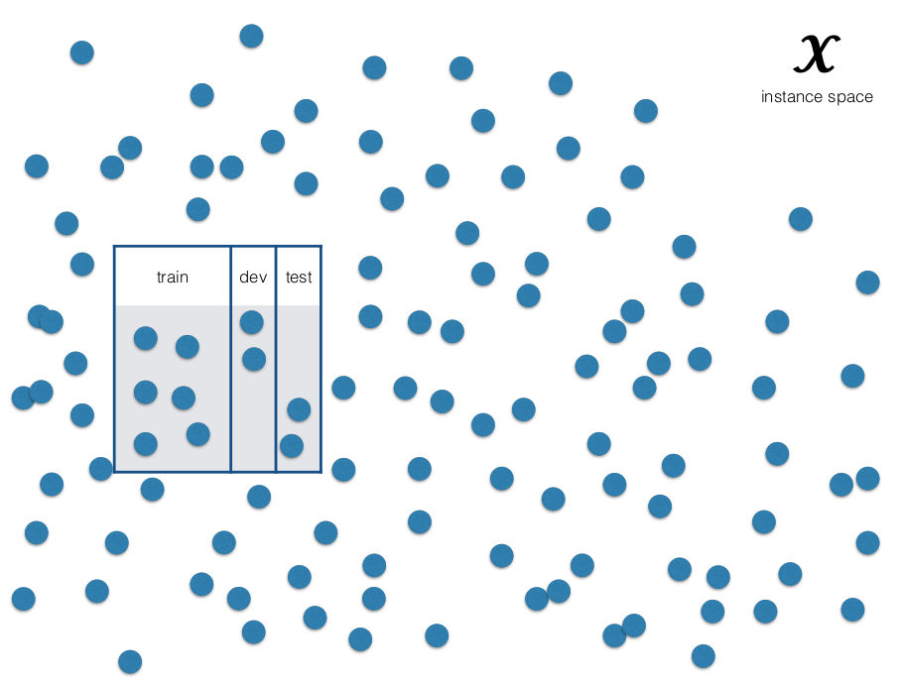
Evaluation - Supervised approach

Slide 27
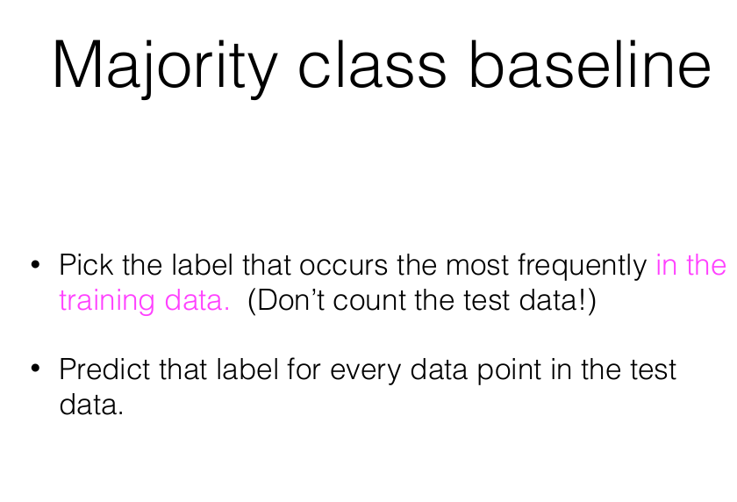
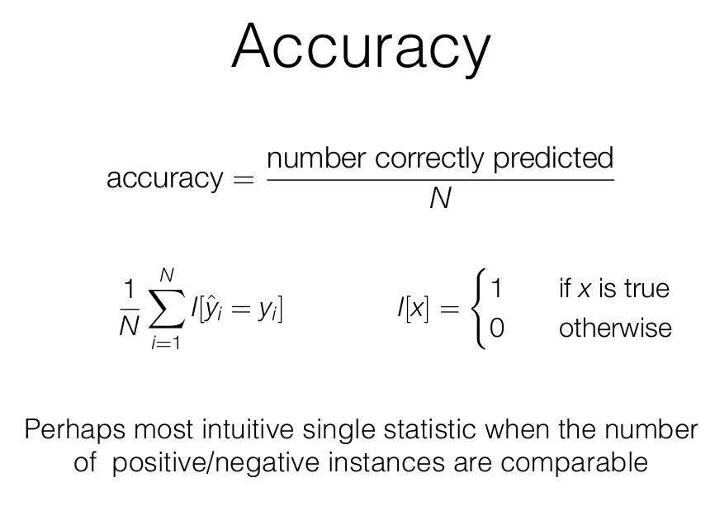
Evaluation - Supervised approach

Slide 28
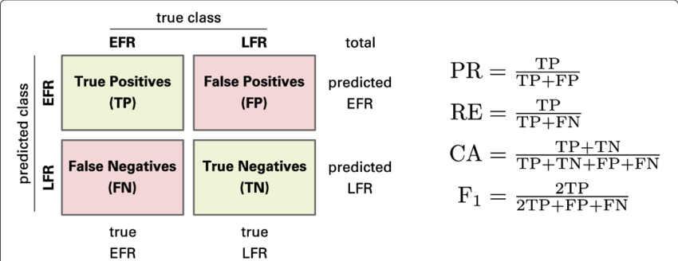
Evaluation - Supervised approach
Accuracy may favour most common class
https://www.researchgate.net/publication/330174519_Application_of_an_interpretable_classification_model_on_Early_Folding_Residues_during_protein_folding

Slide 29
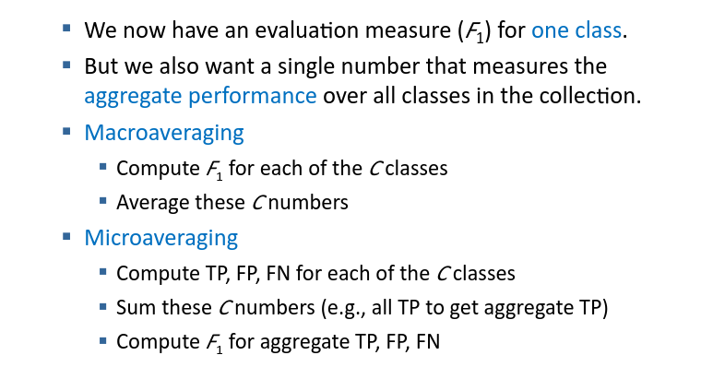
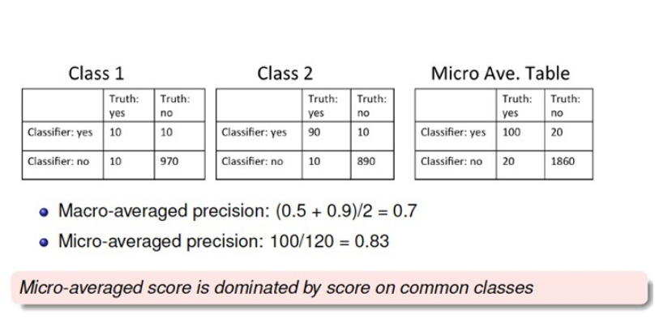
Evaluation - Supervised approach

Slide 30
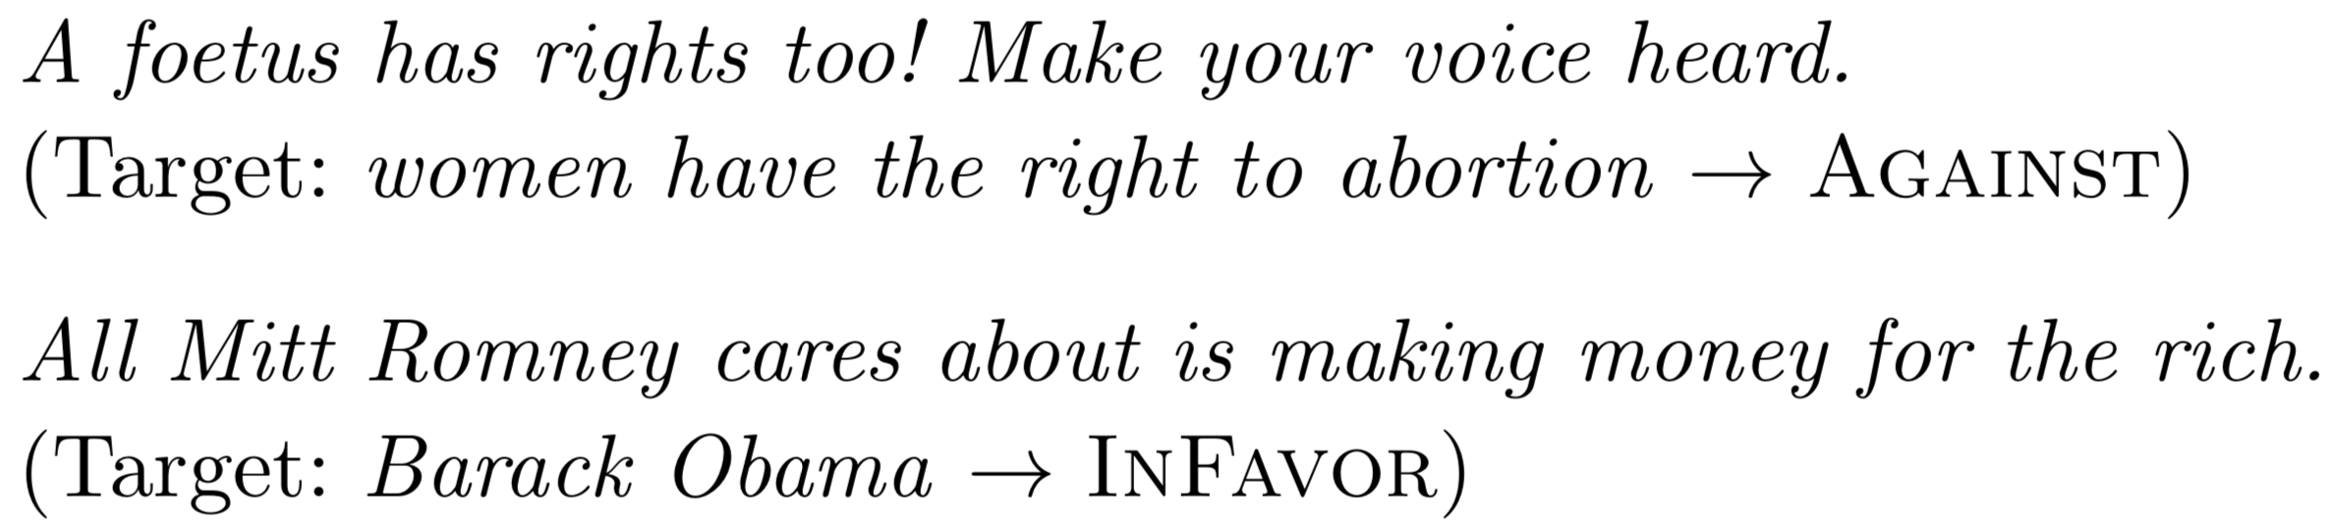

Labs: Stance Detection with respect to a topic

Slide 31
Stance Detection in Twitter: SemEval 2016
Task A (supervised framework) This task tested stance towards five targets: Atheism, Climate Change is a Real Concern,Feminist Movement, Hillary Clinton, and Legalization of Abortion.
2,914 labeled training data instances for the five targets. The test data included 1,249 instances.
Task B (weakly supervised framework) This task will test stance towards one target Donald Trump (707 tweets for testing).
The organizers did not provide any training data for this specific target, just a large set of unlabeled tweets associated with the target Donald Trump.

Slide 32
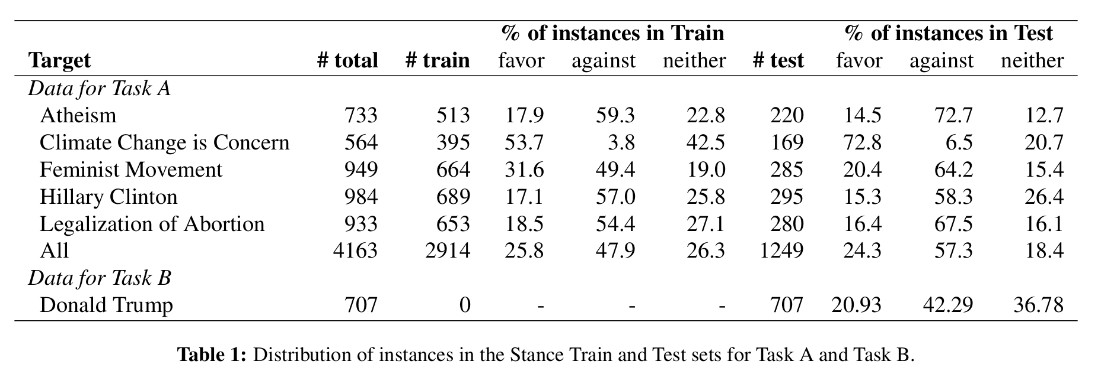
Stance Detection in Twitter: SemEval 2016

