Slide 1
Contextual Lemmatization
http://www.ixa.eus/iltapp/
@ragerri @joseba_fdl @iker_garciaf #iltapp

Slide 2
Lemmatization
English | Spanish | Russian | Basque
cat | gato | кот | katu
cats | gatos | коты | katuak
 |  | кота | katua
 |  | коту | katuari
 |  | котом | katuarekin
 |  | коте | katuek
 |  | котов | katuekin
 |  | котам | katuei
 |  | котами | katuen
 |  | котах | katurik
 |  |  | katuarentzat
 |  |  | katuentzat
lemma: cat | lemma: gato | lemma: кот | lemma: katu

Slide 3
Why is it important?
named entity recognition
machine translation
information retrieval
lemmatization
parsing
semantic role labeling

Slide 4
Some history
Data-driven
Universal Dependencies
Rule-based
Sigmorphon 2019
statistical
neural -- deep learning
Two level morphology (rules can be applied in parallel)
--
Koskenniemi
Compile regular expressions to Finite State Transducers
--
(Karttunen)
Generation of words based on lemma, POS tag and inflection form
--
(Minnen et al.)
Morphette - Simple data driven context sensitive lemmatization
--
(Chrupala)
Lemming - joint learning for morphology and lemmatization
--
(Müller et al.)
TurkuNLP - seq2seq translation model including morphology
--
(Kanerva et al.)
Joint learning of morphological tags and lemmas - BiLSTM
--
(Malaviya et al.)
1983
1997
2000
2006
2015
2018
2019

Slide 5
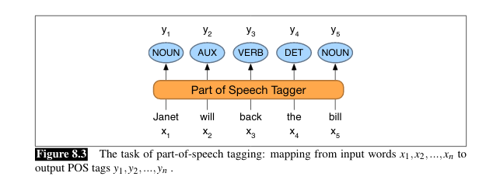
Contextual Lemmatization as Sequence Labelling
Hizkuntzaren eta pentsamenduaren arteko loturarena Benjamin Whorf hizkuntzalariak
lemmatizer
Hizkuntza eta pentsamendu arte lotura Benjamin Whorf hizkuntzalari

Slide 6
Contextual Lemmatization
Hizkuntzaren
eta
pentsamenduaren
arteko
loturarena
Benjamin
Whorf
hizkuntzalariak
NOUN
CONJ
NOUN
ADP
NOUN
PROPN
PROPN
NOUN
hizkuntza
eta
pentsamendu
arte
lotura
Benjamin
Whorf
hizkuntzalari

Slide 7
Contextual Lemmatization (Chrupala 2006)
Hizkuntzaren
eta
pentsamenduaren
arteko
loturarena
Benjamin
Whorf
hizkuntzalariak
hizkuntza
eta
pentsamendu
arte
lotura
Benjamin
Whorf
hizkuntzalari
Dn1De2Dr3
0
Dn1De2Dr3Da4
Do1Dk2
Da1Dn2De3Dr4
0
0
Dk1Da2
Automatically uncovering recurring patterns in the mapping from words to lemmas (Shortest Edit Script)

Slide 8
Shortest Edit Script (Chrupala 2006)
pidieron->pedir
repitieron->repetir
noreidip->ridep
noreitiper->riteper
etxearena->etxe
baserriarena->baserri
aneraexte -> etxe
anerairresab ->baserri
Di2Ie3De5Do7Dn8
Di4Ie5De7Do9Dn10
Dn1Do2De4Di7Ie8
Dn1Do2De4Di7Ie8
Da5Dr6De7Dn8Da9
Da7Dr8De9Dn10Da11
Da1Dn2De3Dr4Da5
Da1Dn2De3Dr4Da5

Slide 9
Contextual Lemmatization (Chrupala 2006)
Hizkuntzaren
eta
pentsamenduaren
arteko
loturarena
Benjamin
Whorf
hizkuntzalariak
NOUN
CONJ
NOUN
ADP
NOUN
PROPN
PROPN
NOUN
Dn1De2Dr3
0
Dn1De2Dr3Da4
Do1Dk2
Da1Dn2De3Dr4
0
0
Dk1Da2
Automatically uncovering recurring patterns in the mapping from words to lemmas (Shortest Edit Script)

Slide 10
Predicting SES -> Lemmas
Text
Hizkuntzaren
eta
pentsamenduaren
arteko
loturarena
Benjamin
Whorf
hizkuntzalariak
Prediction
Dn1De2Dr3
0
Dn1De2Dr3Da4
Do1Dk2
Da1Dn2De3Dr4
0
0
Dk1Da2
Lemma
hizkuntza
eta
pentsamendu
arte
lotura
Benjamin
Whorf
hizkuntzalari

Slide 11
Context-based Lemmatization
Calculate Levenshtein distance
Popular algorithm in: https://en.wikipedia.org/wiki/Levenshtein_distance#Computing_Levenshtein_distance
Compute Shortest Edit Script (SES)
The Levenshtein distance between "kitten" and "sitting" is 3:
- kitten → sitten (substitution of "s" for "k")
- sitten → sittin (substitution of "i" for "e")
- sittin → sitting (insertion of "g" at the end).
Example implementation: https://github.com/ixa-ehu/ixa-pipe-pos/blob/master/src/main/java/eus/ixa/ixa/pipe/pos/StringUtils.java#L393
Learn a Sequence Labelling model
Decode predicted SES to lemmas

Slide 12
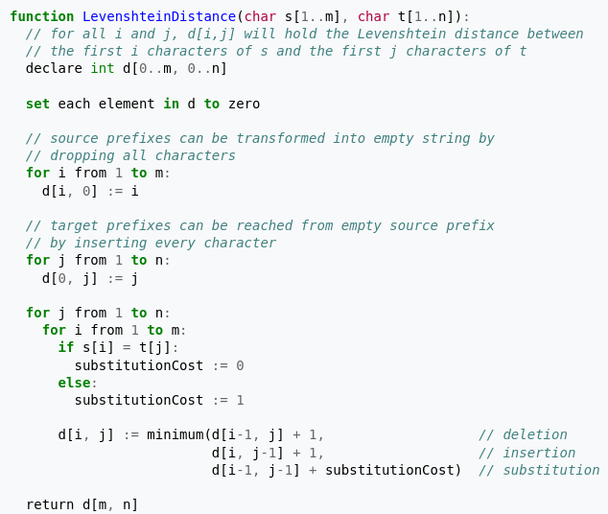
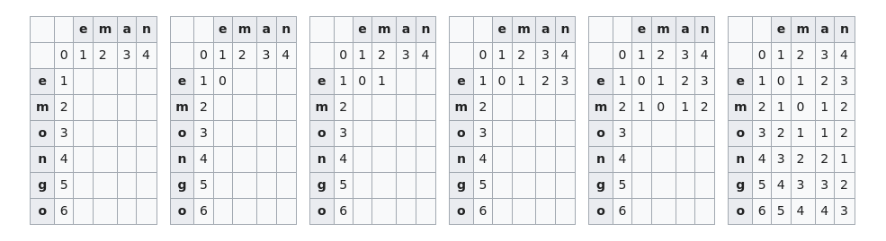
Calculate Levenshtein distance
Wagner, Robert A.; Fischer, Michael J. (1974). "The String-to-String Correction Problem". Journal of the ACM. 21 (1): 168–173. doi:10.1145/321796.321811.
https://en.wikipedia.org/wiki/Levenshtein_distance#Computing_Levenshtein_distance

Slide 13
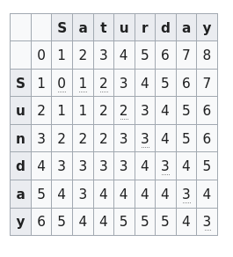
Compute Shortest Edit Script
y equals y
a equals a
d equals d
r substitute for n
u equals u
insert t
insert a
s equals s
Wagner, Robert A.; Fischer, Michael J. (1974). "The String-to-String Correction Problem". Journal of the ACM. 21 (1): 168–173. doi:10.1145/321796.321811.
https://en.wikipedia.org/wiki/Levenshtein_distance#Computing_Levenshtein_distance

Slide 14
Issues with contextual lemmatization
rich morphological information improves lemmatization performance, especially for morphologically rich languages
2. complex morphological tagging may degrade too much when applied out-of-domain, which may in turn negatively affect lemmatization results
3. Leverage new language models to learn lemmatization without morphology

Slide 15
Experimental setup
in-domain evaluation
out-of-domain evaluation
corpora
CoNLL 2017 partitions
Russian – GSD
Basque: BDT
English – EWT
Spanish – GSD
CoNLL 2018 partitions
Russian – TAIGA, SynTagRus
Basque: Armiarma
English – GUM, LinES
Spanish – AnCora
statistical lemmatizer
IXA pipes
both require morphological information
both use short edit distance script during lemmatization
neural lemmatizer
Morpheus
3rd best system in SIGMORPHON 2019

Slide 16
IXA pipes (statistical lemmatizer)
Local features
System features | yes/no
Prefix | yes
Suffix | yes
Token | yes
Token Class | yes
Sentence | yes
Bigram Class | yes
Trigram Class | no
Fourgram Class | no
Fivegram Class | no
CharNgram | no
Window 1:1 | yes
Linear classification for SL
Perceptron
Lemmatization
Lemmatize with gold standard Morphology (ixa-pipe-pos)
Lemmatize with learned morphology (ixa-pipe-ml)
Agerri and Rigau (2016), Artificial Intelligence Journal

Slide 17
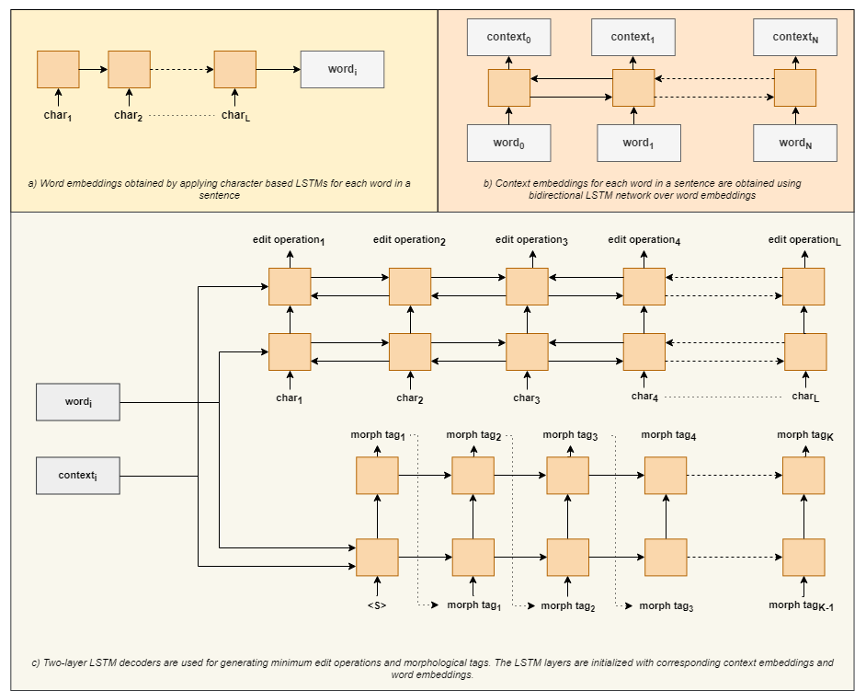
Morpheus
Yildiz et al. 2019, Sigmorphon 2019 shared task

Slide 18
CoNLL 2017 in-domain evaluation
Language | Label | Learned morphology | Gold standard | Morpheus
Russian | UPOS | 0.9435 | 0.9438 | 0.9412
 | UPOS+AllFeat. | 0.9498 | 0.9658 | 0.9458
Basque | UPOS | 0.9270 | 0.9463 | 0.9566
 | UPOS+AllFeat. | 0.9265 | 0.9580 | 0.9595
Spanish | UPOS | 0.9830 | 0.9823 | 0.9861
 | UPOS+AllFeat. | 0.9833 | 0.9836 | 0.9861
English | UPOS | 0.9916 | 0.9968 | 0.9730
 | UPOS+AllFeat. | 0.9916 | 0.9979 | 0.9713
the statistical lemmatizer (IXA pipes) performs competitively with respect to the neural lemmatizer (Morpheus);
performance when using different morphological information varies much less for Morpheus;
for Spanish and English adding more complex morphological information does not help that much
clustering features and gold standard morphology are of special importance for Basque and Russian -- for English and Spanish the differences are minimal

Slide 19
In-domain conclusions
gold morphological tags is always the best choice, although this is particularly clear for Basque and Russian
with learned morphological tags it is better to use simple (UPOS) morphological information to guide the lemmatizer training
for morphologically rich languages it helps to characterize which fine-grained morphological information is beneficial to improve overall lemmatization performance (pending)

Slide 20
Out-of-domain evaluation
we apply models received during in-domain experiments on real world tasks
corpora we use for the evaluation:
Language | Corpus | Corpus source
Russian | TAIGA (UD 2.2) | texts from blogs, Wikipedia, poetry, social networks, news and fiction
 | SynTagRus (UD 2.2) | texts from a variety of genres, such as contemporary fiction, popular science, as well as news and journal articles in the period of 1960 - 2016
Basque | Armiarma | book reviews
English | GUM (UD 2.2) | GUM is a collection of annotated web-texts from interviews, news, travel guides, academic writing, biographies and fiction from such sources as Wikipedia, Wikinet and Reddit
 | LinES (UD 2.2) | a half part of the LinES Parallel Treebank, containing texts from literature, online manual and Europarl data
Spanish | AnCora (UD 2.2) | texts from news

Slide 21
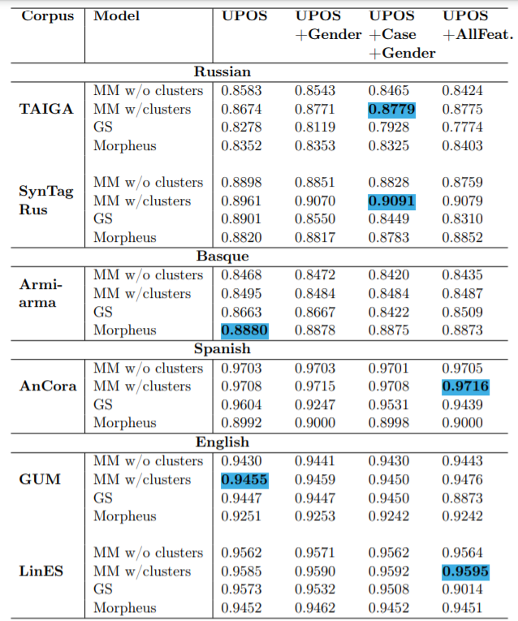
What could be concluded?
The most efficient system for out-of-domain use is a contextual lemmatizer trained with learned morphological models and including semantic distributional information;
Fine-grained morphological information is in general not necessary to obtain competitive contextual lemmatizers for real world use, not even for highly inflected languages.
Gender in Basque is very limited to few forms in informal language
Spanish cases mostly Accusative and Dative in reflexive pronouns and Nominative in some personal pronouns
Notes:
‹#›

Slide 22
In-domain (CoNLL 2017)
Language | Best system | Label | Word Accuracy
Russian | IXA pipes (GS) | UPOS+AllFeat. | 0.9658
Basque | Morpheus | UPOS+Case+Number | 0.9603
Spanish | Morpheus | UPOS | 0.9861
English | IXA pipes (GS) | UPOS+AllFeat. | 0.9979
Out-of-domain
Language | Best system | Label | Word Accuracy
Russian | IXA pipes (w/clusters) | UPOS+Case+Gender | 0.9091
Basque | Morpheus | UPOS | 0.8880
Spanish | IXA pipes (w/clusters) | UPOS+AllFeat. | 0.9716
English | IXA pipes (w/clusters) | UPOS+AllFeat. | 0.9595

Slide 23
What have we learned?
training context-based lemmatizers using rich morphological information is beneficial for in-domain evaluations but does not have the same impact for out-of-domain settings. The performance of contextual lemmatizers is very similar when informed by simple morphological info, such as UPOS;
languages with simpler morphology (such as English and Spanish) do not require fine-grained morphological information for good lemmatization performance;
learning lemmatization with gold standard morphological tags is the worse performing choice when used out-of-domain, the most common setting when applying off-the-shelf linguistic processors;
additional morphological information does improve the performance of the lemmatizer, but similar could be achieved using just Universal POS tags (UPOS).

Slide 24
Lemmatize without morphology
Contextual word representations (Flair, BERT, etc.)
Transfer learning: learn one model and apply it to a variety of tasks
Multilingual pre-trained language models (Transformers)
Fine-tune one model for every language and domain without using morphological information

Slide 25
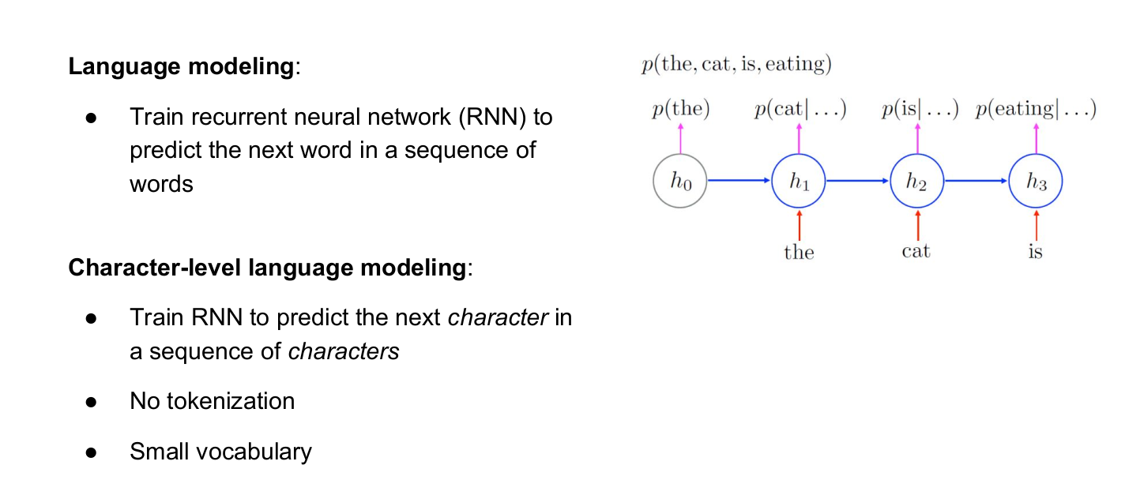
Flair contextual character-based
Akbik et al. 2018. COLING

Slide 26
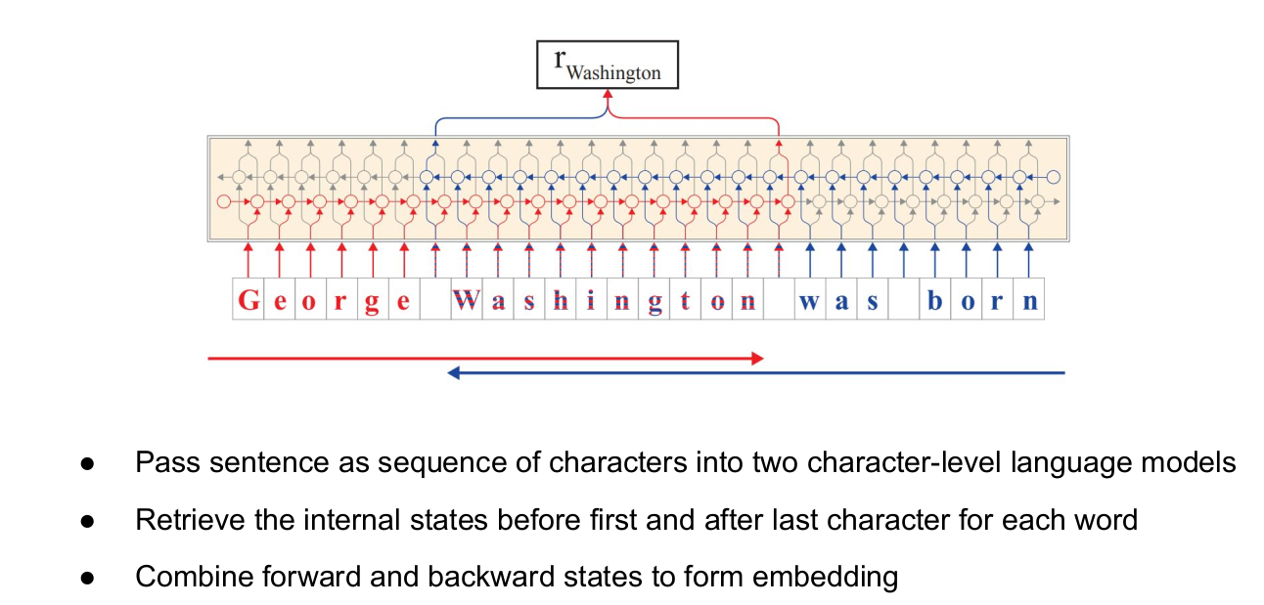
Flair: string-based and contextual
Akbik et al. (2018) in COLING.

Slide 27
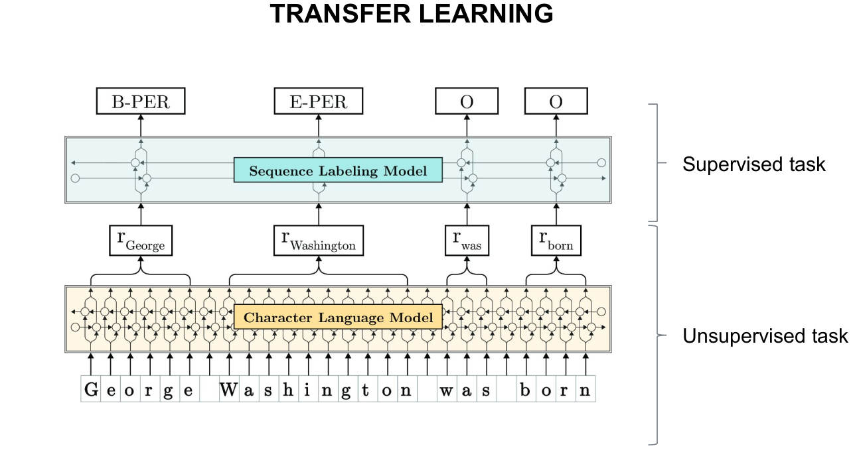
Flair: string-based and contextual
Akbik et al. (2018) in COLING.

Slide 28
Multilingual Transformers
Share vocabulary and representations across languages by training one model on many (100+) languages.
Enables cross-lingual pretraining by itself
Leads to under-representation of low-resource languages (Agerri et al. 2020)

Slide 29
Text Representations for Basque
pre-trained language models allow to build rich multilingual representations of text (mBERT, XML-r)
Expensive to train
Suboptimal as less-resourced languages share the quota of substrings and parameters
en-wiki 2.5K million words vs eu-wiki 35 million
Tokenization
mBERT: Medi #kua #rene #ra
BERTeus: Mediku #aren #era (to-the-doctor)
doctor # [the] # to

Slide 30
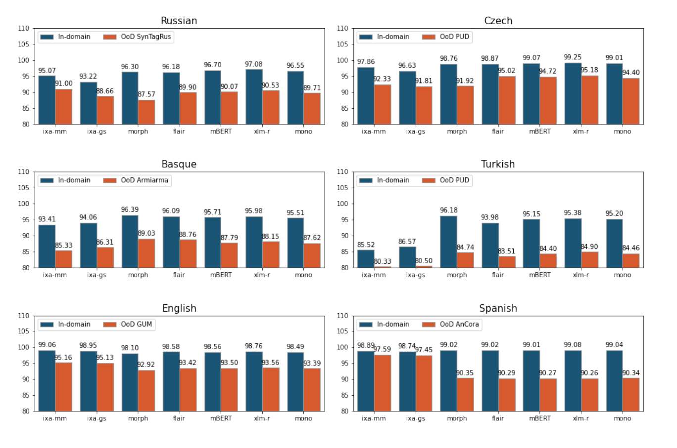
Overall evaluation

Slide 31
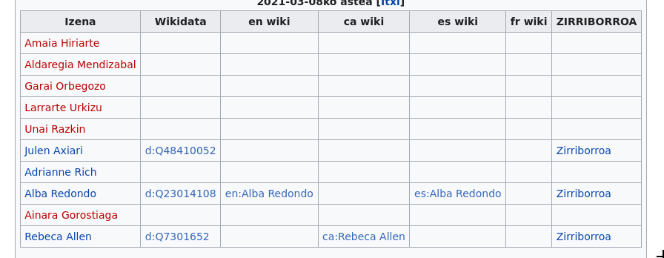
Examples
An application for Basque Wikipedia:
https://eu.wikipedia.org/wiki/Wikiproiektu:Euskarazko_albisteetako_Izen_Entitateak

Slide 32
Mila esker!

