Slide 1
Part-of-Speech Tagging
http://www.ixa.eus/iltapp/
@ragerri @joseba_fdl @iker_garciaf #iltapp
(some slides adapted from ANLP, David Bamman)

Slide 2
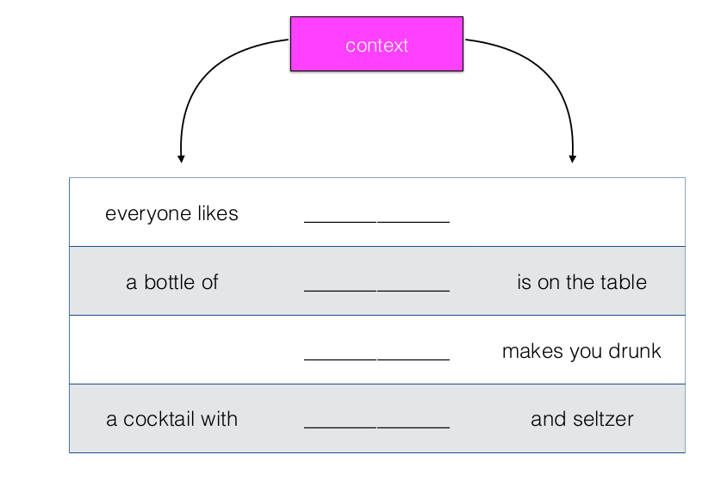

Context and the Distributional Hypothesis

Slide 3
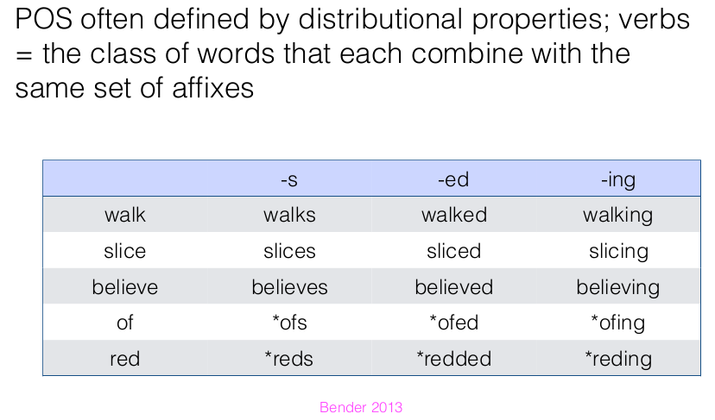

Morphological Distribution

Slide 4
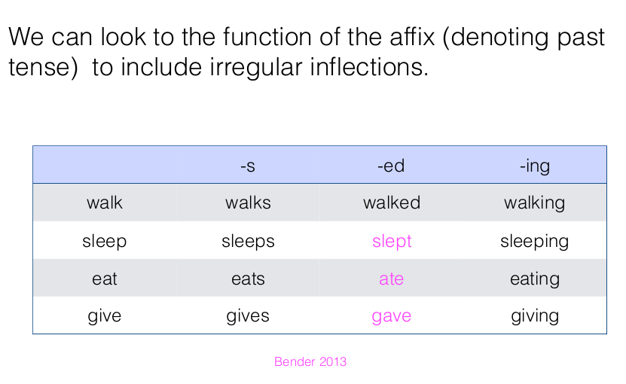
Morphological Distribution
Very useful for lemmatization!

Slide 5
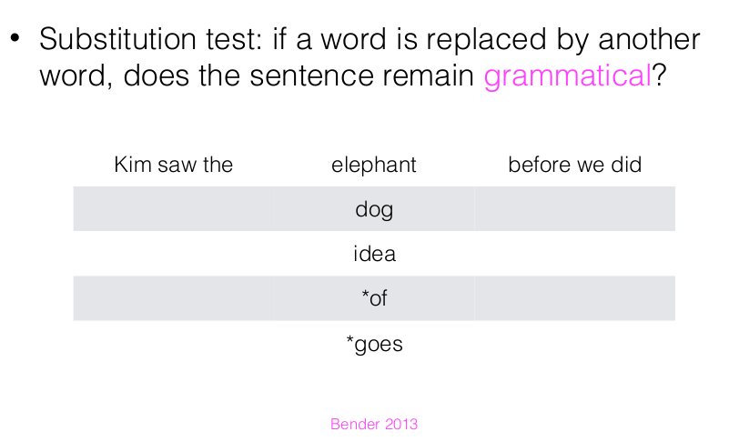
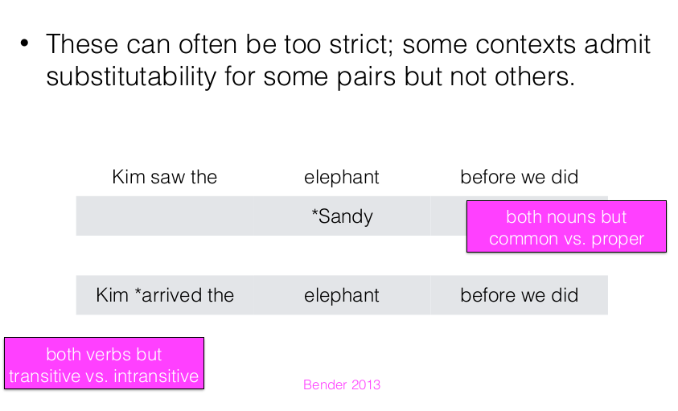
Morphological Distribution

Slide 6
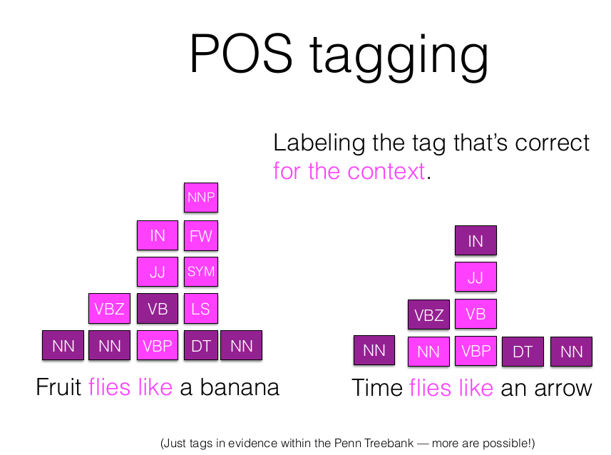
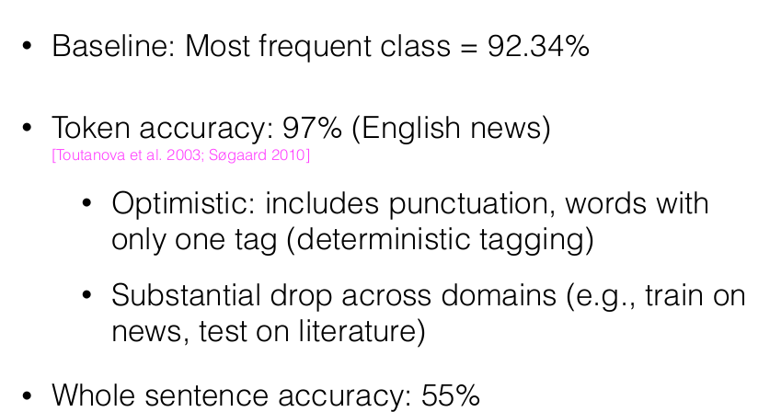
State of the art

Slide 7
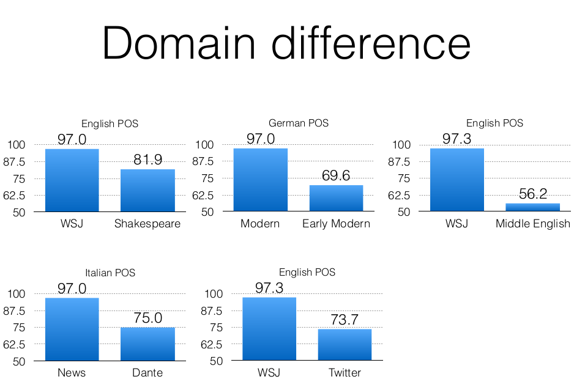
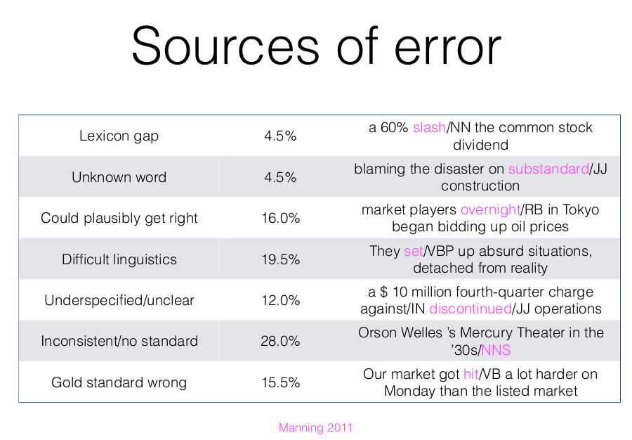
State of the art

Slide 8
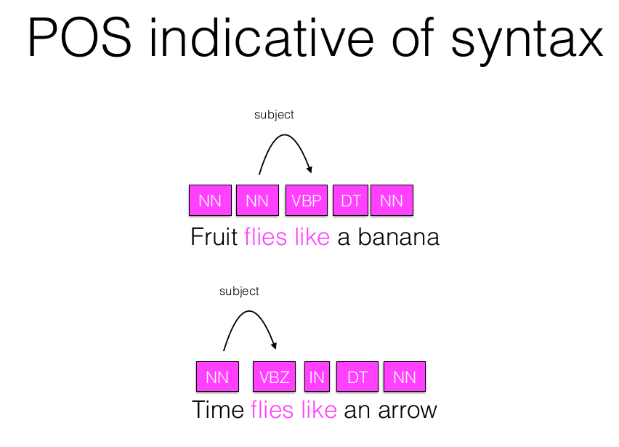
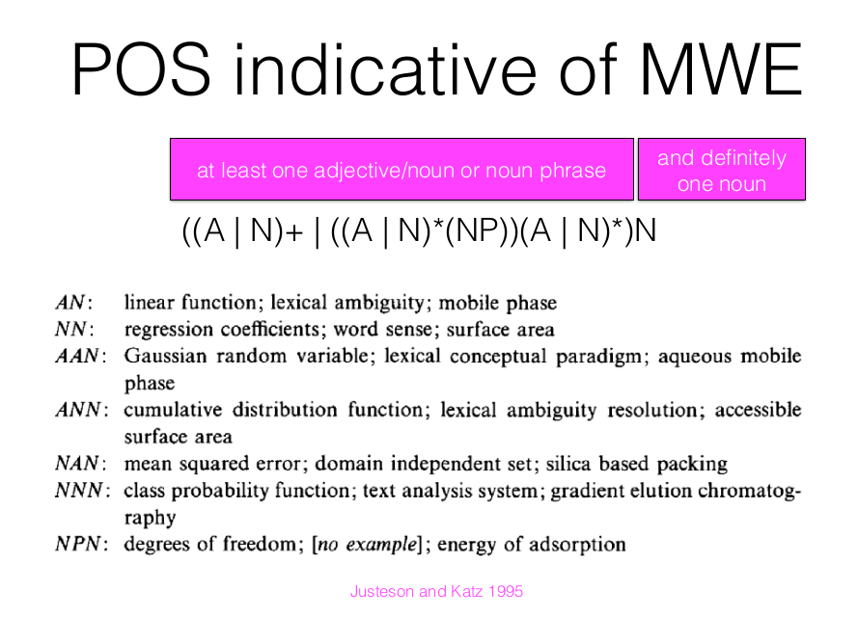
Useful

Slide 9
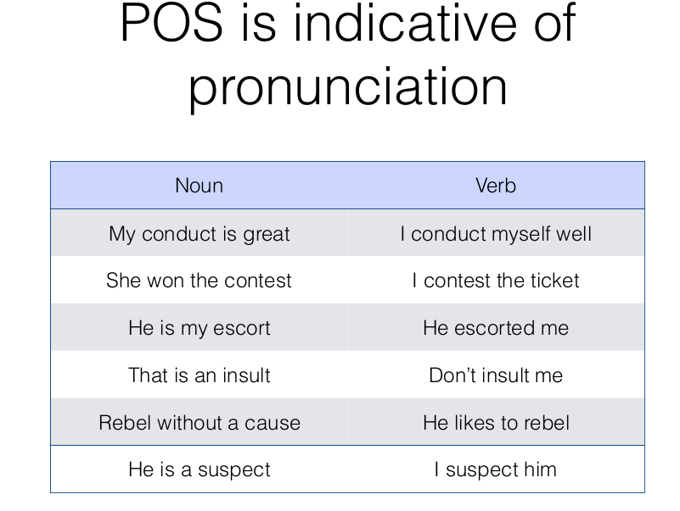
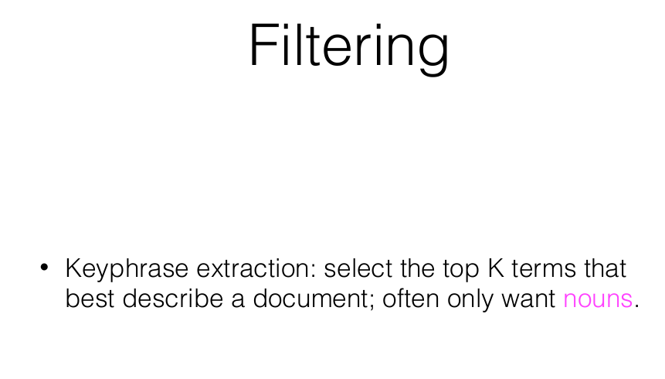
Useful

Slide 10
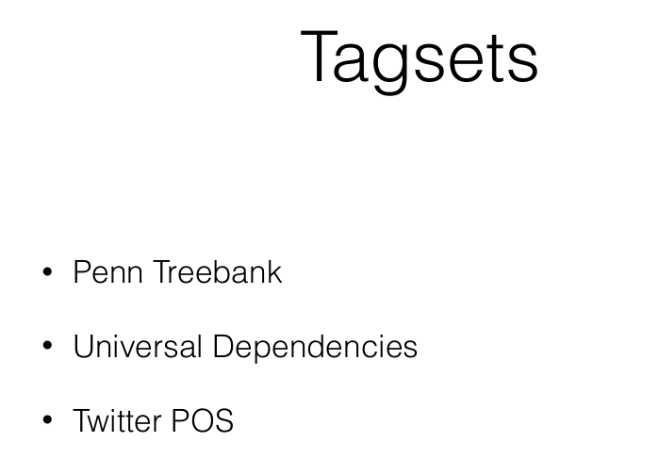
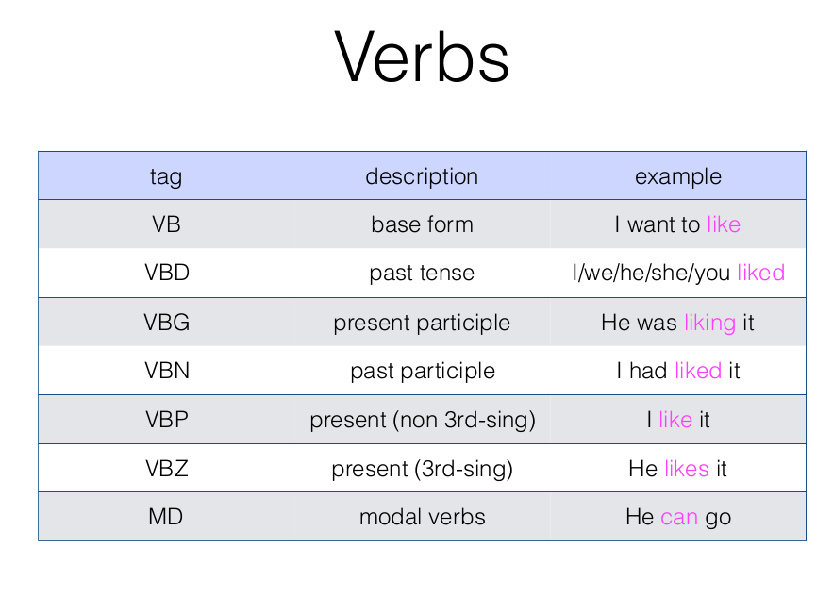
Corpora
https://universaldependencies.org/

Slide 11
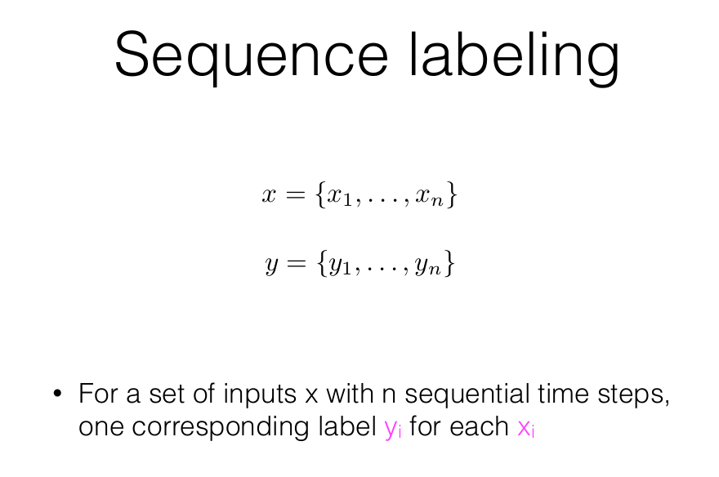
POS tagging as Sequence Labelling
https://universaldependencies.org/

