Slide 1


Sentiment Analysis and Opinion Mining
http://www.ixa.eus/iltapp/
@ragerri @joseba_fdl @iker_garciaf #iltapp
(some slides adapted from Bing Liu AAAI tutorial 2011)

Slide 2
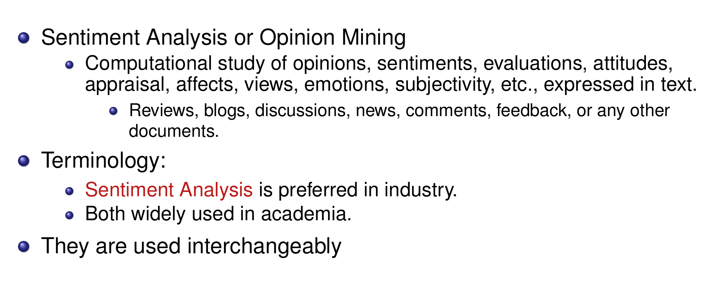
Introduction

Slide 3
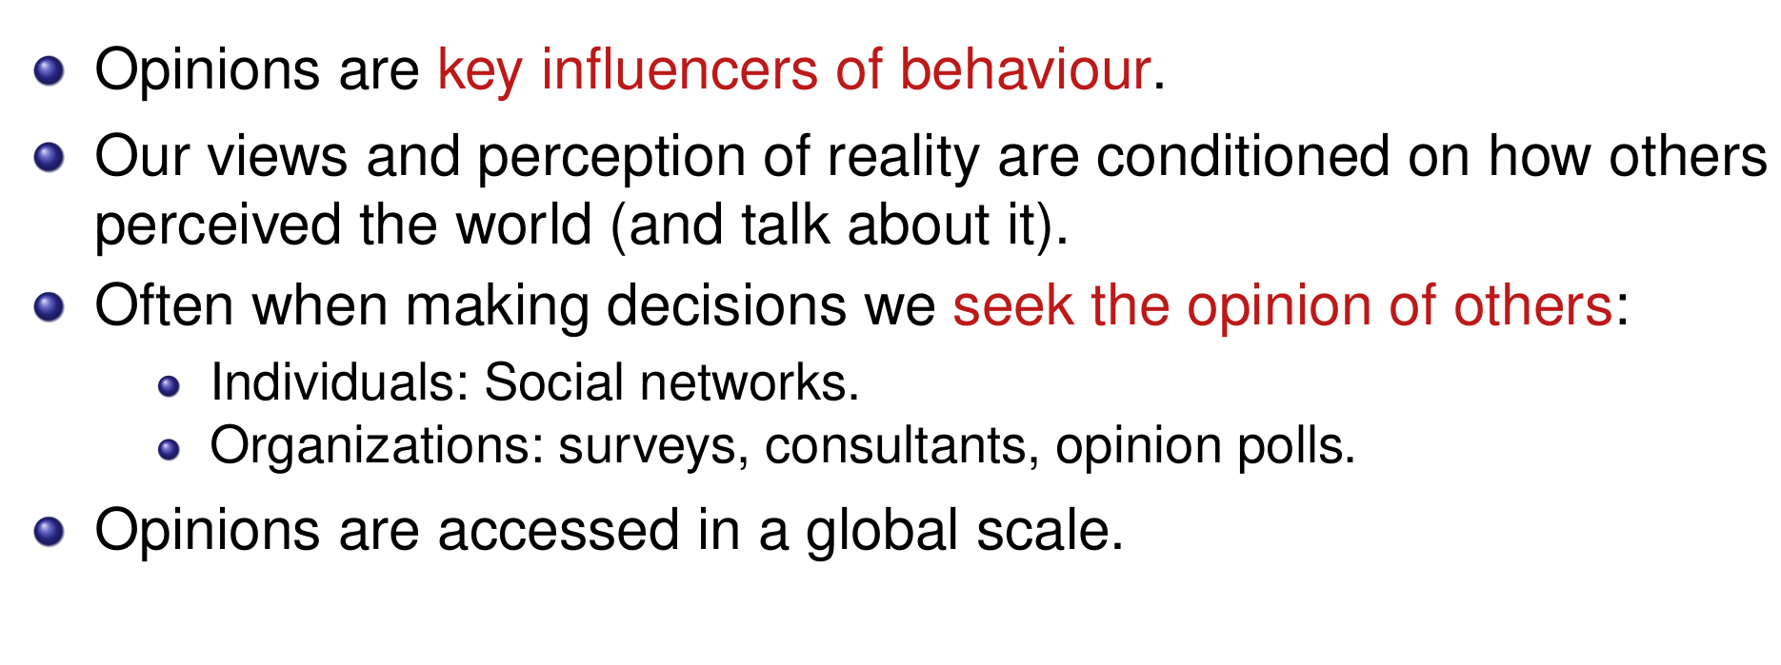
Why are opinions important?

Slide 4
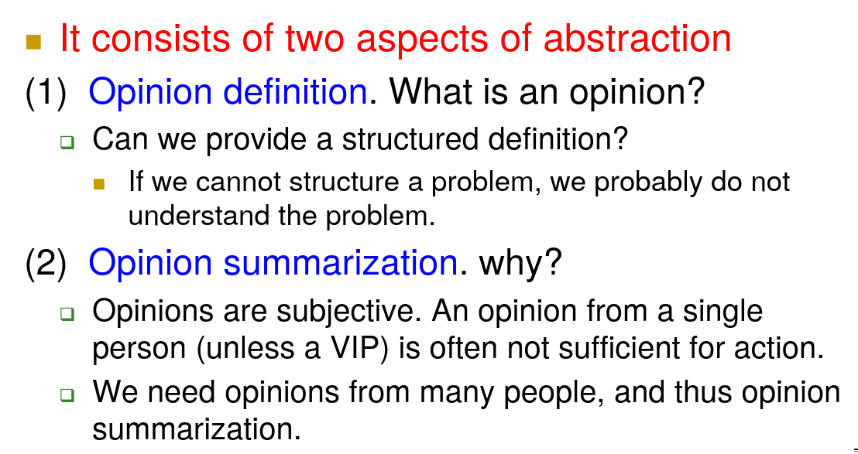
Problem

Slide 5
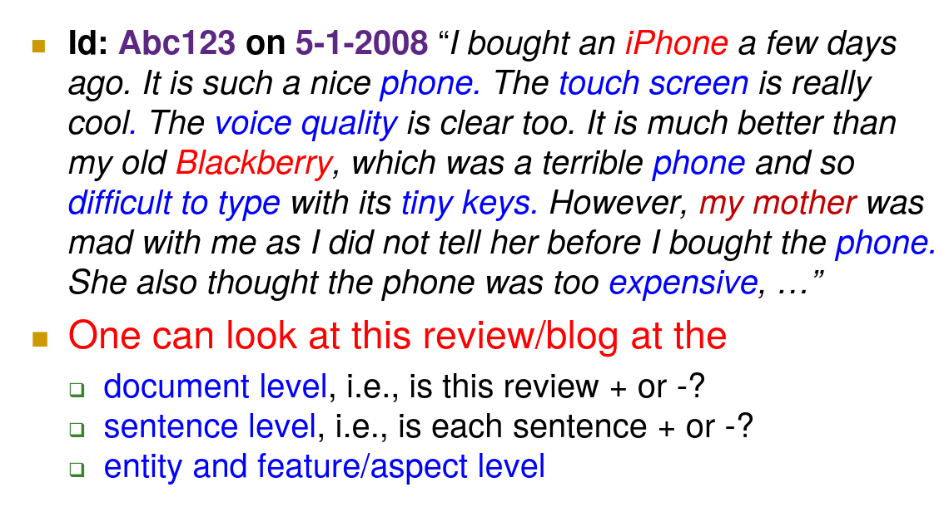
What is an opinion?

Slide 6
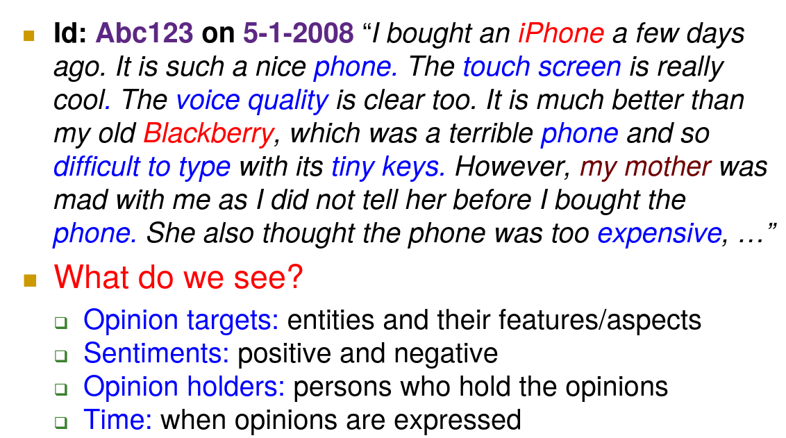
Feature or aspect level

Slide 7
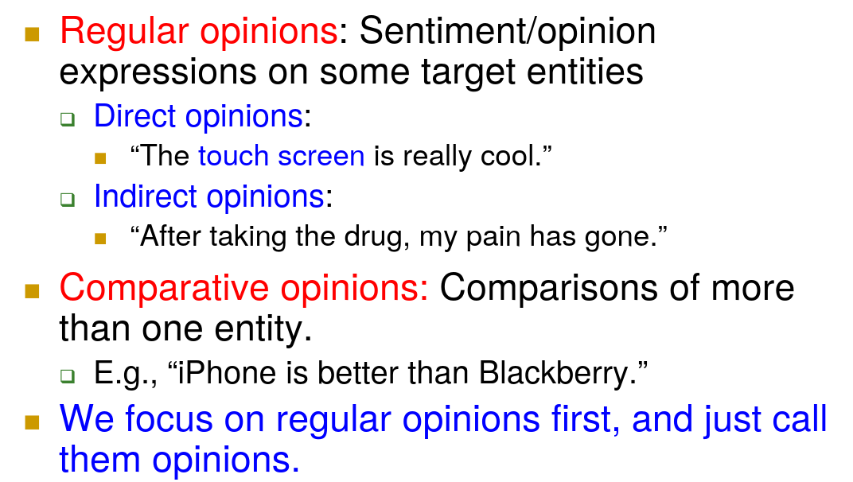
Two types of opinions

Slide 8
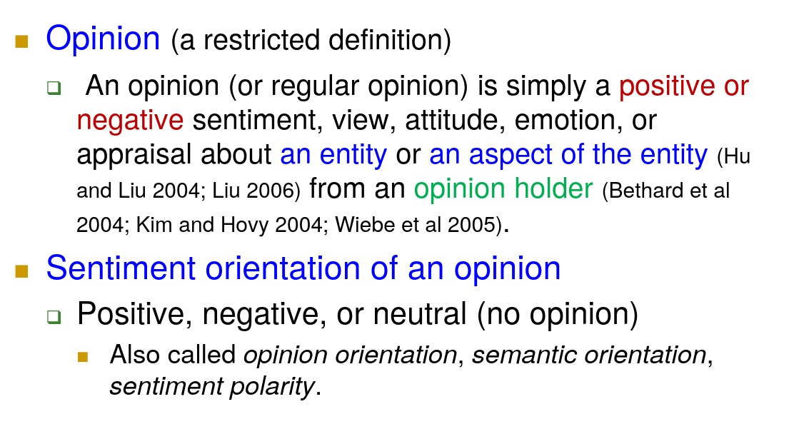
An example of an opinion

Slide 9
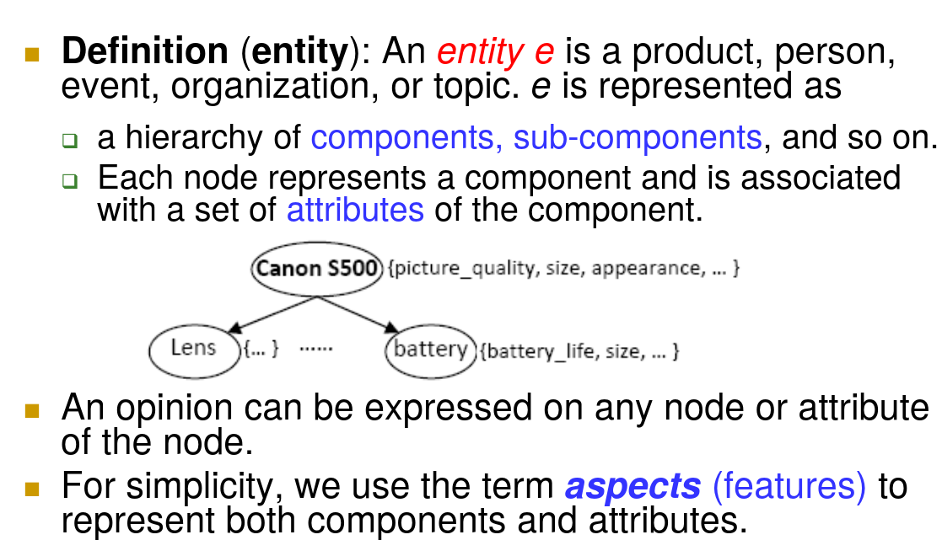
Entities and Aspects

Slide 10
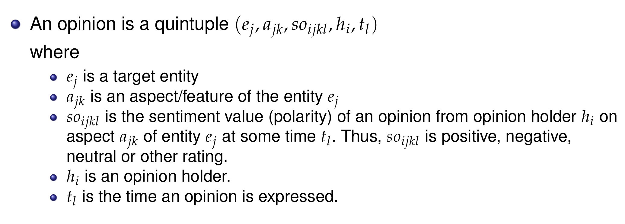
Opinion

Slide 11
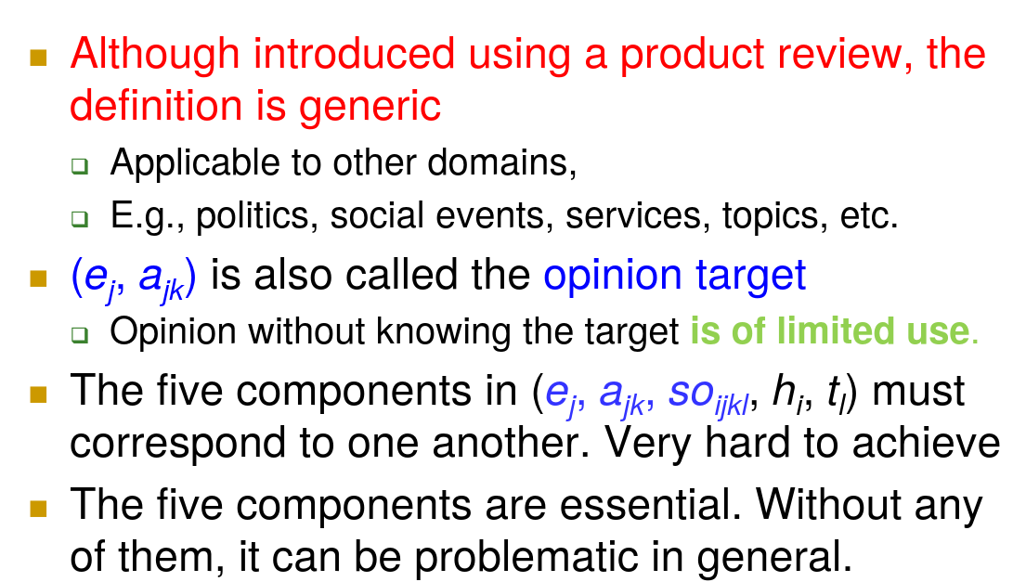
General definition

Slide 12
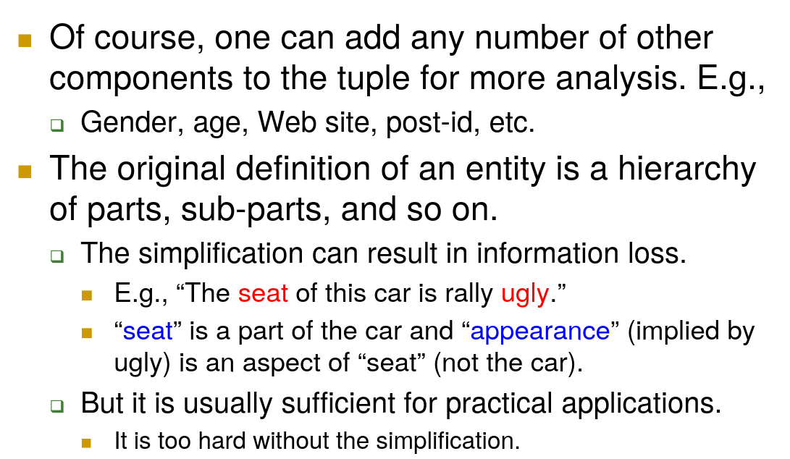
General definition

Slide 13
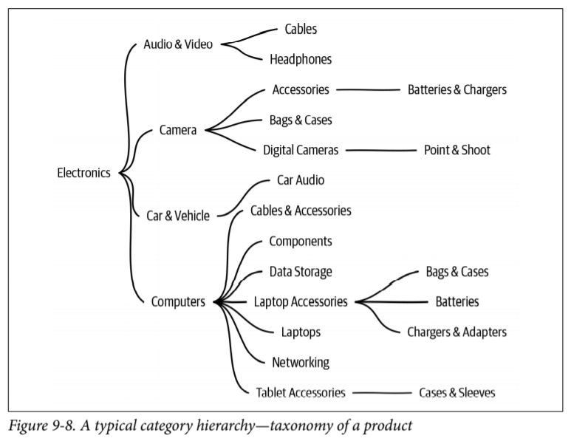
Hierarchy

Slide 14
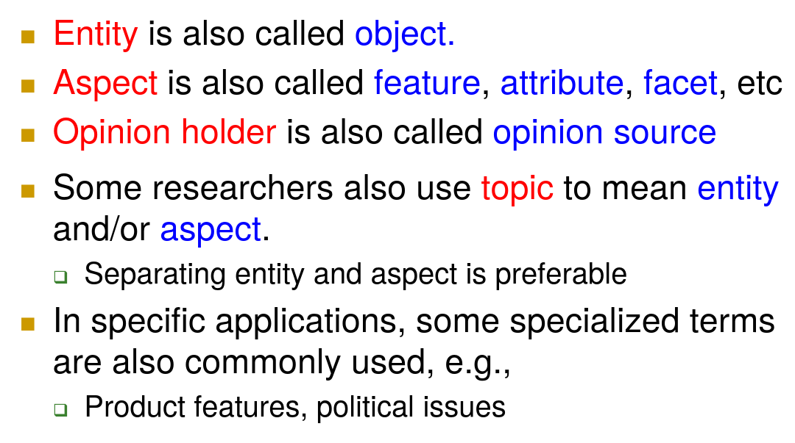
Terminology

Slide 15
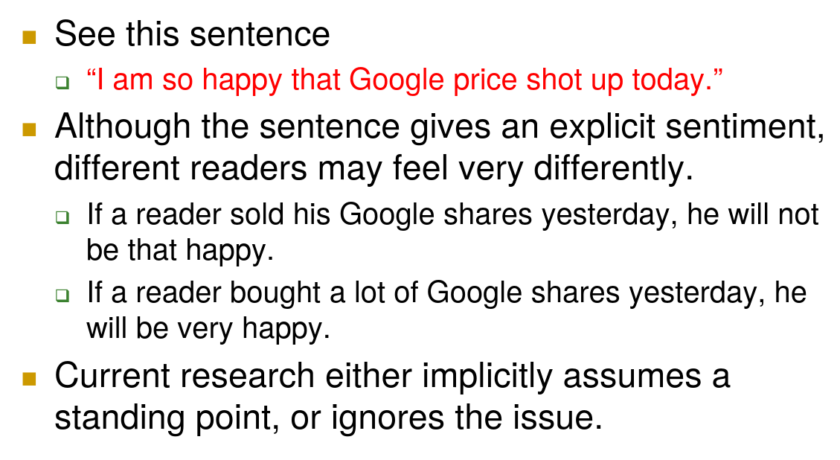
Point of view

Slide 16
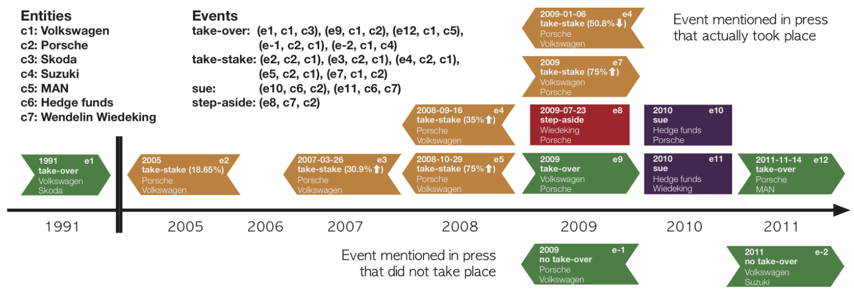
Point of view

Slide 17
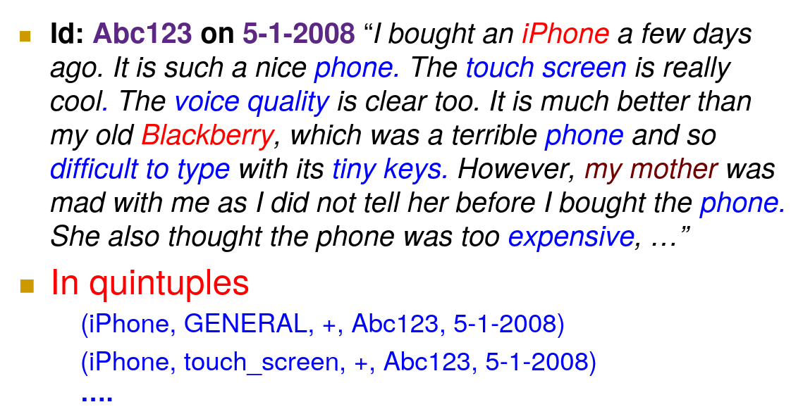
Example of quintuples

Slide 18
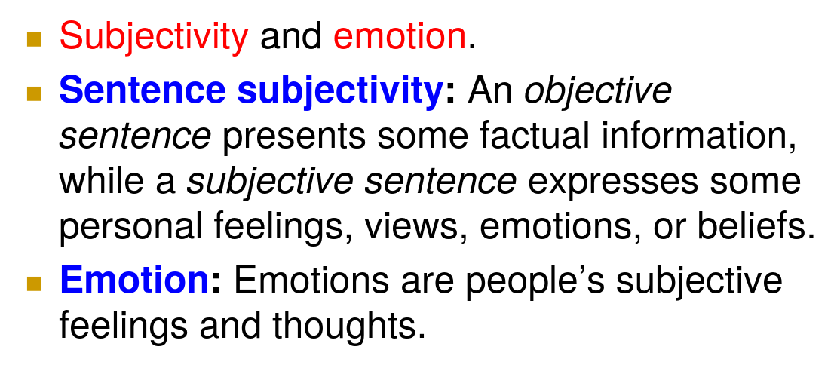
Closely Related Concepts

Slide 19
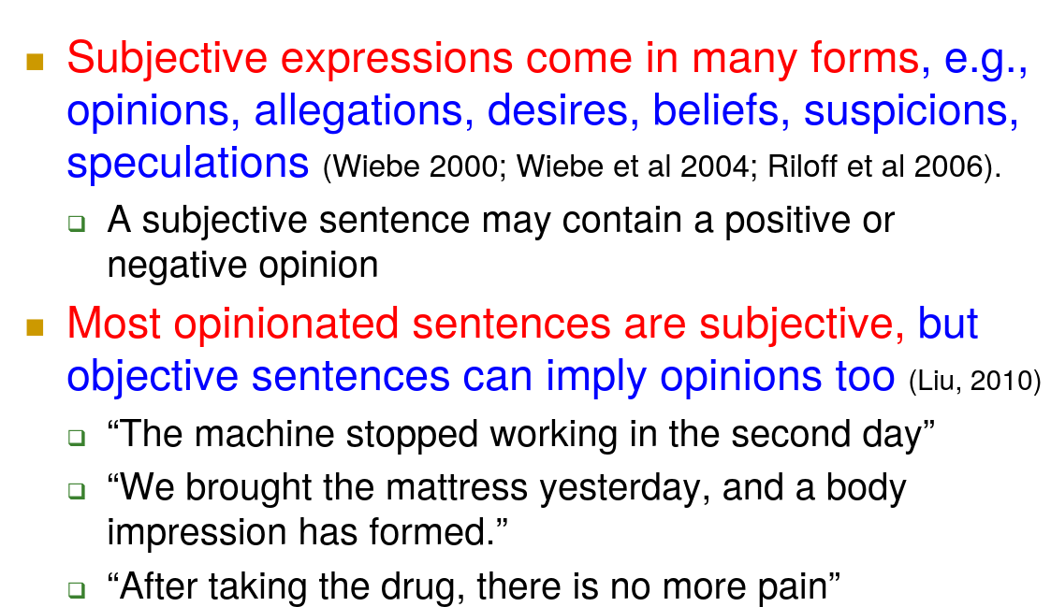
Subjectivity

Slide 20
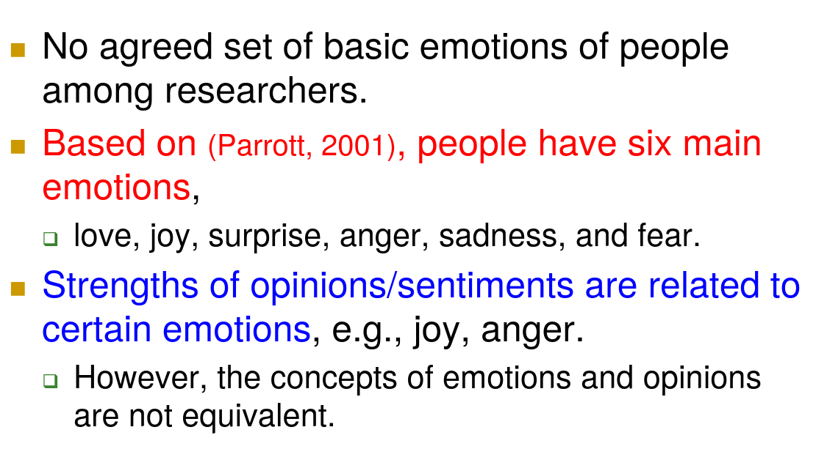
Emotions

Slide 21
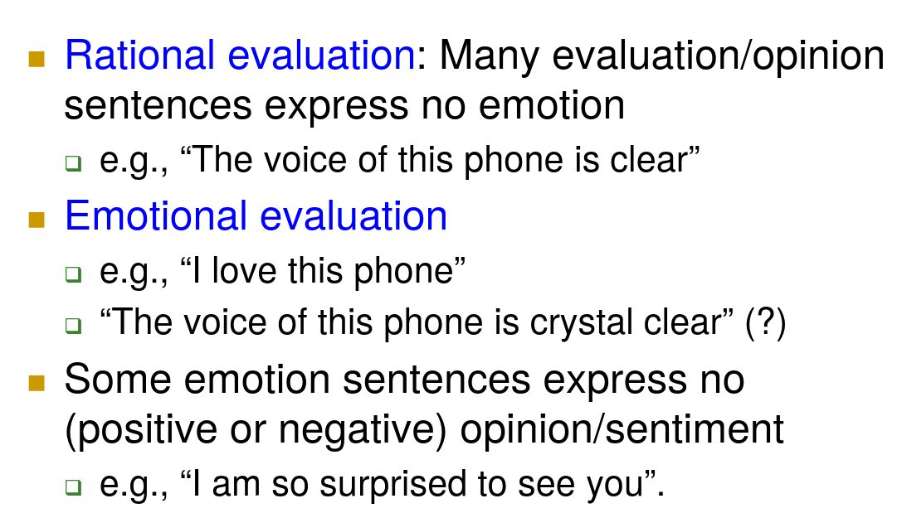
Rational and Emotional Opinions

Slide 22
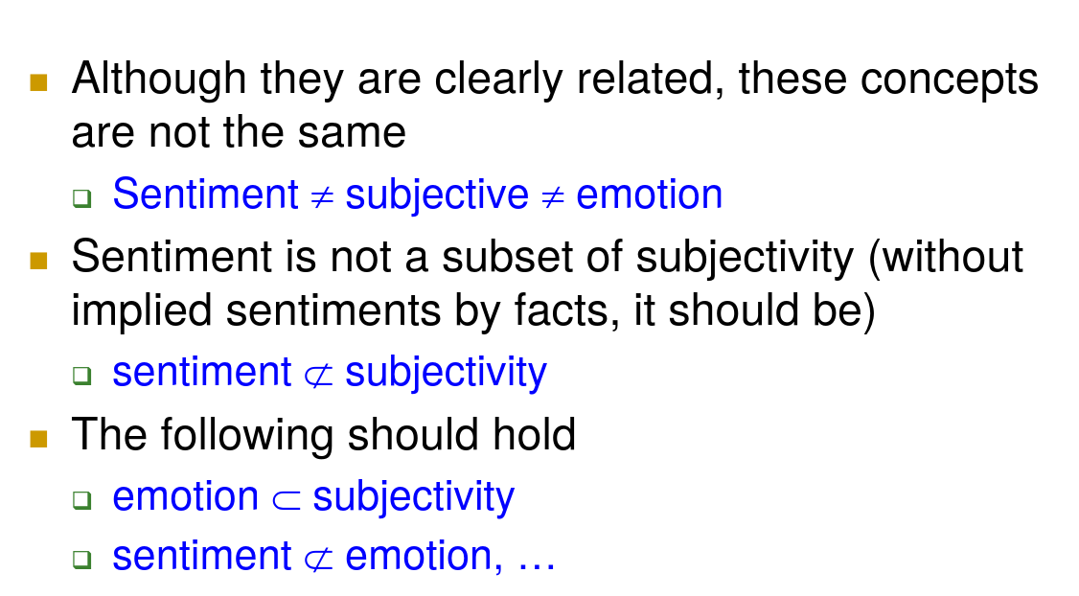
Sentiment, Subjectivity and Emotions

Slide 23
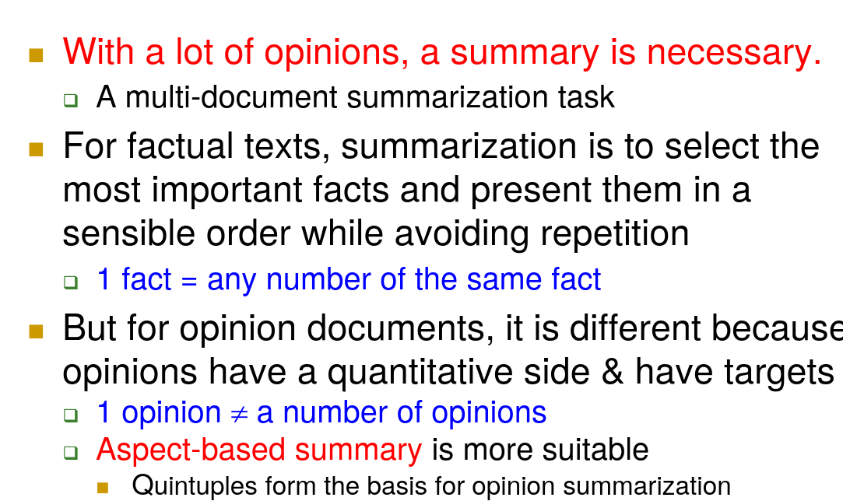
Opinion Summary

Slide 24
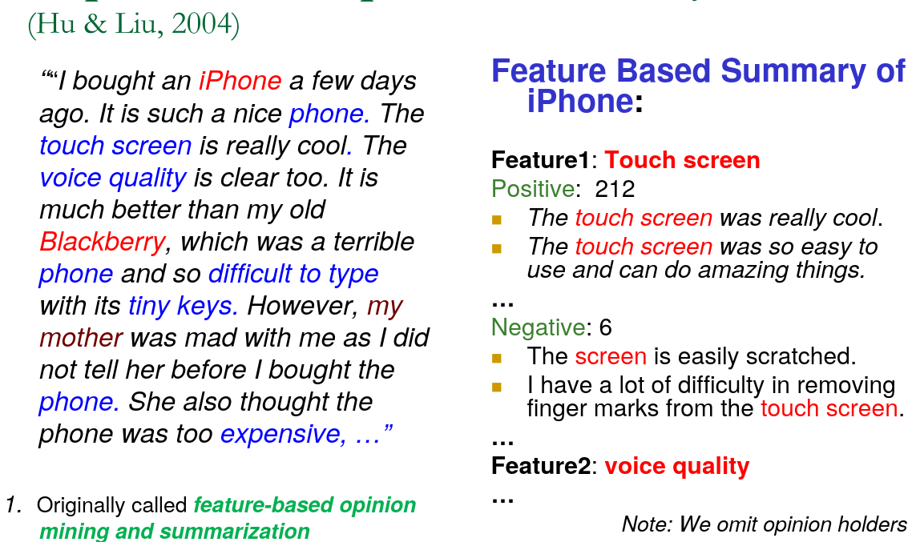
Aspect Based Opinion Summary

Slide 25
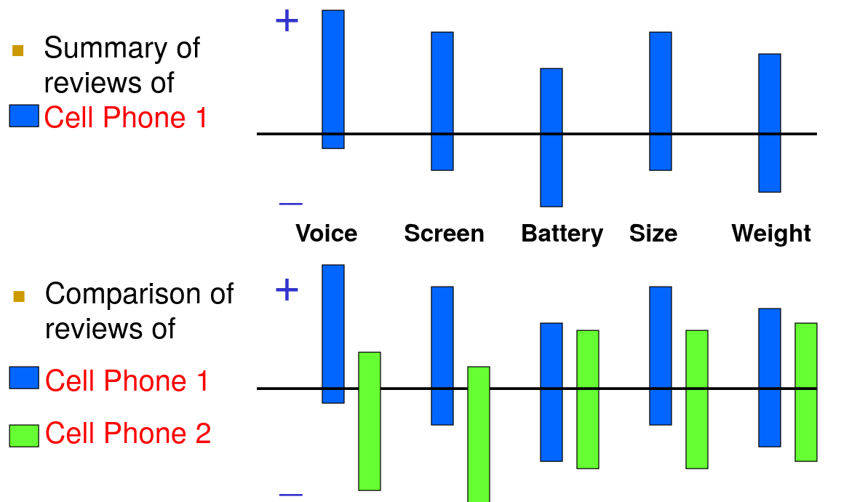
Opinion Observer (Liu et al. 2005)

Slide 26
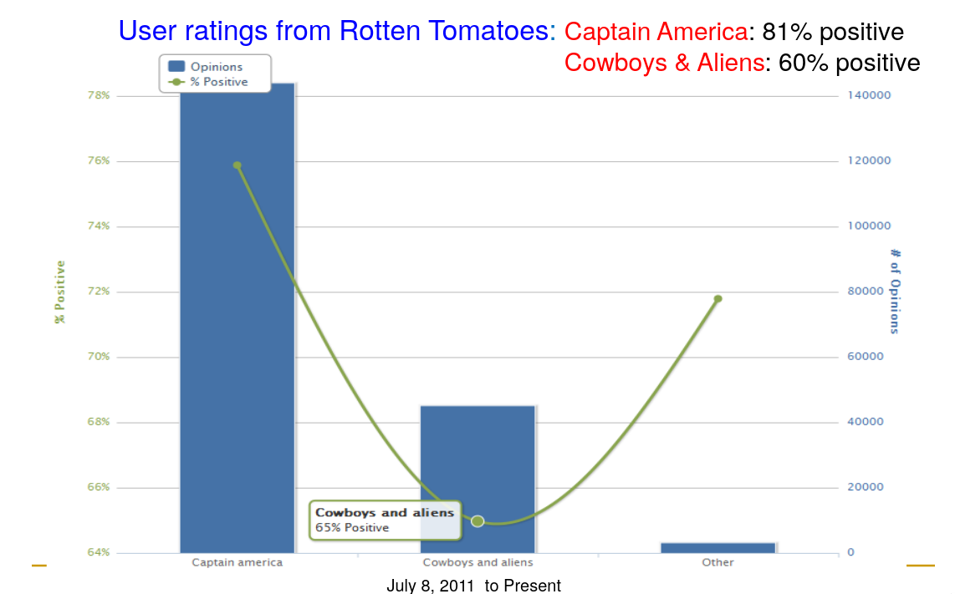
Live tracking of two movies

Slide 27
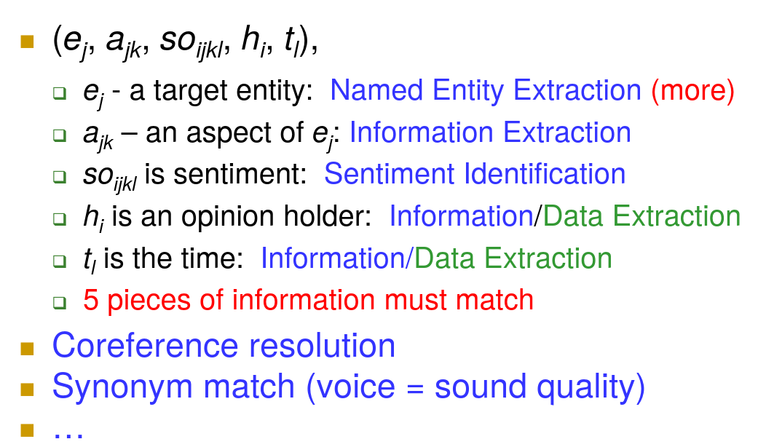
Multi-faceted problem

Slide 28
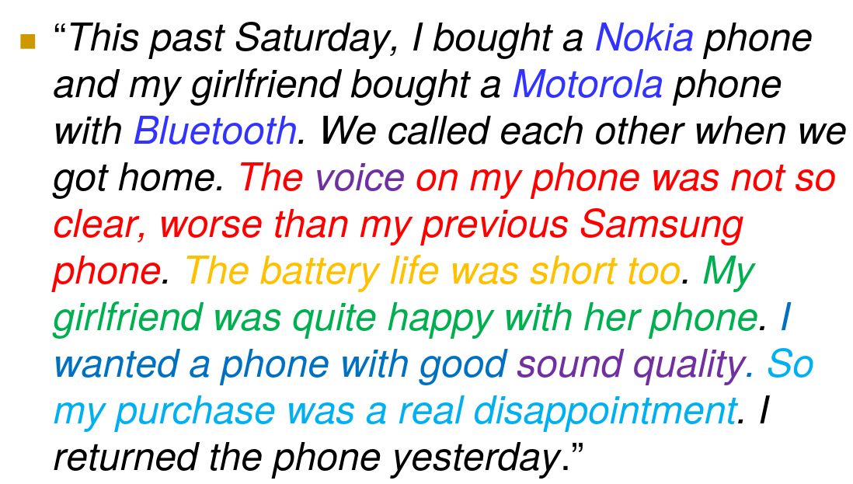
It could be difficult

Slide 29
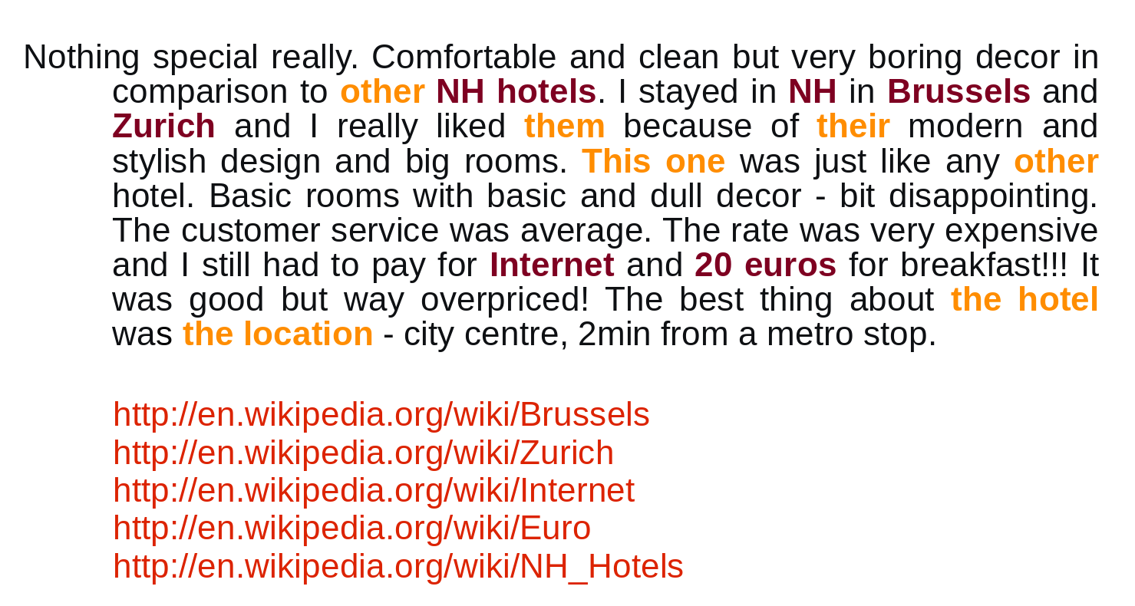
Coreference

Slide 30
Coreference in ABSA 2016
<Review rid="1118167">
<sentences>
<sentence id="1118167:2">
<text>The pizza was delivered cold and the cheese wasn't even fully melted!</text>
<Opinions>
<Opinion target="pizza" category="FOOD#QUALITY" polarity="negative" from="4" to="9"/>
<Opinion target="cheese" category="FOOD#QUALITY" polarity="negative" from="37" to="43"/>
</Opinions>
</sentence>
<sentence id="1118167:3">
<text>It looked like shredded cheese partly done - still in strips.</text>
<Opinions>
<Opinion target="NULL" category="FOOD#STYLE_OPTIONS" polarity="negative" from="0" to="0"/>
</Opinions>
</sentence>
</sentences>
</Review>

Slide 31
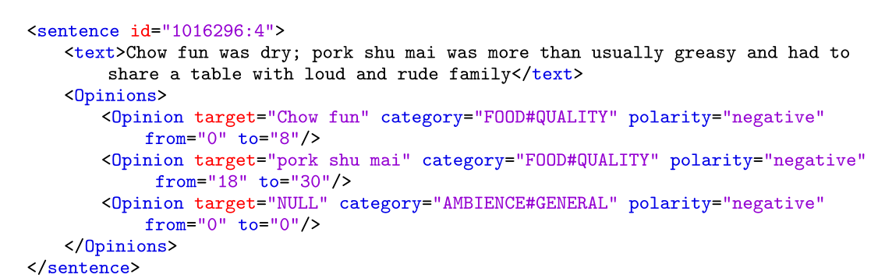
ABSA 2016

Slide 32
Opinion Target Extraction
Chow/B-target fun/I-target was/O dry/O;
pork/B-target shu/I-target mai/I-target was/O more/O than/O usually/O greasy/O and/O
had/O to/O share/O a/O table/O with/O loud/O and/O rude/O family/O (NULL)

Slide 33
Sequence Labelling
Chow/B-FOOD#QUALITY fun/I-FOOD#QUALITY was/O dry/O;
pork/B-FOOD#QUALITY shu/I-FOOD#QUALITY mai/I-FOOD#QUALITY was/O more/O than/O usually/O greasy/O
and/O had/O to/O share/O a/O table/O with/O loud/O and/O rude/O family/O.

Slide 34
Sequence Labelling
Chow fun was/O dry/B-FOOD#QUALITY;
pork shu mai was/O more/O than/O usually/O greasy/O
and/O had/O to/O share/O a/O table/O with/O loud/B-AMBIANCE#GENERAL and rude/B-AMBIANCE#GENERAL family/O
Chow fun (target) was O dry (polarity expression).

Slide 35
Multilabel Classification
Chown fun was dry, pork shu mai was more than usually greasy and had to share a table with loud and rude family
Task: FOOD#QUALITY FOOD#QUALITY AMBIANCE#GENERAL

Slide 36
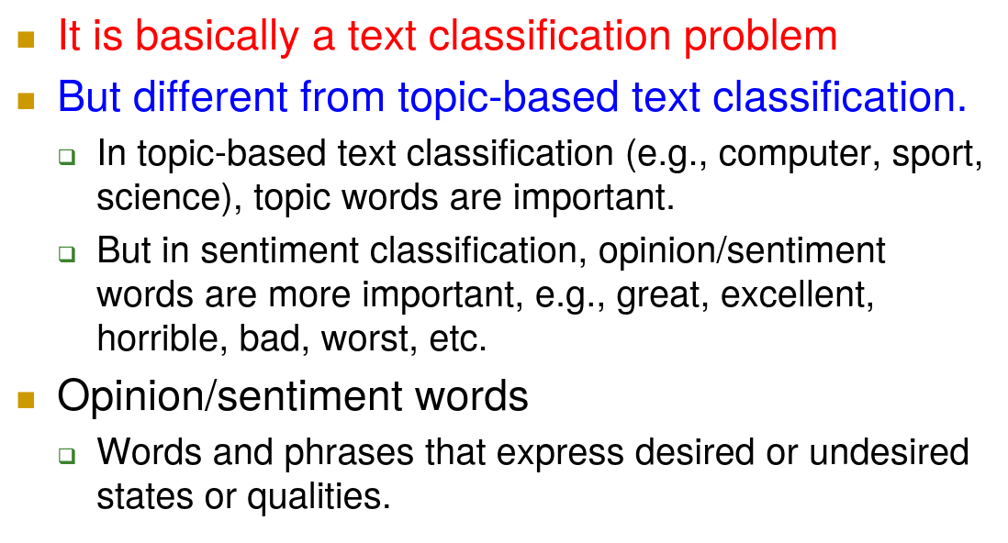
Sentiment Analysis (polarity classification)

Slide 37
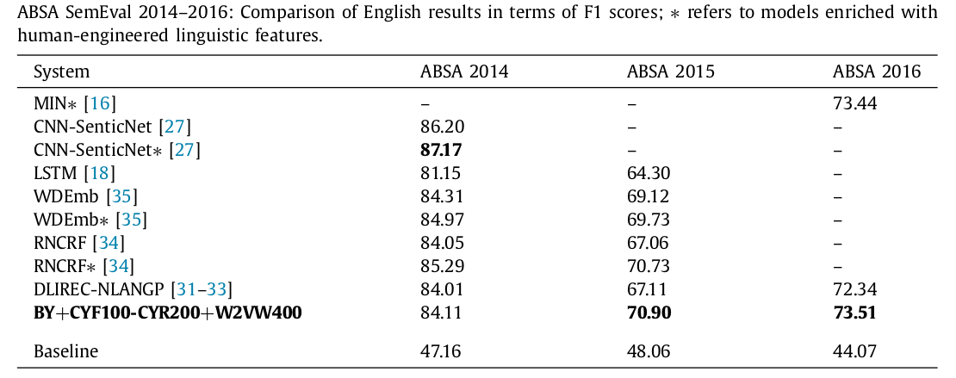
English results

Slide 38
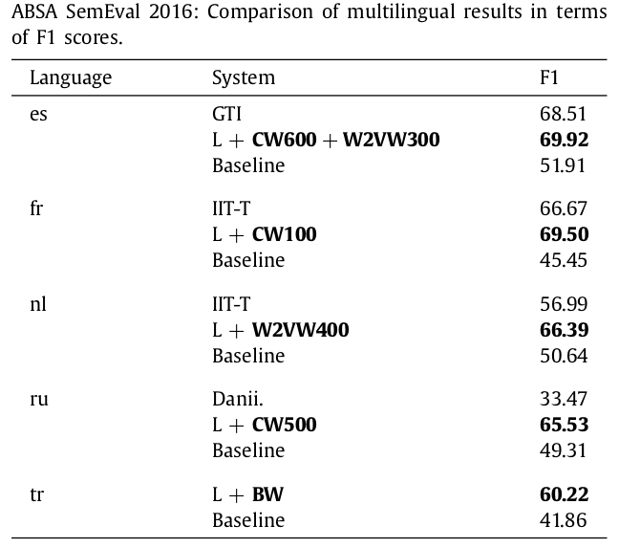
Multilingual results

Slide 39
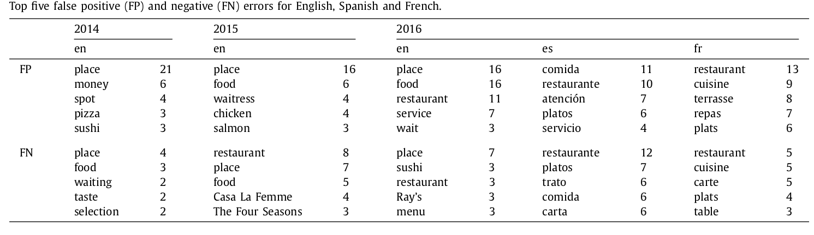
Error analysis

Slide 40
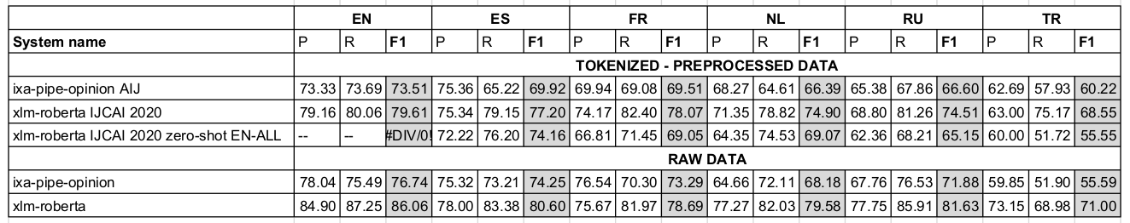
Preprocessing does not help
Huge benefits of tagging on raw data:
ixa-pipe-opinion improves over previous sota, including neural network approaches
xlm-roberta: large pre-trained LMs help with small training datasets

Slide 41
Mila esker!
Thanks!

