Slide 1
Text Classification
http://www.ixa.eus/iltapp/
@ragerri @joseba_fdl @iker_garciaf #iltapp
(some slides adapted from ANLP, David Bamman)

Slide 2
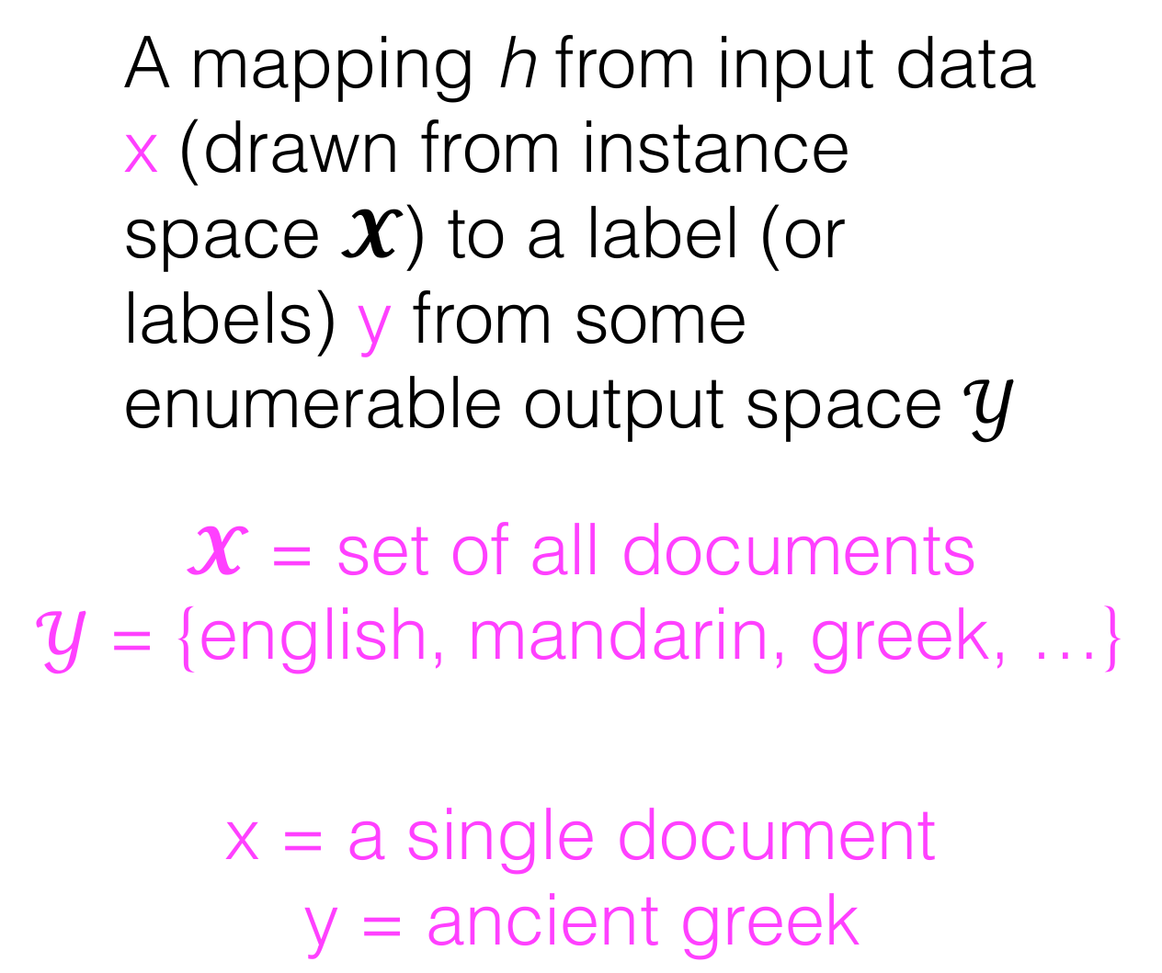
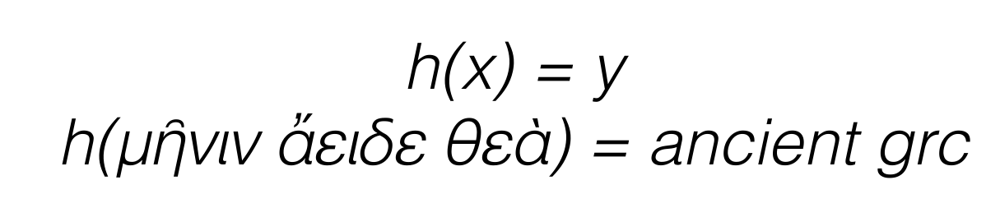
Classification

Slide 3
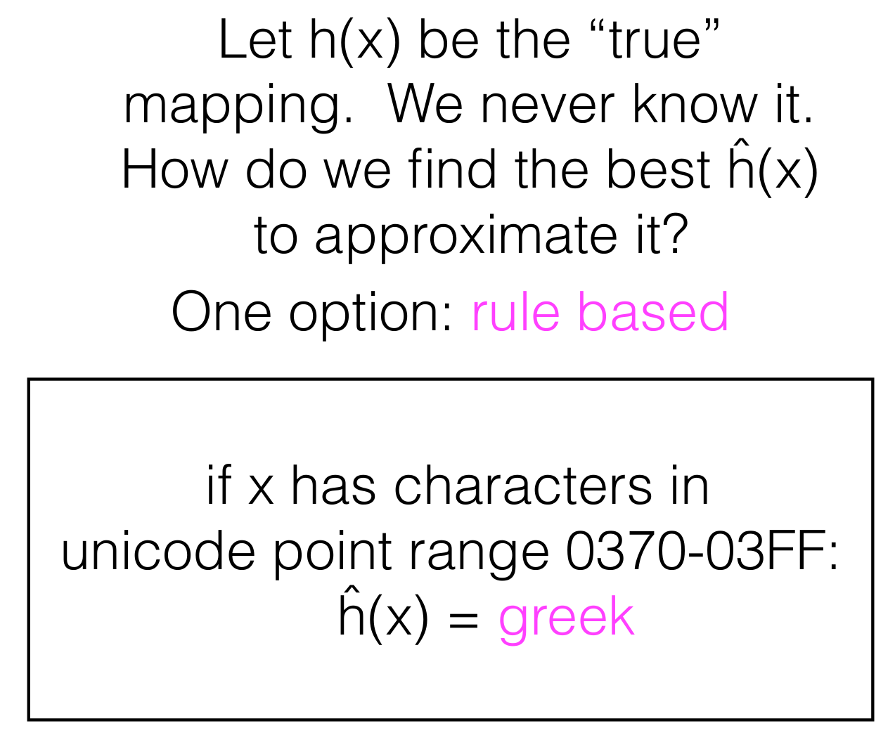
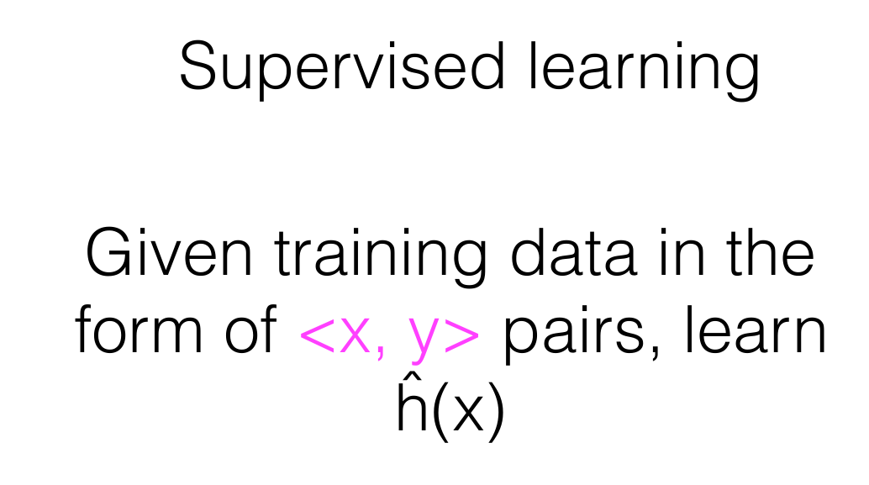
Classification

Slide 4
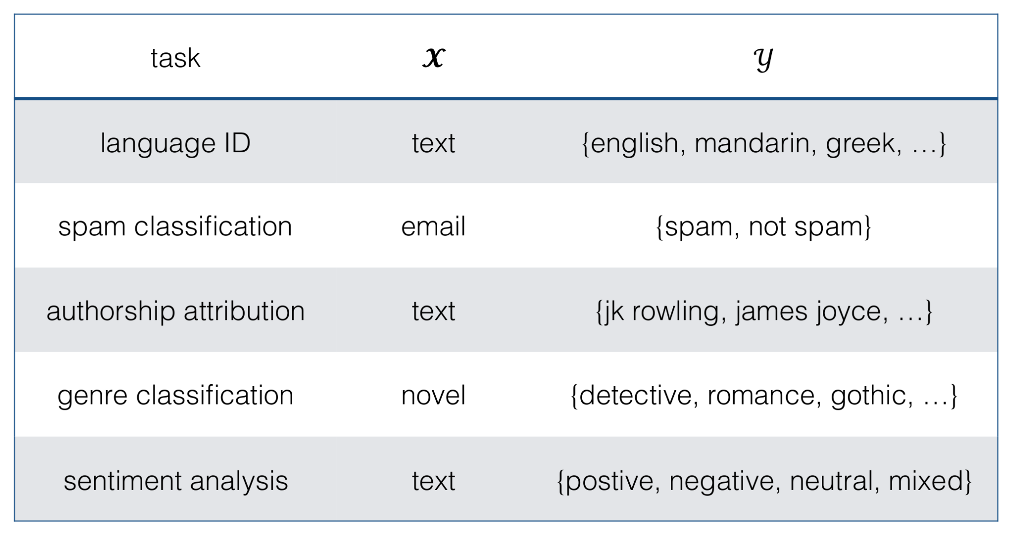
Text Classification - Tasks

Slide 5
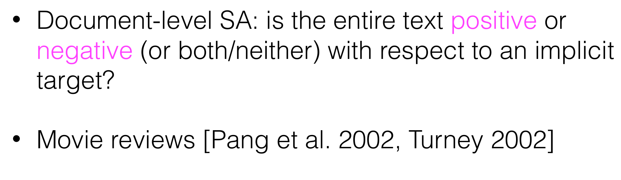
Sentiment Analysis

Slide 6
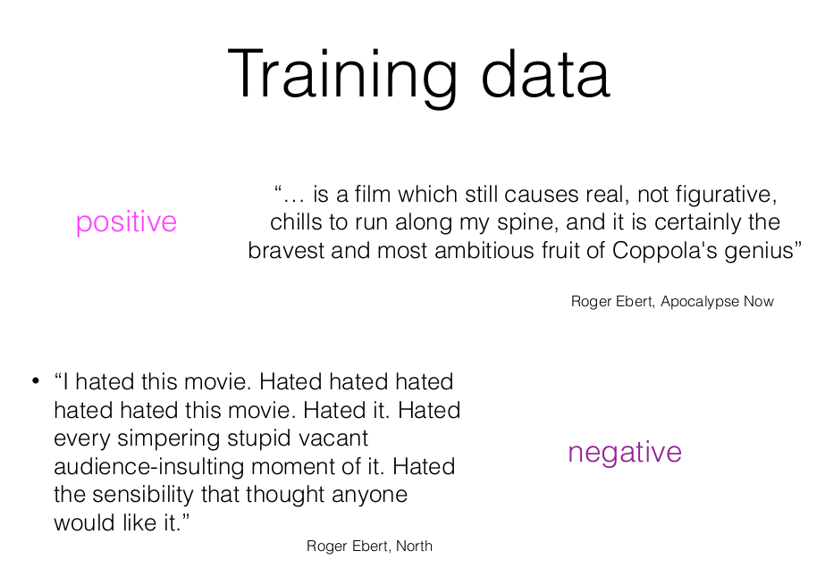
Sentiment Analysis - Supervised approach

Slide 7
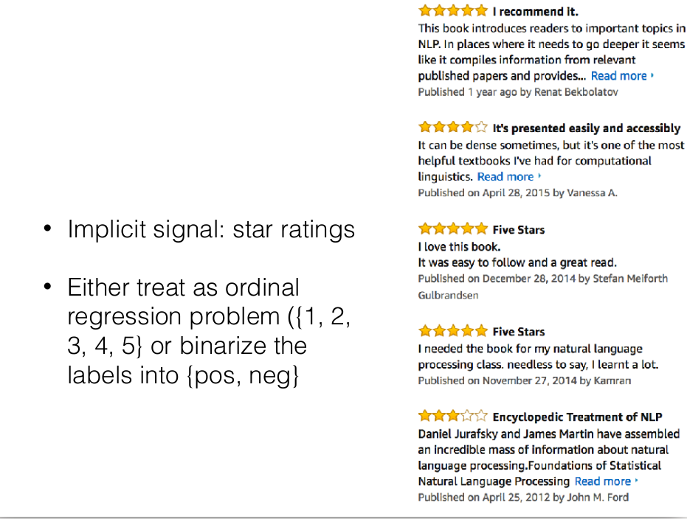
Sentiment Analysis - Supervised approach

Slide 8
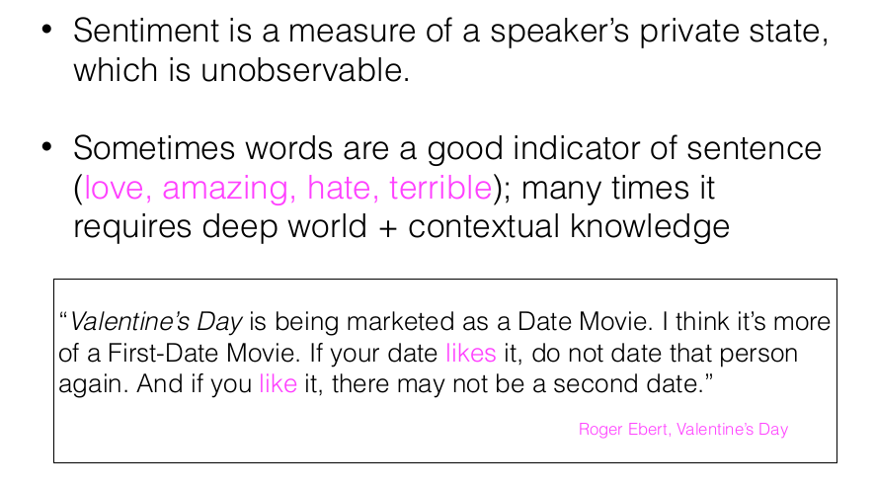
Sentiment Analysis - Supervised approach

Slide 9
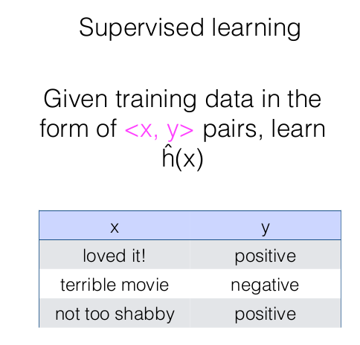
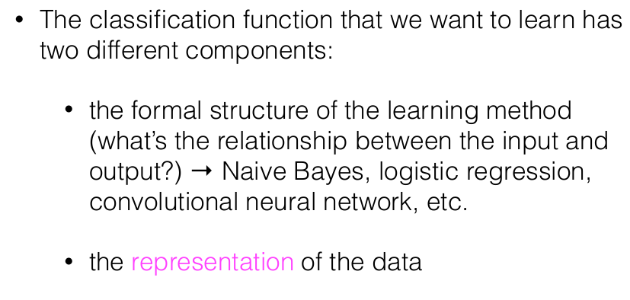
Sentiment Analysis - Supervised approach

Slide 10
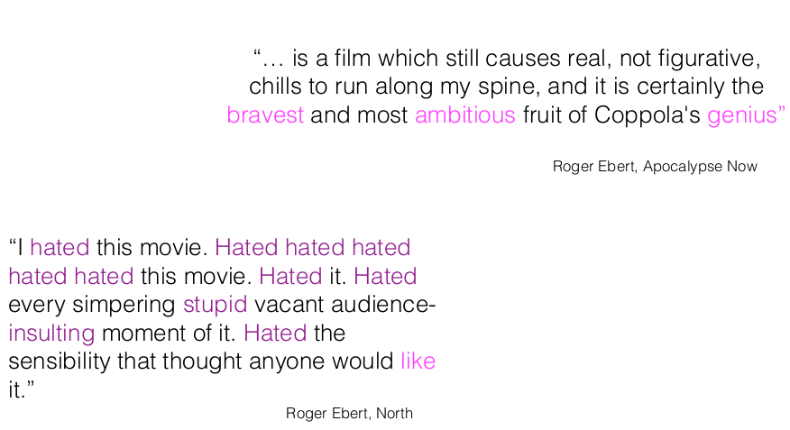
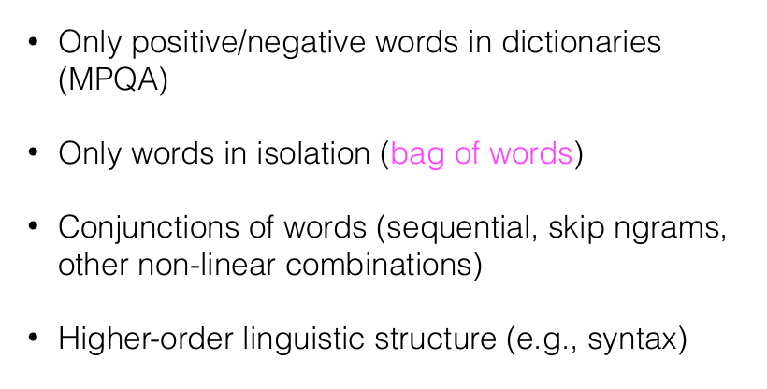
Representation of Words - Supervised approach

Slide 11
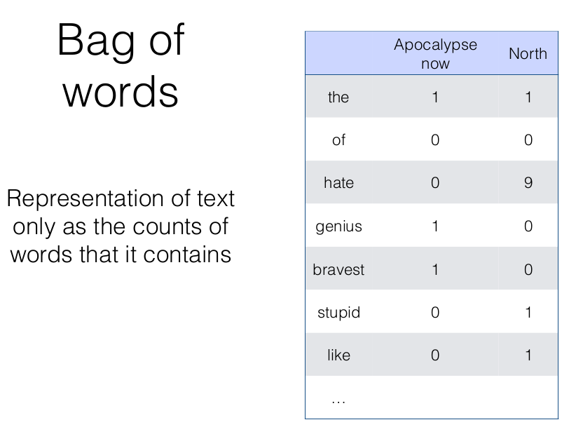
Representation of Words - Supervised approach

Slide 12
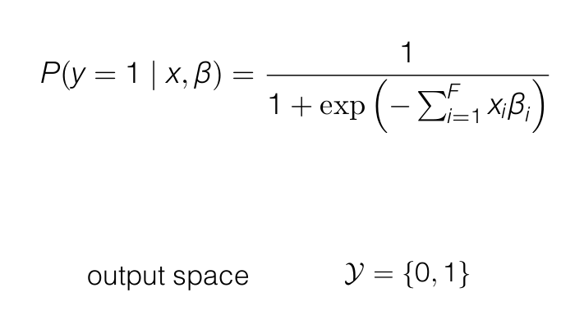
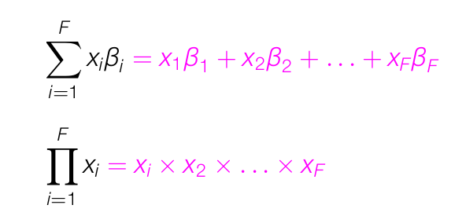
Classification method - Supervised approach

Slide 13
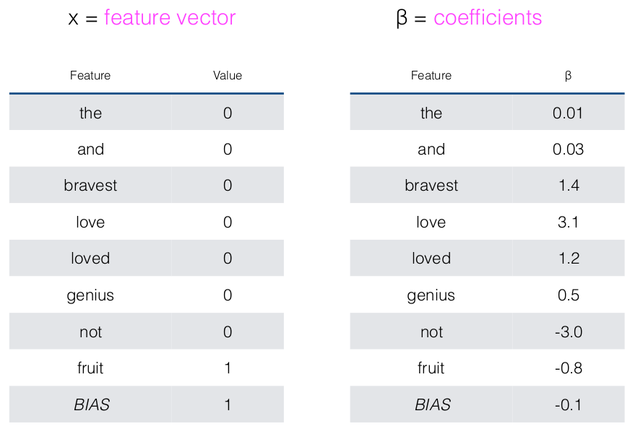
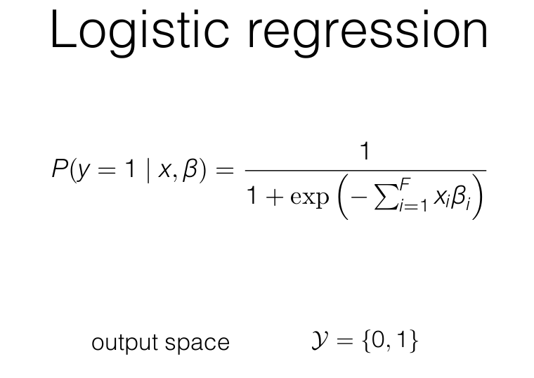
Classification method - Supervised approach

Slide 14
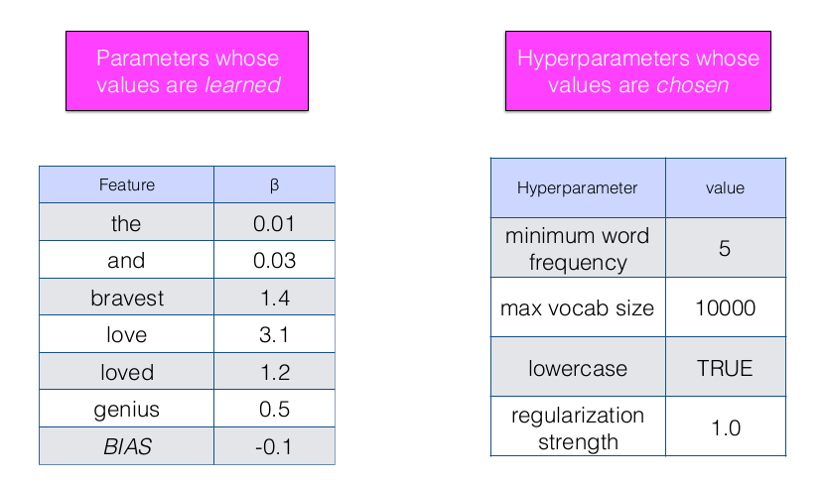
Classification method - Supervised approach

Slide 15
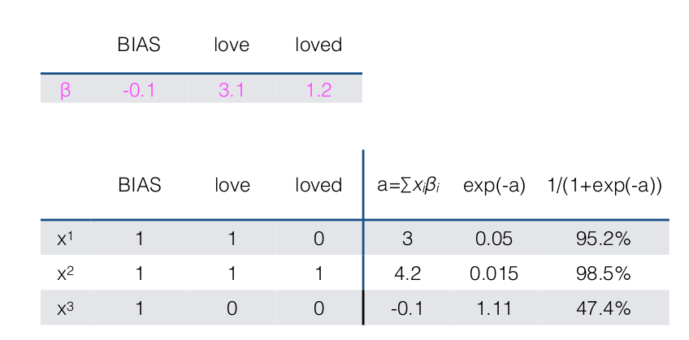
Classification method - Supervised approach

Slide 16
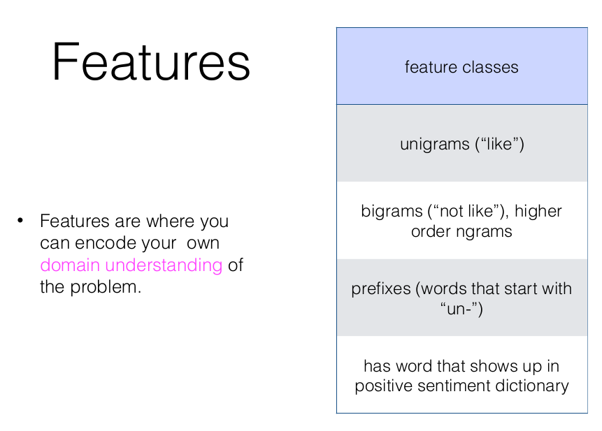
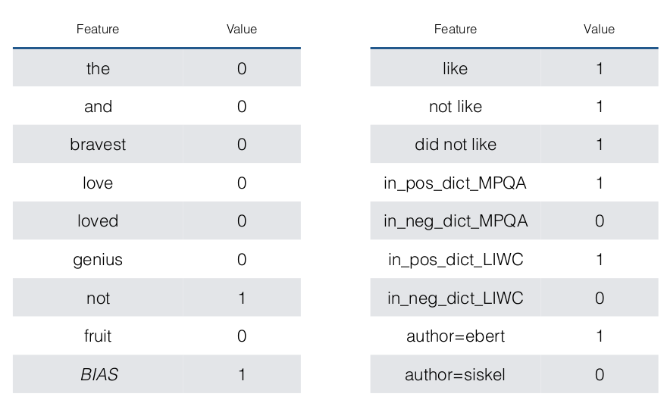
Classification - Supervised approach

Slide 17
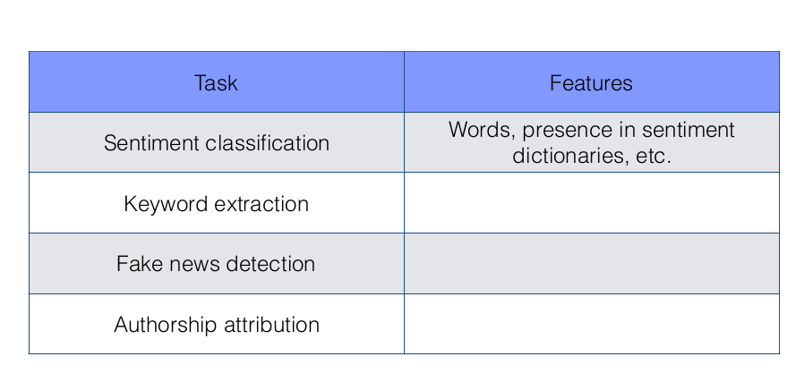
Classification - Supervised approach

Slide 18
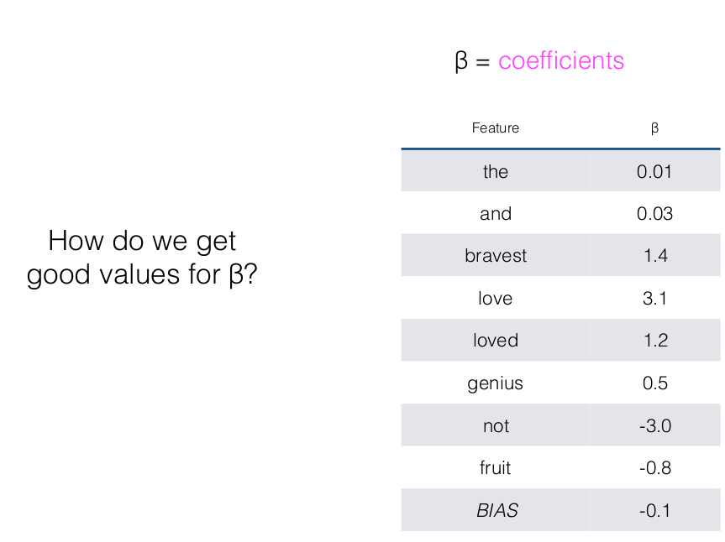
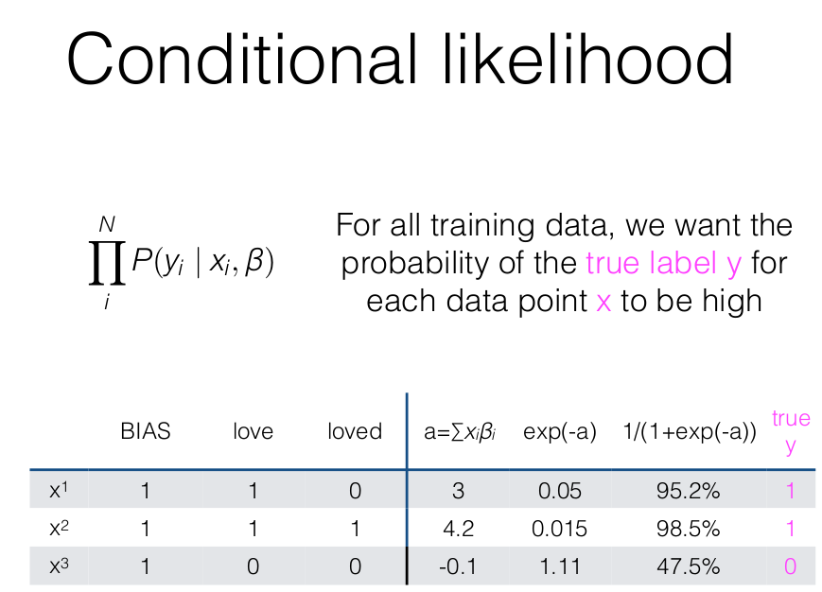
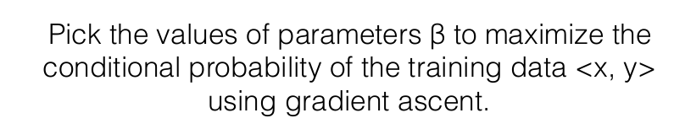
Learning Parameters - Supervised approach

Slide 19
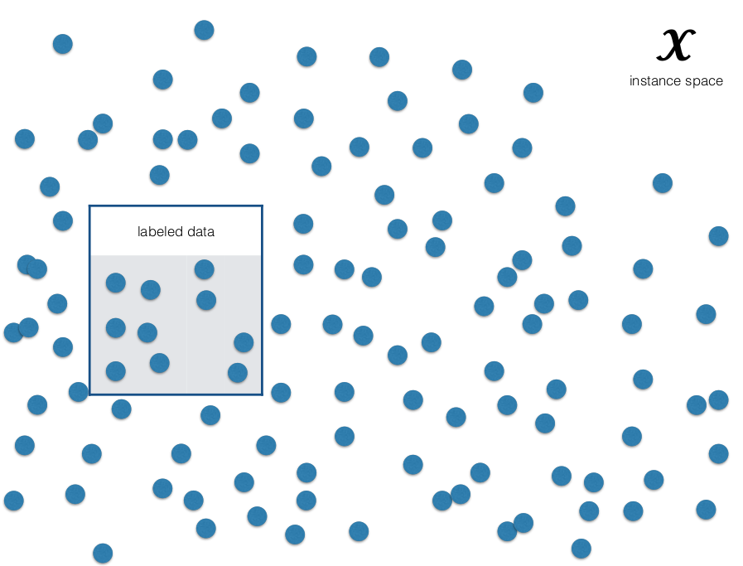
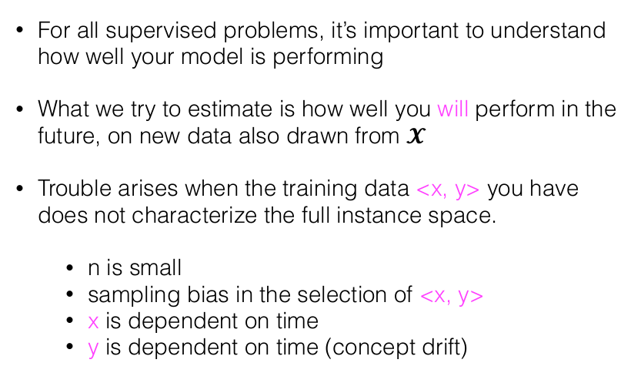
Evaluation - Supervised approach

Slide 20
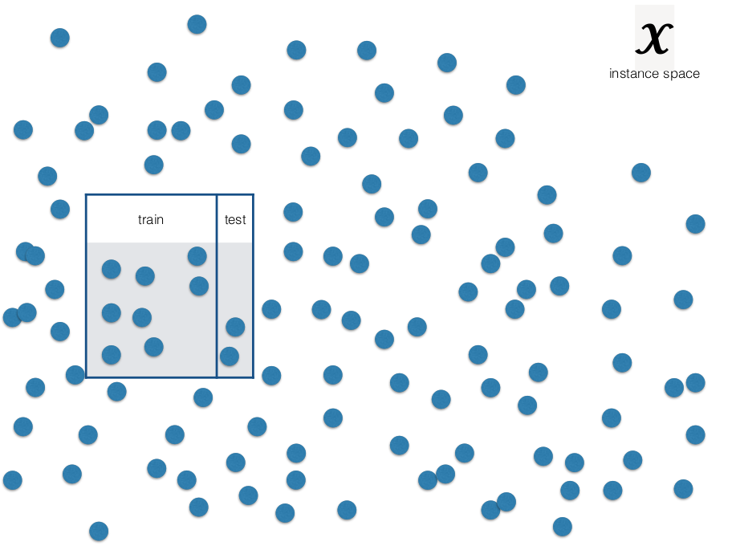
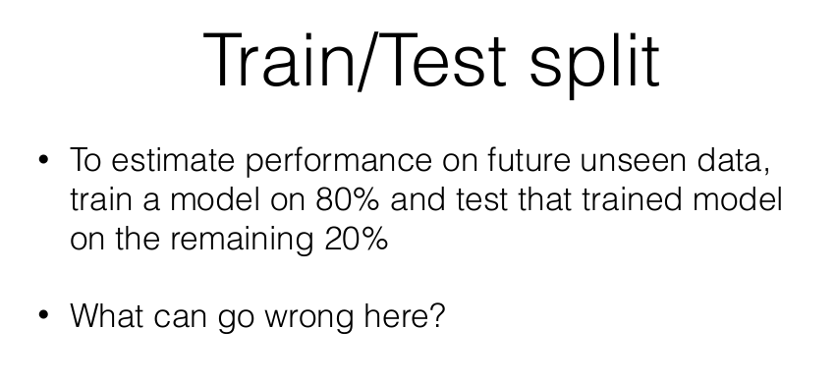
Evaluation - Supervised approach

Slide 21
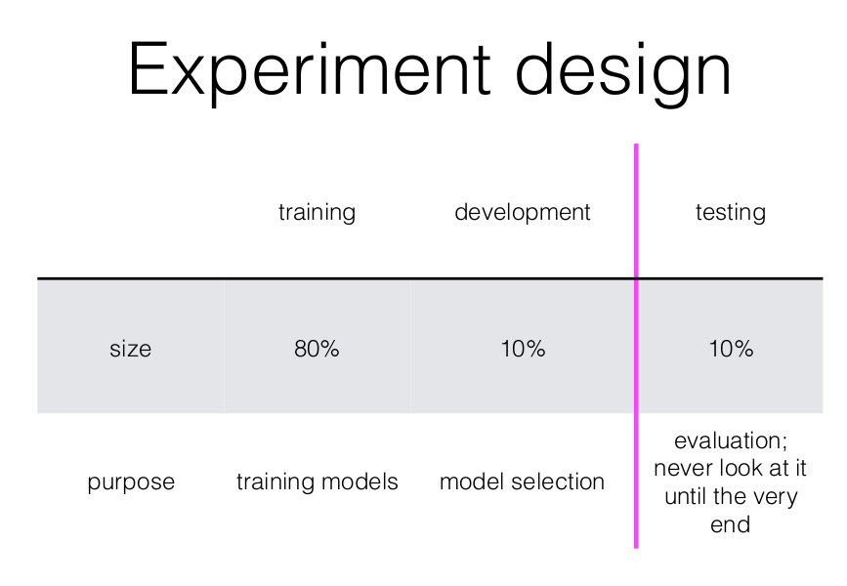
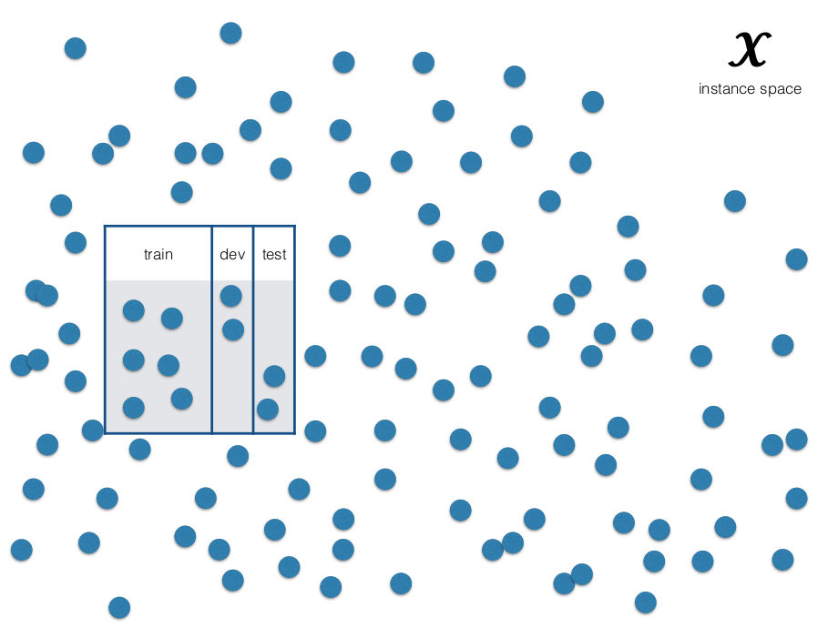
Evaluation - Supervised approach

Slide 22
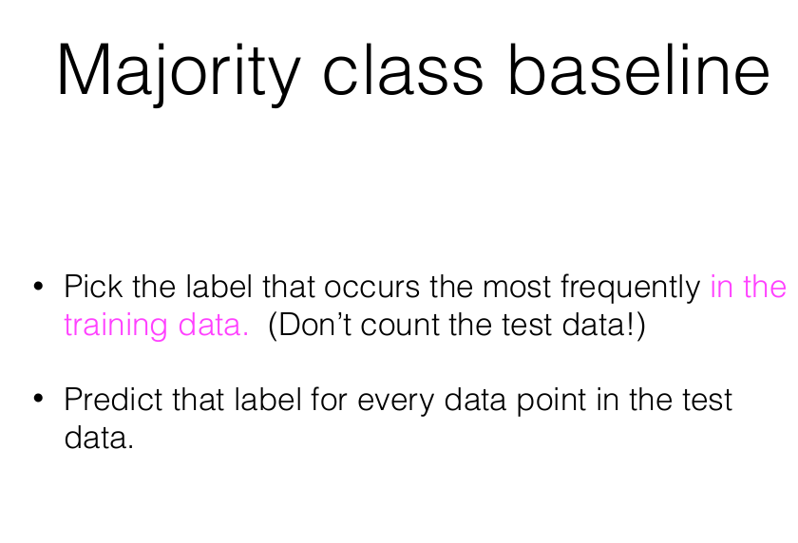
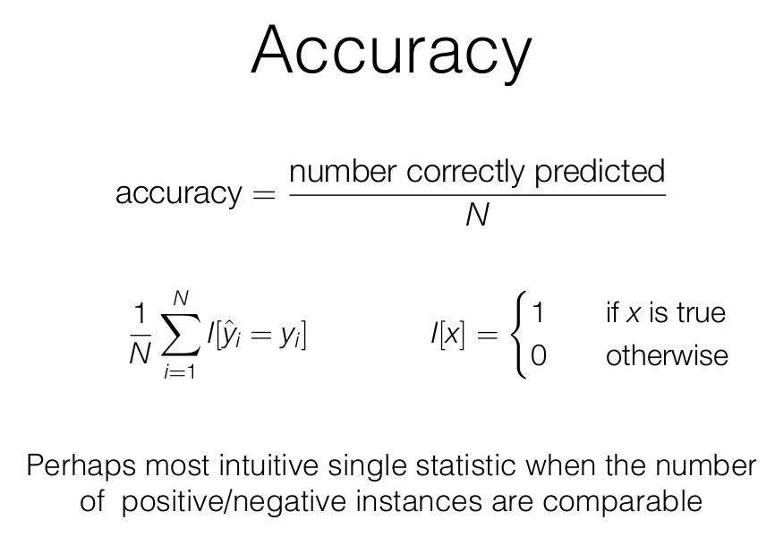
Evaluation - Supervised approach

Slide 23
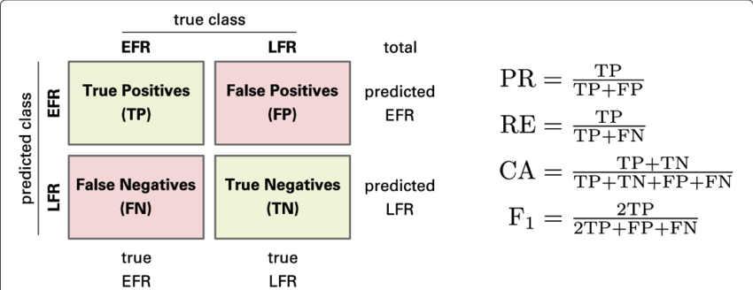
Evaluation - Supervised approach
Accuracy may favour most common class
https://www.researchgate.net/publication/330174519_Application_of_an_interpretable_classification_model_on_Early_Folding_Residues_during_protein_folding

Slide 24
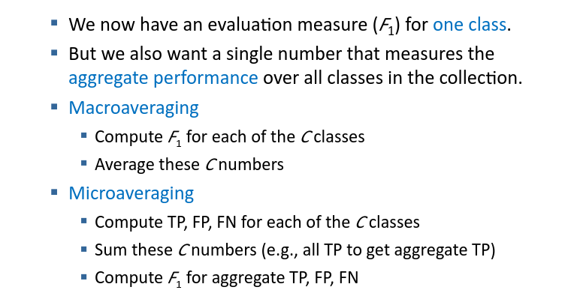
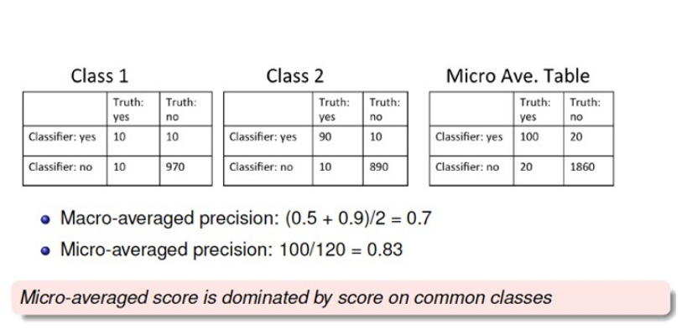
Evaluation - Supervised approach

