Slide 1
Twitter corpus about technology for sentiment and emotion analysis with automatic and manual annotation
Building Language Resources
Oihane Cantero, Julen Etxaniz and Jose Javier Saiz

Slide 2
Index
1. Description
2. Examples
3. Methodology
4. Data Statement
5. License
6. Guidelines
7. Inter Annotator Agreement
8. Adversarial examples
9. Automatic analysis
10. Visualization
11. Remaining work
12. Conclusions

Slide 3
Description
140 monolingual tweets in English
Topic: Technology
Sentiment analysis (positive, negative, neutral)
Emotion detection (joy, sadness, anger, optimism)
Automatic and manual annotation
Regular text and adversarial text

Slide 4
Examples
id | text | adversarial_text | sentiment_manual | sentiment_auto | sentiment_auto_adv | emotion_manual | emotion_auto | emotion_auto_adv
1488301060334759939 | just put a CD into my MacBook to burn it and my computer is literally trembling with reawakened recognition 😆 | just put a compact disk into… | negative | positive (0.532) | positive (0.658) | joy | joy (0.921) | joy (0.725)
1488301057650438144 | oh yeah tesla well what about a car that just logs into your tiktok acct and drives you to starbucks | …about a automobile that… | neutral | neutral (0.655) | neutral (0.782) | joy | joy (0.450) | optimism (0.433)
1488301040160043008 | #100DaysOfCode Haven’t updated in a while due to not feeling well, just been reviewing some HTML/CSS &amp; JavaScript until I feel better to take on new concepts Also been watching mock interviews :) | …been viewing mock interviews :) | negative | neutral (0.500) | positive (0.465) | optimism | sadness (0.691) | sadness (0.536)

Slide 5
Methodology
140 tweets about technology
Exclude retweets, replies, quotes, links to avoid repetitions or spam
20 annotations in common for ITA and guidelines
40 annotations individually after deciding guidelines
Compare manual and automatic annotations
Compare automatic annotations of adversarial examples

Slide 6
Data Statement
Curation Rationale |  | Obtain opinions with pronounced sentiments
Language Variety |  | English BCP 47 code (en)
 |  | Male (70.4%)
Speaker Demographic |  | 18 - 49 years old (78.7%)
 |  | United States
Speech Situation |  | Spontaneous; Time sensitive text
Text Characteristics |  | Context “Interests and Hobbies: Technology''

Slide 7
License
The resource and code are publicly available at GitHub.
Problems with new Twitter policy
Remove tweet text and only keep ID
The code is licensed under the MIT open source license.
Non-code materials provided under terms of the CC BY 4.0 license.

Slide 8
Initial Guidelines
Select only one label for each task
Read one tweet and annotate sentiment and emotion
3 labels for sentiment (positive, negative, neutral)
4 labels for emotion (joy, anger, sadness, optimism)

Slide 9
Inter Annotator Agreement
20 annotations in common for ITA
Calculate agreement and kappa in sentiment and emotions
Look at individual examples for disagreement
Update guidelines if necessary
Repeat annotation with new guidelines
Recalculate agreement and kappa to see improvement
Select the majority class for the final corpus

Slide 10
Inter Annotator Agreement
text | sentiment_ julen | sentiment_ oihane | sentiment_ javier | emotion_ julen | emotion_oihane | emotion_javier
just put a CD into my MacBook to burn it and my computer is literally trembling with reawakened recognition 😆 | negative | positive | negative | anger | joy | joy
oh yeah tesla well what about a car that just logs into your tiktok acct and drives you to starbucks | neutral | positive | negative | joy | joy | anger
#100DaysOfCode Haven’t updated in a while due to not feeling well, just been reviewing some HTML/CSS &amp; JavaScript until I feel better to take on new concepts Also been watching mock interviews :) | negative | negative | negative | sadness | optimism | optimism

Slide 11
Inter Annotator Agreement
Initial agreement and kappa values for each task
Better than expected with very few guidelines
Not good enough, update guidelines
 | sentiment agreement | sentiment kappa | emotion agreement | emotion kappa
julen - oihane | 0.70 | 0.54 | 0.55 | 0.33
julen - javier | 0.60 | 0.40 | 0.40 | 0.13
javier - oihane | 0.60 | 0.39 | 0.65 | 0.46
average | 0.63 | 0.44 | 0.53 | 0.31

Slide 12
Updated Guidelines
Misunderstanding some words (burn CD)
Misunderstanding some symbols (&lt;3 = <3) (&gt; = >)
Look or ask for the meaning
EMOTION |  | SENTIMENT
Problem | Solution | Problem | Solution
If not sure / No emotion | Less specific: Joy | Irony / Sarcasm | Sentiment opposed to the overall sentiment. Either “positive” or “negative”
Joy / Optimism | More general: Joy | Contradicting sentiments | Overall sentiment

Slide 13
Adversarial examples
Create adversarial tweets automatically if possible
Create adversarial tweets manually if necessary
Measure the impact in the accuracy of the models
The aim is to confuse the models
Keep the manual label, no need to annotate again
For example, substituting words with their synonyms
Add these adversarial examples to our final resource

Slide 14
Automatic Analysis
Automatic sentiment and emotion analysis
Huggingface Transformers fine tuned for those tasks (TweetEval)
We select the most probable tag
Pie charts for tag counts
Wordclouds for word frequencies
Comparison with manual annotation
Comparison with adversarial tweets

Slide 15
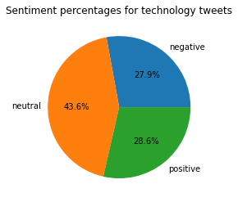
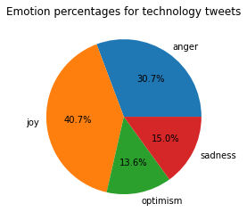
Pie charts
Sentiments
Emotions

Slide 16
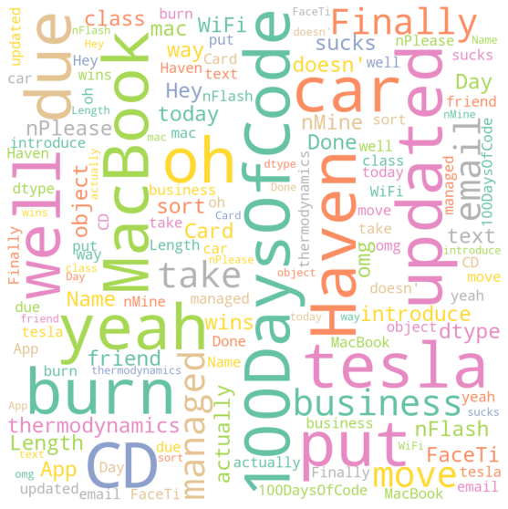
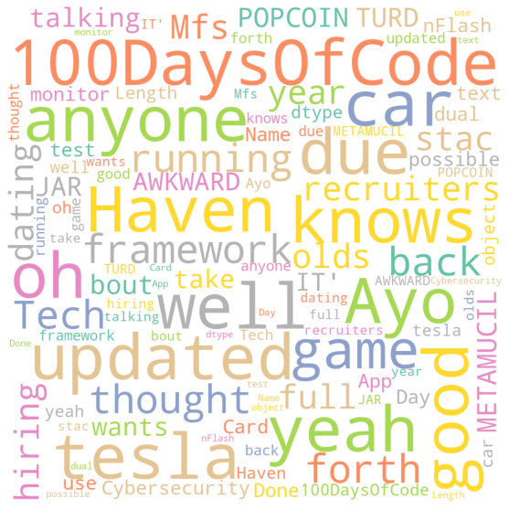
Sentiment wordclouds (all vs neutral)

Slide 17
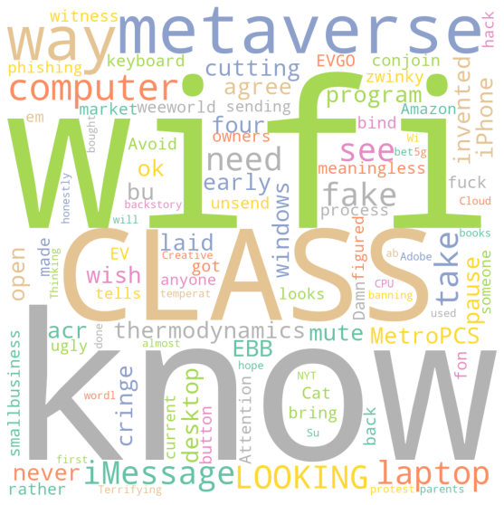
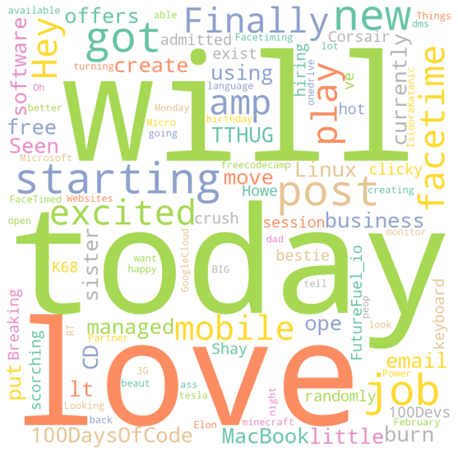
Sentiment wordclouds (negative vs positive)

Slide 18
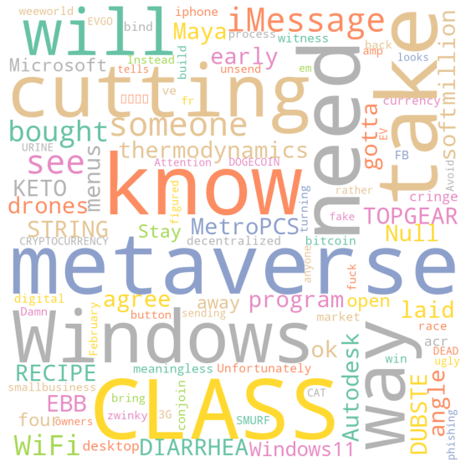
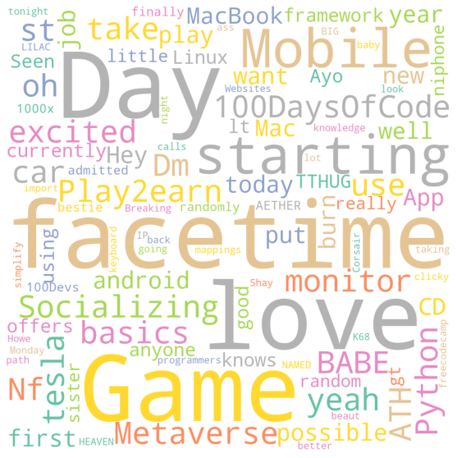
Emotion wordclouds (anger vs joy)

Slide 19
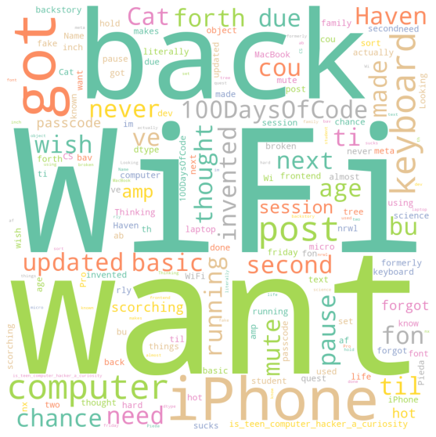
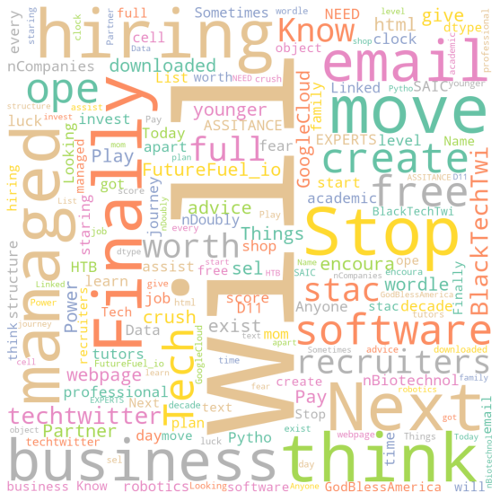
Emotion wordclouds (sadness vs optimism)

Slide 20
Remaining work
Annotate ITA tweets with new guidelines
Recalculate ITA measures
Annotate 40 tweets individually
Create adversarial tweets
Compare manual and automatic annotation
Compare adversarial results
Pie charts and wordclouds for manual annotation

Slide 21
Conclusions
Annotation is more difficult than we thought
Sentiment annotation easier than emotion annotation
Defining good guidelines is important
Creating good adversarial examples automatically is difficult
Visualization is very helpful to identify patterns

Slide 22
Thank you!

