Slide 1
Twitter corpus about technology for sentiment and emotion analysis with automatic and manual annotation
Building Language Resources
Oihane Cantero, Julen Etxaniz and Jose Javier Saiz

Slide 2
Description
Monolingual: English
Topic: Technology
Sentiment analysis (positive, negative, neutral) and emotion detection (joy, sadness, anger, optimism)
Automatic and manual annotation
Regular text and adversarial text

Slide 3
Dataset slice example
id | text | adversarial_text | sentiment_auto | sentiment_annotator | emotion_auto | emotion_annotator
1488301060334759939 | just put a CD into my MacBook to burn it and m... |  | positive (0.532) | positive | joy (0.921) | joy
1488301057650438144 | oh yeah tesla well what about a car that just ... |  | neutral (0.655) | neutral | joy (0.450) | anger
1488301040160043008 | #100DaysOfCode Haven’t updated in a while due ... |  | neutral (0.500) | neutral | sadness (0.691) | joy

Slide 4
Objective
Compare automatic and manual annotation
Compare performance with adversarial instances

Slide 5
Methodology
140 tweets
Exclude retweets, replies, quotes, links
To get better tweets and avoid spams
20 annotations in common + 40 individually
Compare with automatic annotations

Slide 6
Methodology
20 annotations in common
To calculate inter annotator agreement
To make modifications in the guidelines
Adversarial examples
To see if automatic annotation changes

Slide 7
Guidelines

Slide 8
Guidelines for
EMOTION |  | SENTIMENT
If not sure / No emotion | Less specific: Joy | Irony / Sarcasm: | Sentiment opposed to the overall sentiment. Either “positive” or “negative”
Joy / Optimism | More general: Joy | Contradicting sentiments | Overall sentiment

Slide 9
Inter Annotator Agreement
Agreement in sentiment and emotions
20 annotations in common
ITA between us
40 individual annotations
ITA between the annotator and the automatic annotation

Slide 10
Inter Annotator Agreement
Agreement and kappa values for each task
 | sentiment agreement | sentiment kappa | emotion agreement | emotion kappa
julen - oihane | 0.70 | 0.54 | 0.55 | 0.33
julen - javier | 0.60 | 0.40 | 0.40 | 0.13
javier - oihane | 0.60 | 0.39 | 0.65 | 0.46
average | 0.63 | 0.44 | 0.53 | 0.31

Slide 11
Automatic Analysis
Automatic sentiment and emotion analysis
Huggingface Tranformers finetuned for those tasks
These models return the probability of each class
We select the most probable tag
Pie charts for tag counts
Wordclous for word frequencies

Slide 12
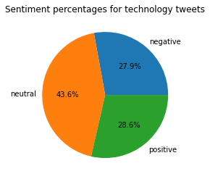
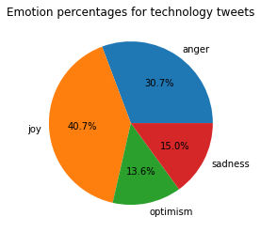
Pie charts
Sentiments
Emotions

Slide 13
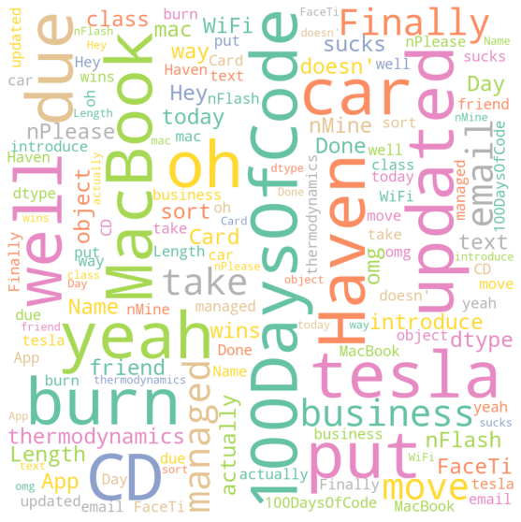
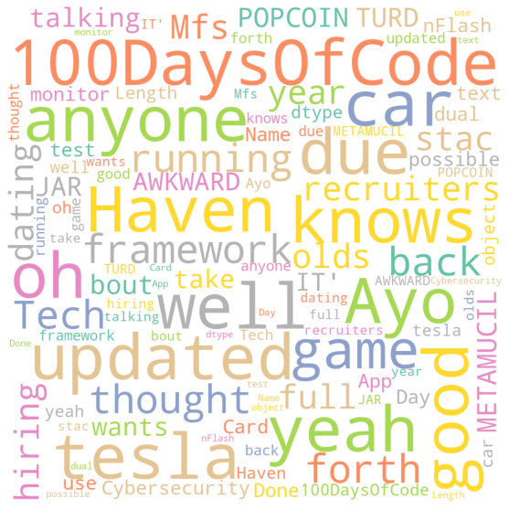
Sentiment wordclouds (all vs neutral)

Slide 14
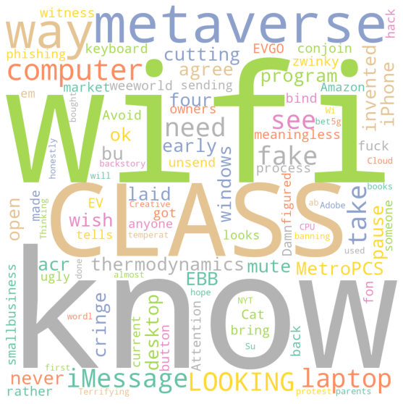
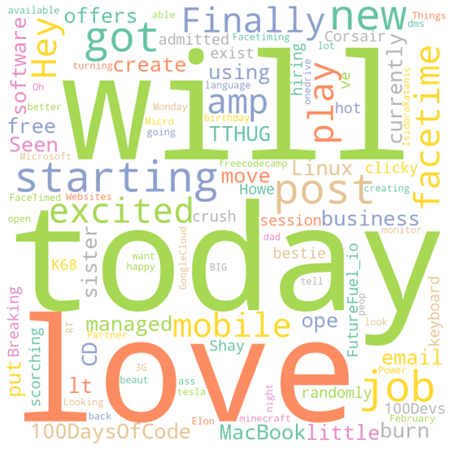
Sentiment wordclouds (negative vs positive)

Slide 15
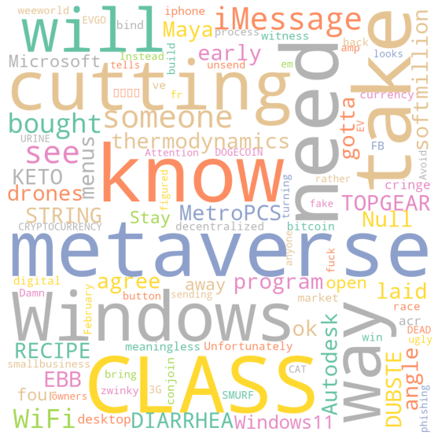
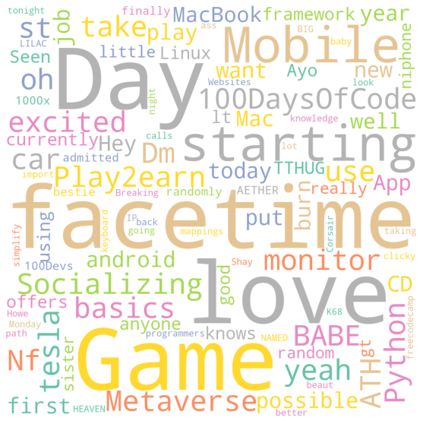
Emotion wordclouds (anger vs joy)

Slide 16
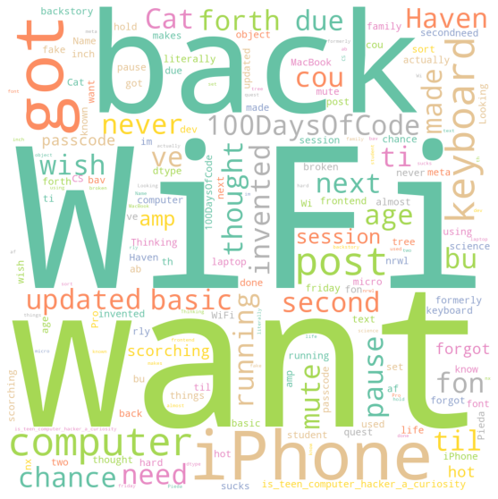
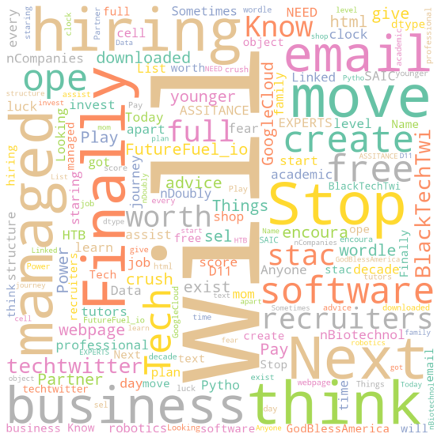
Emotion wordclouds (sadness vs optimism)

