Slide 1
Comparing Writing Systems with G2P and P2G
University of the Basque Country
Language Analysis and Processing
Computational Morphology
Julen Etxaniz

Slide 2
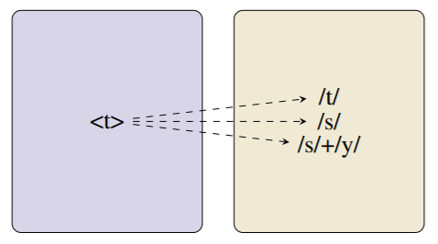
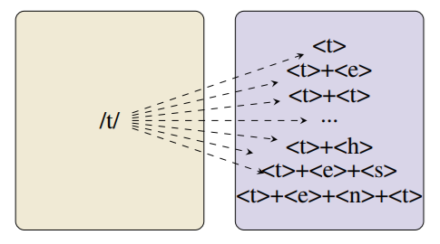
1. Introduction
G2P (Reading)
P2G (Writing)
acquitter a k i t e
ablatif a b l a t i f
auguste o ɡ y s t
athlète a t l ɛ t
abolition a b ɔ l i s j ɔ̃
actes a k t
assistent a s i s t

Slide 3
Data

Slide 4
Preprocessing
Language | Code | Graphemes | Phonemes | Average Graphemes | Average Phonemes
Armenian (Eastern) | arm_e | 38 | 41 | 7.09 | 7
Bulgarian | bul | 29 | 45 | 8.44 | 8.64
Dutch | dut | 30 | 45 | 7.71 | 6.99
French | fre | 37 | 37 | 7.52 | 5.75
Georgian | geo | 33 | 33 | 7.74 | 7.74
Serbo-Croatian (Latin) | hbs_latn | 27 | 61 | 7.47 | 7.36
Hungarian | hun | 34 | 61 | 7.65 | 7.18
Japanese (Hiragana) | jpn_hira | 76 | 64 | 4.21 | 6.56
Korean | kor | 559 | 60 | 2.58 | 6.54
Vietnamese (Hanoi) | vie_hanoi | 89 | 49 | 5.81 | 7.51
Average | average | 95.2 | 49.6 | 6.62 | 7.13

Slide 5
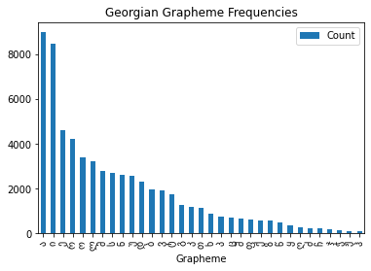
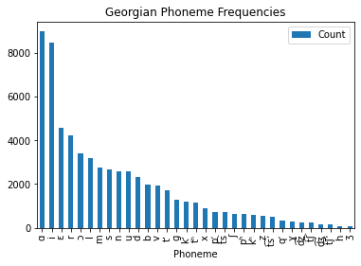
Preprocessing

Slide 6
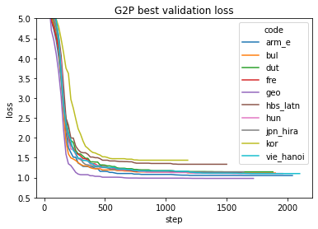
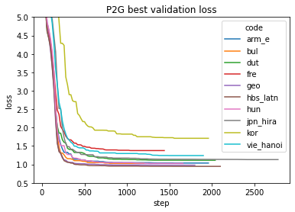
Training

Slide 7
Testing

Slide 8
Results – G2P Baseline
Code | Baseline Dev | Transformer Dev | Baseline Test | Transformer Test
arm_e | 4.50 | 6.5 | 7.00 | 8.90
bul | 8.30 | 14.9 | 18.30 | 20.10
dut | 10.80 | 12.0 | 14.70 | 16.90
fre | 7.40 | 9.5 | 8.50 | 10.20
geo | 0.00 | 0.3 | 0.00 | 0.10
hbs_latn | 34.70 | 49.2 | 32.10 | 47.70
hun | 1.50 | 2.8 | 1.80 | 1.90
jpn_hira | 6.20 | 8.4 | 5.20 | 8.50
kor | 18.40 | 33.4 | 16.30 | 30.20
vie_hanoi | 1.30 | 4.0 | 2.50 | 6.00
average | 9.31 | 14.1 | 10.64 | 15.05

Slide 9
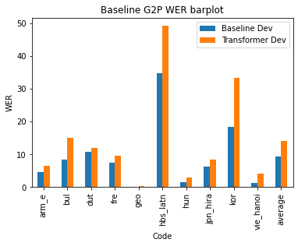
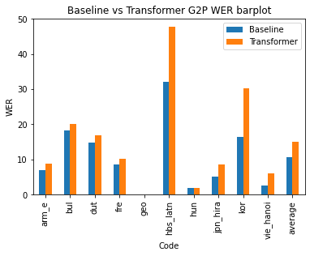
Results – G2P Baseline

Slide 10
Results – G2P and P2G
Code | G2P Train | G2P Dev | G2P Test | P2G Train | P2G Dev | P2G Test
arm_e | 1.16 | 6.5 | 8.90 | 0.57 | 4.40 | 5.70
bul | 0.34 | 14.9 | 20.10 | 16.25 | 19.70 | 27.30
dut | 2.59 | 12.0 | 16.90 | 2.67 | 18.00 | 23.00
fre | 2.04 | 9.5 | 10.20 | 32.96 | 53.50 | 54.00
geo | 0.06 | 0.3 | 0.10 | 0.12 | 0.30 | 0.50
hbs_latn | 22.56 | 49.2 | 47.70 | 0.09 | 0.20 | 0.60
hun | 0.64 | 2.8 | 1.90 | 0.84 | 6.20 | 4.80
jpn_hira | 2.74 | 8.4 | 8.50 | 0.59 | 2.40 | 3.90
kor | 19.27 | 33.4 | 30.20 | 11.84 | 22.80 | 22.10
vie_hanoi | 0.44 | 4.0 | 6.00 | 5.35 | 15.00 | 16.30
average | 5.18 | 14.1 | 15.05 | 7.13 | 14.25 | 15.82

Slide 11
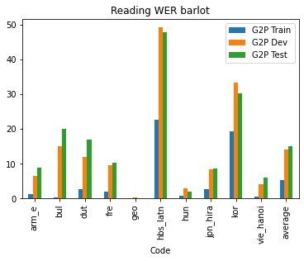
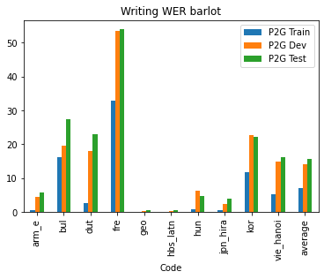
Results – G2P and P2G

Slide 12
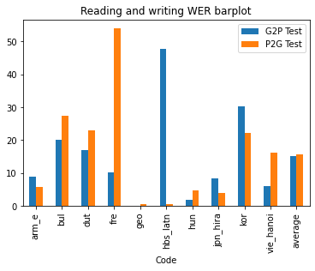
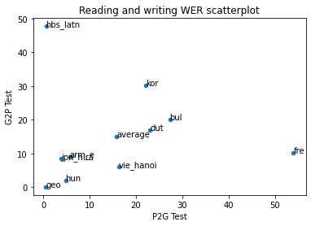
Results – G2P and P2G

Slide 13
Conclusions

