Slide 1
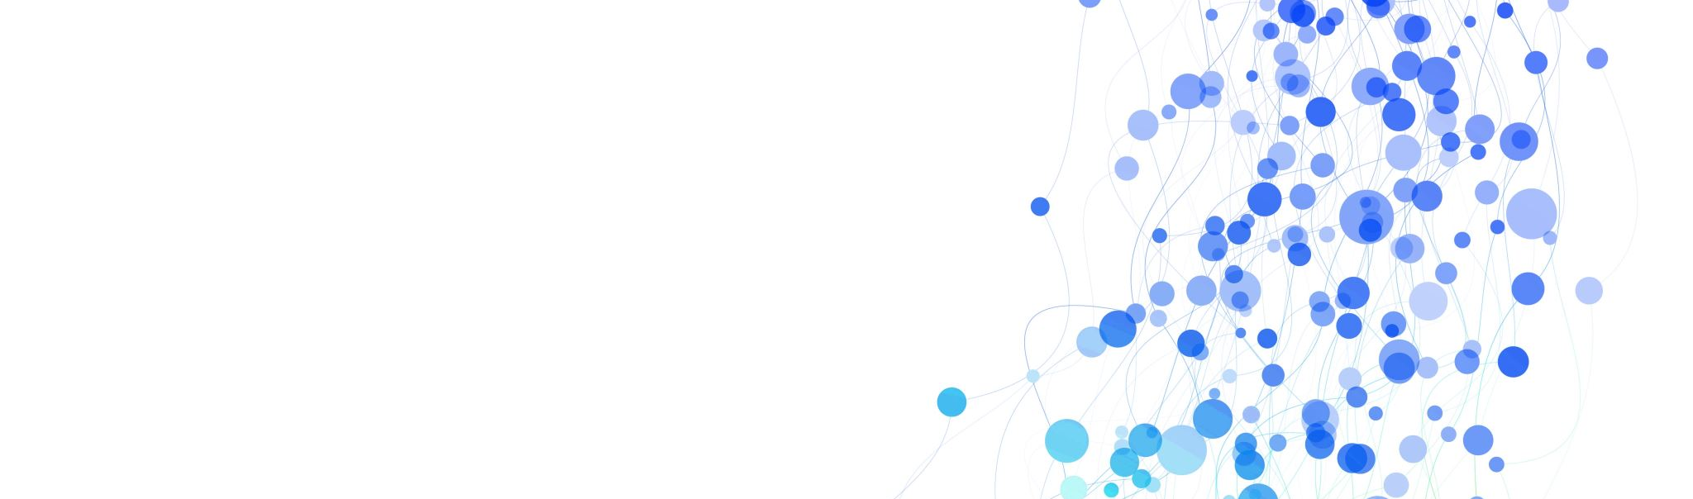
5/15 Ammonia and Hydrogen Work Review
Visiting Student: Julian Florez

Slide 2
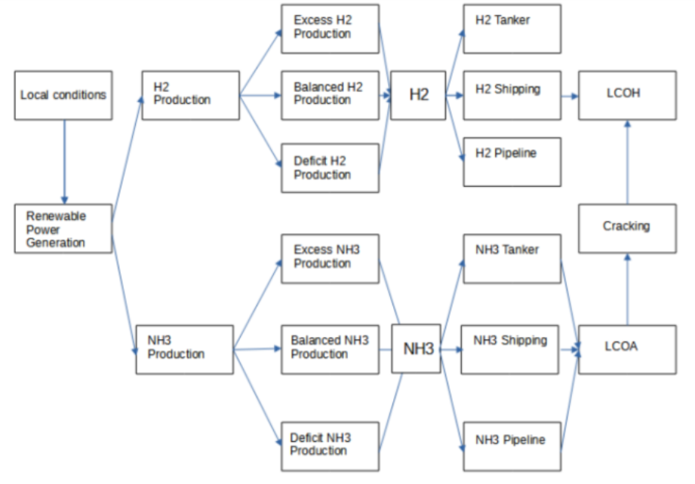
Reviewing Prior work by Duncan Taylor
Main project goal was computing the LCOH and LCOA
Built in Matlab and run through a GUI
Really not the most user friendly and little documentation on the code
Not extensible for including other decision vars
No optimization being done
H₂ has 2 different production routes and 3 transportation options
Assume tanker implies road transportation
Not clear why exactly they are mutually exclusive
E.g. shipping to port, transport to decentralized cacker by rail/truck for eventual hydrogen consumption
*From last weekly report by Duncan Taylor

Slide 3
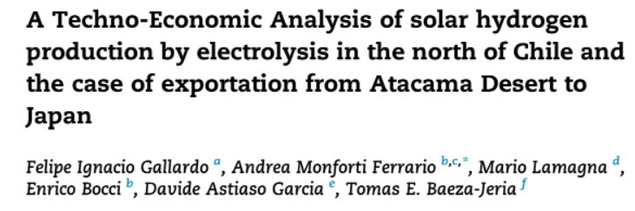
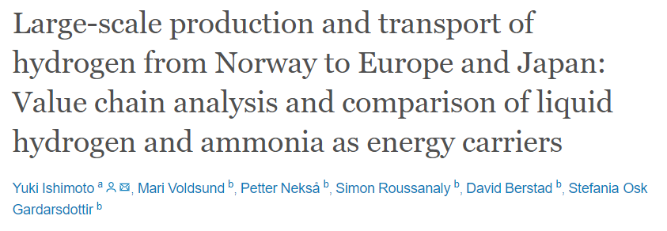
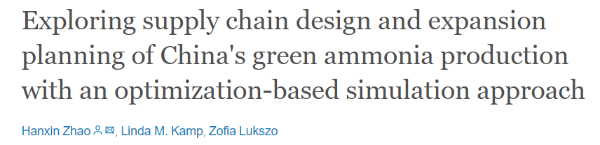
Comparison of Work with other Lit
Decent amount of work has been done on computing LCOH and LCOA with case studies on specific locations/assumptions employed
Lots of sensitivity and assumptions in projects conducted
Need to figure out the core strengths of the model and the end goal
NEOM applications to be considered
4 GW of RE to produce 1.2 million tons of green NH₃ per year and 650 tons of H₂ per day

Slide 4
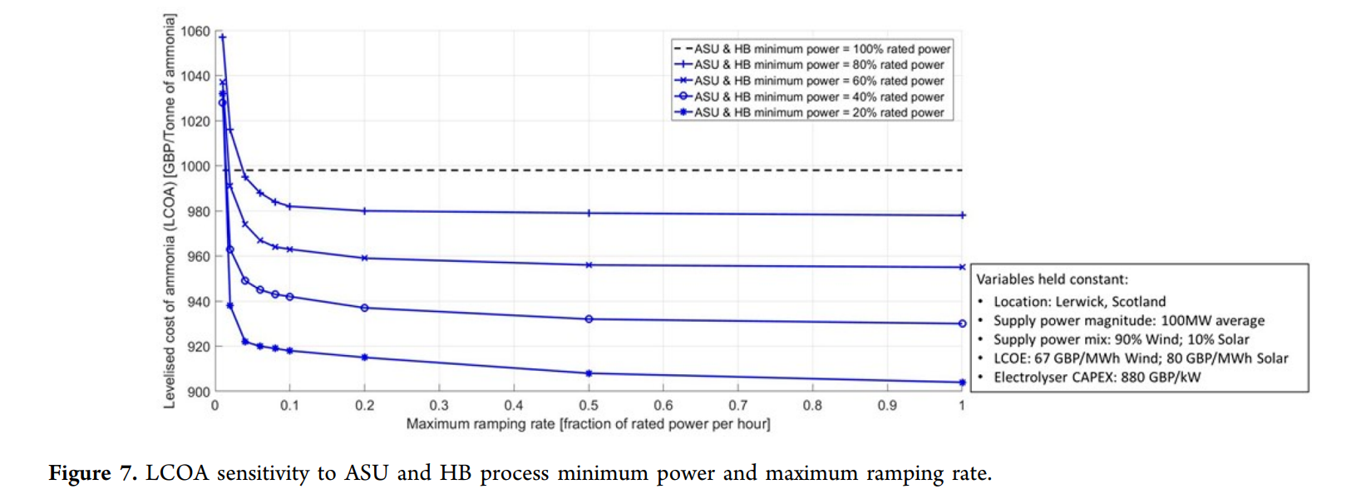
Example sensitivity on ramping
*From Nayak-Luke, Richard, René Bañares-Alcántara, and Ian Wilkinson. "“Green” ammonia: impact of renewable energy intermittency on plant sizing and levelized cost of ammonia." Industrial & Engineering Chemistry Research 57.43 (2018): 14607-14616..

Slide 5
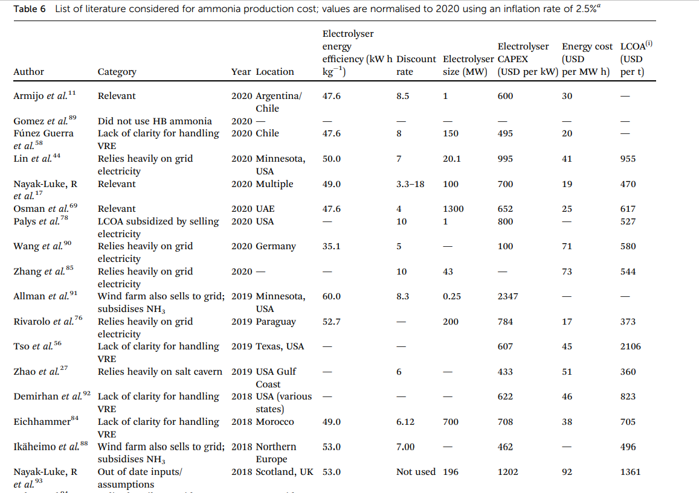

Slide 6
Recommended Next Steps: Create New model w/ simplified UI around specific goal
Restructure models into python equivalents employing pyomo as backbone for optimization
Allows for greater versatility and clarity in code operations (separation of optimization vs capacity factor calculations)
Can build greater documentation around code, make open source, and restructure goal
Slightly modify the production value chain
Enable for multimodal transportation depending on origin and destinations
Enable option between centralized vs decentralized cracking

Slide 7
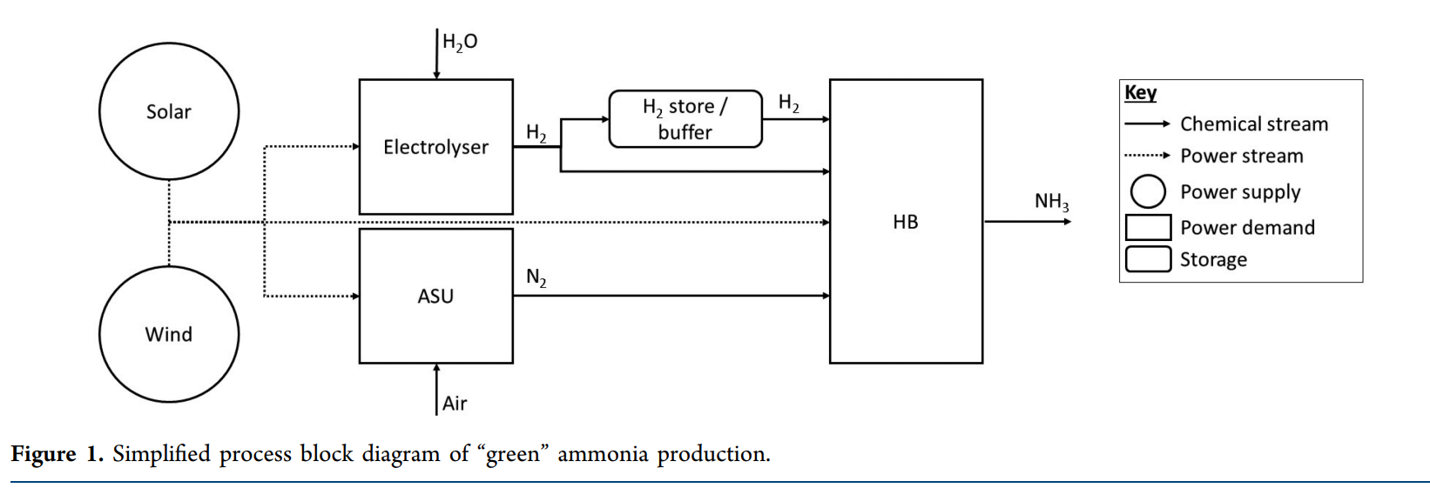
*From Nayak-Luke, Richard, René Bañares-Alcántara, and Ian Wilkinson. "“Green” ammonia: impact of renewable energy intermittency on plant sizing and levelized cost of ammonia." Industrial & Engineering Chemistry Research 57.43 (2018): 14607-14616..

Slide 8
Next Steps for Project
Create Formal outline of optimization model for Hydrogen and Ammonia production paths to final H₂
Need clarification on how to incorporate transportation costs- can save for later
Create script for calculating generation of wind and solar at a selected location for a typical day
Can start with single day, however seasonal variation is something to be aware of
Do we have data for wind and irradiance at NEOM sites?
Create python hydrogen/ammonia supply chain optimization model
Run scenarios/tests on first cases
Synthesis results into report
Deploy open source model to website for further use by others

Slide 9
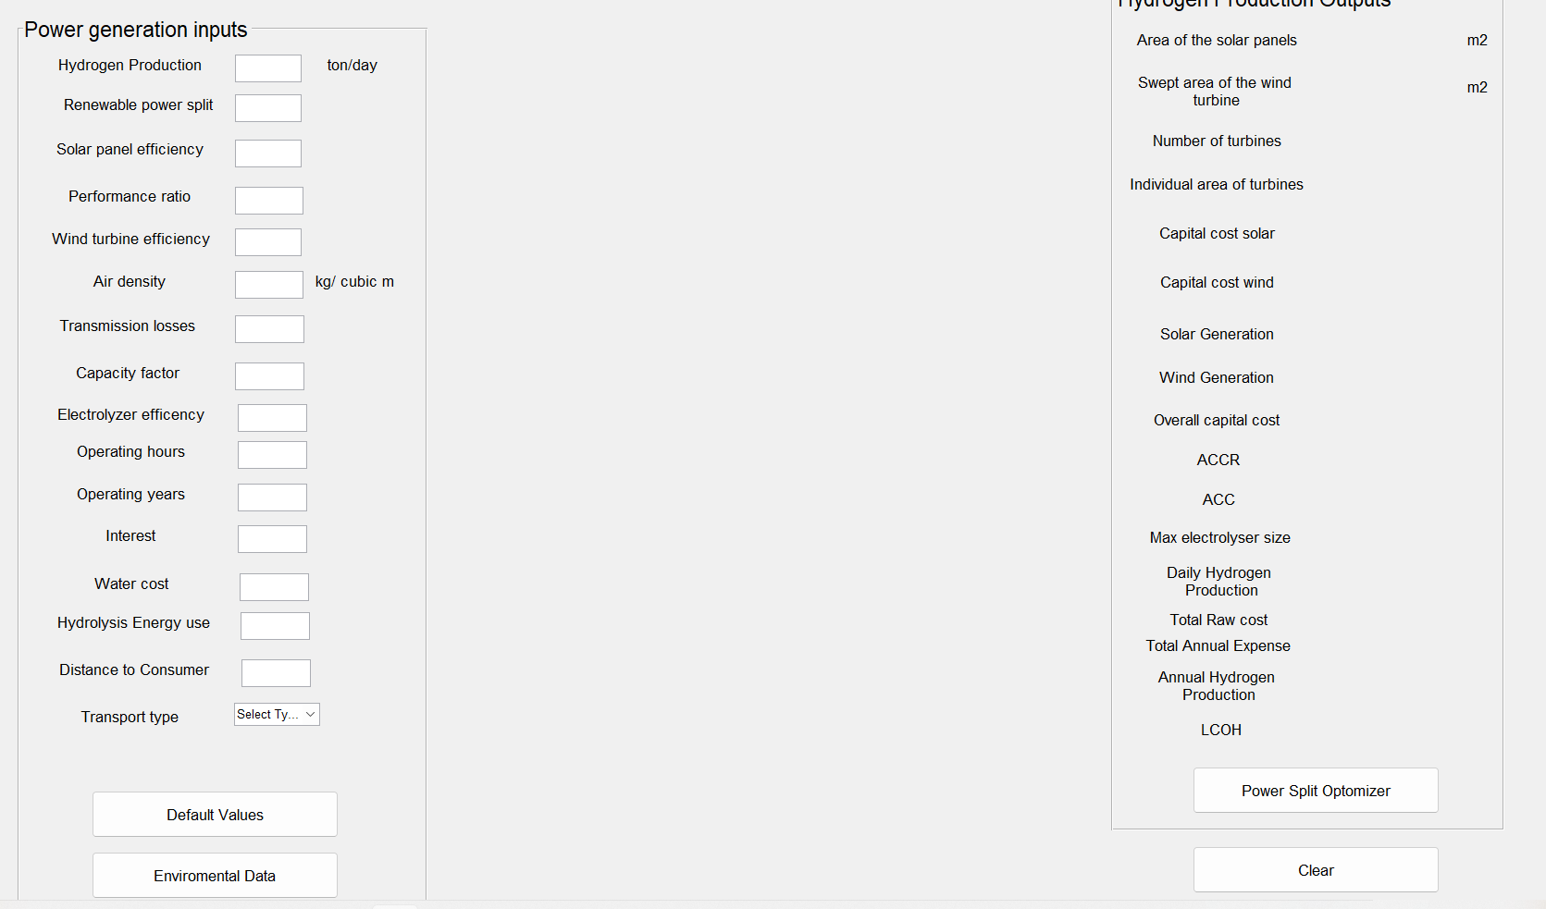

Slide 10
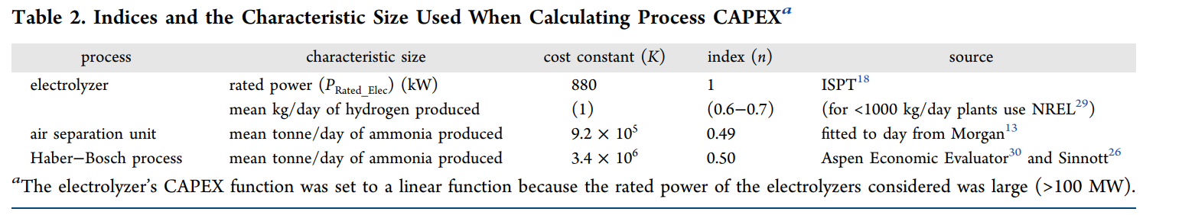

From the paper which the work was based on, takes a black box model approach
* “Green” Ammonia: Impact of Renewable Energy Intermittency on Plant Sizing and Levelized Cost of Ammonia, Nayak-Luke

Slide 11
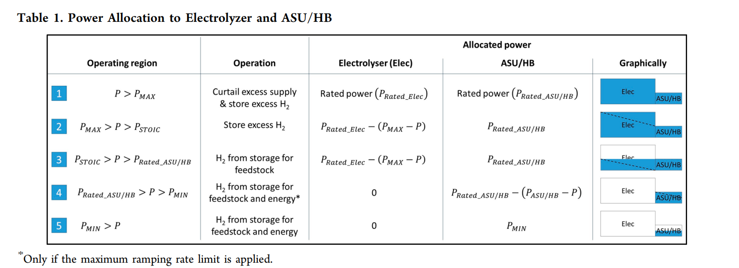
One route of including variable RE in hydrogen/ammonia production
* “Green” Ammonia: Impact of Renewable Energy Intermittency on Plant Sizing and Levelized Cost of Ammonia, Nayak-Luke

