Slide 1


SQL for Data Science Capstone Project by University of California, Davis
Capstone Final (week4) – Most Frequent Tweeters and Tweets with strongest sentiment

Slide 2
Content
Review of Questions to Answer / Hypotheses / Approach
Discuss Technical Challenges
Detail: Entity Relationship Diagram (ERD)
Initial Findings
Deeper Analysis
Hypothesis Results

Slide 3
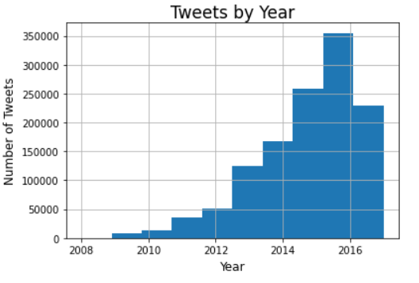
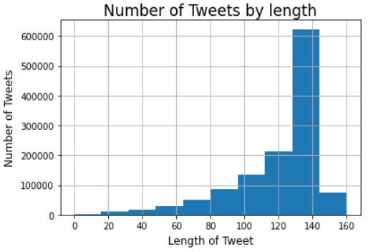
Vast # of tweet analyses possible for Political Research Company and Political Campaign Managers → Questions:
will sharing of more content (length, pics, quotes) leads to more retweets and favorites ?
will a more polarizing tweet lead to more responses?
Most tweets have maximum length but data is skewed
2016 is the busiest year for tweets in dataset

Slide 4
Hypotheses
1.There are more tweets in recent years because politics is more polarized.
2. More active users get more favorites and retweets.
3. Tweets with stronger negative sentiment
(text analysis) are more often flagged as
‘possibly sensitive’ .

Slide 5
Technical Challenges
Difficult to import large json file into jupyter. Had to reformat and save it as .csv
Transform datatypes for separate year, calculate tweet length
Make SQL work in jupyter, install software packages and search for sample syntax
Download stopwords, format

Slide 6
ER Diagram
tweet_feature
Tweet_Id
Extended entities: photo/video yes /no ?
Sensitive content : yes no
Quoted yes no
EM_tweet
Id
Created_at
text
User_id
Sentiment analysis
Tweet_Id
Sentiment: positive/negative TF-IDF
text
feature
Tweet_id
Count_favorites
Count_retweet
tweet_user
Tweet_Id
User_id
User_name

Slide 7
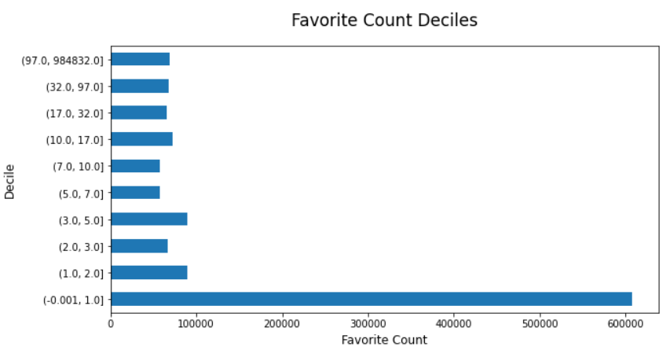
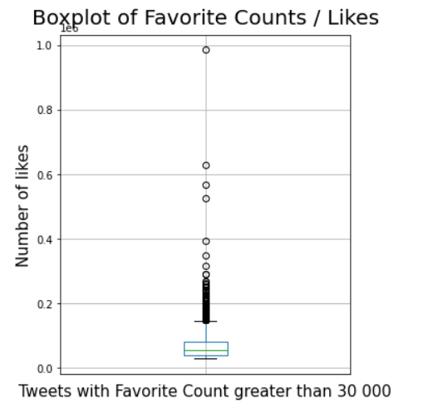
Initial Findings I – Many zero values and large outliers for Likes (and retweets)

Slide 8
Initial Findings II – less outliers for by-user figures, most active Tweeter’s tweets are not longer , positive correlation between number of tweets and length
 | Average Tweets by User | Average Tweets length by user
User Count | 45 | 45
Mean | 2281 | 119.9
Min | 4 | 73.8
Max | 3258 | 136.2
25% | 1398 | 116.0
50% | 2691 | 120.9
75% | 3222 | 124.9
 | 20 Most active Tweeters | Rest of Tweeters
AVG # of tweets | 3248 | 2245
AvG tweet length | 121.7 | 119.9
Pearson Correlation | 0.156

Slide 9
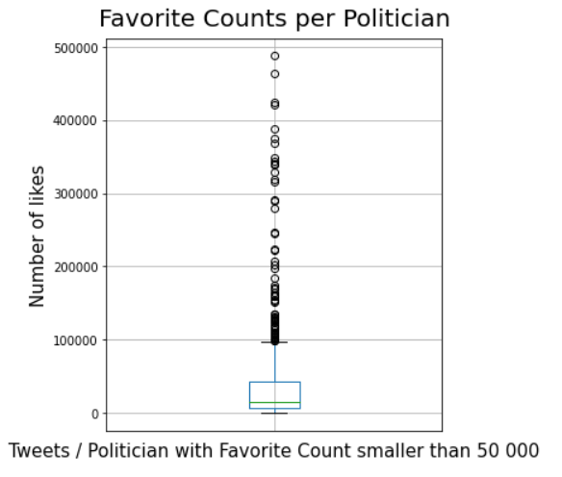
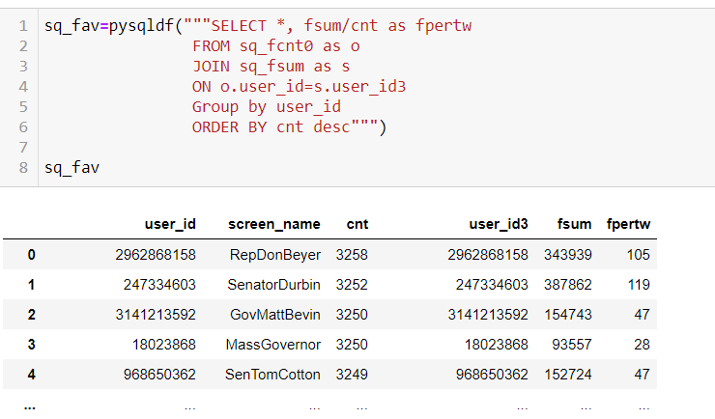
Deeper Analysis I – Creation of new metrics: AVG (Likes, Retweets, Quotes per Tweets) per User/Politician

Slide 10
Deeper Analysis I – Less frequent Tweeters get more likes and retweets (hypotheses rejected), but frequent Tweeters use more quotes per tweet (hypothesis maintained)
A first look indicates that Number of tweets are not important for likes for the top 20 tweeters, other relationships are less or not indicative
The positive correlation between Favorite Count and Number of tweets indicates that there is a positive (albeit small) relationship, meaning that the top 20 alone don’t reflect the trend.
Other features:
The relationship between extended media used (images, videos) and likes is also not given (-0.002) on a per tweet basis.
Sensitive content was not further examined, because only three politicians were affected.
 | 20 Top Tweeters | Rest | Correlation to Number of tweets
Favorite Count | 79 | 177.5 | 0.029
Retweet Count | 177 | 190 | -.001
Quotes | 0.074 | 0.046 | -0.05

Slide 11
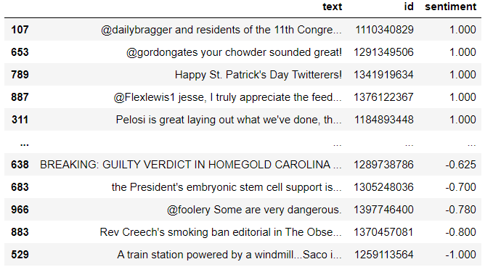
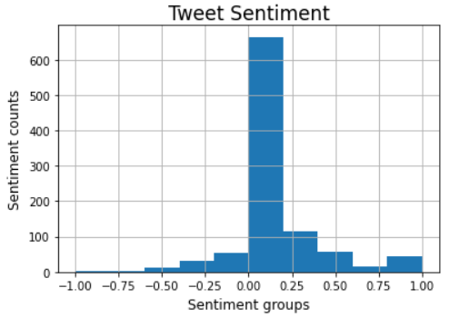
Text analysis TF-IDF
Tweets with most positive and negative sentiments
Correlation between sentiment and Number of Likes | Pearson Corr.
Total Population (2016) | -0.011
Tweets with strongly positive sentiment (>0.5) | 0.006
Tweets with strongly negative sentiment (<0.5) | 0.032
Slightly positive skewed sentiment among political tweeters
Positive correlation between very positive and very negative sentiments and number of likes

Slide 12
Deeper Analysis II - Text analysis TF-IDF
innovation
#startuptoday!
horrific
victims
heart
happy
Today!
affected
stand
America
us
jobs
opioid
visit
terror
go
welcome
Sample most frequent words with positive sentiment
Sample most frequent words with negative sentiment
Positive sentiment tweets are related to upcoming events, well – wishes and positive (economic) news , negative sentiment tweets are related to tragedies and exclusion

Slide 13
Advice to political advisors (hypotheses results)
There are more political tweets in 2015/2016 because of the more polarized political climate (hypothesis 1)
Positive relationship (0.156) between number of tweets and tweet length (although not for top 20 Tweeters)
The top 20 tweeters get significantly less likes (79 vs 177 for anyone else) (Hypothesis 2a) → thus the content of the tweet is more important that the amount of tweets (2b: relationship for retweets is less significant )
➔ advice: candidates should focus on a few pointed tweets instead of quantity
The top 20 tweeters use more quotes in tweets → advice: tweeting original content might be better

Slide 14
Advice to political advisors (hypotheses results)
Text analysis: Overall political tweeters have positively skewed sentiment
➔ attention political advisors: both very positive and very negative sentiment tweets get more likes
more advice: for your political candidates to get more likes …
➔ get in on positive sentiments through tweeting upcoming events, welcoming messages and positive economic news
➔ get in on negative sentiments: take notice on political tragedies and self-centric messaging
this concludes hypothesis 3: more polarizing (or positive/negative) sentiment tweets get more likes

