Slide 1
Energy DATA Time Series Analysis

Slide 2
Table of Contents
Description of data
Main objectives
One type of Analysis, variations of model , which is the best
Key Findings to objectives
Report with Insights
Next Steps/ flaws, more data , different model
Appendix: visuals from your code / python notebook printout

Slide 3
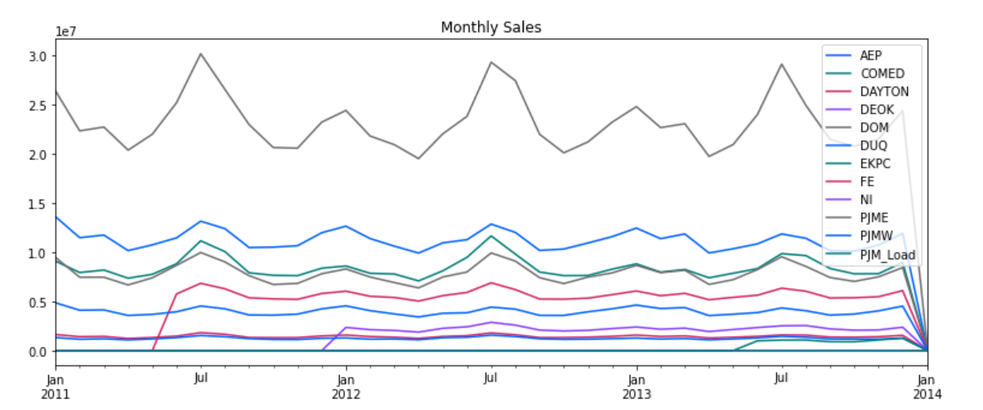
Description of Data
Energy consumption data from Comed and other providers in megawatts for the last two decades download from kaggle

Slide 4
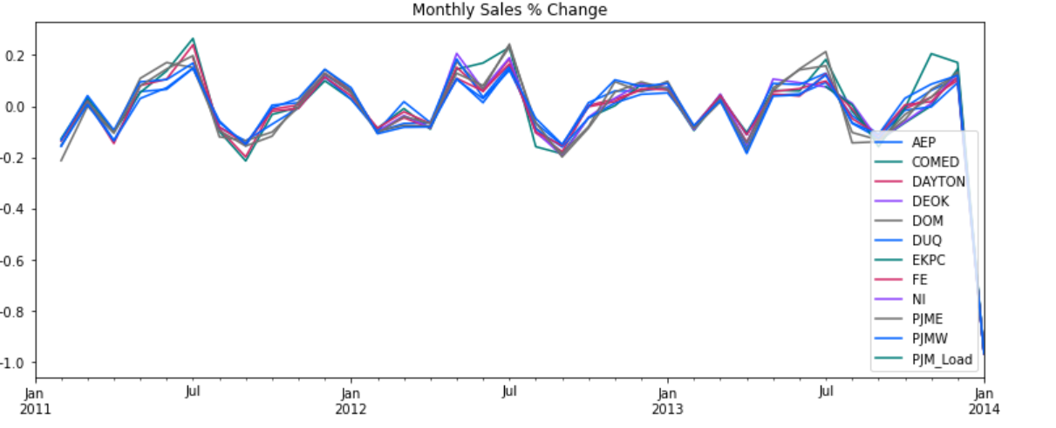
Goals
Prediction of consumption for COMED and market share changes

Slide 5
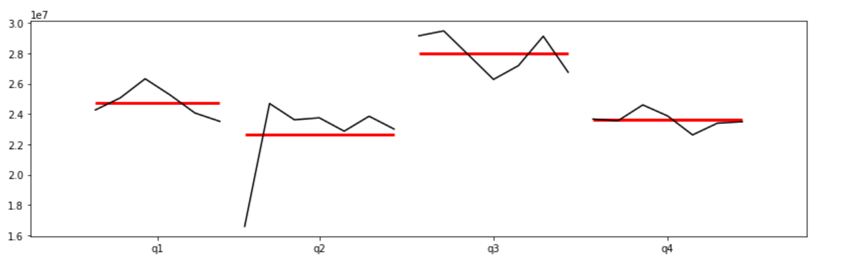
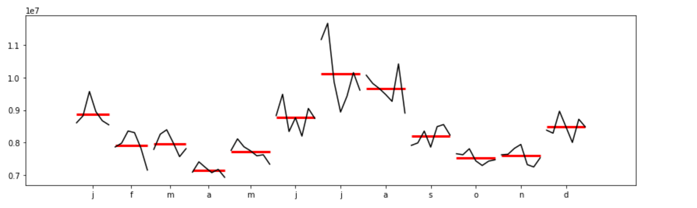
Dependency on month / season

Slide 6
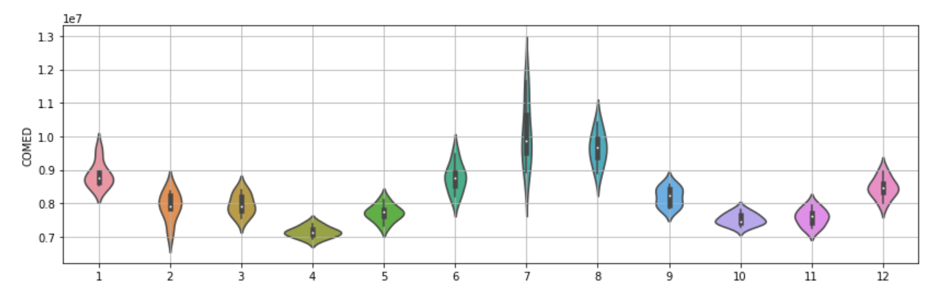
Dependency on month / season 2

Slide 7
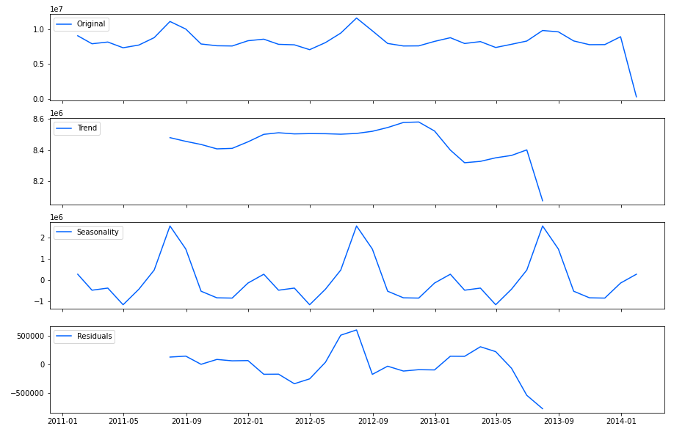
Manual Decomposition 1
Additive and Multiplicative models yield similar results

Slide 8
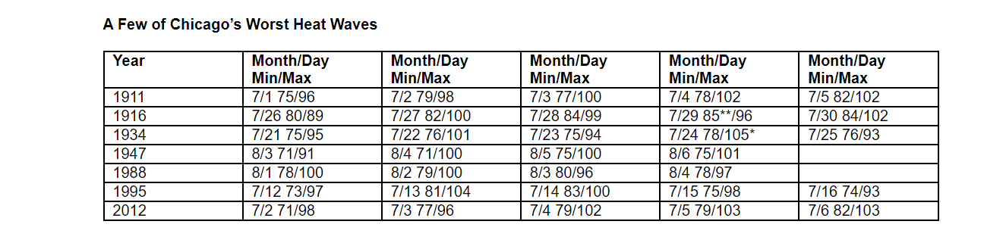
Manual Decomposition 2
Explanation for spike in summer 2012 in residual (historical heat waves)

Slide 9
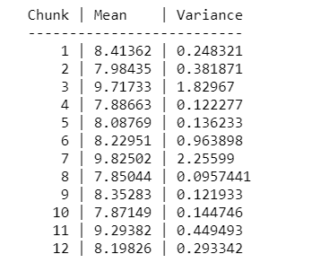
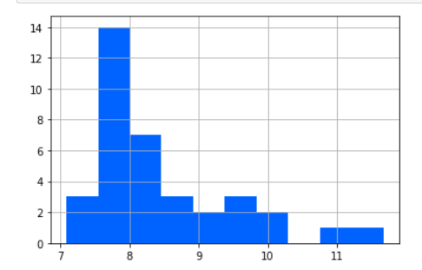
Explorative 1
Normality but with skewness in histogram

Slide 10
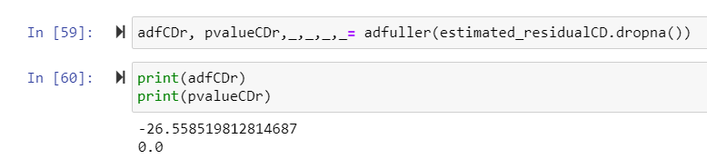
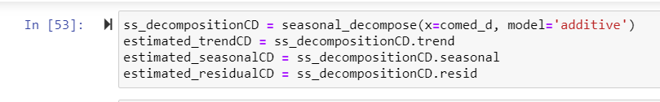
Explorative 2
Augmented Dickey-Fuller : only residual estimate rejects null hypothesis (meaning stationary)
Also smaller MSE

Slide 11
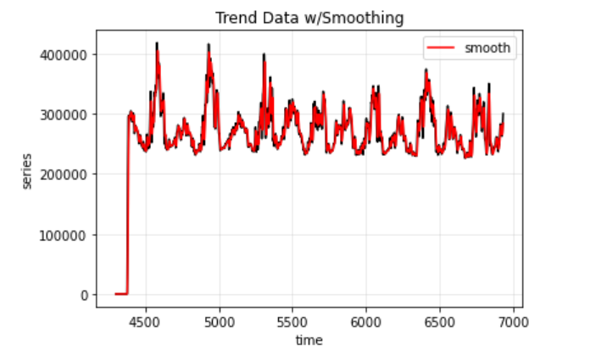
7-day Moving Average
reduces MSE further

Slide 12
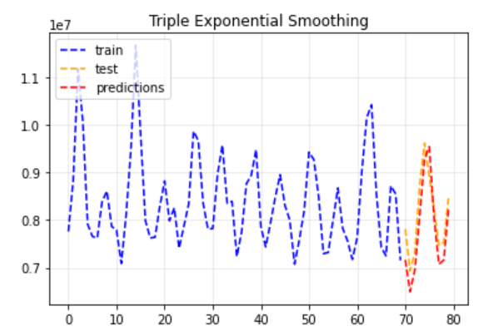
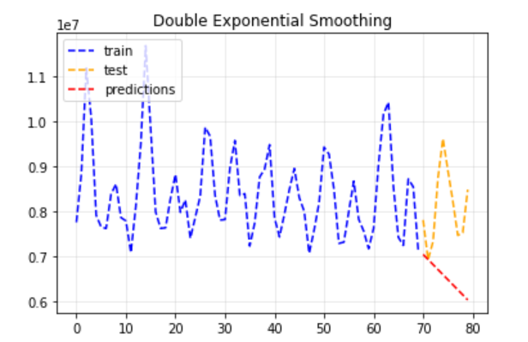
Predicting Data – Holt vs Triple Exponential

Slide 13
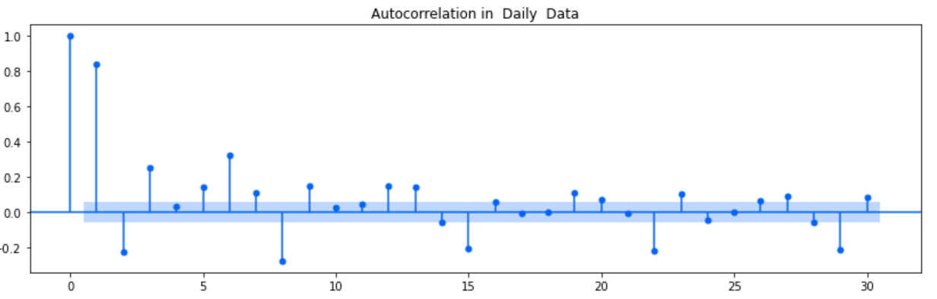
Time Series Analysis: ACF PLot
Autocorrelation points to seasonal data

Slide 14
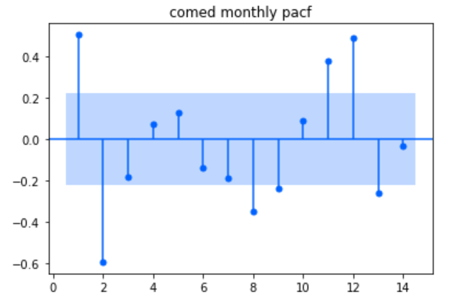
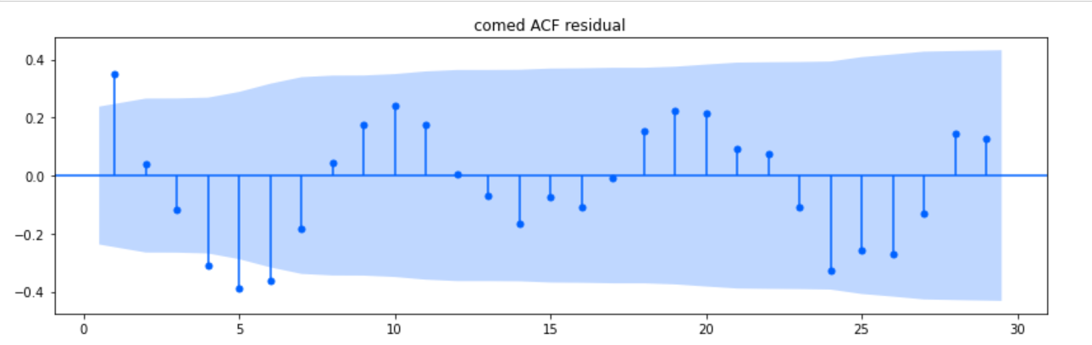
Seasonality reflected in lag plots
ARMA Models – ARMA Coefficients suggest 2 lag model (appendix)
-combination of AR & MA because they are components that's not decaying but it's decaying a little bit like in AR should decay and then there are shocks like in AM model

Slide 15
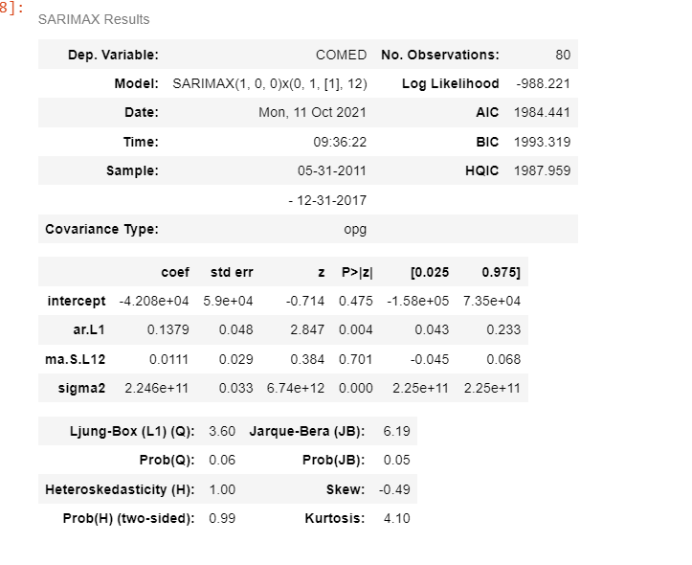
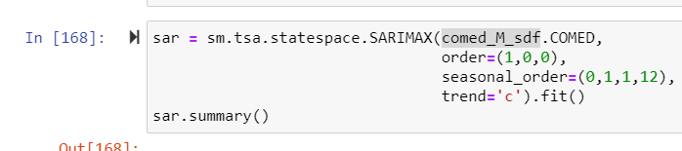
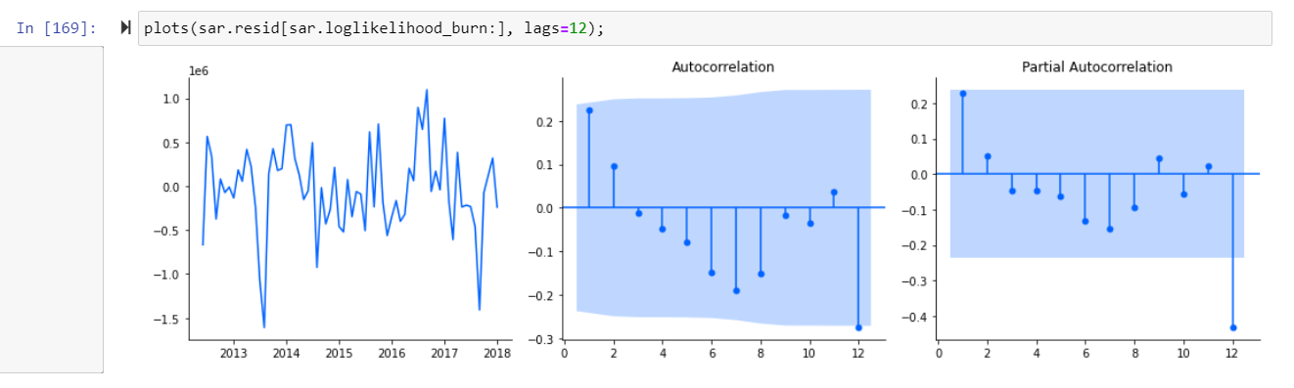
SARIMA – finds parameters with less autocorrelation

Slide 16
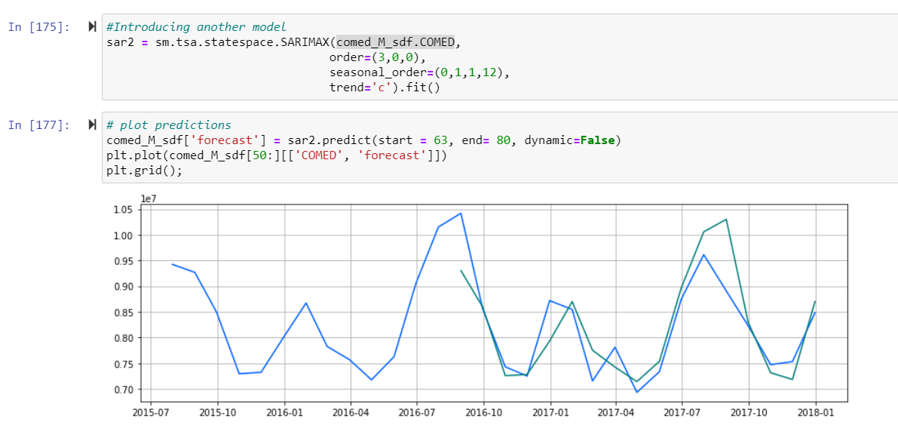
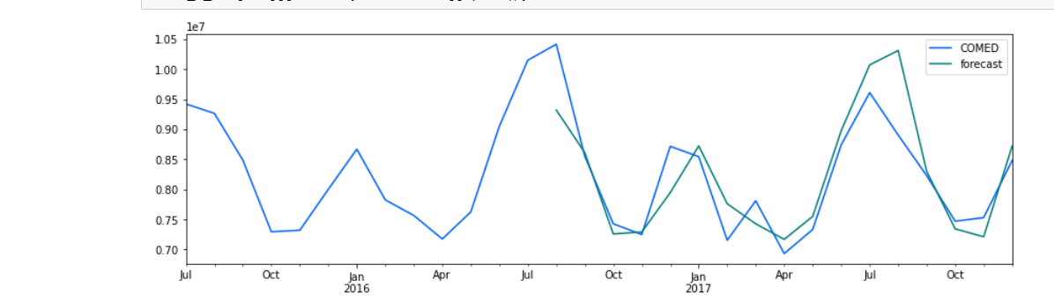
SARIMA predictions – both models do well!

Slide 17
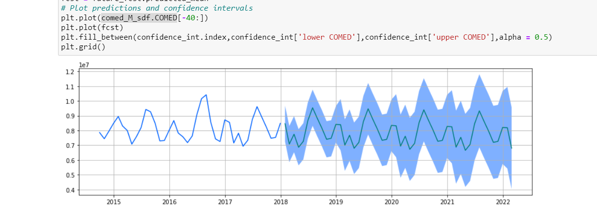
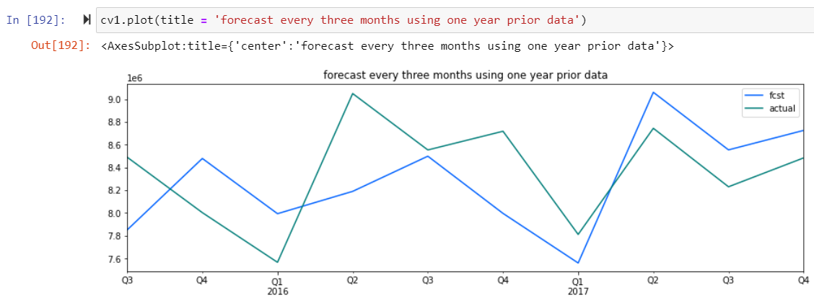
SARIMA – high confidence and good cross validation

Slide 18
Key Findings and Insights
Trend, Seasonality and Residuals identified
SARIMA does better job in decomposing into stationary process
Autocorrelation plots reveal the obvious dependance with several lags
Energy consumption spike of 2012 could be isolated and traced back to a heat wave
ARMA models identified both autoregression and moving average components that match data
Both triple smoothing exponential and SARIMA did well in predicting
SARIMA has high confidence, although not all stationary tests succeed

Slide 19
Next Steps/ flaws, more data , different model
Grid search for ARIMA no results→improve
Try other suppliers
Examine Hourly Data/intra-day spikes
Try Prophet
Try PMDARIMA
Experiment with Deep Learning for Time Series

Slide 20
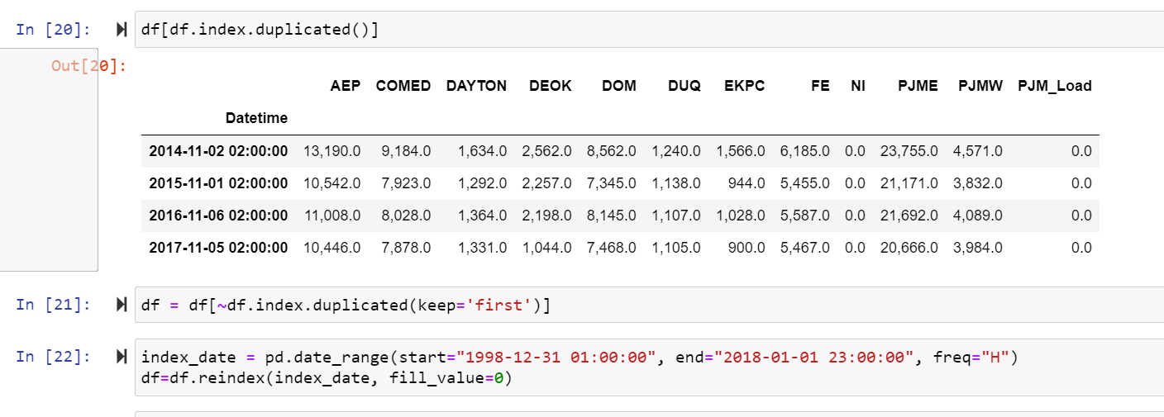
Appendix: Code excerpts
Data Wrangling

Slide 21
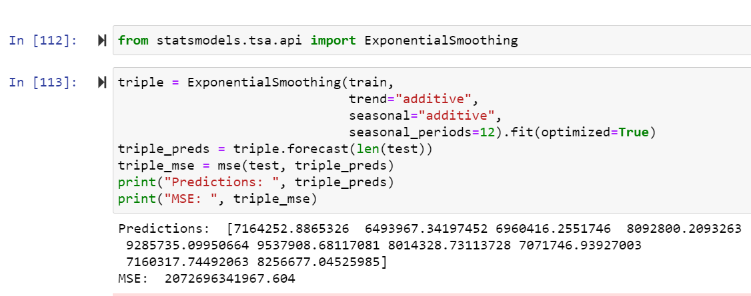
Appendix: Code excerpts

Slide 22
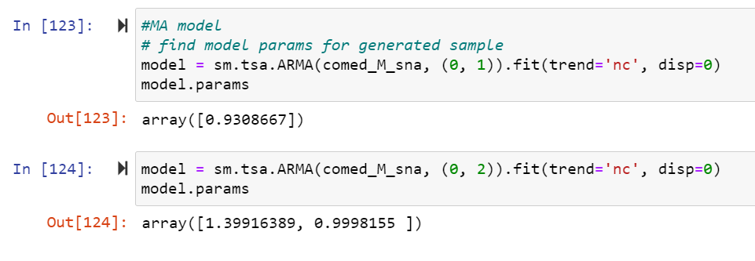
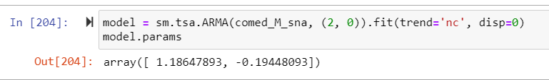
Appendix: ARMA 2 lag model more reasonable

Slide 23
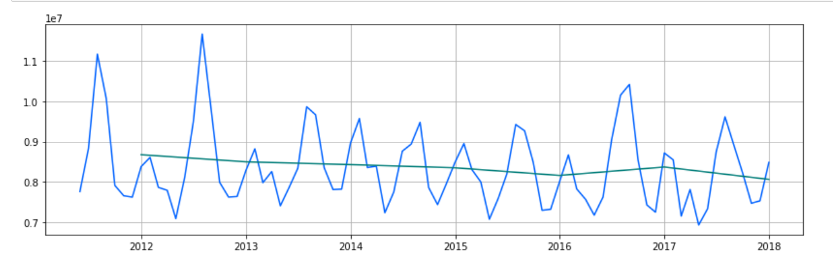
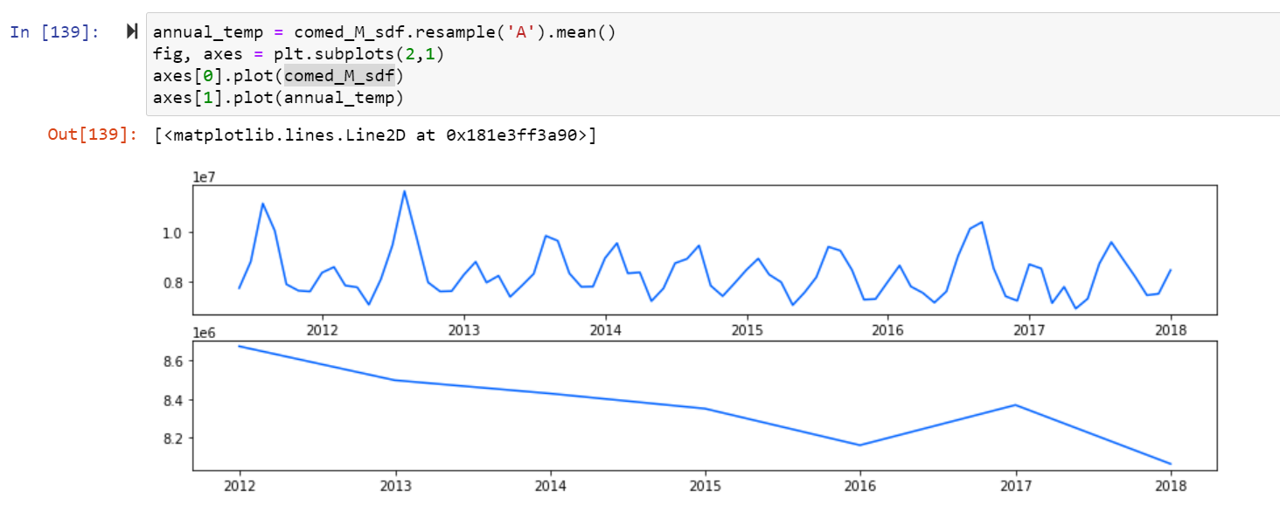
Annual trend downwards but that’s due to early spikes

Slide 24
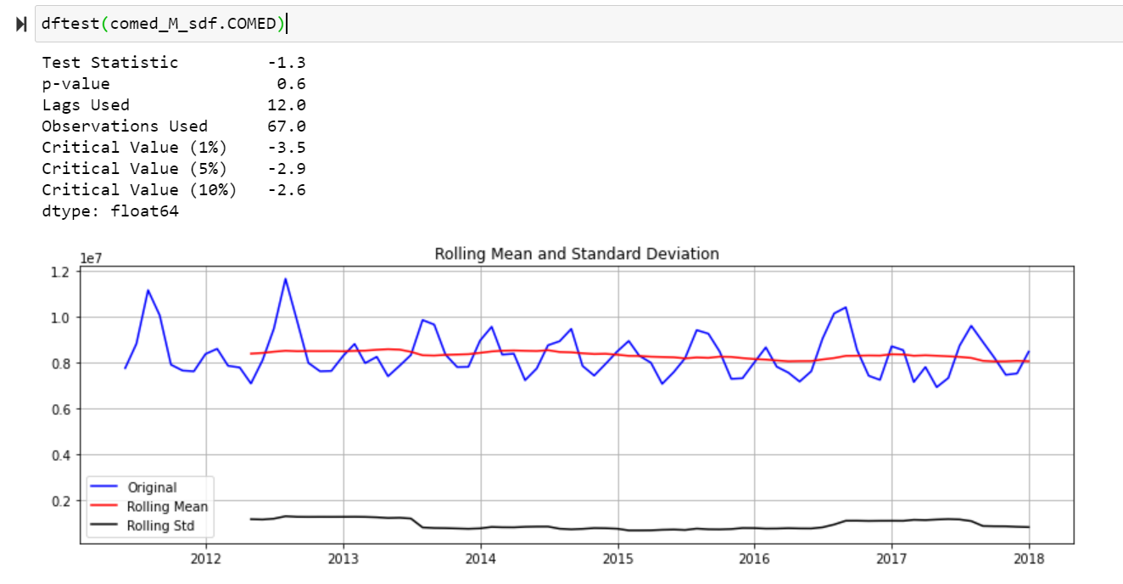
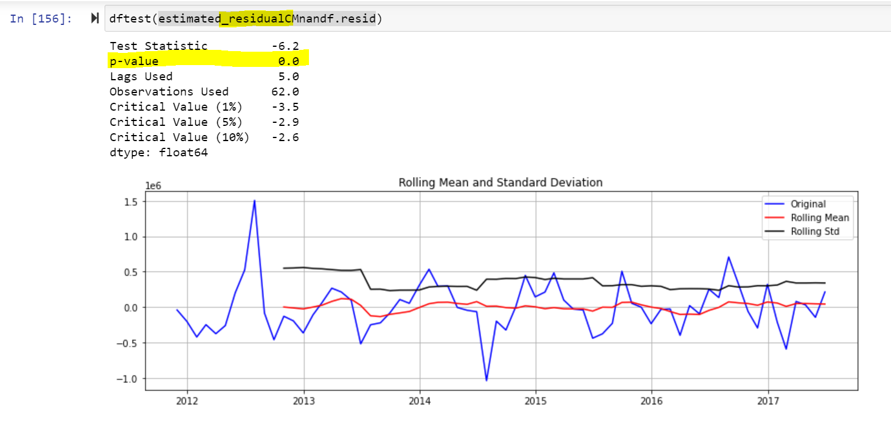
Residuals are stationary

Slide 25
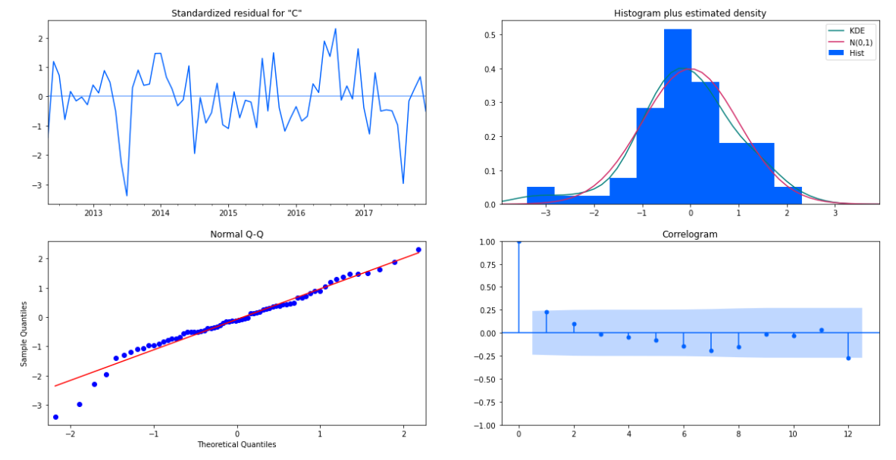
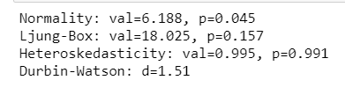
SARIMA normality of residual

