Slide 1

DealMaker AI
AI-Powered Amazon Price Tracker & Negotiation Chatbot
PRESENTED BY:
Nency Pansuriya
Jaimi Ahir
Juli Kyada
Darshika Dudhat

Slide 2

Problem Statement
Shoppers struggle to know when prices will drop and miss out on deals.
Negotiating prices is usually manual and dependent on seller willingness.
There’s a lack of integrated tools that both track and allow negotiation.
Lack of Transparency: Customers often don’t know the actual price trends of a product, making it hard to judge whether the “deal” is genuinely good.

Slide 3
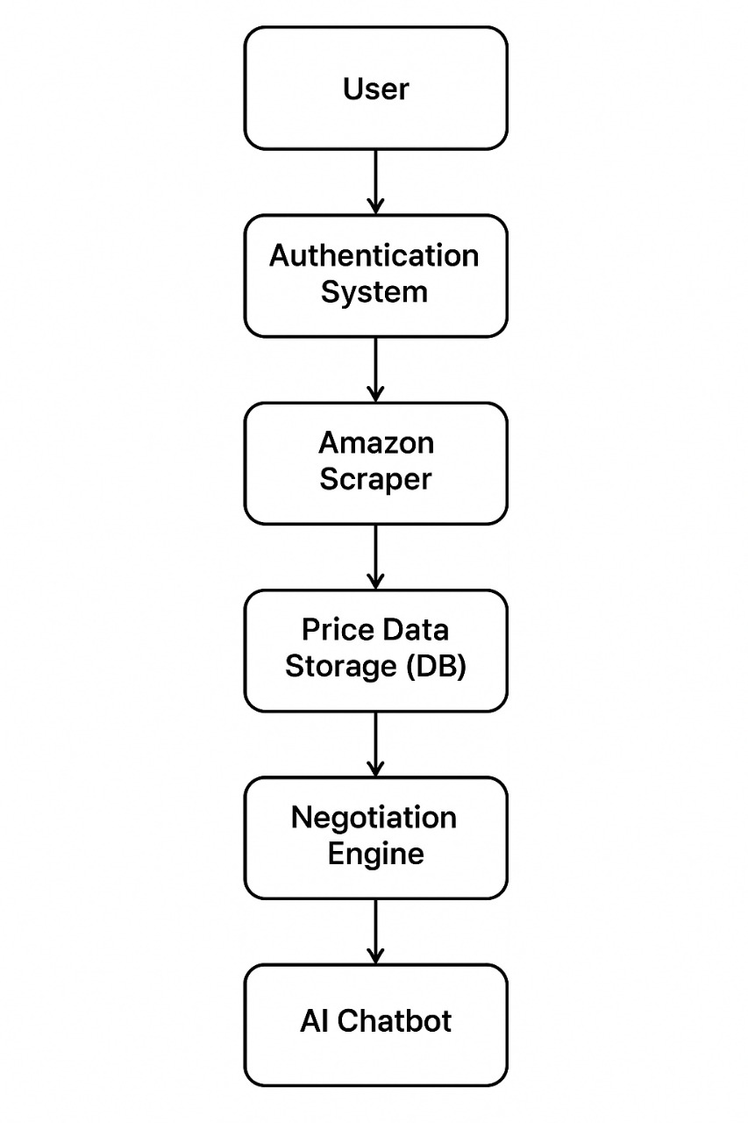
SolutionOverview
DealMaker AI combines:
Price tracking + trend history
AI-powered price predictions
Interactive chatbot for negotiating optimal deals
One-stop tool for data-driven tracking and interactive negotiation.

Slide 4
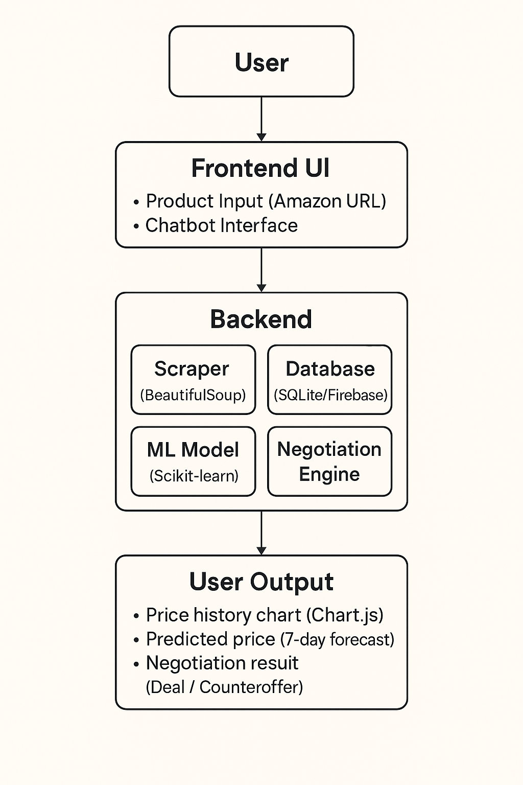



Tech Stack & Architecture
Backend: Flask, web scraping, Scikit-learn, Flask-Login, Flask-Mail, Flask-Bcrypt, Flask-SQLAlchemy
Frontend: Responsive UI using Bootstrap + Chart.js for visualization
Data Storage & Integration: Firebase (real-time), Amazon scraping
4

Slide 5
Core Features
a) Authentication & Security
User registration/login, password reset with email tokens
Password hashing (Flask-Bcrypt)
b) Price Tracking & History
Add Amazon product via URL real-time scraping
View charts: current, min, average, max prices
Price history stored for analytics
c) AI Price Prediction
Forecast future price (next 7 days) using ML model
d) Negotiation Chatbot
AI chatbot that uses price history & prediction to counteroffer dynamically
Enables interactive negotiation with the user — “Deal making”

Slide 6
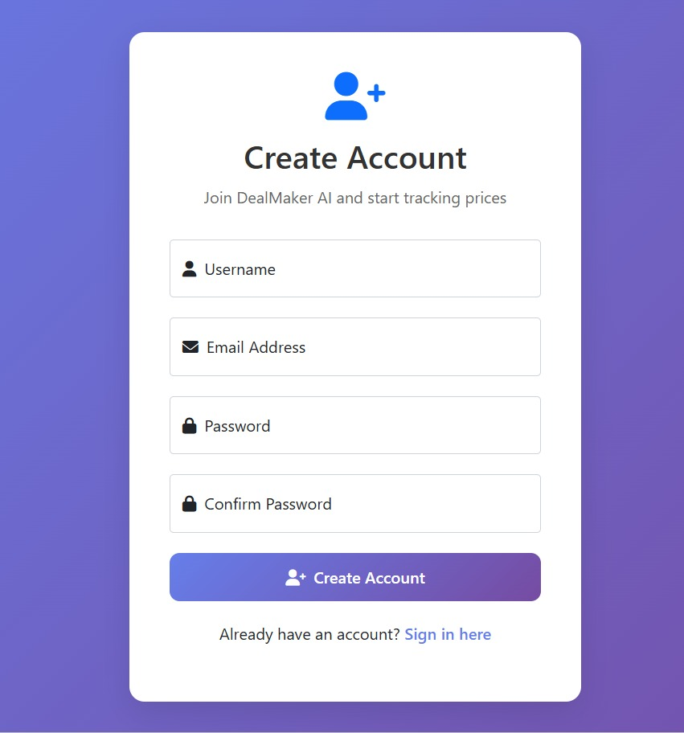
Demo Flow

Slide 7
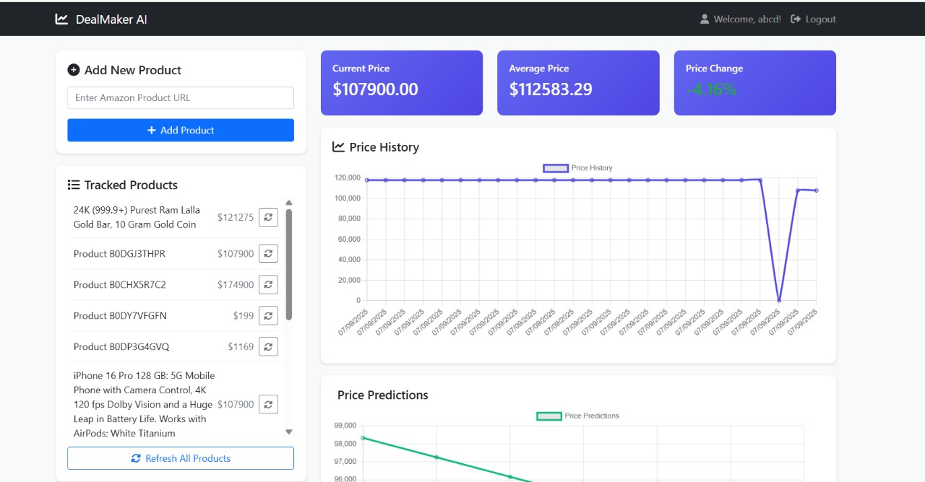
Demo Flow

Slide 8
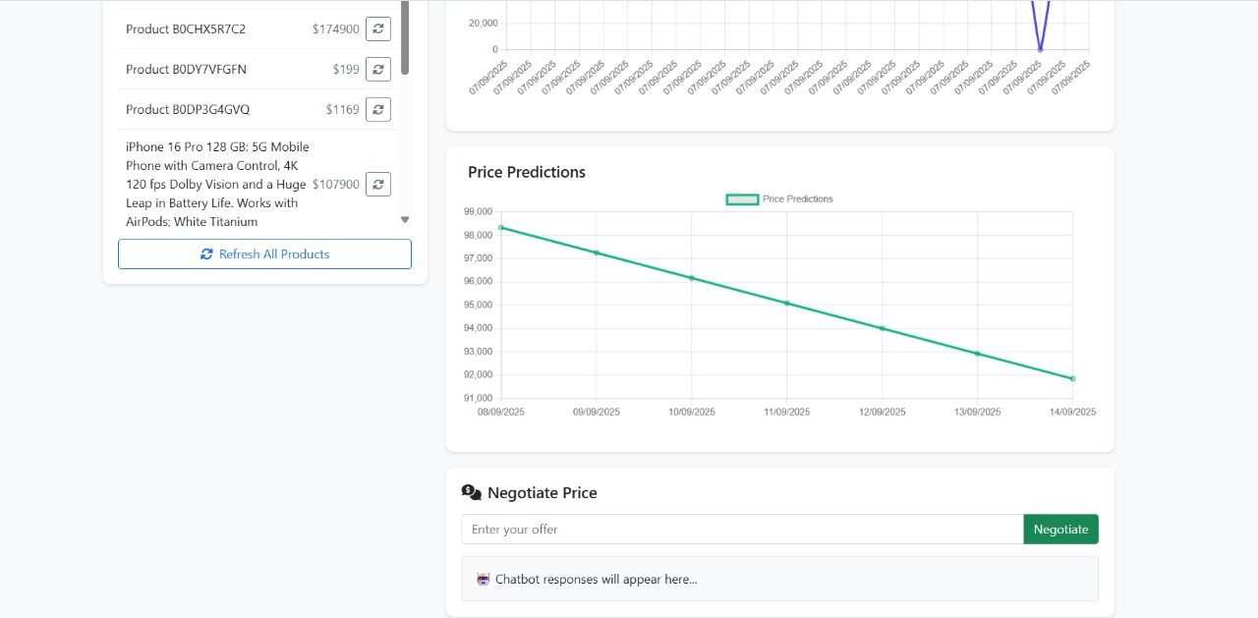
Demo Flow

Slide 9
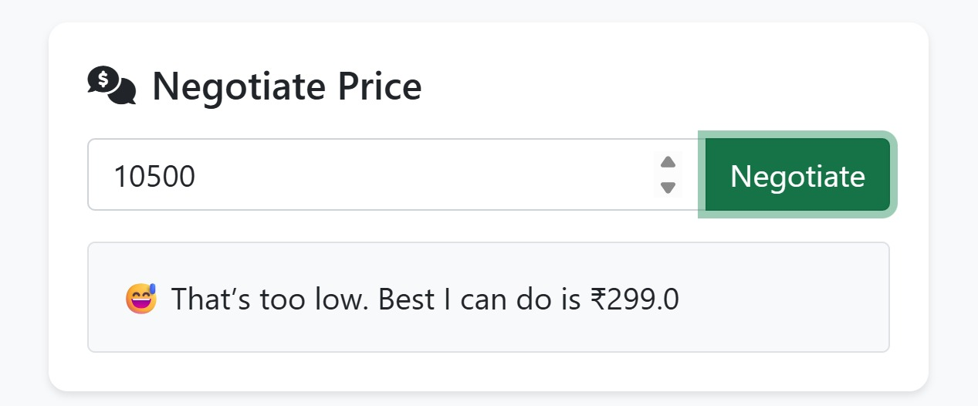
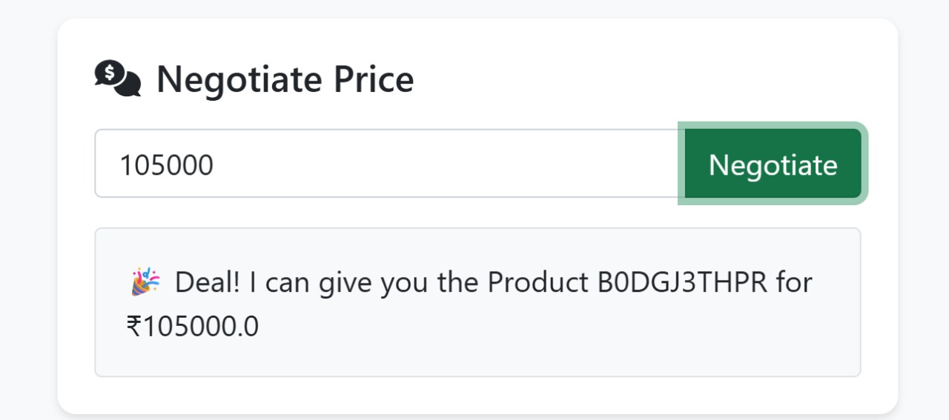
Demo Flow

Slide 10

Impact & Benefits
Smart Shopping: Users get notified and predict pricing, reducing impulse overpaying
Better Deals: Negotiation chatbot gives a scalable way to get discounts
Competitive Differentiation: Most trackers stop at analytics; yours adds negotiation layer

Slide 11
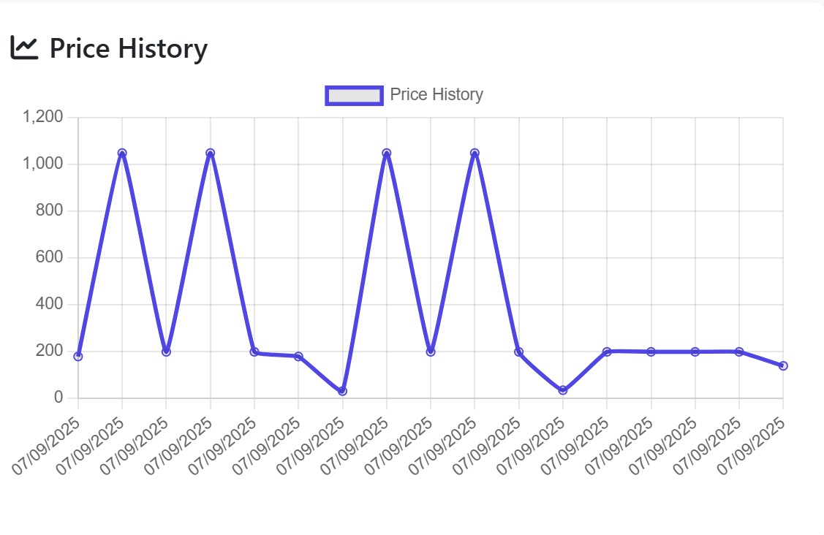
Technical Highlights
Secure and user-friendly authentication flows
Interactive visualizations with Chart.js
Machine learning powered price forecasting
Real-time scraping + Firebase integration
Chatbot uses dynamic logic based on price trends

Slide 12
Future Enhancements
Expand to other e-commerce platforms (Flipkart, eBay, etc.)
Integrate GPT-style conversational models for more natural negotiation
Mobile app / browser extension for notifications
Custom seller dashboards & bulk negotiation
Pricing prediction improvement with deep learning models
9

Slide 13
Thank You
https://github.com/juliKyada/DealMakerAI

